Slide 1
Leveraging Scale-down Methods to Accelerate Harvest Characterization
A.A. Joseph, M. Mollet & J. Bender
2016 Harvest Industry Summit
Company Restricted
3rd-5th May 2016

Slide 2
Introduction
Pilot-scale centrifuge is typically utilized to model commercial-scale systems
Large material & resource requirement
Testable parameters limited & narrow data set obtained
Objective to develop a scale-down model to improve efficiency
Scale-Down model benefits:
High throughput → can test more conditions
Ability to use material from bench-scale bioreactors
At least $13,000 cost savings in raw materials per study
Material evaluated to confirm comparable shear and particle characteristics
Established bench-scale conditions to model Alfa-Laval LAPX-404 & BTPX-305

Slide 3
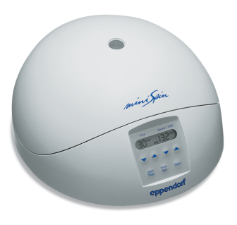
USD Centrifugation: Approach
Pilot-Scale Centrifugation
Scale-Down Model
EDR
Shear Device
Lab-Scale
Centrifuge
Disk-Stack Centrifuge
Bioreactor
Attribute | LDH | Calculated EDR | Turbidity | PSD | Filterability
Theoretical Shear | ☑ | ☑
Degree of Cell Damage | ☑ |  | ☑
Particle Characteristics |  |  | ☑ | ☑ | ☑
3

Slide 4
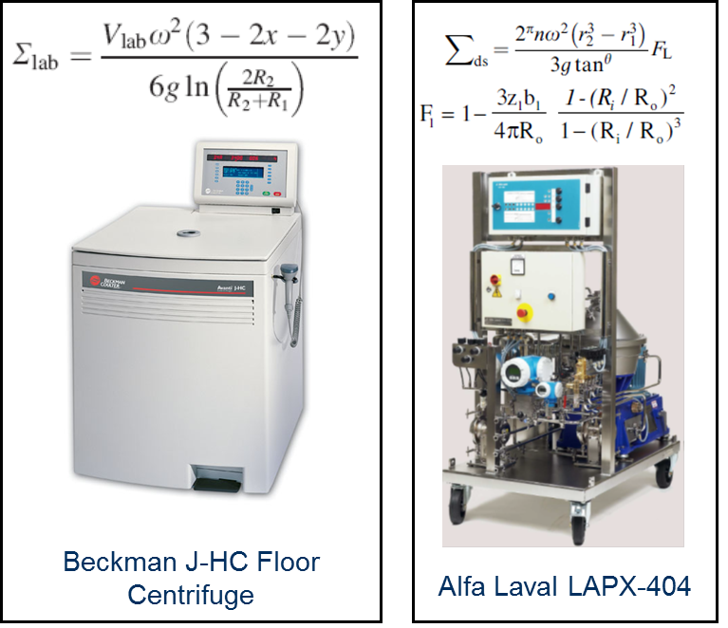
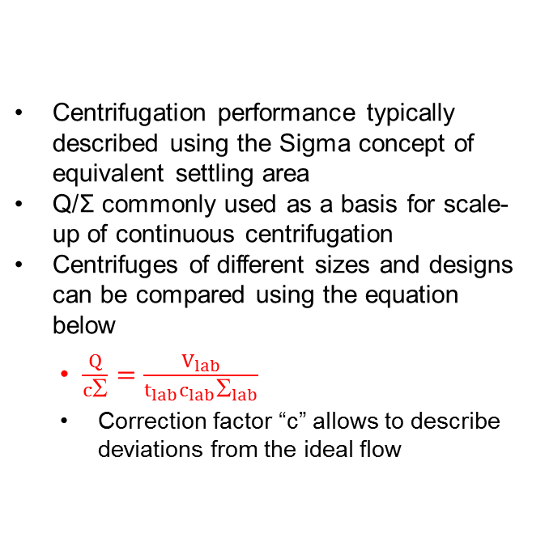
USD Centrifugation: Separation
Centrifugation performance typically described using the Sigma concept of equivalent settling area
Q/Σ commonly used as a basis for scale-up of continuous centrifugation
Centrifuges of different sizes and designs can be compared using the equation below
$\frac{Q}{cΣ}=\frac{V_{lab}}{t_{lab}c_{lab}Σ_{lab}}$
Correction factor “c” allows to describe deviations from the ideal flow

Slide 5

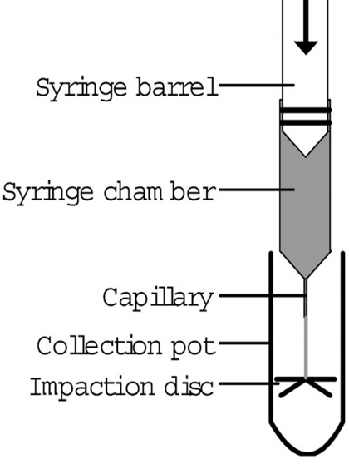
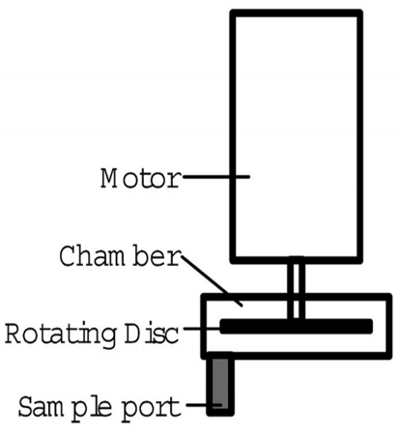
USD Centrifugation: Shear
Pilot-Scale Disk-Stack Centrifuge
Rotating Shear Device
Capillary Shear Device
Levy et al., 1999, Boychyn et al., 2000
Hutchinson et al., 2006
Tait et al., 2009
Mollet et al., 2006
Westoby et al, 2011

Slide 6
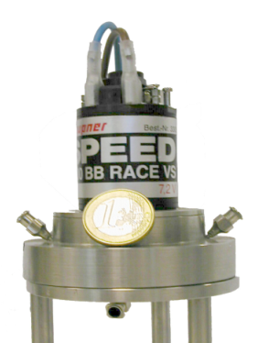
USD Centrifugation: RSD (Rotating Shear Device)
Difficult to directly quantify the shear rate within a centrifuge
Limited CFD work has been published for some centrifuge models
Easier to quantify the shear in a simplified system to estimate the energy dissipation rate indirectly
UCL developed the RDS as a way to mimic cell shear in a continuous centrifuge
Device is capable of generating different shear environments by changing the RPM

Slide 7
USD Centrifugation: EDR (Energy Dissipation Rate)
CFD model developed to calculate the EDR within the rotating shear device
EDR values are within the range reported in literature for a pilot-scale centrifuge
Boychyn et al., (2004) Bioprocess Biosyst Eng., 26: 385–391

Slide 8
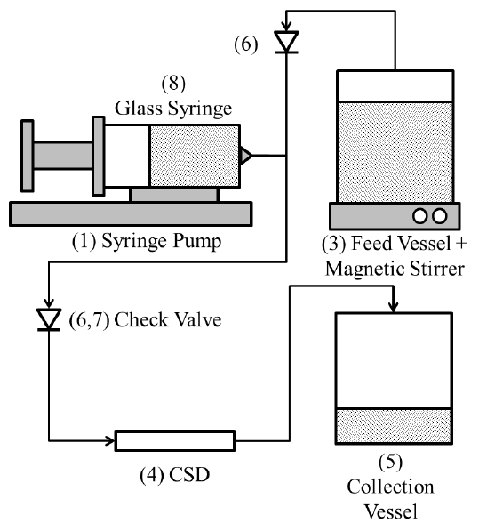
Capillary Shear Device (CSD) Schematic Version-1
RSD is limited to 20mL per batch
>1L is typically required to perform a filter sizing study
CSD was explored to generate enough material for filter sizing studies
Syringe pump is used to control flow rate through the capillary
Pump can be programmed

Slide 9
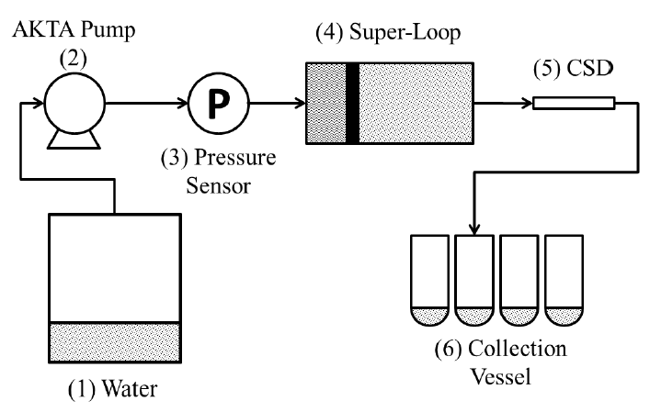
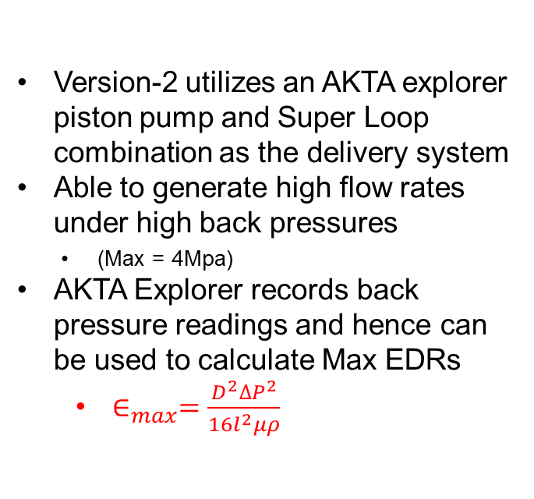
CSD Schematic Version-2
Version-2 utilizes an AKTA explorer piston pump and Super Loop combination as the delivery system
Able to generate high flow rates under high back pressures
(Max = 4Mpa)
AKTA Explorer records back pressure readings and hence can be used to calculate Max EDRs
$∈_{max}=\frac{D^{2}{∆P}^{2}}{16l^{2}μρ}$

Slide 10
Bridging Study: RDSD vs CSD
(1)
(2)
Developed capillary shear device creates the levels of shear quoted in literature to match centrifuges
(1) Boychyn et al., (2004) Bioprocess Biosyst Eng., 26: 385–391
(2) Westoby et al., (2011) Biotechnology and BioEngineering., 108: 990–998

Slide 11
USD Centrifugation Development

Slide 12
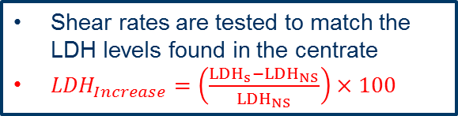
Experimental Methodology
Shear rates are tested to match the LDH levels found in the centrate
${LDH}_{Increase}=\left(\frac{{LDH}_{s}−{LDH}_{NS}}{{LDH}_{NS}}\right)×100$
≈1L of USD centrate generated for filter sizing studies
LDH screen
V/tΣ
screen
Verify
Scale up
Filter
Range of V/tΣ values are tested to match LAPX-404 centrate
Correction factor quantified
Verification based on:
- Turbidity
- PSD
Filter sizing studies conducted comparing filterability of pilot-scale and USD centrates

Slide 13
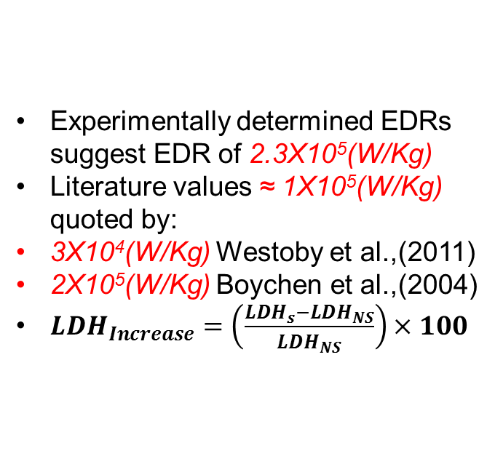
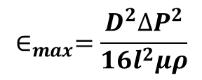
LDH Screen
LDH
Screen
V/tΣ
Screen
Scale
up
Verify
Filtration
Sheared Cell Culture
○ LAPX-404 Centrate
Experimentally determined EDRs suggest EDR of 2.3X10⁵(W/Kg)
Literature values ≈ 1X10⁵(W/Kg) quoted by:
3X10⁴(W/Kg) Westoby et al.,(2011)
2X10⁵(W/Kg) Boychen et al.,(2004)
${LDH}_{Increase}=\left(\frac{{LDH}_{s}−{LDH}_{NS}}{{LDH}_{NS}}\right)×100$
$$∈_{max}=\frac{D^{2}{∆P}^{2}}{16l^{2}μρ}$$

Slide 14
Correction Factor
LDH
Screen
V/tΣ
Screen
Scale
up
Verify
Filtration
Correction factor identified experimentally at 0.31
Experimental value similar to those in literature of around 0.40 Pinhiero et al., (1993)
Lab-scale Centrate
○ LAPX-404 Centrate

Slide 15
Verification: Turbidity
LDH
Screen
V/tΣ
Screen
Scale
up
Verification
Filtration
Similar turbidities were created by USD mimic to that of the LAPX-404 centrate over 10 runs
Tested multiple cell cultures

Slide 16
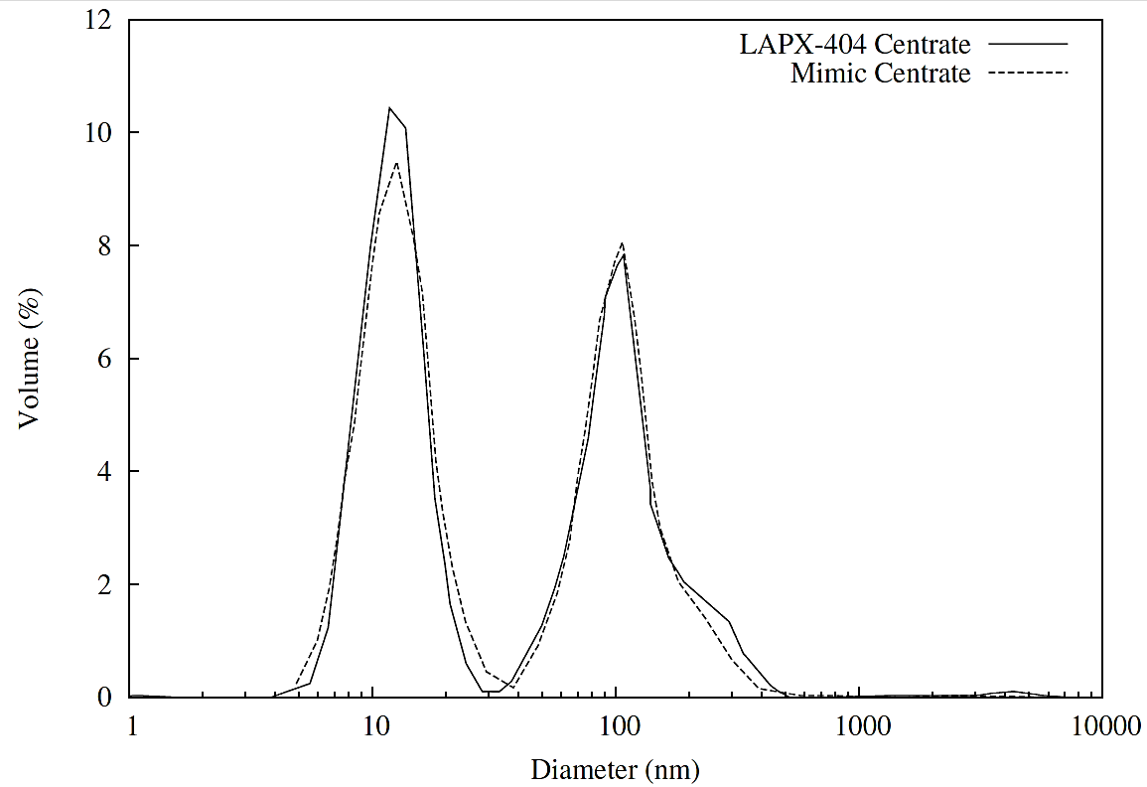
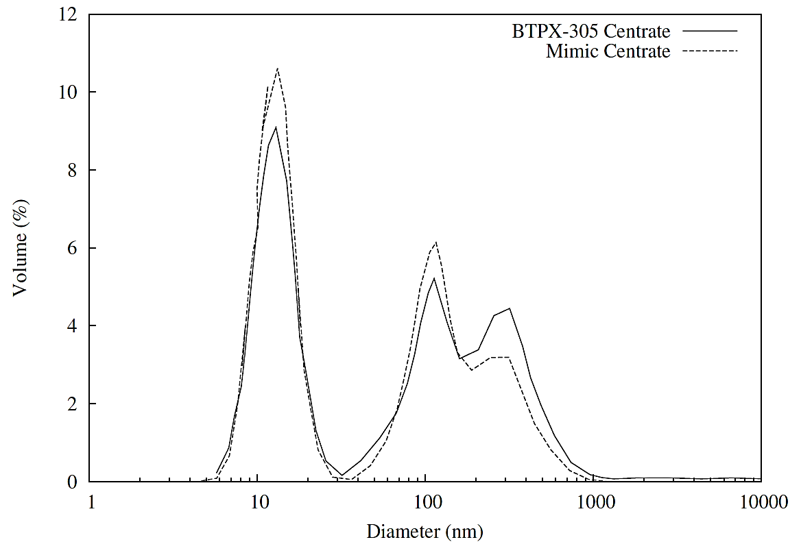
Verification: PSD
LDH
Screen
V/tΣ
Screen
Scale
up
Verification
Filtration
Malvern Zetasizer used to measure PSD
Mimic centrate matched clarified material from LAPX-404 & BTPX-305

Slide 17
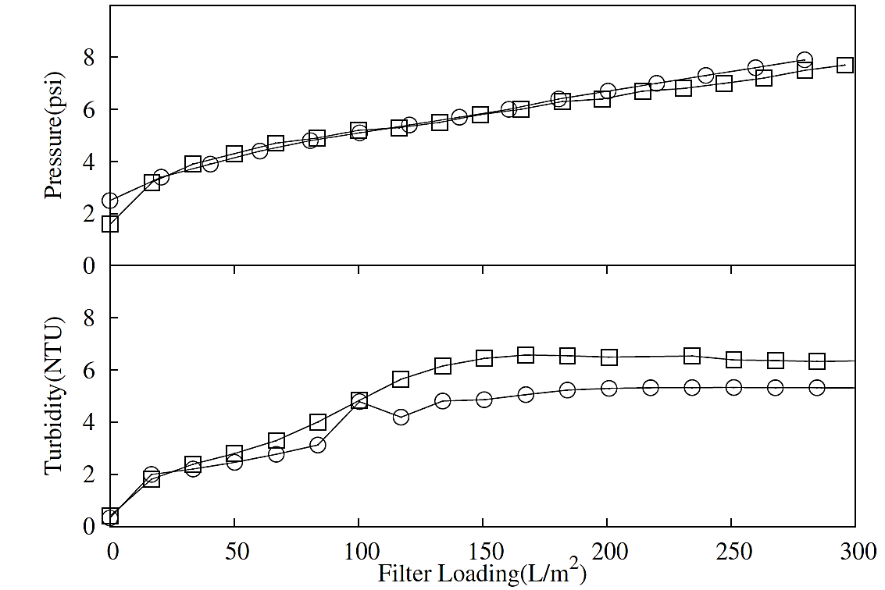
Filterability: X0HC
LDH
Screen
V/tΣ
Screen
Scale
up
Verification
Filtration
Mimic material () and pilot-scale centrate () passed through 23cm² bench-scale X0HC filter
Similar fouling observed between both during filtration
Pressure & Turbidity

Slide 18
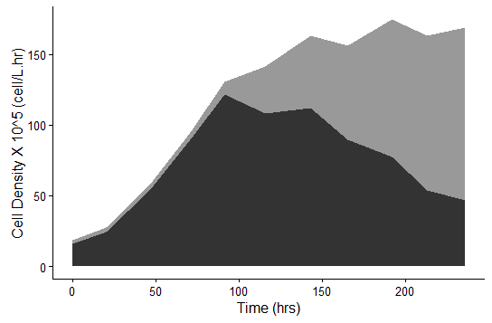
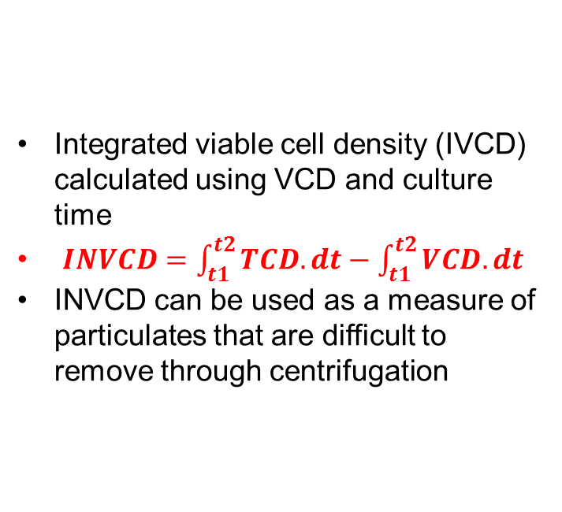
Integrated Non Viable Cell Density (INVCD)
Integrated viable cell density (IVCD) calculated using VCD and culture time
$INVCD=\int_{t1}^{t2}{TCD.dt−\int_{t1}^{t2}{VCD.dt}}$
INVCD can be used as a measure of particulates that are difficult to remove through centrifugation

Slide 19
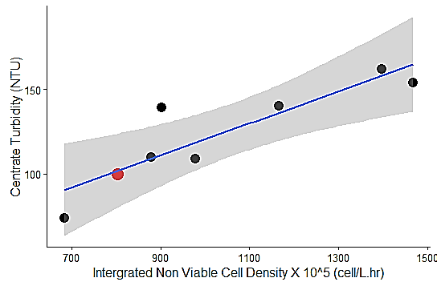
USD Centrifugation Predictive Data: Project A
3L Bioreactors used to generate material for experiments
Material passed through the CSD and lab-scale centrifuge to mimic LAPX-404 platform operating conditions
USD approach provided predictive capability for pilot scale performance
 LAPX-404 Centrate
 3L Model Centrate

Slide 20
USD Centrifugation Predictive Data: Project B
INVCD used to predict performance of Project B with modelling data providing a strong fit (R²=0.98)
Strong predictive capabilities using this method.
LAPX-404 Centrate
✵ 3L Model Centrate

Slide 21
Conclusions USD Centrifugation
Paper accepted by Journal of Biotechnology & Bioengineering
The scale-down model generated comparable material on multiple occasions:
Confirmed similar shear rate by matching increase in LDH
Settling characteristics confirmed by turbidity
Particle size distribution profiles are similar
Matching filtration pressure and turbidity profiles
Significant savings in Material, Cost & Time:
50L Stainless Steel → 3L Bench Reactor
Allows for centrifuge characterization at an earlier stage of process development
Plan to extend work to include samples from a commercial scale centrifuge

Slide 22
Depth Filtration Development Strategy

Slide 23
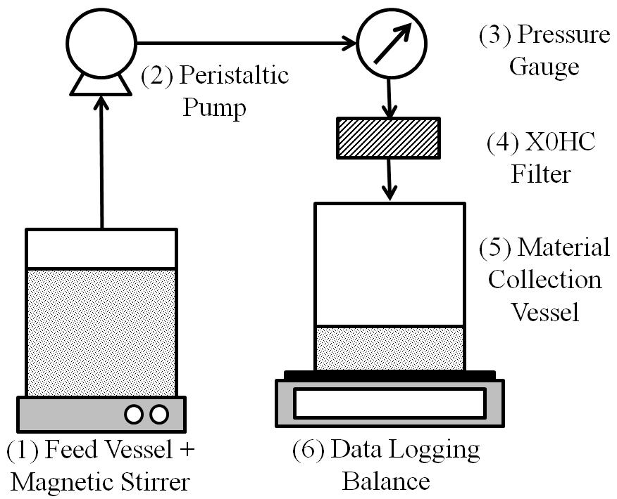
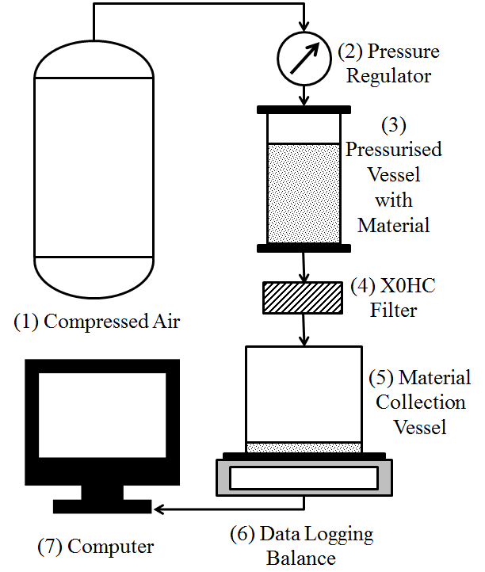
Introduction
Depth filters are used in combination with a disk-stack centrifuge or as a train.
Characterization requires large material & resource requirement
Sizing only conducted for worse case material
Development of more efficient method for filter sizing
Two main modes of filtration
Constant Flow Constant Pressure
Experimentally determined capacity Theoretically determined capacity
Used to size depth filters Used to size Sterile Filters
Requires large pools of material (1.5 L) Requires small pool of material
Developed method benefits
Material & time reduction for characterization
Wider range of materials tested
Established predictive models for D0HC and X0HC filters
Constant Flow
Constant Pressure

Slide 24
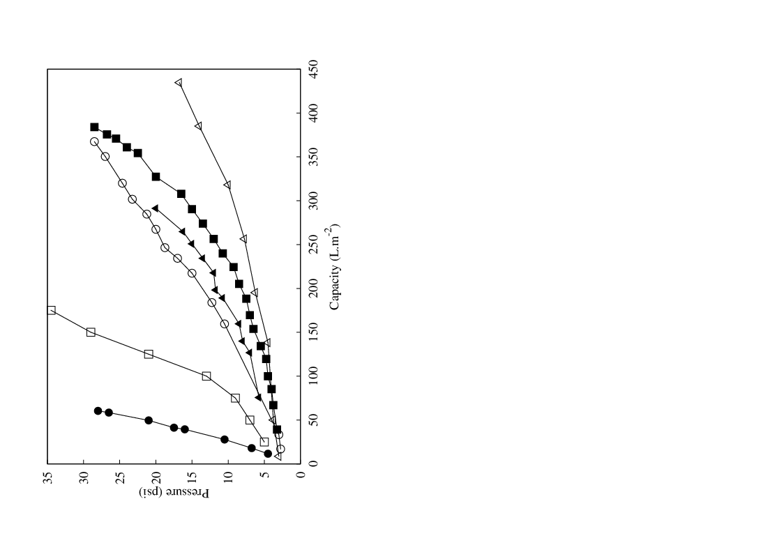
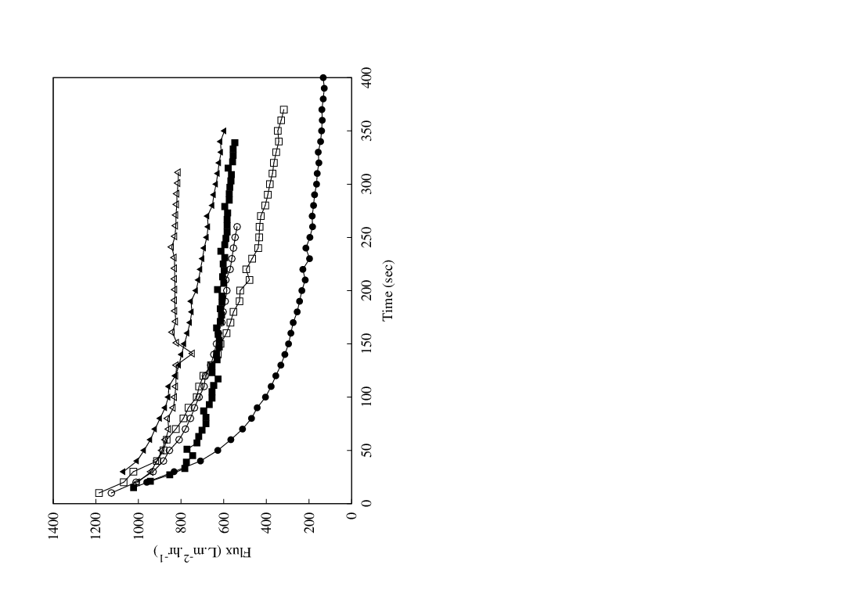
Constant Flow Constant Pressure
A
B

Slide 25
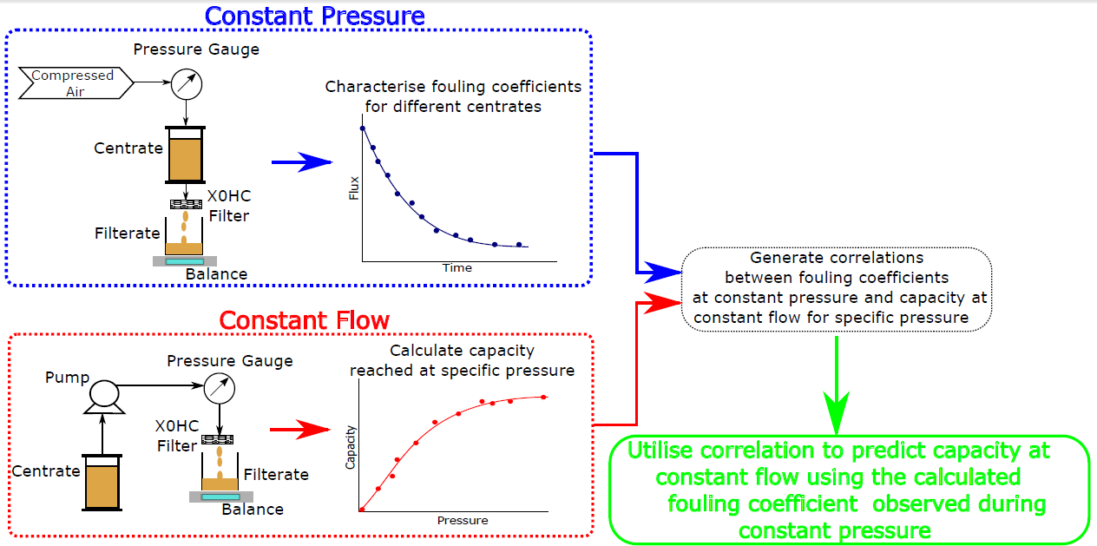



D0HC Prediction Strategy
Requirements of good correlation between CF_{cap} and K_{s}
Also accurate quantification of K_{s}
$${CF}_{cap,P_{i}}∝K_{s,P_{i}}$$
$$K_{s,P_{i}}$$
$${CF}_{cap,P_{i}}$$

Slide 26
Fouling Analysis
Complete
Cake
Constant pressure experiments data analyzed to identify best model by linearity (R²)
Data analyzed to quantify gradient for each data set (K_{i})
K₁(R²)
K₂(R²)
K₃(R²)
Intermediate
Standard
Scaling and Particulate Fouling in Membrane Filtration Systems Volume 26 of IHE Dissertation Page 123

Slide 27
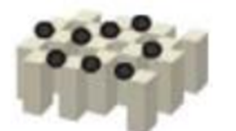

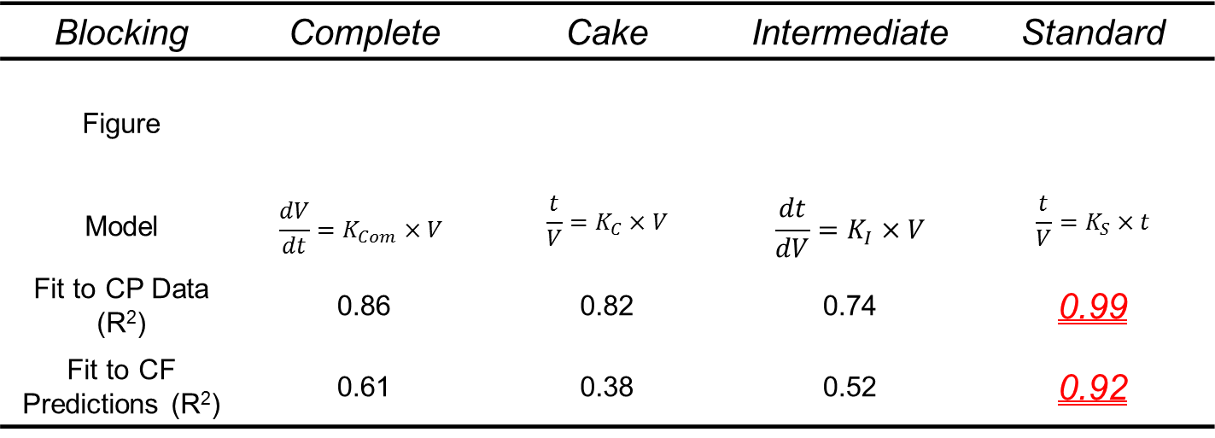
D0HC Constant Pressure Fitting Data
Blocking | Complete | Cake | Intermediate | Standard
Figure
Model | $$\frac{dV}{dt}=K_{Com}×V$$ | $$\frac{t}{V}=K_{C}×V$$ | $$\frac{dt}{dV}=K_{I}×V$$ | $$\frac{t}{V}=K_{S}×t$$
Fit to CP Data (R²) | 0.86 | 0.82 | 0.74 | 0.99
Fit to CF Predictions (R²) | 0.61 | 0.38 | 0.52 | 0.92
4 standard fouling mechanisms when operating at constant pressure
Other combination models can also be used to describe the fouling

Slide 28
D0HC Filtration Capacity Prediction
10 separate cell cultures sourced from 3 projects were used during the development of this model.
Strong correlation between CP fouling coefficient and CF capacity R²=0.92
Independent verification run to confirm findings

Slide 29
D0HC Model Verification
Average deviation between experimental and predicted value is 14.4%
Filter to filter deviation is around 30%** for Millipore depth filters.
**The clarification of bioreactor cell cultures for biopharmaceuticals Yavorsky et al., (2003) Pharm Technol

Slide 30
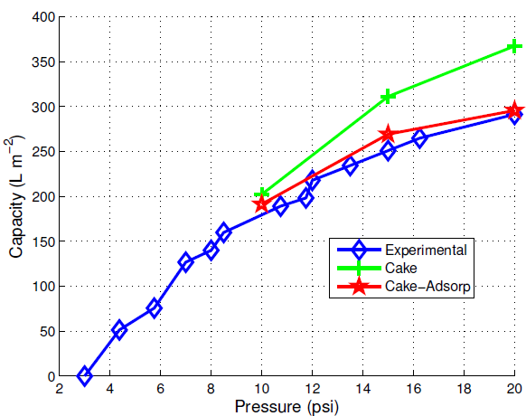
X0HC Model Verification
Cake Model
Fit to CP Data: R²=0.85
Fit to CF Predictions: R² =0.90
Cake Adsorption Model
Fit to CP Data: R² =0.93
Fit to CF Predictions: R² =0.95
Independent material tested to verify the modelling data set
Strong predictions for both Standard and Mixed models

Slide 31
Conclusion Scale-Down Depth Filtration
Novel method of sizing depth filters
Paper submitted to Journal of Membrane Sciences
The newly developed approach requires:
1-2L Centrate /Cell Culture → 100mL Centrate /Cell Culture
5 Hrs Process Time → 3 mins Process Time
Constant flow capacity predicted using constant pressure data within ±15% for both X0HC and D0HC filters
Potential for method to be used for screening at an earlier stage of process development

Slide 32
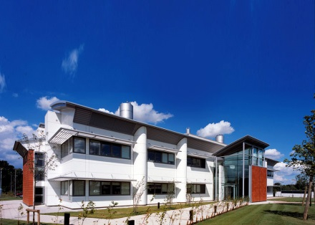
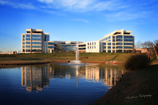

Acknowledgements
J.Bender
S.Bosley & M.Meyers
J.Dyer II
S.Goldrick, D.Gruber & R.Turner
K.Hwang
N.Fuchs, M.Liang, A.Martinez, K.Singarapu & W.Yang
B.Kenty
Proff. N.Titchener-Hooker & Proff. SS.Farid
M.Mollet
M.Mlawa
S.Rose
J.Savery
Franklin Building
OMW
UCL

