Slide 1
Tetris
Brandon Sweitzer

Slide 2
Motivation
Modern games run on software processors
Hardware-only systems are faster
Need for real-time embedded systems
Notes:
The goal was to build a real-time interactive system entirely in hardware. Unlike software-based games, this design uses pure digital logic, making it faster, deterministic, and closer to mission-critical embedded systems used in Air Force applications.

Slide 3
Technical Objectives
Implement Tetris in pure VHDL
Real-time video output
Hardware FSM game control
External controller
Notes:
The Air Force need is for deterministic, low-latency systems. This project demonstrates that by implementing a complete interactive system in hardware, including control logic, memory, and video rendering.

Slide 4
FSM
Clk
Reset
Game_tick
Btn_left
Btn_right
Btn_rotate
Btn_drop
Btn_start
Move_valid
Down_valid
Spawn_valid
Move_left
Move_right
Rotate
Soft_drop
Hard_drop
Spawn_piece
Lock_piece
Clear_en
Wr_en
State_out
Piece Logic
Clk_div
Clk
Reset
Move_left
Move_right
Rotate
Soft_drop
Hard_drop
Spawn_piece
Collision Detector
Piece_x
Piece_y
Rotation
Piece_type
Piece_cells
Clk
reset
Game_tick
Input_tick
Piece_x
Piece_y
Rotation Piece_cells
Board_data
Move_valid
Down_valid
Rotate_valid
Spawn_valid
Board Memory
Video
NES
Nes_latch
Nes_clk
Btn_left
Btn_right
Btn_drop
Btn_start
Clk
Reset
Wr_en
Piece_cells
Piece_x
Piece_y
Clear_en
Shift_en
Board_data
Clk
Reset
Row
col
Tmds
tmdsb
Clk
Reset
Input_tick
Nes_data
Line Clear
Clk
Reset
Board_data
Clear_en
Rows_cleared
Shift_en
score
Notes:
I designed the system to be modular, with the FSM controlling the game flow, piece logic handling movement of the tetrominos,, collision detection validating your moves, board memory storing the current game state, and video handling the VGA/HDMI output.

Slide 5
Data Flow
Inputs to FSM decisions
FSM to movement commands
Board updates, rendered by frame
Notes:
Data flows one direction: inputs affect FSM decisions, which update the board, and the video module continuously renders that board state.

Slide 6
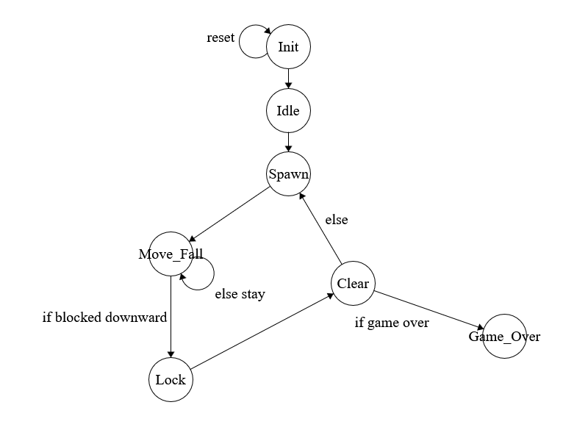
FSM
Notes:
The FSM is the core controller. It handles spawning, movement, locking, and clearing. A key improvement was adding WAIT states to prevent timing issues between modules.

Slide 7
Piece Logic
Tracks piece position
Handles left/right movement, rotation, drops
Piece Logic
Clk
Reset
Move_left
Move_right
Rotate
Soft_drop
Hard_drop
Spawn_piece
Piece_x
Piece_y
Rotation
Piece_type
Piece_cells
Notes:
Piece logic is responsible for maintaining the current piece state. It updates position based on FSM commands and outputs the piece shape.

Slide 8
Collision Detector
Checks move validity
Outputs valid signal
Computes hard drop
Collision Detector
Piece_x
Piece_y
Rotation Piece_cells
Board_data
Move_valid
Down_valid
Rotate_valid
Spawn_valid
Notes:
Collision detection is separated from the FSM. This improves modularity and ensures clean, reusable logic for validating moves and computing final drop positions.

Slide 9
Board Memory
Stores 10x20 grid as array
Writes only on lock
Handles moving pieces down after line clear
Board Memory
Clk
Reset
Wr_en
Piece_cells
Piece_x
Piece_y
Clear_en
Shift_en
Board_data
Notes:
Board memory stores the game state. A key design fix was using a temporary board to prevent partial writes and random corruption during updates.

Slide 10
Line Clear
Detects full rows
Outputs rows_cleared
Keeps track of score
FSM Handles shift after clear
Line Clear
Clk
Reset
Board_data
Clear_en
Rows_cleared
Shift_en
score
Notes:
Line clear is purely a detector. The FSM controls when rows are removed to avoid race conditions.

Slide 11
Issues!
False game over, add wait states!
Random Colors, rework board memory
Hard drop glitches, move logic to collision detector
Controller issues
Notes:
The biggest challenges were timing issues between modules. These were solved by adding buffer states and separating responsibilities between modules.

Slide 12
Questions?

