Slide 1
What are Microservices?
Donald Cousar
Bellevue University
RESTFul APIs

Slide 2
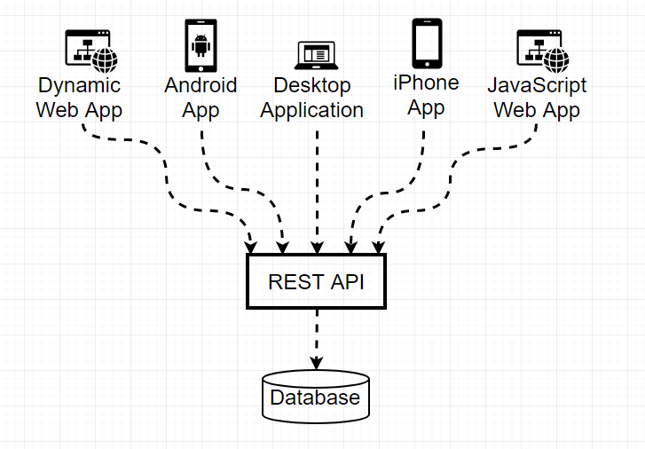
What is a Microservice?
A microservice is an architecture that structures an application as a collection of services.

Slide 3
Microservice Characteristics
Highly maintainable
Easily testable
Loosely coupled
Independently deployable
Organized around business capabilities
Enables the continuous delivery/deployment methodology

Slide 4
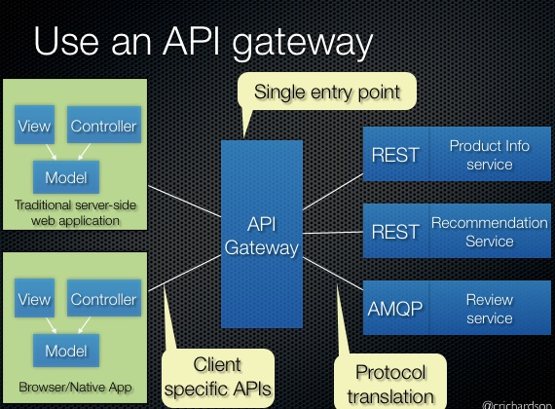
What is an API Gateway?
An API Gateway is a single point of access for all clients into Microservices.

Slide 5
Advantages of an API Gateway?
Improve fault isolation
Easier to build and maintain apps
Organized around business capabilities
Improved productivity and speed
Eliminate vendor or technology lock-in
Ease of Understanding

Slide 6
Disadvantages of an API Gateway?
Developing distributed systems can be complex.
Multiple databases and transaction management can be painful.
Testing a microservices-based application can be cumbersome.
Deploying microservices can be complex.
Increases in documentation overhead as organization has to keep schemas and interface documents up to date.
Each service have to be tested and monitored increasing the demand for automation.

Slide 7
MicroserviceDeployment Options
Virtual Machine
Amazon EC2 Virtual Machines
Physical Machines
Serverless Solutions
AWS Lambda
Google Cloud Functions
Azure Functions
Containers
Kubernetes
Amazon EC2 Container Service

Slide 8
MicroserviceScaling
Popular Microservice Scaling methods
X-axis scaling
Y-axis scaling
Z-axis scaling

Slide 9
X-axis scaling consists of running multiple copies of an application behind a load balancer.
X-axis scaling
Challenge
Requires more memory to be effective

Slide 10
Y-axis scaling consists of running multiple identical copies of the application, splitting the application into multiple different services.
Y-axis scaling

Slide 11
Z-axis scaling consists of multiple servers running identical copies of the code, similar to X-axis, but the main difference is each server is responsible for only a subset of the data..
Z-axis scaling
Challenge
Increased application complexity

Slide 12
References
Kong. n.d. Microservices Architecture - What are microservices Retrieved from: https://microservices.io
Kong. n.d. Microservices Architecture – API Gateway Retrieved from: https://microservices.io/patterns/apigateway.html
Skelia. n.d. 5 Major benefits of microservice Architecture. Retrieved from: https://skelia.com/articles/5-major-benefits-microservice-architecture/

