Slide 1
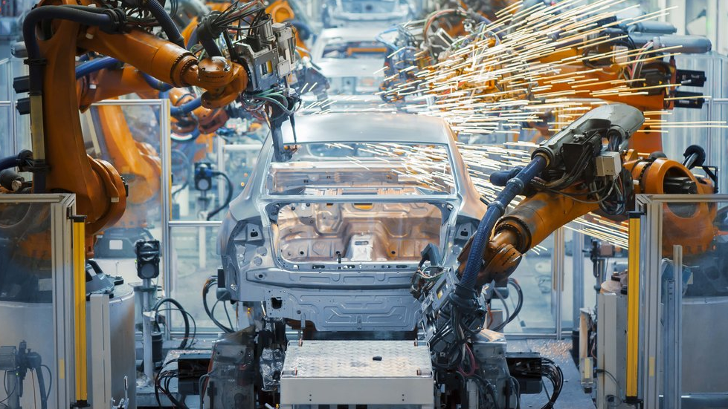
Machine Learning for Product Quality
Module 2 - Design & Architecture

Slide 2
Key Design Considerations
Cost
Auto-Off
“Elastic Charge”
Automation
Skills Required
Python & Java Script Only
Scalability
Everything dynamically scales
Security
Key Vault, Env Vars & RBAC

Slide 3














Current Architecture
Stream Transform
Big ML Explore & Train
Model Zoo
Data Generator
Event Hub
ML Prediction
Web Application
Private PyPi
Azure Dev Ops
Azure Key Vault
Container Registry

Slide 4

Better Architecture
Big ML Explore & Train
Model Zoo
Stream Transform
Data Generator
Event Hub
ML Prediction
Web Application
Private PyPi
Azure Dev Ops
Azure Key Vault
Container Registry

