Slide 1
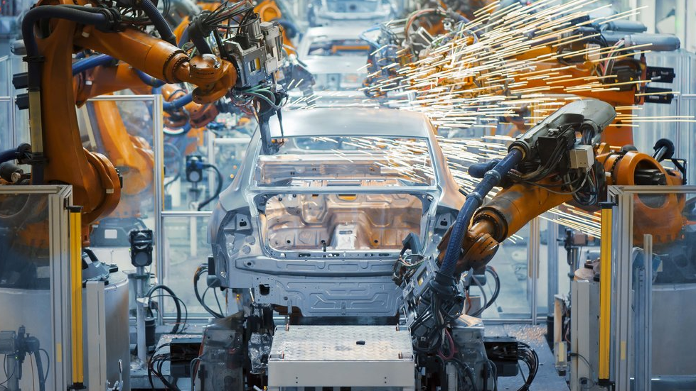
Machine Learning for Product Quality
CSE Accelerator

Slide 2
Modules
Introduction
Design & Architecture
The Data Stream
The Distributed Package
Machine Learning & Data Science
Inference Function
The Web Application
Dev Ops

Slide 3
Industrial Trends
Focus Areas
Quality Detection
Operational Efficiency
Preventative Maintenance
Supply Chain Management
Compliance
Key Challenges
Low margins per solution
Lack of labelled data
Availability of skilled workers
Security & Compliance
True ML Ops
Also multiplies costs
Code replication
Testing

Slide 4
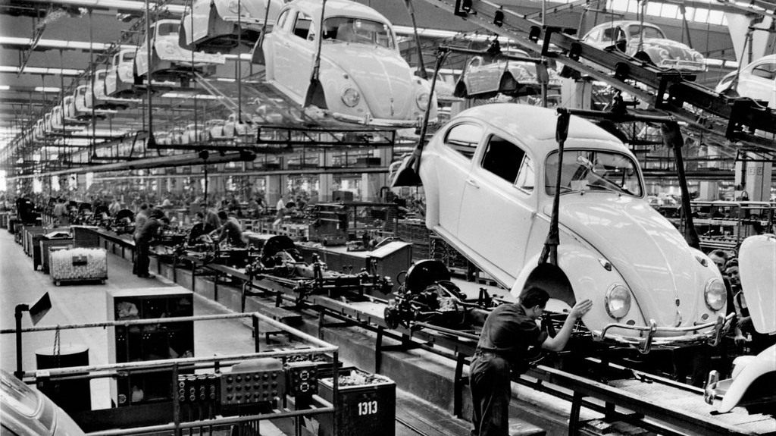
Typical Scenarios
Typical Project
Holistic Product Quality Determination
Product Subcomponent Quality Determination
Process Quality Determination
Equipment Preventative Maintenance
Outcomes
Reduce Product Quality Issues
Improve Manufacturing Process
Notes:
Many of these engagements are related and is a bit dependent on the actual manufacturing process itself.
For example: in electronics manufacturing, solder paste application is a process in a specific machine. Even though we can tell which spot on the board is defective, the entire board would need to be wiped and go through the whole process again. If it makes it to pick and place, baking and then Optical Inspection and a defect is determined, then individual sub component, such as a ball grid array component if identified could be manually reworked without having to scrap the whole motherboard.
It is important to think of product quality in the context of all the parts, assemblies, sub assemblies and how they are composed within the process. Due to the tight relationship between product quality and manufacturing process, improvements, a side effect can occur where you can easily expand a project into new directions. For example, if you develop a weld quality analysis solution you can see that a particular welder is slowly degrading which would in fact be a preventative maintenance solution built on top of the product quality solution. Keep an eye out of those.

Slide 5
Classes of Solutions
Internal Solutions
Designed and built by a manufacturer for itself.
Typically Cloud Based interacting with 3rd party IoT
Directly interacting with hardware that publishes, but more typically through a 3rd party collector such as Thingworx or a historian such as OSI Pi.
ISV Solutions
Designed and built by a software vendor to service a manufacturing customer.
Some hardware vendors are looking to expand into the ML space for more value add and upsell.
Spreads a large gambit of solution types from Cloud SaaS to Deployed on Premise, Edge & even with device firmware involved.
Commonalities
Algorithmic Training typically happens in the cloud
Algorithmic Inference location is dependent on latency, bandwidth and fault tolerance requirements for predictions.
Python is a central theme
Notes:
The class of solution is important for a few key reasons:
Scale: The way the solution scales is different. An ISV solution does not have a predefined scale and starts small and then grows. An internal solution is typically easy to fully define the speeds, feeds, factories up front.
Data: The data formats are less easily defined in the isv space
Onboarding: The ISV space has to account for customer onboarding and typically needs to design for having a third party or services group executing an engagement to onboard the customer. Internal solutions the dev team is typically this team.
ROI: ISV space the costs can be distributed across multiple customers and there is a threshold of break even, its typically an easier calculation. The internal solutions are more challenging from the ROI conversation because there are so many influential points and impacts.
Environmental Configurations: Internal Solutions for many customers have dev & prod; sometimes its just prod. ISV scenarios typically have multiple rings of releases with the most common being dev, qa & prod. Internal solutions tend to have less restrictions and constraints.

Slide 6
Classes of Algorithms Used
Multi-System Correlation
Use downstream data to make upstream decision
Most classes of supervised learning algorithms tend to yield decent performance
Get a v1 stupid algorithm working. MSFT’s Auto-ML performs well.
Pros: If enough data present, this is a great thing to do and well documented.
Cons: Usually not enough data and significant investments required in data collection & labelling.
Anomaly Detection w/ Trend Overlay
Look in the unsupervised space for algorithmic inspiration
Essentially standard deviations away from normality w/ trends for prioritization of maintenance
Pros: No need for downstream data and reduced data collection & labelling requirements.
Cons: The algorithm and training schedules can be tricky to figure out. Decisions around automating data collection & toss out can be tricky as well.

Slide 7
DEMO OF APPLICATION

Slide 8
Engagement Process
Week 1
Envisioning + Architecture Design Session (ADS)
Week 2
ADS + Code Acceleration Workshop
Week 3+
Sprints w/ ramp down & hand off from CSE
Notes:
ADS gets repeated in Week 2 because week 1 is usually the “Theoretically you can/should be able to do X, Y or Z with this” and Week 2 when you start coding is when you dive in and rubber hits pavement. Little details start to have larger implications in week two.

Slide 9
Example Envisioning + ADS Agenda
Day 1 (Tuesday)
9am – 9:30am: Intros & Breakfast/Coffee 9:30am – 10am: Review Objectives & Goals 10am - Noon: X Presents Current State & Future Vision (technical & business) Noon – 1pm: Lunch 1pm – 2:45pm: Phases, Milestones & Value Markers (ROI) 2:45pm – 3pm: Break 3pm – 4:30pm: MSFT & X – How do we play together?
Day 2 (Wednesday)
9am – 9:30am: Quick Recap, Review & Readdress Objectives & Goals. + Coffee 9:30am – 10:30am: ADS - Concrete Requirements Collection (Functional & Non Functional) 10:30am – 10:45am: Break 10:45am – Noon: Review Current Architecture & Workloads Noon – 1pm: Lunch 1pm – 2:30pm: ADS – Refine Architecture w/ Workloads for functional requirements (speeds & feeds etc) 2:30pm-2:45pm: Break 2:45pm-4:30pm: ADS – Refine Architecture w/ Workloads for nonfunctional requirements (security & compliance etc)
Thursday
9am – 9:30am: Quick Recap, Review & Readdress Objectives & Goals. + Coffee 9:30am – 10:30am: ADS – Refine Architecture w/ Workloads for Dev Ops 10:30am – 10:45am: Break 10:45am – Noon: Revisit Phases, Milestones & Value Markers (ROI) - MVP & GA Focused Noon – 1pm: Lunch 1pm – 2:30pm: Phase 1 break down 2:30pm-2:45pm: Break 2:45pm-4:30pm: Next Steps 4:30pm-5pm: Note Taker Czar Emails everybody notes.

Slide 10
Example ADS + Code Acceleration Workshop (CAW)
Day 1 (Tuesday)
9am – 9:30am: Intros & Breakfast/Coffee 9:30am – 10am: Review Objectives & Goals 10am - Noon: Discuss Architecture & Code Components (how code works in various components)
Day 2 (Wednesday)
9am – 9:30am: Standup
Thursday
9am – 9:30am: Standup
9:30am – 5pm: Code
9:30am – 4:15pm: Code 4:15pm-5pm: Wrap Up & Next Steps
Noon – 1pm: Lunch 1pm – 4:30pm: Task Creation & Task Discussions for Everyone – Rebuild Architecture if necessary

