Slide 1
Why Use R and What Kinds of Apps Can I Make?
Dr. Dan Holmes, MD
Department of Pathology and Laboratory Medicine
University of British Columbia
AACC Atlanta, 30-Sep-2021

Slide 2
Conflicts of Interest
None

Slide 3
General Overview
R language is an open-source computational and statistical computing language originally developed as an answer to the S language.
R language highly adapted to analyzing spreadsheet-like data as would be seen in statistical analyses.
Extremely rapid development of R began in 2012 as “Data Science” entered the common vernacular.
RStudio IDE
Tidyverse
New modes of visualization

Slide 4
Some Vocabulary
RStudio
The open-source and commercial integrated development environment designed for R by the company of the same name.
Permits the authorship of R code in a very R-centric workflow with lots of “helps” to make the coding easier
Quick Demo

Slide 5
Some Vocabulary
R Markdown is an adaptation of the Markdown “markup” language that permits a very simple syntax to generate:
Free text
Lists
Tables
Embedded images created with “chunks” of R
Inline (i.e. within-sentence) calculations
Output can be “knit” to be Word, PDF, HTML (Slides, Posters)
Excellent overview: https://oliviergimenez.github.io/intro_rmarkdown/#1
Quick Demo

Slide 6
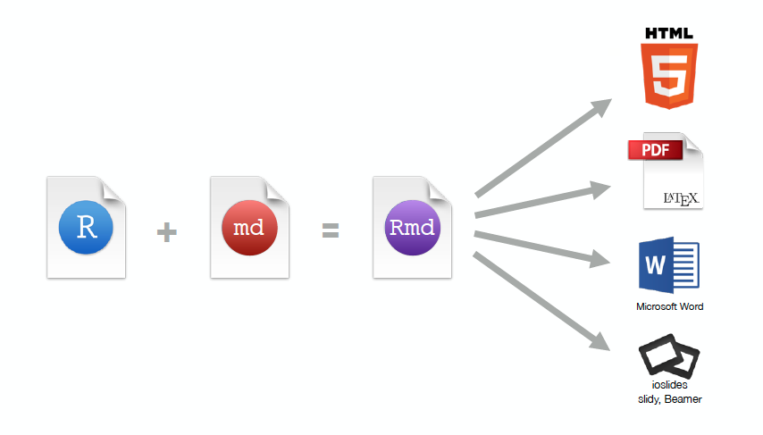
Some Vocabulary

Slide 7
Some Vocabulary
Pandoc – a universal document converter leveraged by R Markdown to produce the variety of outputs
LaTeX – a scientific markup language used by R Markdown to produce PDF output.
Plotly – a visualization library we can use to easily create interactive HTML from Rmarkdown.
Flexdashboard – an easy-to-use library for making static dashboards in R
Shiny – a slightly harder to use tool for making fully interactive web applications

Slide 8
Why on Earth would I do this?
Reproducibility
All analysis is exposed and clear in the code
If you change the data, the document rewrites itself upon “knitting”
You will not forget what you did, because you have a record
Version control – to be discussed by Dr. Kadauke.
Automation
You can set up Mac/Linux cron jobs or Windows scheduled tasks to create your document and email it or post it to web automatically.
Can interact with other languages or a database.

Slide 9
Examples
We will want to walk through a number of examples of increasing complexity and flexibility
R Markdown to static report – PDF or Word
R Markdown to HTML
R Markdown to interactive static HTML
R Markdown to fully interactive web-apps using Shiny
NB: Deployment of Shiny apps requires a Linux Server, use of public facing servers with Rstudio, or purchase of a commercial solution (R Studio Connect)
RShiny apps have authentication and throttling limitations without purchase of commercial solutions – but these limitations can be entirely overcome (for free) by using Shiny Proxy.

Slide 10
Gander at some Examples
Inhouse COVID Dashboard – made in March 2020 in two evenings
More complex example:
https://beta.rstudioconnect.com/jjallaire/htmlwidgets-ggplotly-examples/htmlwidgets-ggplotly-examples.html

Slide 11

Let’s make examples

Slide 12
Github
All the source code and output can be downloaded at:
https://github.com/drdanholmes/AACC2021

