Slide 1
Making Reliable Lab Apps: Demystifying Good Software Engineering Practices
Stephan Kadauke, MD, PhD
Assistant Professor of Pathology and Lab Medicine
Children’s Hospital of Philadelphia
AACC Atlanta, 30-Sep-2021

Slide 2
Conflicts of Interest
None

Slide 3
Learning Objectives
After this session, participants will be able to:
Define “production” as it relates to software
Explain the role of software engineering practices to mitigate risks inherent in developing software for production
List three commonly employed software engineering practices that should be routinely employed when building custom lab apps

Slide 4
Motivating Case Studies

Slide 5
Case 1
A very smart lab director taught himself programming in R.
Using his R skills, he develops multiple applications that implement automations to facilitate workflows in the chemistry lab. Some of these apps feed result values into the LIS.
He discovers an issue in the logic of one of the apps that leads to misreporting of a time stamp of one of the result values.
A month after fixing the issue, he discovers that the fix inadvertently caused a different calculation to fail, leading to misreported time stamps for a different result value.
Notes:
** Drive home that it would be good to be able to run automated tests to assess the

Slide 6
Case 2
To address operational needs on his service, an apheresis director built a database in Microsoft Access in 2001.
To this day, this database serves as the de-facto information system for the apheresis service.
Over the years, the database has been extensively customized. It now contains many features that are no longer being used, and others that are essential for day-to-day activities of the apheresis service.
This individual is now nearing retirement.

Slide 7

Notes:
**Risks
Can creep up on you
You may feel like it’s fine but all of a sudden realize that the room is one fire.

Slide 8
Demo
Notes:
Show the Engraftment app
Point out:
- This is a production app
- There are multiple complex calculations

Slide 9
Production

Slide 10
What is “Production”?
An application is said to be in production if the following are true:
1. It is being used, even if only by one person. 2. It is being relied upon by its user(s). 3. It has real life impact if something goes wrong.
Engineering Shiny (Fay et al., 2021)
Notes:
Add something interactive to test prod vs not prod?
A CDS app that is used to make decisions about triaging platelet transfusions. The BB director wrote the app, and he is the only person using the app.
Yes!
A testing instance of Epic that is being used to evaluate issues that may come up during an upcoming EHR update. For a month
No! Testing only. No real life impact if things go wrong. You actually want things to go wrong here.
A physician writes an app that checks his computer for large files and sends him an email listing all files larger than 1 GB.
No! Not really a terrible impact

Slide 11
Which of the following applications are in production?
A Blood Bank director writes an app to help triage platelet units. She wrote the app, and she is the only person using the app.
A testing instance of Epic is deployed that will be used to evaluate issues that may come up during an upcoming EHR upgrade.
A physician writes an app that checks his computer for large files and sends him an email listing all files larger than 1 GB.
Notes:
Add something interactive to test prod vs not prod?
A CDS app that is used to make decisions about triaging platelet transfusions. The BB director wrote the app, and he is the only person using the app.
Yes!
A testing instance of Epic that is being used to evaluate issues that may come up during an upcoming EHR update. For a month
No! Testing only. No real life impact if things go wrong. You actually want things to go wrong here.
A physician writes an app that checks his computer for large files and sends him an email listing all files larger than 1 GB.
No! Not really a terrible impact

Slide 12
Software Engineering

Slide 13
The Cliff of Complexity
Usually, a small app that is useful does not stay small.
You add a feature
Then another
Eventually, it will become to complex to understand how all pieces fit together
At this point, you may be afraid to make any changes for fear that they will break something

Slide 14
Software Engineering
IEEE: The application of a systematic, disciplined, quantifiable approach to the development, operation, and maintenance of software
Software engineering is the art of building maintainable software, and it does so in large part by employing practices that reduce complexity of the code.

Slide 15
Software Engineering Practices
Version Control
Automated Testing
Code Review
…
Notes:
Do I need to learn all of this stuff? Really?!
No! But as a stakeholder of a project that involves building an application it may be a good idea to have a working understanding of what they are and what their purpose is.

Slide 16


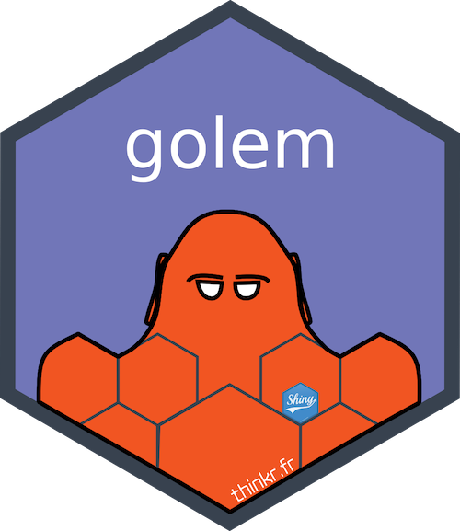

Slide 17
Version Control

Slide 18
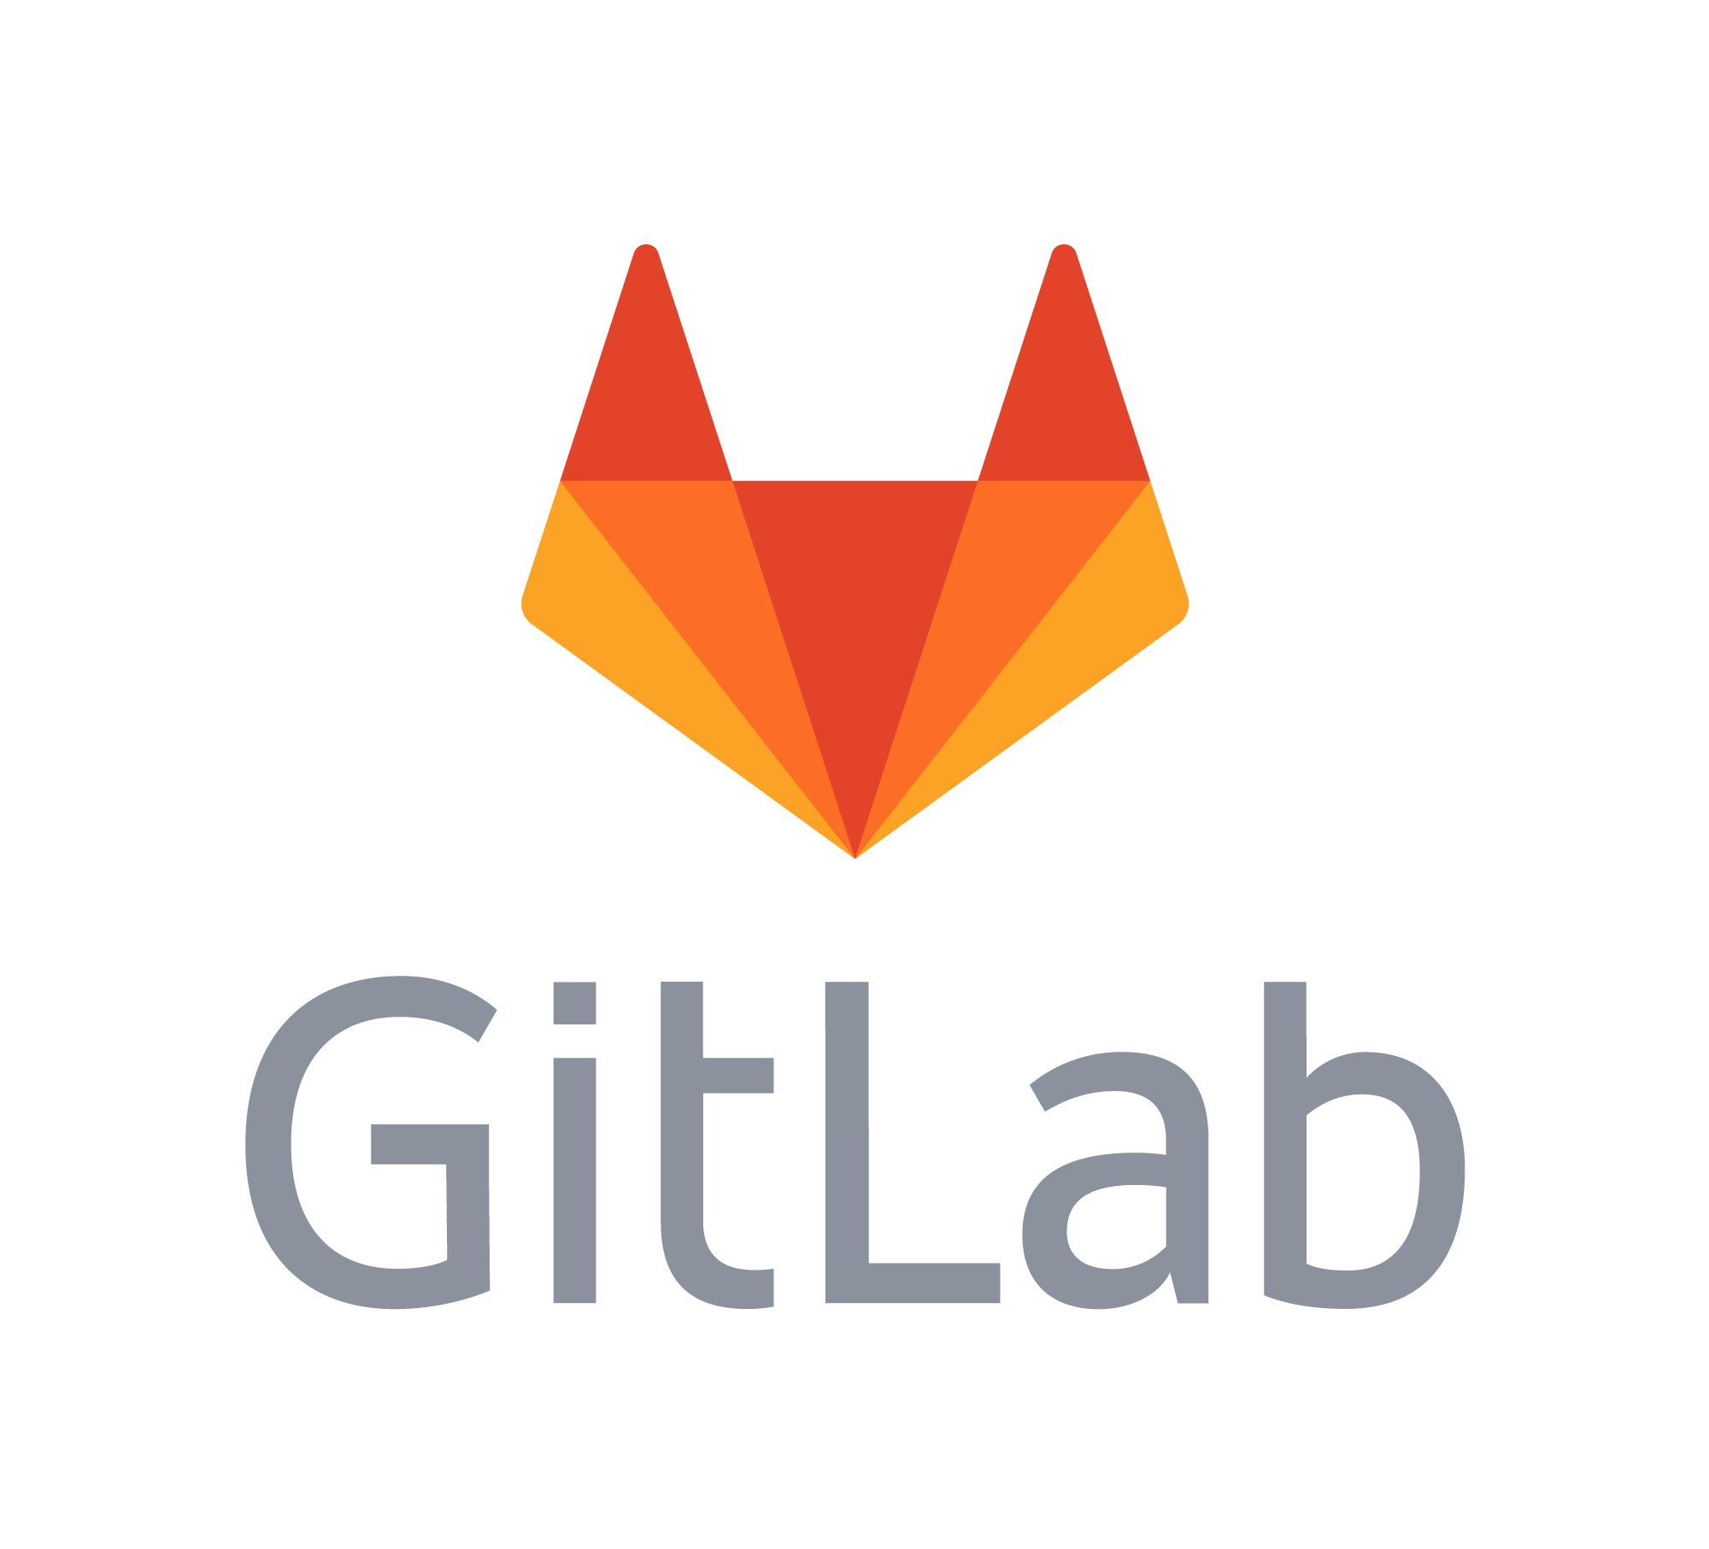

What is Version Control?
A set of practices that enable change control and collaboration for software code.
Commit
Check out
Merge
Repository
(“repo”)
https://www.nobledesktop.com/blog/what-is-git-and-why-should-you-use-it
Notes:
Most common VCS are GitHub and GitLab
Code for a project lives in a repository (repo)

Slide 19
?
?

Slide 20
Demo
Notes:
Show the Engraftment app’s repo
Point out:
GitHub is accessible from a browser and is actually pretty user friendly.
We have Github Enterprise institution wide. If you don’t have it you should request that your hospital purchase a license.
Branch = master but could have a working branch to write new code
Repo for the cibmtrFormsAssistant lists all the files in thee current branch
History is available of all previous versions committed to the repo
Can see differences in code
Can also see the files at different stages

Slide 21
Other benefits of using a VCS
Can roll back the application to a previous known working state
Can trigger code review and automated tests (“continuous integration”)

Slide 22
Automated Testing

Slide 23
What is Automated Testing?
A key mechanism of quality control in software development.
Unit tests are small pieces of software designed to check the logic of individual pieces of code.
Yes, we write code to test code
No, we don’t write code to test the code that tests the code!
Unit tests reduce complexity by un-coupling: they force the programmer to build small independent modules of code
Integration tests exercise multiple modules of code together
A medium-size software project often contains a hundred or more automated tests.
It usually takes fewer than ten minutes to run all tests, making it feasible to exercise the test suite frequently.

Slide 24
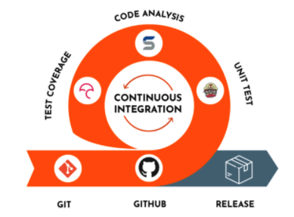
Continuous Integration
https://www.devonblog.com/continuous-delivery/continuous-integration-best-practices/
Notes:
Integrating automated testing with version control

Slide 25
Demo
Notes:
Show the tests folder
Anc500_day test. Point out:
Using the “testthat” package
Creating some fake data to simulate a test case
Use test_that to exercise a specific function anc500_day()
Call the function with my fake data
Use “expect” function to communicate to the test system what I expect the answer to be
If it’s wrong I get an email telling me specifically which test has failed
If all tests pass, I get a nice green checkbox
Show Actions – point out checkboxes and that running tests took <10 min

Slide 26
B
A
C
Notes:
Let’s say you configure your GitHub repository so that automated tests are run after every commit. At which point will tests run? A? B? C?

Slide 27
Code Review

Slide 28
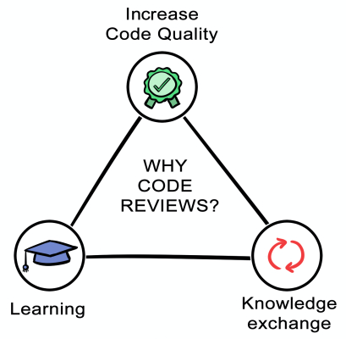
What is Code Review?
A kind of peer review in which someone other than the person who wrote the code looks at the source code and adds their comments and/or approval.
https://quickbirdstudios.com/blog/code-review-best-practices-guidelines/
Notes:
Why do we do code reviews? Shown to
Increase code quality. You’re going to do a better job if you know someone else will look at it. This reduces complexity by forcing programmers to write code that is not so complicated that it will be rejected by the reviewer
2. Learning: In some ways, code review is similar to medical documentation when trainees are involved: the medical student or resident drafts a note, and the attending reviews, revises, and co-signs it.
3. Knowledge exchange: transparency and mutual responsibility

Slide 29
Pull Request
A pull request lets others know that you would like to merge your changes to the master branch.
Pull Request
Merge
Notes:
Mechanism for integrating code review with your version control system.

Slide 30
Demo
Notes:
Show PR #20
On GitHub, you can see what a PR look like
- A key piece is the timeline which contains comments and other events
Here the developer tells me about the changes he has made.
I can see that there are a number of commits that have been made. The last one has a checkmark, telling me that he’s successfully exercised the test suite.
Then he requested a review from me
Knowing that all the tests worked make my life way easier because I don’t have to look for syntax errors and can instead focus on whether the logic is sound
Click on “View Changes” – can see all the changes. GitHub is smart enough to show me all the changes from all the relevant commits for this pull request.
Allows me to verify that he made exactly the changes we had discussed and how.

Slide 31
Recap

Slide 32
Learning Objectives
After this session, participants will be able to:
Define “production” as it relates to software
Explain the role of software engineering practices to mitigate risks inherent in developing software for production
List three commonly employed software engineering practices that should be routinely employed when building custom lab apps

Slide 33
Recap
An application in production if it is being used, even if only by one person; it is being relied upon by its user(s); and it has real life impact if something goes wrong.
Software engineering is the art of building maintainable software, and it achieves this largely by reducing complexity of the code.
Key software engineering practices include using a version control system, automated testing, and code review.
Notes:
Again, you don’t have to really master all of these tools.
But having a basic understanding of these practices enables you to ask probing questions. For example, you may want to ask what the test coverage of the app is, whether there is version control, and whether there is a process in place to run automated tests with each commit to the VCS. You may also ascertain that developers routinely perform code reviews.
If you are responsible for the outcome of a project that involves building an production-grade application, it will pay off to pay attention to software engineering practices!

