Slide 1

Prudential Life Insurance Assessment
Machine Learning Project
Presented by: Mark Hanson

Slide 2
Contents
Introduction
Objective
Source Data
Exploratory Data Analysis / Feature Building
Feature Selection
Modeling
Evaluation
Conclusions

Slide 3
Introduction
Big data technologies already revolutionize the way insurance companies to collect, process and analyze data more effectively e.g. customer analytics, product development, marketing analytics, and claims analysis.
Using vehicle telematics is a typical example where big data analytics is being vastly implemented and is transforming the way auto insurers price the premiums of individual drivers.
Use of predictive analytics approaches across life insurance practices have mainly focused on modeling mortality rates of applicants to improve underwriting decisions and profitability of the business.
Manulife insurance company in Canada was the first to offer life insurance to HIV suffering applicants through predictive analysis of survival rates.¹
¹ Bell M (2016) Is analytics the underwriting we know? [Hyperlink].

Slide 4
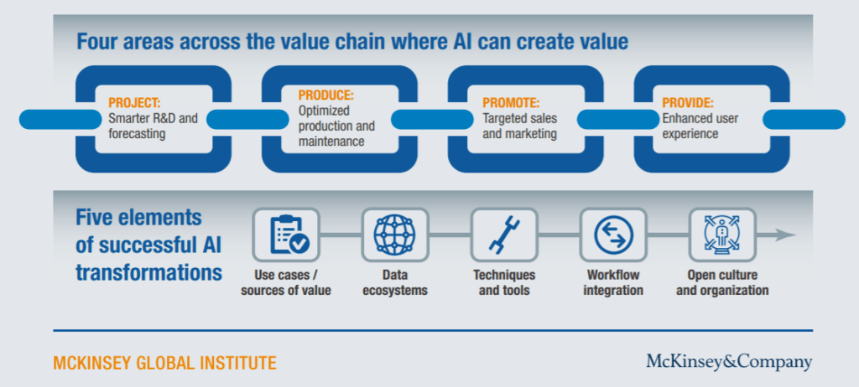
Introduction
In 2017 McKinsey article outlined four broad areas where machine learning could increase the value chain within the life insurance industry: projecting (forecasting), producing (operations), promoting (sales and marketing) and providing (enhanced user experiences).
² Bughin, Jacques, Eric Hazan, James Manyika, and Jonathan Woetzel. 2017. “Artificial Intelligence The Next Digital Frontier”. Mckinsey Global Institute.

Slide 5
Introduction
Applicant Evaluation:
Risk profiles of individual applicants are analyzed by underwriters, especially in the life insurance business. The role of the underwriter is to ensure that the risks are evaluated, and premiums as accurately as possible.
Risk classification is a common term used among insurance companies, which refers grouping customers according to their estimated level of risks, determined from their historical data.³
³ Cummins J, Smith B, Vance R, Vanderhel J (2013) Risk classification in Life Insurance, 1st edn. Springer, New York [Hyperlink].

Slide 6
Introduction
Problem: The current life insurance application process is considered by prospective clients to be slow, in part:
Customers need to provide extensive information (medical exams) to assess their risk classification and eligibility, a process that takes an average of 30 days.
Life insurance organizations still rely on traditional mortality tables and actuarial formulas to predict mortality rates and premiums of life policies.
Result: People are turned off because of the application process and costs. Only 59% of Americans have some form of life insurance with approx. 50% of those are underinsured according to LIMRA research.⁴
⁴ US Individual Life Insurance Sales – LIMRA research [Hyperlink].

Slide 7
Objective
The purpose of this research is to apply predictive modeling to classify the risk level based on the available past data in the life insurance industry and recommend the most appropriate model to assess risk and provide solutions to refine underwriting processes.
The focus is not to compare predictive performance against existing industry ‘actuarial’ risk methods, but to apply a 'data science’ approach, through focus on model robustness and data understanding.

Slide 8
Source Data
Using a data set provided by Prudential Financial as part of their recent Kaggle Challenge, a number data science techniques will be used to prepare and statistically analyze and applying to various machine learning models.
Prudential Financial is a financial wellness and global investment organization operating in the United States, Asia, Europe and Latin America. It has approx. $1.55 trillion (USD) in Assets Under Management.
Dataset consist of 126 features describing attributes of life insurance applicants, with a Response (target) variable for each id in the test-set.
60 categorical (nominal) variables, e.g. Product, Employment and Medical history attributes.
13 continuous variables e.g. age, weight, BMI.
53 discrete variables.
"Response" is an ordinal measure of risk that has 8 levels. This is an ordinal variable relating to the final decision associated with an application.
Dataset consists of c.60,000 insurance applications (records).

Slide 9
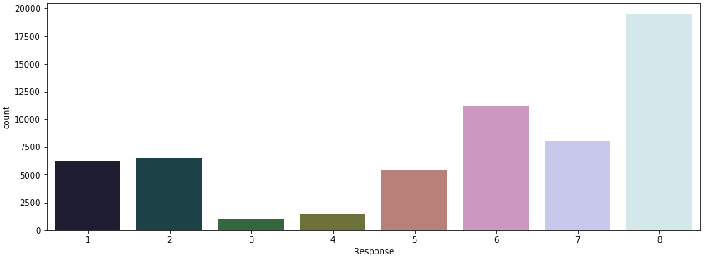
Exploratory Data Analysis (EDA)
The above graph shows that the class 8 has most data where class 3 has least data. This shows an imbalance in our target variable, which suggests caution when performing k-fold cross-validation (Stratified).
Machine Learning will apply Synthetic Minority Over-sampling (SMOTE ), which is a commonly used oversampling method.

Slide 10
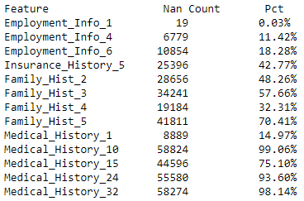
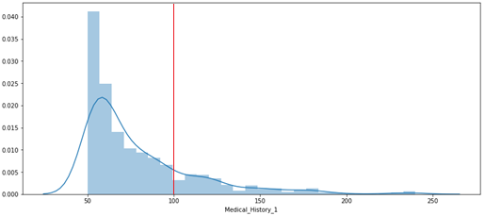
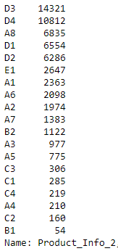
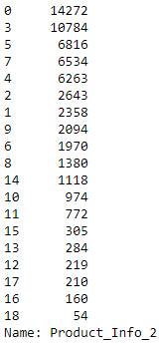
Exploratory Data Analysis (EDA)
Missing Data: 13 features with missing data.
Drop: >70% missing data (4 features).
Imputation:
Mean (3 features),
Backfill/Pad method: filling gaps in data (8 features).
Outliers: 3 features with significant outliers:
Medical_History_1, Medical_History_24, Medical_History_32.
Factorize: Encoding any feature object type as an enumerated type.

Slide 11
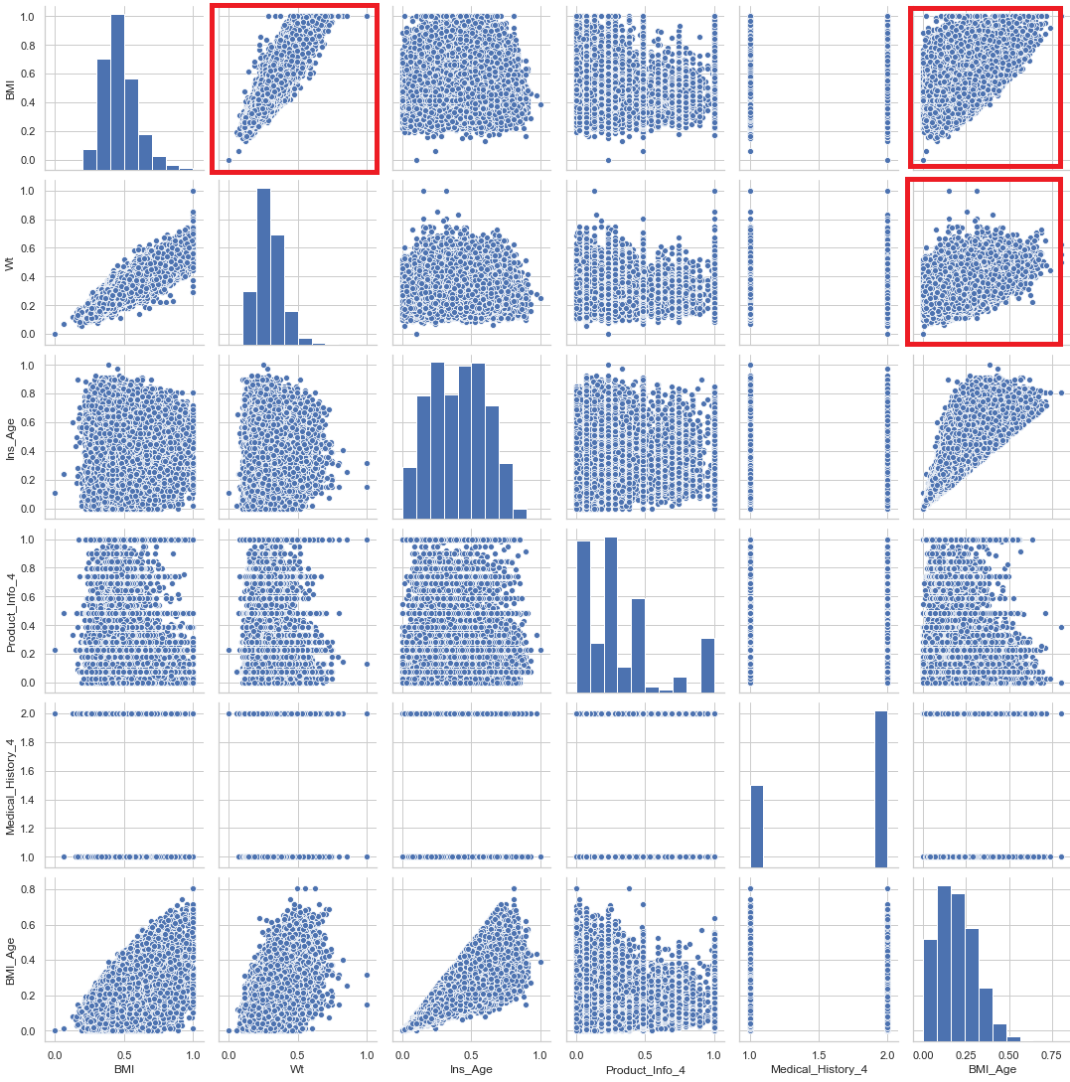
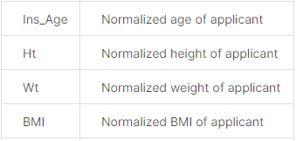
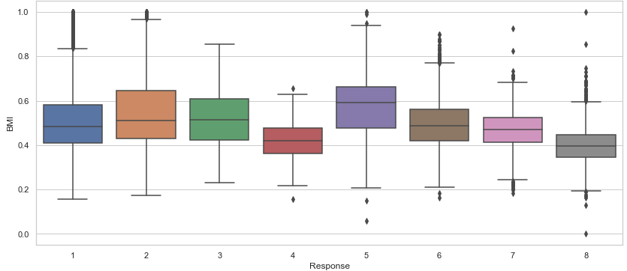
Feature Building
Given that BMI (Body mass index), Weight and Age are important features for categorizing insurance risk of a client, we can create new features by combining existing features e.g. Multiply the value between BMI and Ins_Age to create BMI_Age.

Slide 12
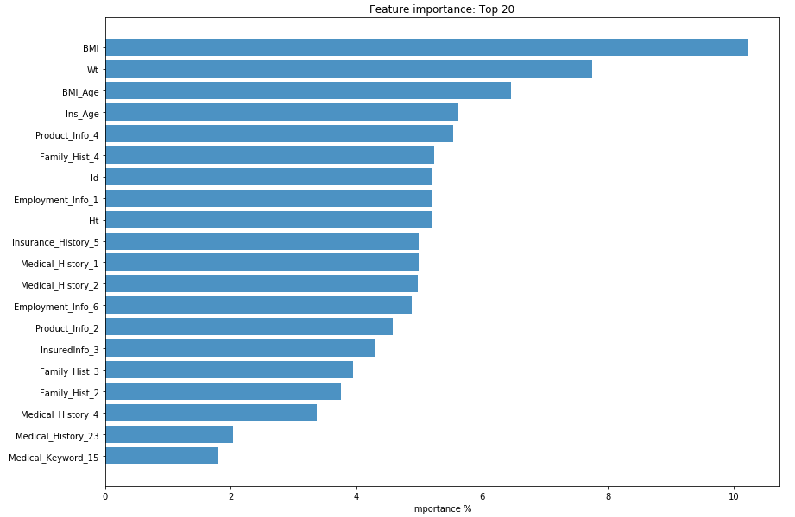
Feature Selection
To determine features which contribute most to prediction variable 'Response“, use a basic model classifier in order to assess feature ‘importance’.
Benefits of performing feature selection before modeling your data: reduces overfitting, Improves accuracy and reduces training time
Classifier used was Extremely Randomized Trees - 'ExtraTreesClassifier'.
Top 40 Features account for over 75% of the importance in our model.
Top 20 Features account for over 50% of the importance in our model.

Slide 13
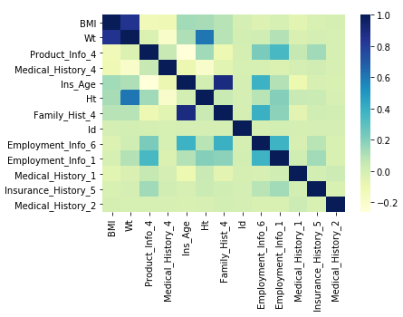
Feature Selection
Removal of highly correlated values through Correlation Analysis.

Slide 14
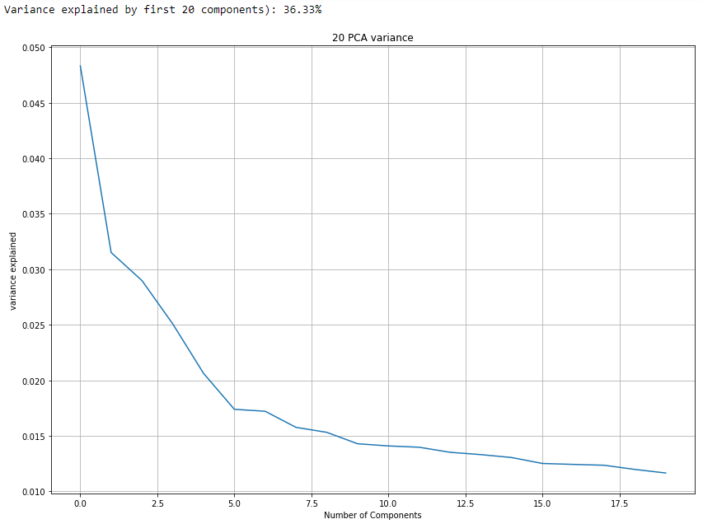
Feature Selection
By way of comparison to our Extra Trees model above, run a Principal Components Analysis on the same Feature set
40 Features: PCA returns 55%.
20 Features: PCA returns 38%.
Features Selected:
BMI
Wt
BMI_Age
Product_Info_4
Medical_History_4
Ins_Age
Ht
Family_Hist_4
Id
Employment_Info_6
Employment_Info_1
Medical_History_1
Insurance_History_5
Product_Info_2
Medical_History_2
InsuredInfo_3
Family_Hist_2
Family_Hist_3
Medical_History_23
Medical_Keyword_15

Slide 15
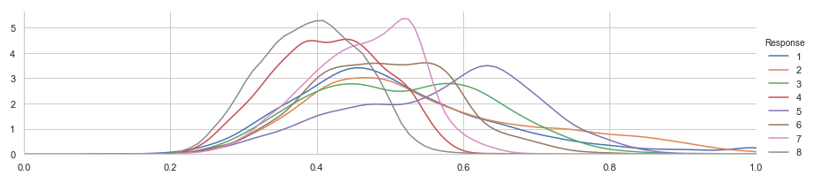
Modeling
Factors to models for prediction:
View as a 'Multi-Class' Classification problem (with 8 target responses 1-8) for our risk ratings.
Regression and a Classification task: an 'Ordinal Regression' task. The 'ordinal' nature of the response variable (a risk rating).

Slide 16

Modeling
For all modeling will apply:
Preprocessing: feature scaling - to standardize the independent features present in the data in a fixed range.
Grid Search CV, to perform k-fold cross-valuation (splits = 10) to partition data with training to test/validation dataset ratio of 70:30. The outputs on the training set provide the optimal Hyperparameters based on the supervised parameter range.
The best estimators/hyperparameters are then applied to a model pipeline in order to produce a final estimator.
The pipeline includes scaling of values to ensure proper normalization, and SMOTE (Synthetic Minority Over-sampling Techniques), an oversampling approach that by default (‘sampling_approach=‘auto’) creates synthetic minority class samples.
Produce: Cross_Valuation Score, (Training) Accuracy Score, and Classification Report and Confusion Matrix.
Models selected for this machine learning exercise are:
XGBoost (Gradient Boosting Tree algorithm).
Gradient Boosting Classifier (Gradient Boosted Tree algorithm).
Random Forest (Ensemble learning method).
AdaBoostClassifier (Ensemble learning method).
LogisticRegression.

Slide 17
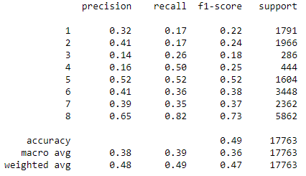
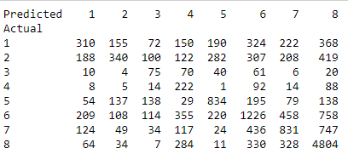
Modeling: XGBoost
params= {
'min_child_weight': [1, 5],
'gamma': [0.5, 1, 1.5],
'subsample': [0.6, 0.8, 1.0],
'colsample_bytree': [0.6, 0.8, 1.0],
'max_depth': [3, 4]}
Hyperparameters / Best Parameters:
{'colsample_bytree': 0.6, 'gamma': 0.5, 'max_depth': 3,
'min_child_weight': 1, 'subsample': 1.0}
Mean score 0.41
Classification Accuracy: 40.85% (std_dev: 10.47%)
Training score: 0.512148044490554
Predicted: 8642 / Actual: 17643 (49%)
Confusion Matrix:
Precision: What percent of +ve were detected
(true positive/total predictive positive)
Recall: What % of +ve predications were correct.
(true positive/total actual positive)
F1 score: What % of predictions were correct.

Slide 18
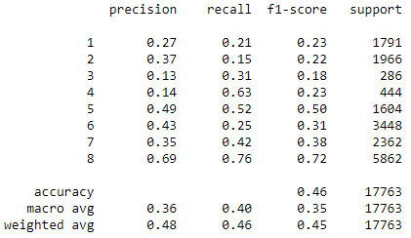
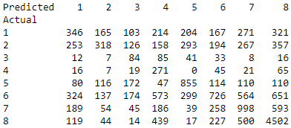
Modeling: GradientBoostingClassifier
params= {
‘loss’:["deviance"],
‘max_depth’:[3,5,8],
‘max_features’:["log2","sqrt"],
‘n_estimators’:[10] }
Hyperparameters / Best Parameters:
{'loss': 'deviance', 'max_depth': 8, 'max_features': 'log2', 'n_estimators': 10}
Mean score: 0.43
Classification Accuracy: 43.27% (3.25%)
Training score: 0.5392911429053973
Predicted: 4480 / Actual: 17763(46%)
Confusion Matrix:

Slide 19
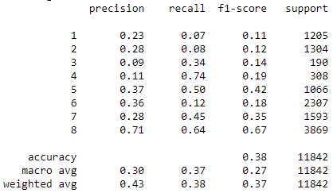
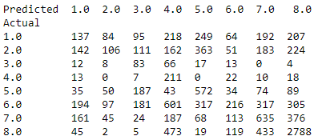
Modeling: AdaboostClassifier
params= {
'algorithm' : ['SAMME', 'SAMME.R'],
'learning_rate': [0.01,0.2,0.5],
'n_estimators': [1.0, 10, 50, 100, 200, 1000]
}
Hyperparameters / Best Parameters:
{'algorithm': 'SAMME.R', 'learning_rate': 0.01, 'n_estimators': 50}
Mean score 0.395
Classification Accuracy: 39.49% (std_dev: 0.62%)
Training score: 0.39518240162134777
Predicted: 4748 / Actual: 11842 (40%)
Confusion Matrix:

Slide 20
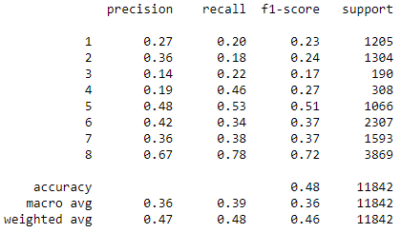
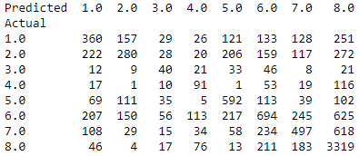
Modeling: RandomForest
params= {
'min_child_weight': [1, 5], #10
'gamma': [0.5, 1, 1.5], #2,5
'subsample': [0.6, 0.8, 1.0],
'colsample_bytree': [0.6, 0.8, 1.0],
'max_depth': [3, 4] #5 }
Hyperparameters / Best Parameters:
{'colsample_bytree': 0.6, 'gamma': 0.5, 'max_depth': 3, 'min_child_weight': 1, 'subsample': 1.0}
Mean score 0.50
Classification Accuracy: 49.71% (std_dev: 0.15%)
Training score: 0.7986826549569329
Predicted: 5783 / Actual: 11842 (49.59%)

Slide 21
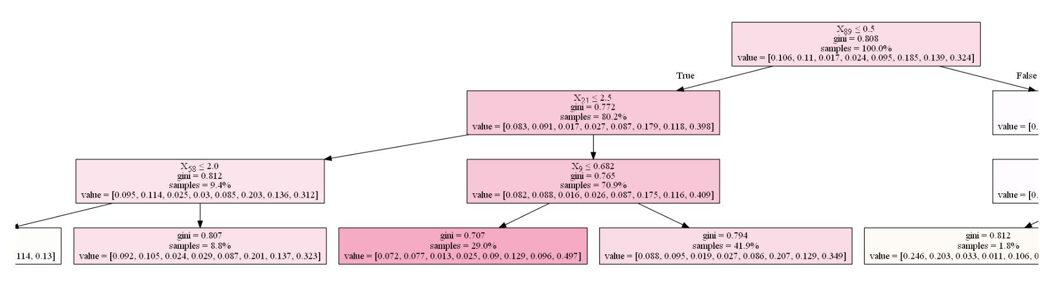
Modeling: RandomForest
Sample RandomForest Tree/Leaf nodes:
gini: The Gini Impurity of the node. The average weighted Gini Impurity decreases as we move down the tree.
samples: The number of observations in the node.
value: The ratio of samples in each class.

Slide 22
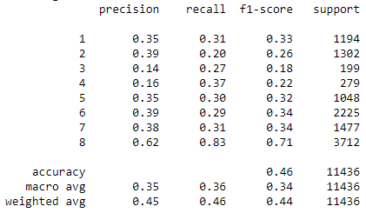
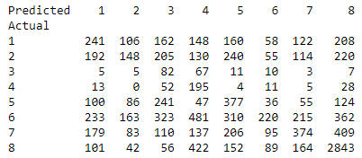
Modeling: LogisticRegression
params= {
'penalty':['l1', 'l2'], # l1 is Lasso, l2 is Ridge
'solver':['liblinear'],
'C':[0.001,.009,0.01,.09,1,5,10,25] }
Hyperparameters / Best Parameters:
{'C': 25, 'penalty': 'l1', 'solver': 'liblinear'}
Mean score 0.38
Classification Accuracy: 38.43% (std_dev: 0.40%)
Training score: 0.38668322667564836
Predicted: 4480 / Actual: 11842 (38%)
Confusion Matrix:

Slide 23
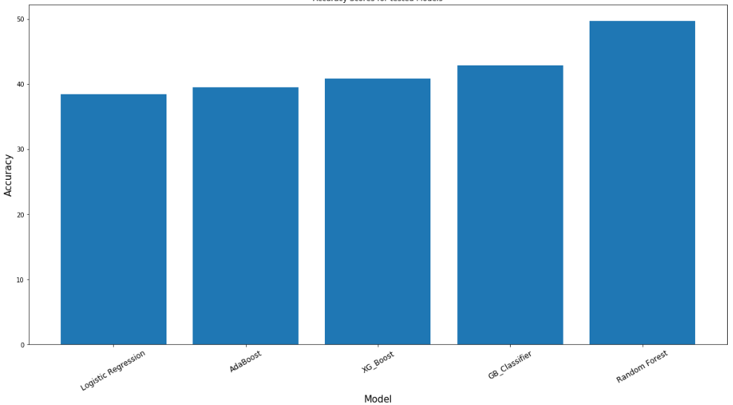
Modeling: Comparison
Random Forest provided the best model fit against the data.
Model | Accuracy %
Logistic Regression | 38.43
AdaBoost | 39.49
XGBoost | 40.85
Gradient Boosting Classifier | 42.90
Random Forest | 49.71

Slide 24
Conclusion
Most models predictive F1-scores impacted by the model bias towards the highest Response class viz. type 8.
Various oversampling approaches taken:
Weighting class ratios (within algorithm parameters): class_weight: dictionary based on count frequency
class_weight = dict({1:3.5, 2:3.5, 3:20,4:15,5:4.0,6:1.8,7:2.5,8:1.0})
SMOTE Sampling_Strategy:
float (as above),
‘minority’ resample minority classes only.

Slide 25


Conclusion
Submissions to Prudential Life Insurance Kaggle challenge are scored based on the Quadratic weighted kappa score, which is a chance-adjusted measure of agreement between two ratings (expected vs known). This metric typically varies from:
0 (random agreement) between the raters
1 (complete agreement) between raters.
Quadratic_Kappa score: 0.431
The original kappa coefficient assumed nominal categories but this was later extended to non-nominal categories through "weighting."
Quadratic Weighted Kappa score: 0.431

Slide 26
Next steps
Resolution of model bias towards the majority class response type. Look at other weighting or penalizing approaches to misprediction.
Future work more in-depth analysis of the problem and new methods to deal with refining Customer Segmentation (grouping based on similar attributes), and client risk and corresponding insurance premium levels.
Rethinking customer segmentation
In 2015 MetLife began a year-long brand discovery process. At the core of this strategic refresh, was a fundamentally data driven approach, enabled by advances in machine learning, and proliferation of disruptive newcomers to underwriting, such as Lemonade.
To better understand their customers, MetLife strove to “move from basic demographics and life stages to a view based on mindsets and attitudes.”⁵
⁵ Bell M (2016) Is analytics the underwriting we know? [Hyperlink].
⁶ Mehra, Sanjay, and Leah van Zelm. 2013. Segmentation. Customer Strategy Done Right [Hyperlink].

Slide 27
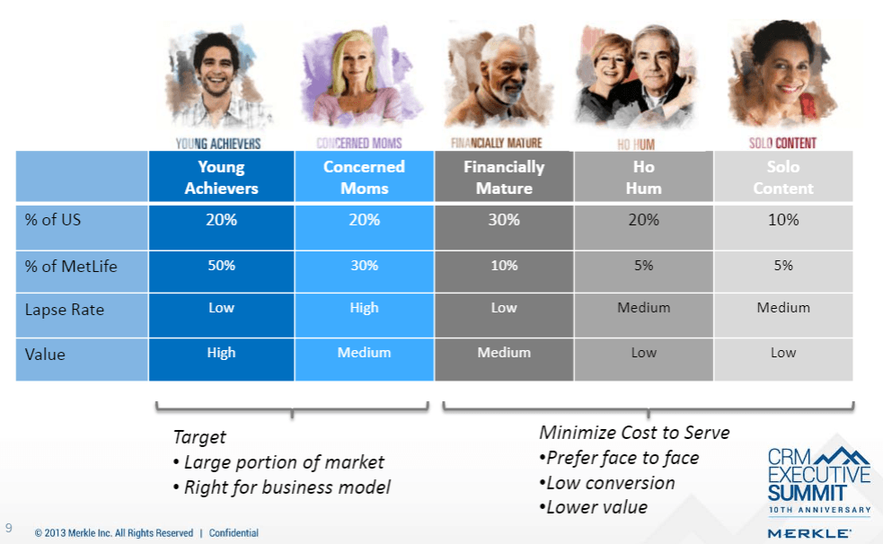
Next steps
MetLife interviewed and surveyed more than 50,000 customers. Using big data clustering techniques to analyze the survey information to better understand and segment their customers and subsequently redesign their go to market approach.
Survey respondents were clustered into distinct groups based on their individual survey responses resulting in, a refined picture of who their customers were.
These groups (or segments) based on attitudes and demographics, provided a new way to think about allocating resources against the pursuit of the “right” customers.

