Slide 1
High-Frequency Ventilation in Neonates
Dr Deepak Chawla

Slide 2
Learning objectives
1 - Gas exchange during HFV
2 – Lung dynamics during HFV
Describe how gas is exchanged when tidal volume is at or below dead space
Use impedance, resonant and corner frequency to predict how much oscillatory pressure reaches the alveolus.
3 - Setting the ventilator
4 - Application at the bedside
Choose MAP, amplitude and frequency rationally; target DCO₂ for a safe PaCO₂; use volume guarantee with HFV.
Match strategy to the disease, recognize complications
INTRODUCTION
High-Frequency Ventilation in Neonates

Slide 3
DEFINITION
What is high-frequency oscillatory ventilation?
3-20 Hz
V_{tidal} <= V_{dead}
active
180-1200 breaths / min
tidal volume approx 2-3 mL/kg
both inspiration AND expiration
FUNDAMENTALS
High-Frequency Ventilation in Neonates

Slide 4
Why HFV?
1. Failure of invasive ventilation
2. Complications of invasive ventilation
Volutrauma - excessive cyclic volume swings
Atelectrauma - repeated re-opening of collapsed units
Rheotrauma - shear from flow / re-inflation
Risk of Ventilator-induced lung injury (VILI) >> Pneumothorax, BPD, Disability and Death
FUNDAMENTALS
High-Frequency Ventilation in Neonates

Slide 5
RATIONALE
Why HFV?
Lung mechanics
Gas exchange & drugs
Lower peak alveolar pressures
Preserves lung architecture even at high MAP
Easier recruitment of the diseased lung
Relatively independent control of oxygenation & ventilation
Enhances distribution and diffusion of gases
Efficient CO₂ removal, independent of mean lung volume
Improved delivery of inhaled NO
Synergy with surfactant and open-lung strategy
FUNDAMENTALS
High-Frequency Ventilation in Neonates

Slide 6
MODALITIES
Types of high-frequency ventilation
Type | How gas is moved | Exhalation | Typical use
HFOV | Piston / diaphragm / jet moves gas back & forth at the airway opening | Active (push & pull) | Most common neonatal mode
HFJV | High-velocity jet injected into the airway via a special ETT adapter | Passive | Air leaks, PIE, inhomogeneous lung
HFFI | Pulses of fresh gas in inspiration; no high-velocity stream | Passive | Less common
Mechanism | Examples
Piston oscillator | SensorMedics 3100A/B
Diaphragm | Drager VN500, Fabian, Leoni Plus
Servo valve + venturi jet | SLE 5000/6000
FUNDAMENTALS
High-Frequency Ventilation in Neonates

Slide 7
CONTROL VARIABLES
HFOV gives you four dials
oxygenation
ventilation
Mean airway pressure
Amplitude (delta P)
Sets distending lung volume -> oxygenation
Sets oscillatory volume -> CO₂ removal
3-20 Hz
1:1 or 1:2
Frequency (Hz)
I:E ratio
Cycles per second;
interacts with VT & damping
Relative time of forward vs reverse flow
FUNDAMENTALS
High-Frequency Ventilation in Neonates

Slide 8
GAS TRANSPORT
A cephalad shift from convection to diffusion
Large airways
Conducting airways
Acini / alveoli
convection / bulk flow
convection meets diffusion
molecular diffusion
HFOV moves the convection-to-diffusion transition cephalad (toward larger airways)
Taylor dispersion
Asymmetric flow profiles
Branching-angle eddies
Direct alveolar ventilation
Pendelluft
Cardiogenic mixing
Molecular diffusion
Radial / laminar mixing
GAS-MIXING PHYSIOLOGY
High-Frequency Ventilation in Neonates

Slide 9
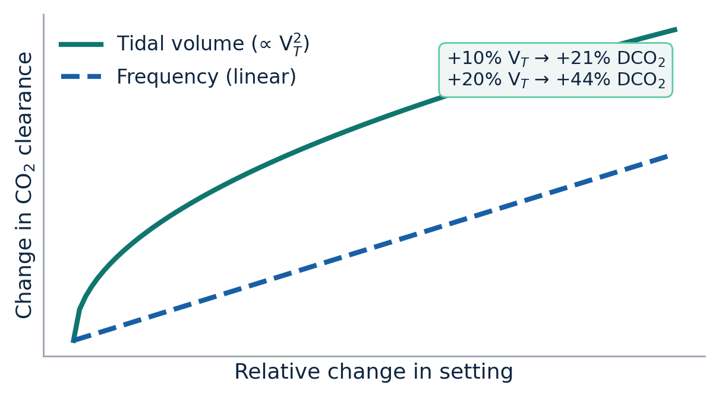
THE KEY COEFFICIENT
DCO₂ = f x VT squared
Target DCO₂ 40-60 mL²/kg²/s for mild permissive hypercapnia.
Effect of change in Frequency :
Without VG: raising f shortens Ti >> less VT, >> lower DCO₂
With VG: the set VT is held, so raising f raises DCO₂.
GAS-MIXING PHYSIOLOGY
High-Frequency Ventilation in Neonates

Slide 10
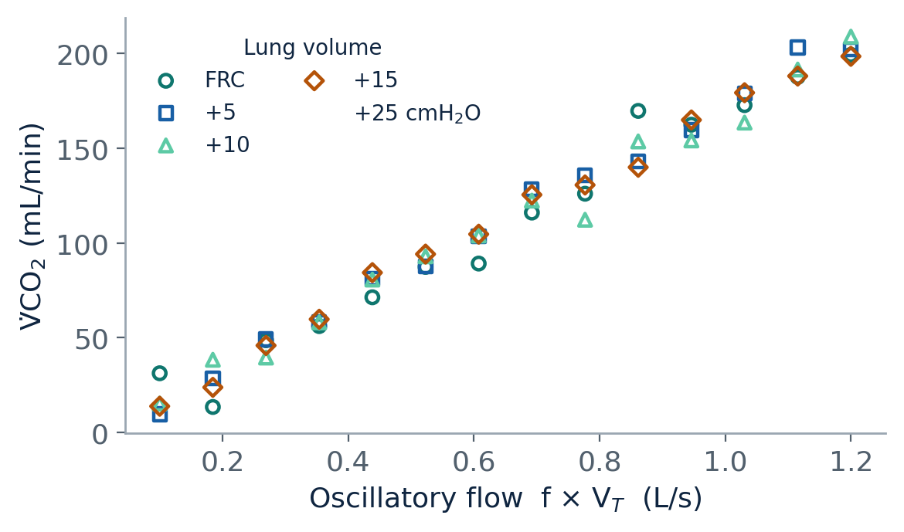
THE EVIDENCE
CO₂ clearance is independent of mean lung volume
Why it matters
CO₂ removal tracks oscillatory flow (f x VT), not how inflated the lung is
DCO₂ = f x VT squared
Clinically: oxygenation set by MAP and volume; ventilation set by amplitude
Recreated from Slutsky et al., 1981 - points overlap across lung volumes.
GAS-MIXING PHYSIOLOGY
High-Frequency Ventilation in Neonates

Slide 11
HFV WORK FOR VENTILATION
Impedance = compliance + resistance + inertance
Compliance (elastic)
Resistance (flow)
Inertance (acceleration)
Lower C gives shorter time constants and MORE transmission to alveoli.
Stiff or atelectatic units receive a higher percentage of the swing - both a risk and a route to recruitment.
Raises impedance at and beyond an obstruction;
Needs higher set delta P, which raises pressure on airways PROXIMAL to the block.
ETT resistance is flow-dependent: R = k1 + k2 x flow.
Negligible in tidal breathing; matters in HFV due to rapid flow reversals.
Arises mainly in the ETT and major airways; does not itself change alveolar transmission.
PRESSURE & FREQUENCY PHYSICS
High-Frequency Ventilation in Neonates

Slide 12
INHOMOGENEOUS LUNG
Where does the oscillatory pressure go?
Atelectatic: high pressure
Pressure transmission
Short-time-constant (low-compliance) units get HIGHER oscillatory pressure
Aerated, longer-time-constant units are relatively protected
High peripheral resistance pushes pressure onto proximal airways and neighbours
The same high pressure that risks barotrauma can recruit if it exceeds opening pressure
Aerated: protected
Central airway
Distal to high R: low pressure
PRESSURE & FREQUENCY PHYSICS
High-Frequency Ventilation in Neonates

Slide 13
HFV WORK FOR VENTILATION
Impedance = compliance + resistance + inertance
Compliance (elastic)
Resistance (flow)
Inertance (acceleration)
Lower C gives shorter time constants and MORE transmission to alveoli.
Stiff or atelectatic units receive a higher percentage of the swing - both a risk and a route to recruitment.
Raises impedance at and beyond an obstruction;
Needs higher set delta P, which raises pressure on airways PROXIMAL to the block.
ETT resistance is flow-dependent: R = k1 + k2 x flow.
Negligible in tidal breathing; matters in HFV due to rapid flow reversals.
Arises mainly in the ETT and major airways; does not itself change alveolar transmission.
PRESSURE & FREQUENCY PHYSICS
High-Frequency Ventilation in Neonates

Slide 14
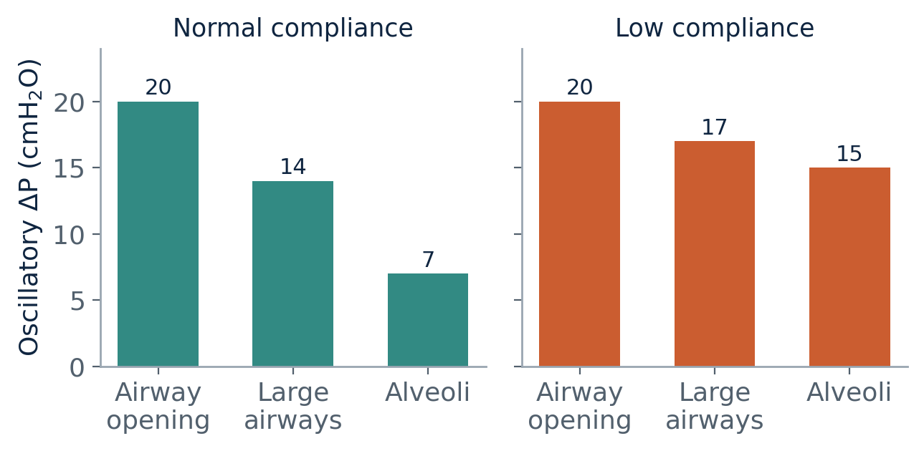
TRANSMISSION
Pressure is damped from airway opening to alveolus
Damped, but not always safe
In a compliant lung, Ti is longer and short HFOV inspiratory times do not fully transmit the wave, so it is heavily damped.
In a low-compliance lung, time constants shorten and a HIGHER fraction reaches the alveolus.
HFOV can still cause barotrauma:
Systematic reviews show more air leak on HFOV.
Low tidal volume does NOT guarantee low alveolar pressure amplitude - it depends on impedance.
PRESSURE & FREQUENCY PHYSICS
High-Frequency Ventilation in Neonates

Slide 15
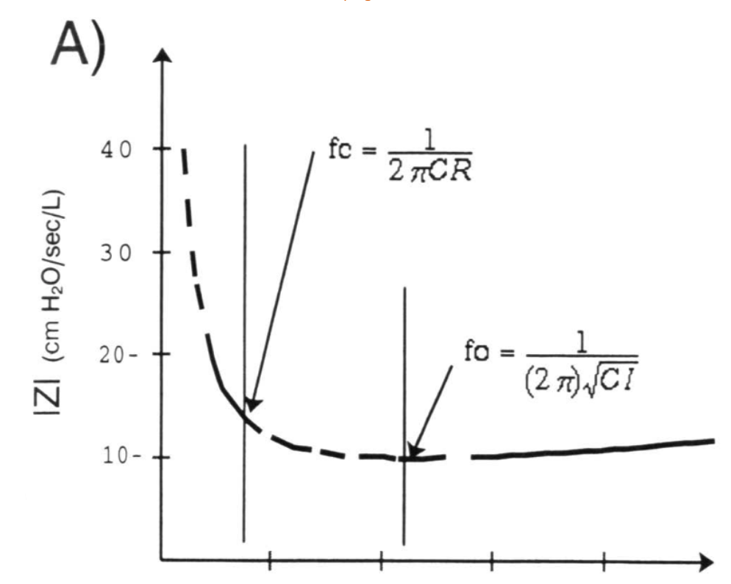
FREQUENCY PHYSICS
Corner frequency (fc): the pressure-cost sweet spot
fc = 1 / (2 pi R x C)
Above fc, little extra alveolar damping is gained, at the cost of higher proximal-airway pressure
Ventilating near fc gives the minimum pressure cost per unit oscillatory flow
Shorter time constant gives higher fc, and vice versa
PRESSURE & FREQUENCY PHYSICS
High-Frequency Ventilation in Neonates

Slide 16
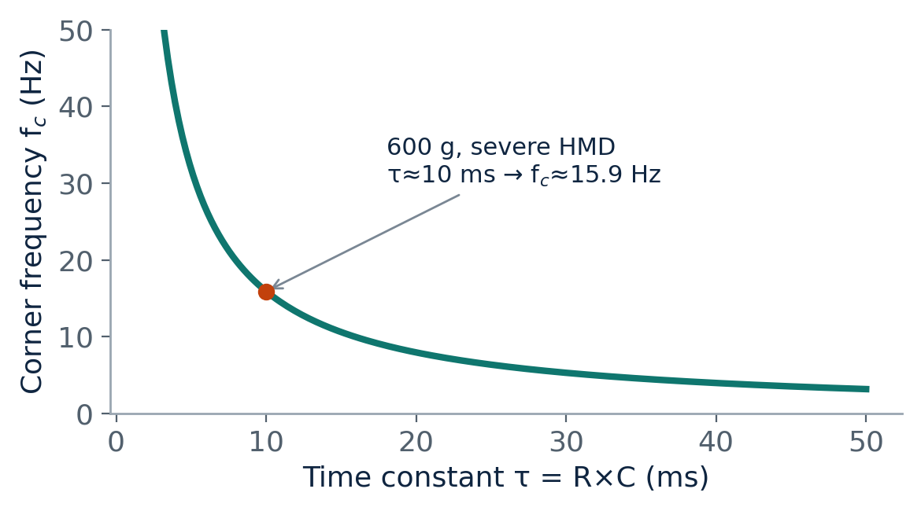
FREQUENCY PHYSICS
Corner frequency (fc): the pressure-cost sweet spot
fc = 1 / (2 pi R x C)
Above fc, little extra alveolar damping is gained, at the cost of higher proximal-airway pressure
Ventilating near fc gives the minimum pressure cost per unit oscillatory flow
Shorter time constant gives higher fc, and vice versa
Example: 600 g preterm, C 0.1 mL/cmH2O, R 100 cmH2O/L/s gives time constant about 10 ms and fc about 15.9 Hz.
As the time constant shortens, corner frequency rises.
PRESSURE & FREQUENCY PHYSICS
High-Frequency Ventilation in Neonates

Slide 17
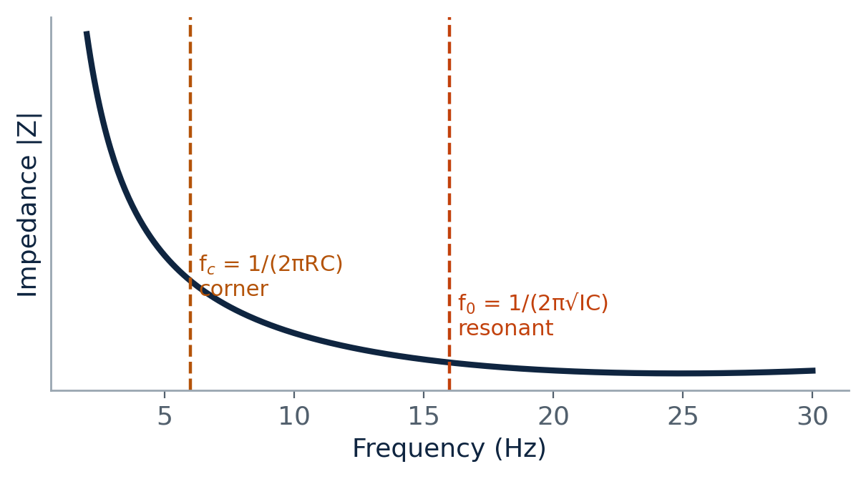
FREQUENCY PHYSICS
Resonant frequency (f0)
f0 = 1 / (2 pi sqrt(I x C))
At f0 the system stores vibrational energy - small forces give large alveolar oscillations
Impedance is at its minimum; alveolar amplitude can equal or exceed central-airway amplitude
Lower compliance gives higher f0 (stiff lungs resonate higher)
Amplification is rarely a problem in the over-damped neonatal lung
Impedance falls with frequency; fc sits below f0.
PRESSURE & FREQUENCY PHYSICS
High-Frequency Ventilation in Neonates

Slide 18
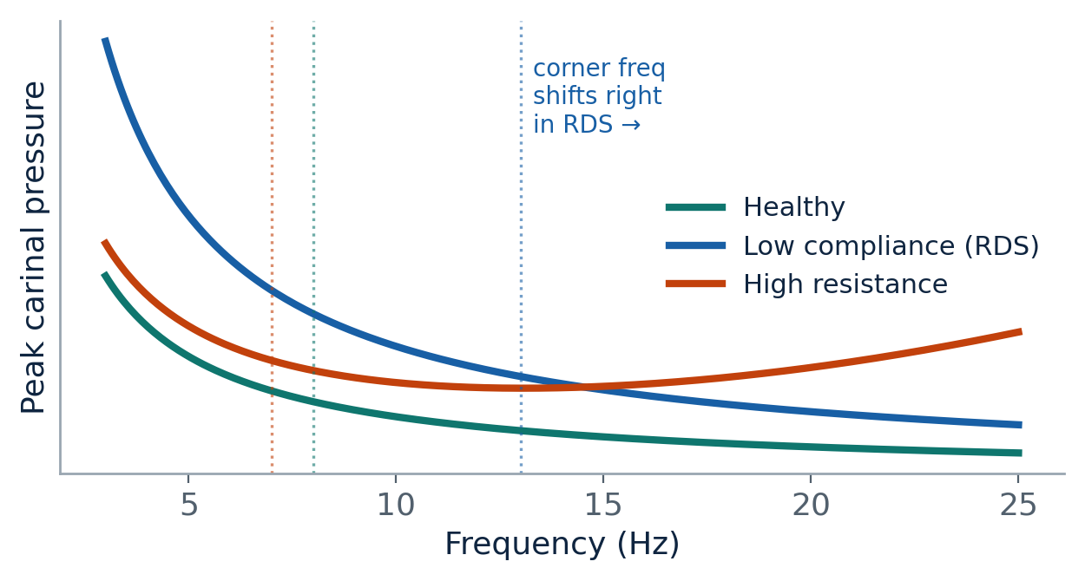
BAROTRAUMA RISK
Peak carinal pressure vs frequency
Clinical application
Peak carinal pressure is the key determinant of barotrauma
It is lowest near the corner frequency
Low compliance (RDS) shifts the curve right - use higher frequency
High resistance narrows the safe range and raises pressures overall
Concept after Venegas & Fredberg, 1994.
PRESSURE & FREQUENCY PHYSICS
High-Frequency Ventilation in Neonates

Slide 19
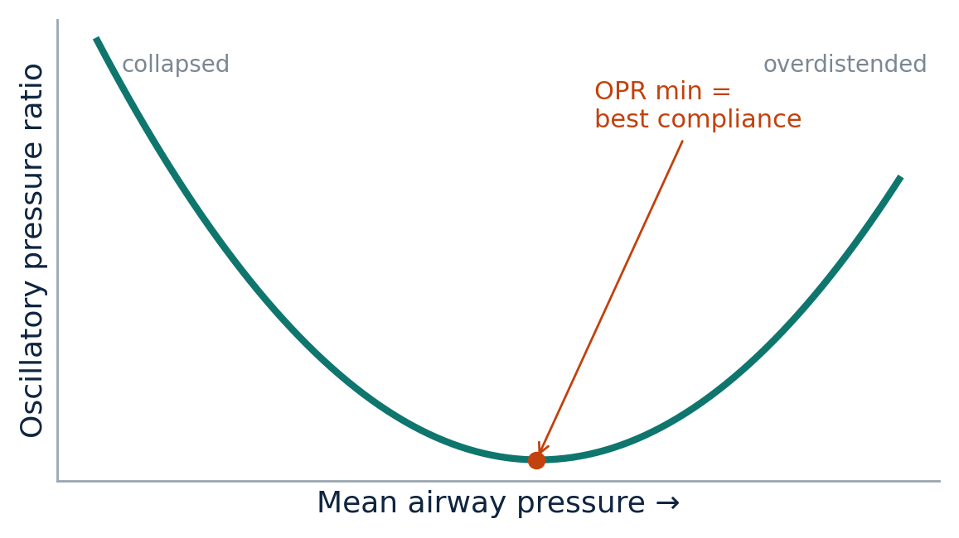
BEDSIDE MARKER
Oscillatory pressure ratio (OPR)
OPR = deltaP(distal ETT) / deltaP(proximal ETT)
Inverse with compliance: as Crs rises, swings are attenuated more and OPR falls
OPR is minimal at maximal compliance - optimal recruitment, minimal overdistension
OPR is high at BOTH extremes: collapsed (low Paw) and overdistended (high Paw)
A U-shaped relationship; the trough marks best distending pressure.
PRESSURE & FREQUENCY PHYSICS
High-Frequency Ventilation in Neonates

Slide 20
TIDAL VOLUME
What sets the delivered tidal volume?
VT = (C x deltaP) x (1 - e^(-Ti/RC))
Mode | Rate / Freq | Cycle time | Ti | Ti/RC (no. of τ) | e^(−Ti/RC) | 1 − e^(−Ti/RC)
Conventional | 40 /min | 1500 ms | 500 ms | 10.0 | ~0.00005 | ≈ 1.00
HFV | 5 Hz | 200 ms | 67 ms | 1.33 | 0.264 | 0.74
HFV | 8 Hz | 125 ms | 42 ms | 0.83 | 0.435 | 0.57
HFV | 10 Hz | 100 ms | 33 ms | 0.67 | 0.513 | 0.49
HFV | 12 Hz | 83 ms | 28 ms | 0.56 | 0.574 | 0.43
HFV | 15 Hz | 67 ms | 22 ms | 0.44 | 0.641 | 0.36
TIDAL & LUNG VOLUME
High-Frequency Ventilation in Neonates

Slide 21
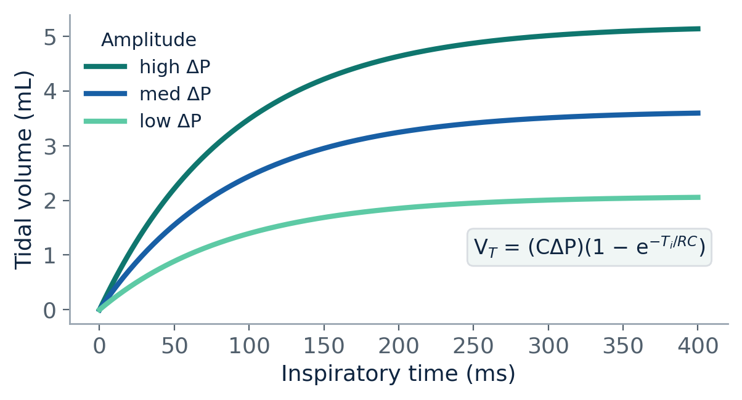
TIDAL VOLUME
What sets the delivered tidal volume?
VT = (C x deltaP) x (1 - e^(-Ti/RC))
Plateau (max VT) = compliance x amplitude
Speed to plateau = the time constant (R x C)
Actual VT = how much of the plateau the available Ti reaches
Same principles as pressure-limited conventional ventilation
Once Ti far exceeds the time constant, more time adds no VT.
TIDAL & LUNG VOLUME
High-Frequency Ventilation in Neonates

Slide 22
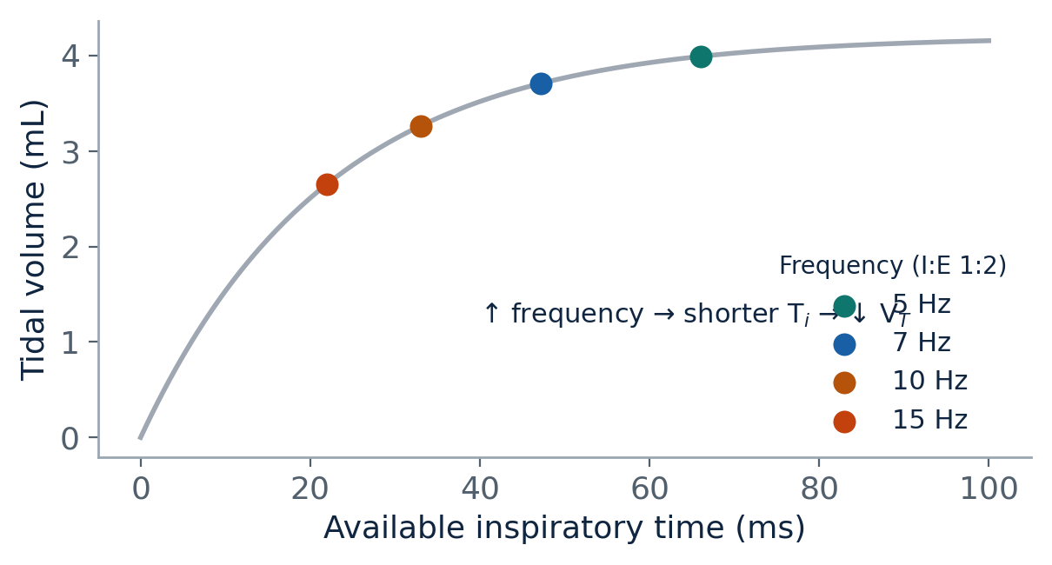
TIDAL VOLUME
How amplitude, frequency, I:E and mechanics move VT
Amplitude: Higher delta P >> rise in VT.
Frequency: Higher f shortens Ti >> fall in VT
I:E ratio: 1:2 to 1:1 lengthens Ti and raises VT; effect largest at high f.
TIDAL & LUNG VOLUME
High-Frequency Ventilation in Neonates

Slide 23
INSPIRATORY:EXPIRATORY RATIO
I:E shapes the pressure waveform
At I:E 1:1
At I:E 1:2
Peak and trough are equidistant from MAP
Mean intrapulmonary pressure stays closest to set MAP
Useful when a hybrid oscillator is underpowered for a small baby
Trough sits about half as far below MAP, but lasts twice as long
A larger inspiratory deltaP is needed for the same VT
Gas trapping is not a real concern when expiration is active
TIDAL & LUNG VOLUME
High-Frequency Ventilation in Neonates

Slide 24
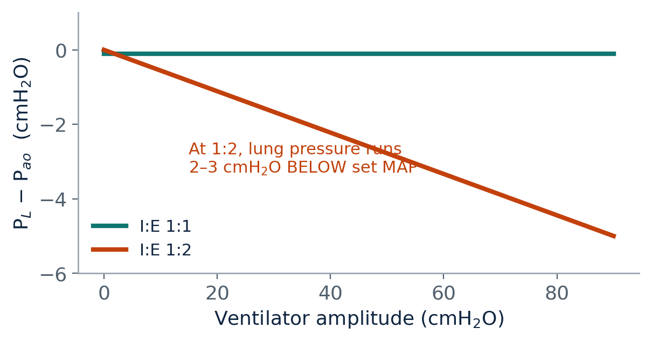
DISTENDING PRESSURE
MAP is set at the machine, the lung sees less
In HFOV, mean intrapulmonary pressure (MIP) differs from set MAP and cannot be measured directly
Usually MIP < MAP; the drop grows with higher frequency and smaller ETT
Resistive drop: Pres = k1 x flow + k2 x flow squared
Bedside: switching CV to HFOV at I:E 1:2, set MAP 2-3 cmH2O ABOVE the CV MAP to reach the same distending pressure; at 1:1 set it EQUAL.
TIDAL & LUNG VOLUME
High-Frequency Ventilation in Neonates

Slide 25
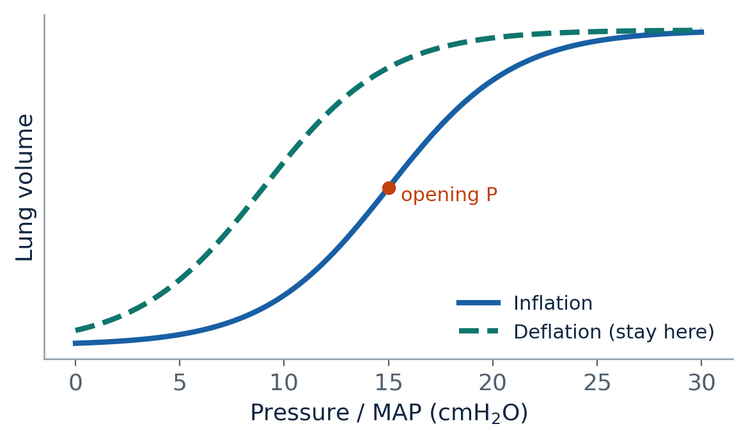
LUNG VOLUME
Recruitment maneuver
TIDAL & LUNG VOLUME
High-Frequency Ventilation in Neonates

Slide 26
OPEN-LUNG STRATEGY
Stepwise recruitment of the atelectatic lung
1
Start MAP 6-8 cm H₂O;
set FiO₂ for SpO₂ 90-95%
4
Decrease MAP 1-2 cmH₂O every 2-3 min until SpO₂ falls = closing pressure
2
Raise MAP 1-2 cm H₂O every 2-3 min; wean FiO₂ in steps of 0.05-0.10
5
Re-recruit briefly to opening pressure, then set MAP 2 cm H₂O above closing pressure
3
Stop when FiO₂ < 0.25 (or no further FiO₂ fall with more MAP) = opening pressure
6
Give surfactant / re-image as indicated, then continue gentle weaning
Goal: find the lowest distending pressure that keeps the lung open on the deflation limb.
TIDAL & LUNG VOLUME
High-Frequency Ventilation in Neonates

Slide 27
LUNG VOLUME
Recruitment maneuver
Recruit above the opening pressure, then reduce MAP and sit on the deflation limb - hysteresis holds more volume at the same pressure
Surrogate that the lung is open: FiO2 falls to 0.25-0.30
Open lung + permissive hypercapnia = lung-protective ventilation
During recruitment the same amplitude delivers different VT as you move along the curve - monitor VT and CO₂, or use volume guarantee.
TIDAL & LUNG VOLUME
High-Frequency Ventilation in Neonates

Slide 28
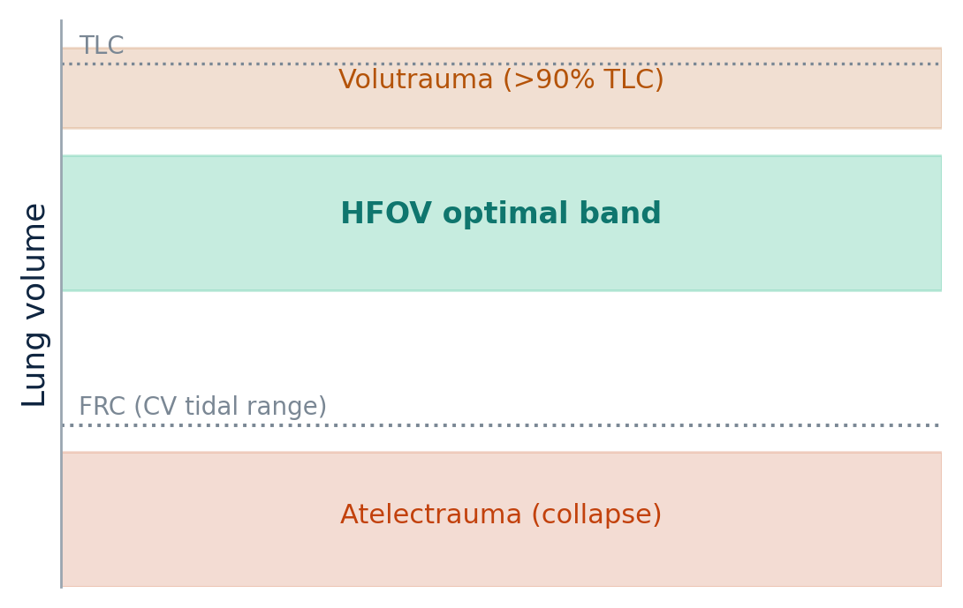
STAYING IN THE SAFE ZONE
Avoid overdistension and atelectasis
Avoid overdistension
Avoid atelectasis
Peak distension < 90% of TLC
Reduce MAP as compliance improves
If persistent overinflation: lower frequency or shorten I:E for fuller exhalation
Humidify well; suction then re-recruit
Avoid over-enthusiastic MAP weaning
Add occasional sighs (about 1/min) in prolonged low-VT HFOV
TIDAL & LUNG VOLUME
High-Frequency Ventilation in Neonates

Slide 29
TRANSITION FROM CONVENTIONAL VENTILATION
Setting up HFV
Prepare monitoring. Note the CV deltaP and MAP. Suction first - secretions hamper HFOV
MAP: rescue at I:E 1:2, set 2-3 cmH₂O above CV MAP; at 1:1 set equal. Titrate by recruitment + FiO₂
Amplitude: start about 1.5x the CV deltaP; confirm by chest wiggle or delivered VT
If treating hypercapnia, drop transcutaneous CO2 gradually (2-3 mmHg/min) to protect cerebral flow
Frequency: 8-10-12
MAS / long time constant
8 Hz
Term lung disease
10 Hz
Preterm HMD (stiff)
12-15 Hz
Aim to sit near the corner frequency.
MANAGEMENT
High-Frequency Ventilation in Neonates

Slide 30
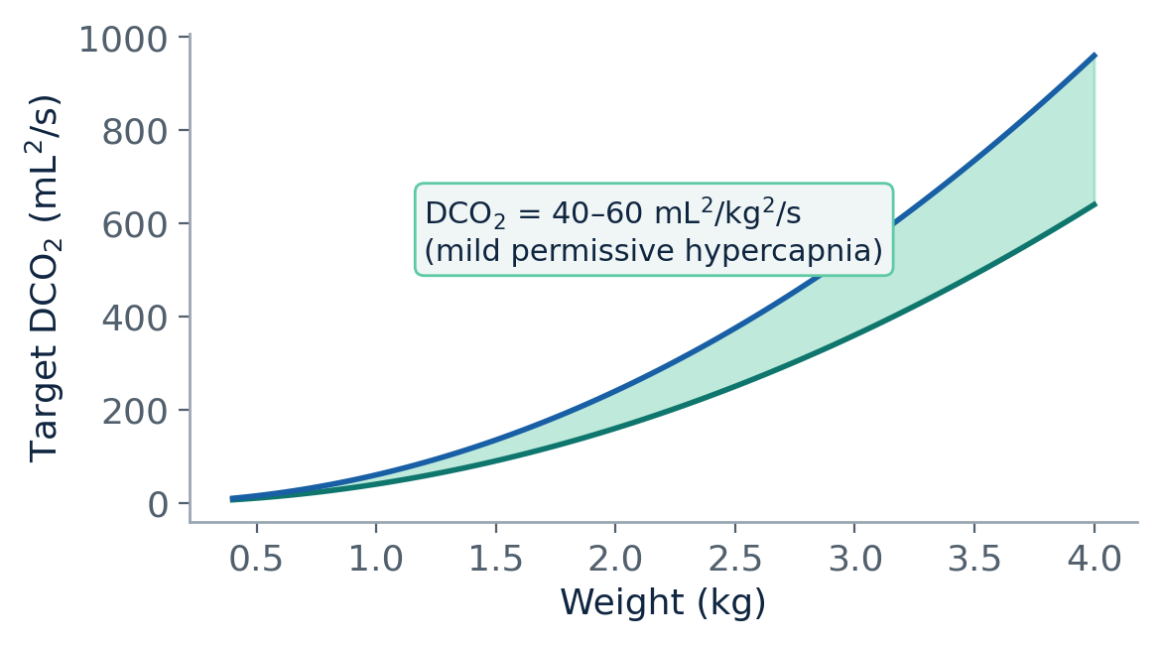
VOLUME-TARGETED HFOV
Volume guarantee - set the volume, not the pressure
Pick VT for the frequency to hit DCO₂ 40-60 mL²/kg²/s (about 3.5 mL/kg at 5 Hz and 2.0 mL/kg at 15 Hz)
Lower frequency needs larger VT for the same DCO₂ - more volutrauma risk
Set deltaP-max about 5 cmH₂O above the deltaP that delivers the target VT
MANAGEMENT
High-Frequency Ventilation in Neonates

Slide 31
CONTINUATION
Managing oxygenation
Once oxygenation is good, wean FiO₂ to 0.25-0.30 first
Then reduce MAP gradually: 1-2 cmH₂O every 1-4 hours
Acute hypoxia: decide whether the lung is collapsed (raise MAP / re-recruit) or overinflated (lower MAP)
Chest X-ray helps
Timing: CO₂ responds to amplitude within minutes; MAP effects on volume take longer - assess after about 15 minutes.
Watch haemodynamics: high MAP can impair venous return, raise CVP and pulmonary vascular resistance.
MANAGEMENT
High-Frequency Ventilation in Neonates

Slide 32
CONTINUATION
Managing carbon dioxide
Keep the airway clear; obstruction hamper HFOV and raises proximal pressures
Manage CO₂ through DCO₂ - and change DCO₂ via amplitude (VT), not frequency
After suction, re-recruit: brief MAP bump (2-4 cm H₂O) or 2-3 sustained inflations
Sighs aim to re-open alveoli (long Ti, low pressure ~5 cmH₂O above MAP), not to add volume
The frequency:
Without VG: lowering frequency raises VT and CO₂ clearance but increases distal pressure transmission
With VG: lowering frequency actually DECREASES DCO₂, so PaCO₂ rises.
MANAGEMENT
High-Frequency Ventilation in Neonates

Slide 33
CONTINUATION
Humidification & weaning
Humidification
Weaning
Too little: viscous secretions block small airways - collapse, low compliance, more barotrauma
Too much: circuit condensation reduces delivered VT
Get it right - it materially changes gas exchange on HFOV
Can wean straight to non-invasive support
Reduce MAP toward NIV levels; lower amplitude so the baby breathes spontaneously
Frequency usually need not change
Pace by disease: hours for RDS / PPHN, days to weeks for BPD
MANAGEMENT
High-Frequency Ventilation in Neonates

Slide 34
MONITORING
Watch the right variables
Domain | What to monitor
Gas exchange | SpO2, tc/pCO2, delivered VT and VT/kg, DCO2
Lung volume & mechanics | Chest X-ray (8th-9th posterior rib), Other dynamics if available
Circulation | Heart rate, arterial BP, central venous pressure, urine output
Caution: do NOT trust the ventilator's displayed lung mechanics on HFOV - frequency-dependent damping makes them unreliable.
CXR target: optimal expansion is the 8th-9th posterior rib in the mid-clavicular line.
MANAGEMENT
High-Frequency Ventilation in Neonates

Slide 35
INDICATIONS
Who, and when
Conditions that may benefit
Elective vs rescue
Homogeneous lung disease (RDS, diffuse pneumonia) - ideal
PPHN, especially secondary to a derecruited lung; pair with iNO
Pulmonary hypoplasia / CDH physiology
Post-surgical, diaphragm-splinting conditions
Air leaks / PIE (often HFJV)
Elective/primary: chosen up front for a recruitable lung.
Rescue: after CV fails to oxygenate/ventilate, or only at injurious settings.
When to start rescue: no firm thresholds. Judge by disease, stage, recruitable volume and the infant's vulnerability rather than a single peak-pressure number.
CLINICAL APPLICATION
High-Frequency Ventilation in Neonates

Slide 36
EVIDENCE
Elective HFOV vs conventional ventilation
Cools IPD meta-analysis (2010)
Cochrane review (2015)
Bollen meta-regression (2007)
10 trials, 3229 infants. No difference in death or BPD, or neurological outcome. More 'any' air leak.
19 studies, 4096 infants. Small reduction in CLD at 36 weeks, but heterogeneous.
Benefit favoured an open-lung strategy and a lung-protective CV comparator.
Context: the largest trial (HIFI) predates surfactant, antenatal steroids, lung-protective comparators and volume guarantee.
Favourable factors: early HFOV (<6 h), I:E 1:2, open-lung strategy, extubation to CPAP.
CLINICAL APPLICATION
High-Frequency Ventilation in Neonates

Slide 37
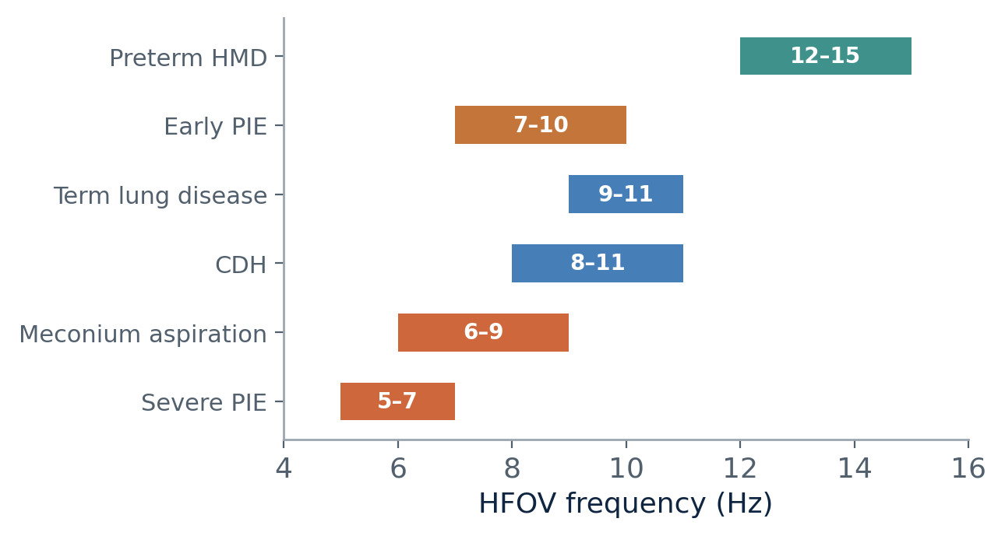
DISEASE-SPECIFIC HFOV
Homogeneous lung disease & frequency choice
Homogeneous (RDS, diffuse pneumonia)
Ideal for HFOV: uniform recruitment, then hold optimal volume
10 Hz (term) up to 12-15 Hz (extreme preterm)
Recruit by the stepwise algorithm; give surfactant after initial recruitment
Volume guarantee gives auto-amplitude and auto-weaning
Suggested starting frequency ranges by condition.
CLINICAL APPLICATION
High-Frequency Ventilation in Neonates

Slide 38
DISEASE-SPECIFIC HFOV
Inhomogeneous lung & air leaks
Inhomogeneous lung
Air leaks (PIE, pneumothorax)
Goal: ventilate injured zones while sparing healthier ones
Regional atelectasis: HIGHER frequency homogenises (more loss in open units, recruits atelectatic)
Air-trapping / high resistance: LOWER frequency + I:E 1:2 for full exhalation; keep MAP up to splint airways
Follow the disease - MAS shifts from resistance-type early to compliance-type later
HFOV is associated with MORE air leak - be cautious
Gross leak / pneumothorax: low VT, higher frequency, no superimposed sigh breaths, lower MAP
PIE: lower frequency + short I:E to empty the lung; keep MAP just enough to stent airways
Continue HFOV 24-48 h after resolution to prevent recurrence
CLINICAL APPLICATION
High-Frequency Ventilation in Neonates

Slide 39
DISEASE-SPECIFIC HFOV
Persistent pulmonary hypertension (PPHN)
Primary PPHN
Secondary PPHN
Optimise the circulation first: treat hypovolaemia and hypotension before HFOV
Aim for normoventilation; choose MAP that neither under- nor over-distends
Frequency guided by size; MAP rarely needs to exceed the CV value
Often a MAP reduction improves cardiac output - monitor CVP
Treat the underlying lung disease - recruiting atelectasis often transforms the picture
Combine HFOV with inhaled nitric oxide - more effective than either alone
Especially valuable with RDS- or MAS-associated PPHN
CLINICAL APPLICATION
High-Frequency Ventilation in Neonates

Slide 40
SAFETY
Complications & the one relative contraindication
Overinflation
Necrotising tracheobronchitis
Haemodynamic compromise
The most frequent complication and cause of failure - common in MAS and PIE
Linked to poor humidification and excessive MAP
High MAP cuts venous return / cardiac output; raises PVR
Intracranial haemorrhage
Irritation & secretions
Relative contraindication
Driven by rapid PaCO2 flux - mitigate with VG / careful amplitude
Settle with permissive hypercapnia, sedation if needed; humidify, suction
Acute large-airway obstruction (early MAS, haemorrhage, RSV)
CLINICAL APPLICATION
High-Frequency Ventilation in Neonates

Slide 41
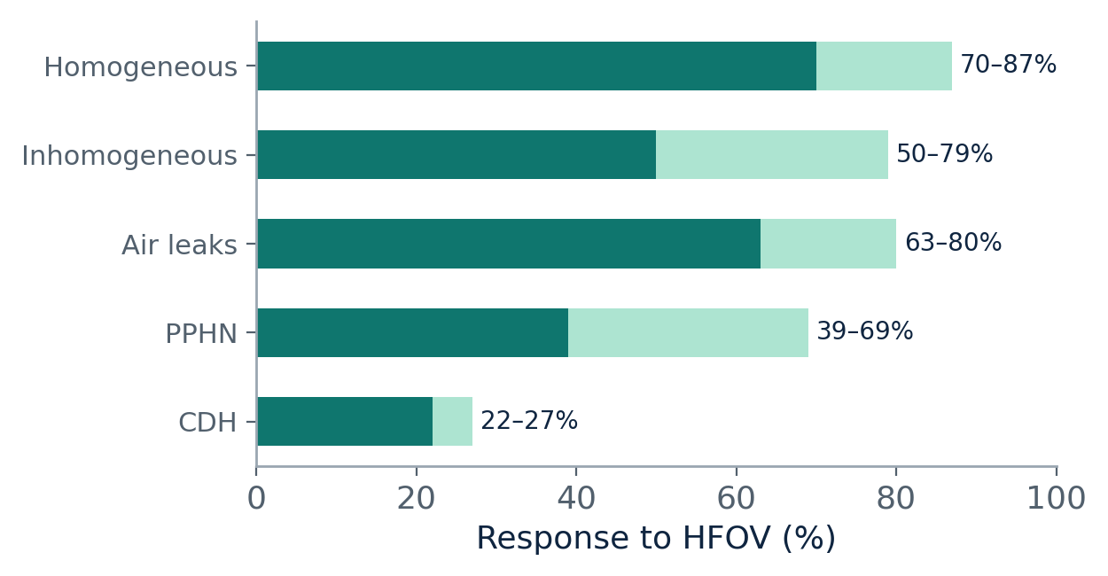
RECOGNISING FAILURE
When HFOV is not working
Failure usually reflects a strategy mismatched to disease or device
Watch for persistently high FiO2, oxygenation index, PaCO2 or MAP
Rising PaCO2 or OI at 2-6 h flags likely failure
An A/a ratio < 0.08 at 6 h predicts need for ECMO
Escalate early: consider HFJV for inhomogeneous disease, or transfer for ECMO.
Approximate response rates to HFOV by disease category.
CLINICAL APPLICATION
High-Frequency Ventilation in Neonates

Slide 42
WRAP-UP
Five things to carry to the bedside
1 – Match the strategy to lung
2 - Amplitude to control CO₂
Recruitable or not, homogeneous or not, compliance vs resistance - the physics tells you which dial to turn.
DCO₂ = f x VT squared; target 40-60.
Tune CO₂ with amplitude, not frequency.
3 - Aim near the corner frequency
4 – MAP to recruit the lung
Lowest peak carinal pressure.
Stiff lung -> higher f (8-10-12).
Recruit, ride the deflation limb, wean MAP once FiO2 <= 0.30.
CLINICAL APPLICATION
High-Frequency Ventilation in Neonates

Slide 43
Questions?
HFOV, used well, is gentle ventilation

