Slide 1


Slide 2
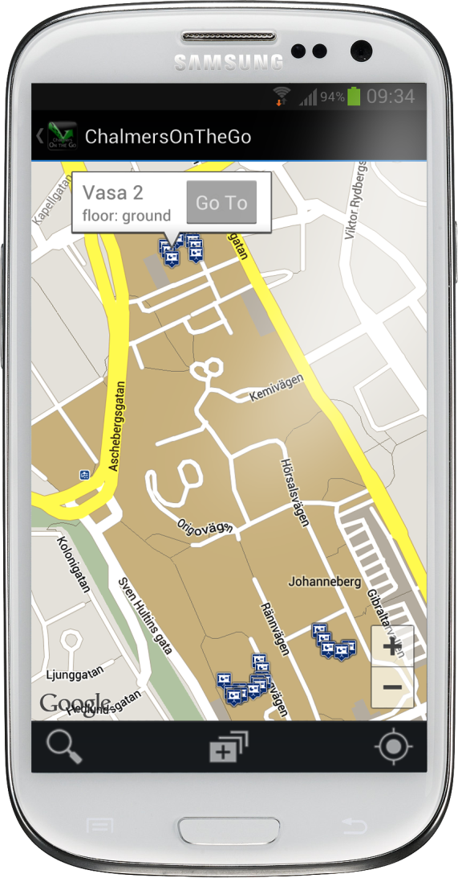
Chalmers on the go
Never get lost again
Enhanced map
The Complete Chalmers Experience- Right at your fingertips!

Slide 3
Agenda
Development
Scrum
Google Maps™ API
Application
Git
Project Burndown
Initial Idea
Core Features
Users
Demo
Notes:
Kanske lägga till testdriven development osv?

Slide 4
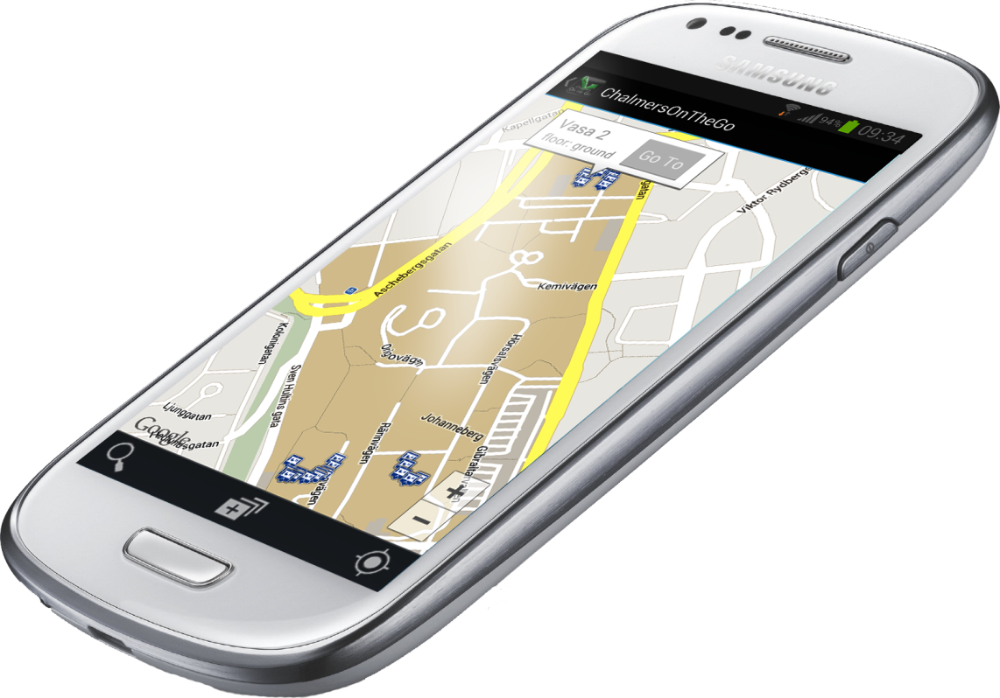
Development

Slide 5
Scrum
Development

Slide 6
Git
Development

Slide 7
Project burndown
Development

Slide 8
Google Maps™ API
Development

Slide 9
Application

Slide 10
Initial Idea
Application
The complete chalmers experience as a map

Slide 11
Initial Idea
Application
Adding all things that are important to a student on a map
Lecture halls
Computer rooms
Group rooms
Pubs
Spare time activities
Never get lost - Always know where you are heading

Slide 12
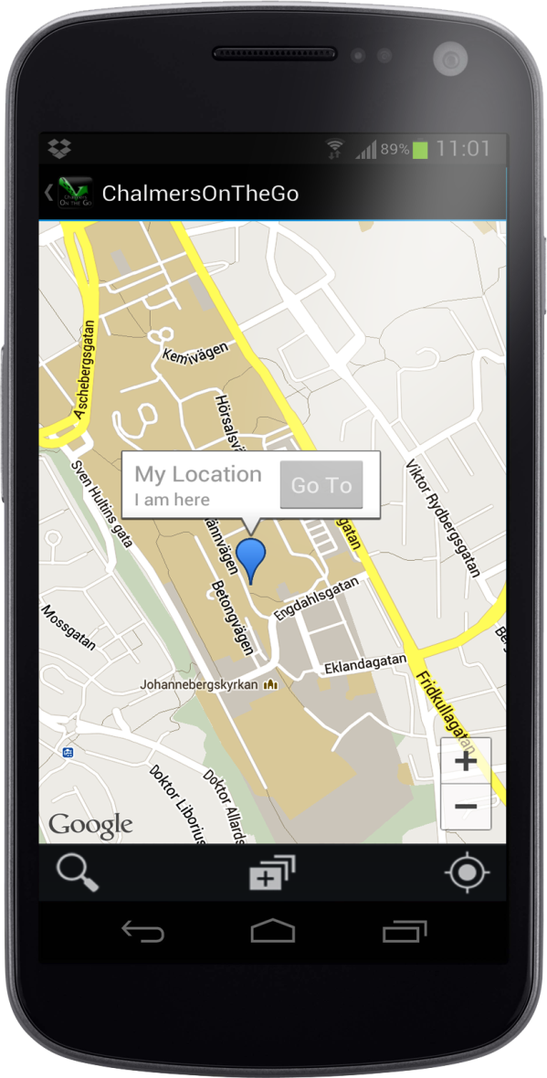
Core Features
Application
Search interface
Layer function
Navigation
User-added positions

Slide 13
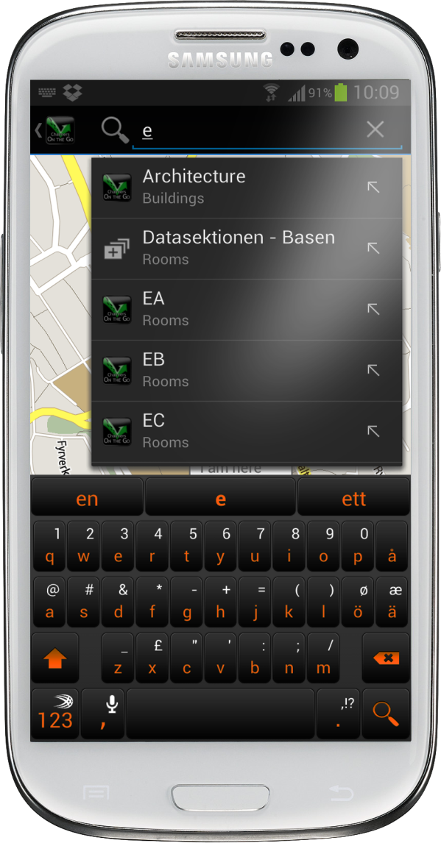
Core Features
Application
Search Interface
Search suggestions
Smart search
Logos on search
Scrollable menu

Slide 14
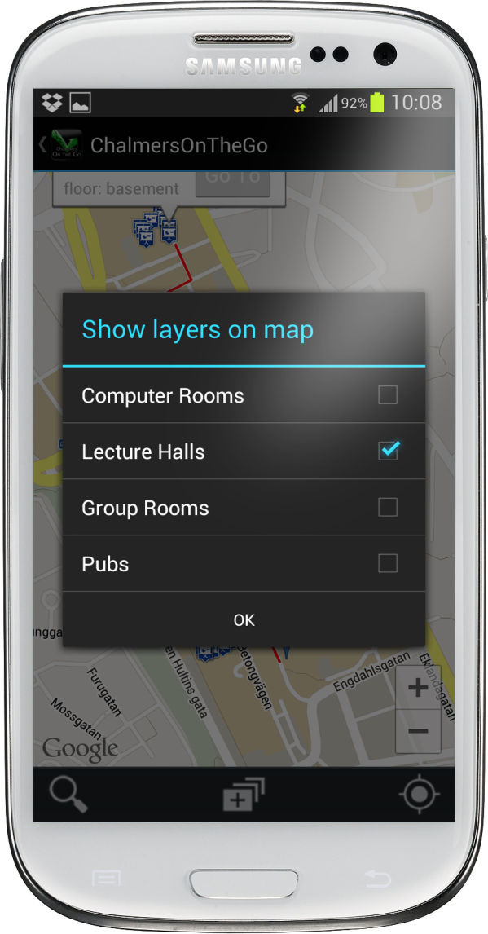
Core Features
Application
Layer function
Show all of specific types
Select visible floors

Slide 15
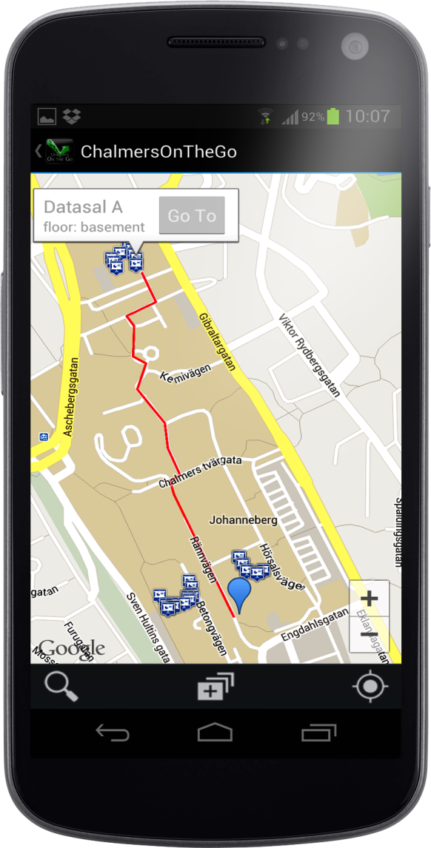
Core Features
Application
Navigation
Navigate to a room with a click
Navigate from two separate locations
Shortest path always

Slide 16
Core Features
Application
User added locations
Add your own favourite positions
Intuitive user interface

Slide 17
Users
Application
Students at Chalmers University of Technology
Guests at chalmers
Tutors
Anyone having to find their way arround Chalmers

Slide 18
Just one more thing…

Slide 19
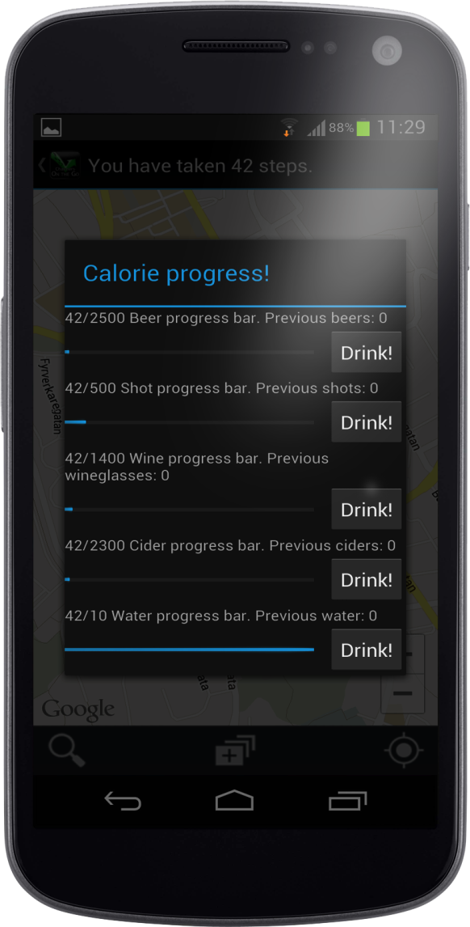
Step tracker
Just one more thing…
Track your steps
Breaking down the steps into beers, ciders, wine, shots or water
Keeping track of what you have taken
Never get fat again

Slide 20
Demo

