Slide 2
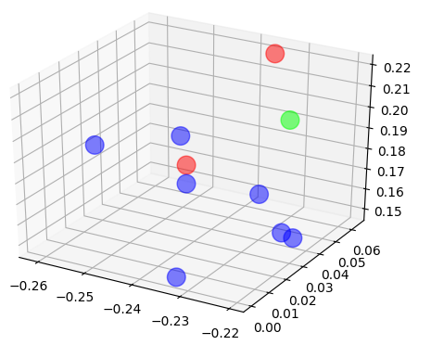
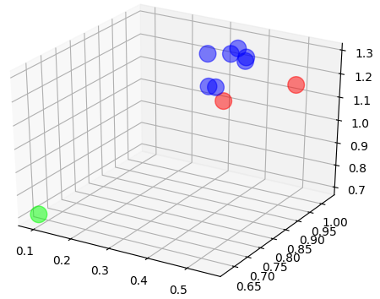
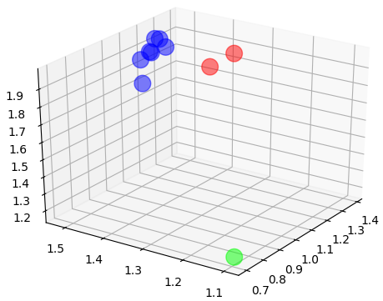
Win
Rate %
Phase 1 Exploring
Phase 2 Learning Specialized Roles
0
6M
10M
60
40
20
0
T (mil)
0
6M
10M
Marine
Learnt
Roles
Medivac
Marauder

