Slide 1
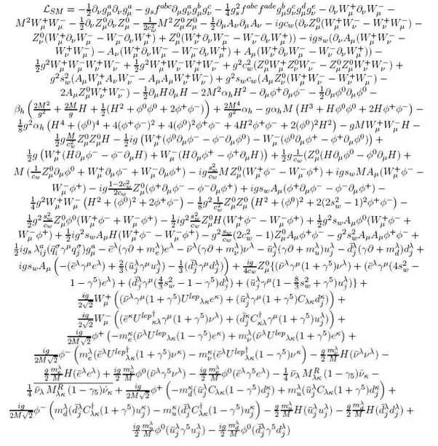
AlgOpt - An algebratic LLVM IR optimizer
丁峰 于颖奇 马凯 曾明亮

Slide 2
Members
PB16110386-丁峰
PB16110846-于颖奇
PB16111428-马凯
PB16060117-曾明亮
结对编程，实现相关算法。
LLVM 调研和 LLVM 相关技术支持。
算法和理论研究。

Slide 3
Part I: LLVM IR Optimizer

Slide 4
Contents
Background
  Architecture of LLVM and Clang
  Brief introduction to related optimizations found in LLVM
A new optimization opportunity – algebraic optimization
Principles, Design, Proof of Concept, and Its Future
Remarks

Slide 5
Clang
Preprocessing
Parsing
Semantic Analysis
Code Generation
AST
LLVM IR
Almost no optimizations

Slide 6
LLVM
Pass
Pass
Code
Gen
IR
IR
IR
Assembly
Analysis
Optimization

Slide 7
LLVM Passes
A module for use with LLVM, either statically or dynamically linked (loadable module)
Exports a Pass object
Manipulating IR is not as easy as it sounds
References:
  Writing An LLVM Pass
  LLVM for Grad Students

Slide 8
LLVM Passes
ImmutablePass
ModulePass
CallGraphSCCPass
FunctionPass
LoopPass
RegionPass
BasicBlockPass
MachineFunctionPass

Slide 9
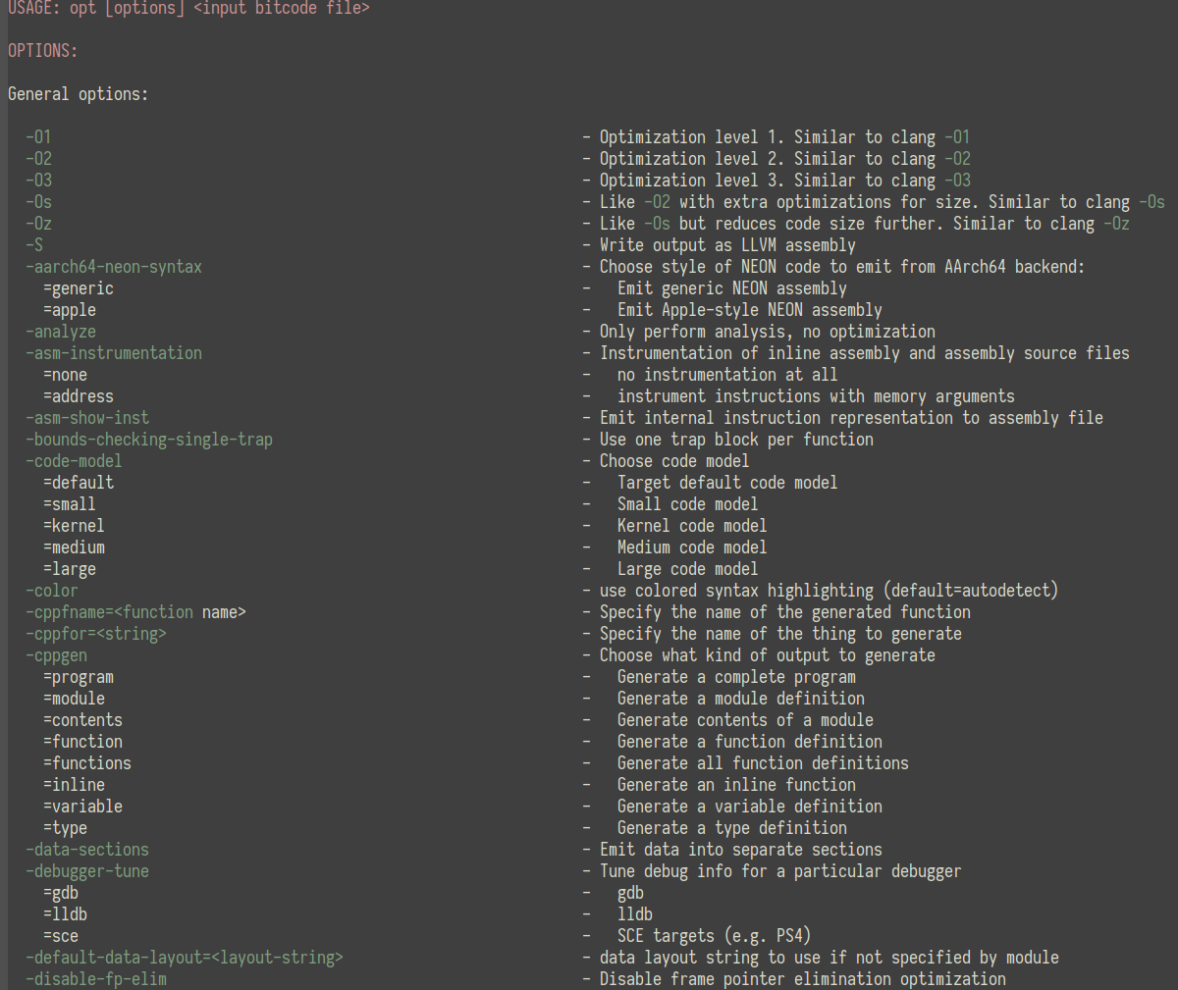
LLVM Passes
$ opt-6.0 -help | wc -l
627

Slide 10
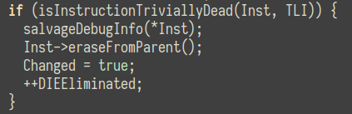
Pass: DCE
Beginning point
A very simple pass to eliminate trivially dead instructions
/lib/Transforms/Scalar/DCE.cpp

Slide 11
Pass: InstCombine
A comprehensive pass to reduce #instructions
This pass is where algebraic simplification happens
Doesn’t modify CFG
Features:
  Constant folding
  Factorization
  Power of two → shift
  …
Tries to simplify: binary operators, calls, casts, loads, stores, …

Slide 12
Pass: InstCombine
Distributive law
  (c*a + c*b) → c*(a+b)
  (a/c + b/c) → (a+b)/c
Associative law
  (op (cast (op X, C2)), C1) → (cast (op X, op (C1, C2)))
  (op (cast (op X, C2)), C1) → (op (cast X), op (C1, C2))

Slide 13
Some other related opt’s
LICM: Loop invariant code motion
SLSR: Straight line strength reduce
LSR: Loop strength reduce

Slide 14
Part II: Algebratic optimization

Slide 15
Motivation
In many situations, relations between variables can be viewed as a polynomial function.
In most cases, compiler will use Horner’s method to calculate this polynomial.
%3 = mul i32 %0, %0 = x²
%4 = shl i32 %0, 1 = 2x
%5 = add i32 %4, %1 = 2x+y
%6 = mul i32 %5, %1 = 2xy+y²
%7 = add i32 %6, %3 = x²+2xy+y²
Code generated with Clang -O2

Slide 16
Motivation
Horner’s method is proved to be optimal when coefficients of polynomial is unknown, but when coefficients can be determined during compilation, there is much space to improve!
%2 = add i32 %0, %1 = (x+y)
%3 = mul i32 %2, %2 = (x+y)²
= x²+2xy+y²
Code generated manually

Slide 17
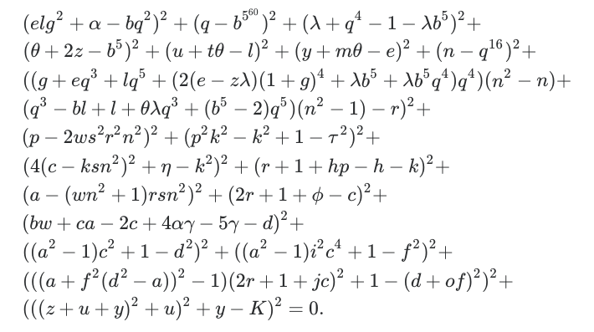
So there comes a question
How to find the fastest way to calculate a polynomial?

Slide 18
Ways to calculate a polynomial
An example: Calculate f(x)=x³⁹⁸
Naïve x¹ x² x³ x⁴ x⁵ ... x³⁹⁸
Method 397 muls 0 adds
Double x¹ x² x⁴ x⁸ x¹⁶ x³² x⁶⁴ x¹²⁸ x²⁵⁶
&Add x³⁹⁸ 398=0b110001110
12 muls 0 adds
Sliding x¹ x² x³ x⁶ x¹² x²⁴ x⁴⁸ x⁹⁶ x¹⁹² x¹⁹⁸ x¹⁹⁹ Windows x³⁹⁸
11 muls 0 adds

Slide 19
Calculating multiple polynomials
An example: Calculate
f(x)=2x+3x²+x³
g(x)=6+11x+6x²+x³
h(x)=(x+1)*(x+2)
f(x)=x*h(x)
g(x)=f(x)+3*h(x)
3 muls 3 adds

Slide 20
Calculating multivariate polynomials
An example: Calculate
f(x,y)=2xy²+3x²y+x³
g(x,y)=6y³+11xy²+6x²y+x³
h(x)=(x+y)*(x+2*y)
f(x)=x*h(x)
g(x)=f(x)+3*y*h(x)
5 muls 3 adds

Slide 21
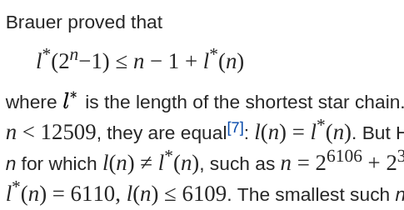
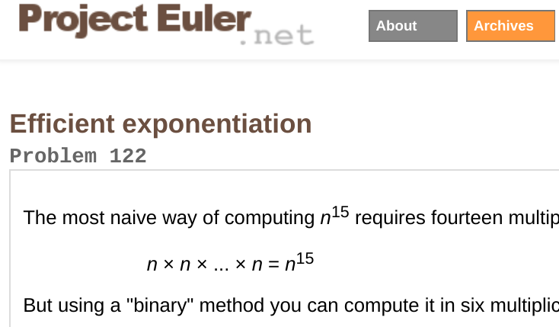
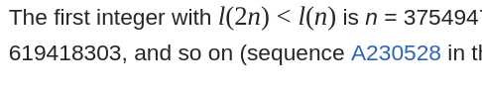
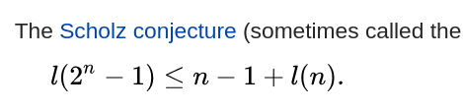
Optimal way to calculate polynomials
Even for the simplest situation, no efficient algorithm has been found. To solve this problem in general case, we need complicated algorithms and deep mathematics theories.

Slide 22
Implementation
Since Clang did nothing on this, there is still space to improve.
We can obverse frequent patterns of polynomial in practice, and write specialize algorithms to optimize polynomials that match these patterns.
For example, we can use extended greatest divisor algorithm to find common factor of a polynomial.
f(x)=2x+3x²+x³
g(x)=6+11x+6x²+x³
GCD(f,g)=2+3x+x²

Slide 23
Implementation
Get basic blocks of IR (in forms of SSA) from LLVM Pass
Extract variable operation chain from basic block that matches our pattern
Optimize operation chain
Covert operation chain to IR and replace original IR

Slide 24
What we have done
Only some optimization for univariate situation is supported currently. (Demonstrate)
Need to implement optimization for multivariate polynomials situation for realistic optimization on realistic code.
Operators may not be add or mul or sub. (Thanks G4!)
Still a long way to go !

Slide 25
Possible flaws
In real world, fewer operations doesn’t always imply faster speed.
Bitwise operation:
8*x is faster than 7*x
Pipelines of processor:
y1=x1*x2 y1=x1*x2
y2=x3*x4 is faster than y2=y1*x3
y3=y1*y2 y3=y2*x4
We need a more accurate evaluation function to avoid negative optimization.

Slide 26
Conclusions
Algebraic optimization is possible and realistic
Doing research is not so easy
Teamwork is important
Realizing ideas is joyful

Slide 27
Q&A

