Slide 1
Lecture 5
Gene prediction Genome Annotation

Slide 2
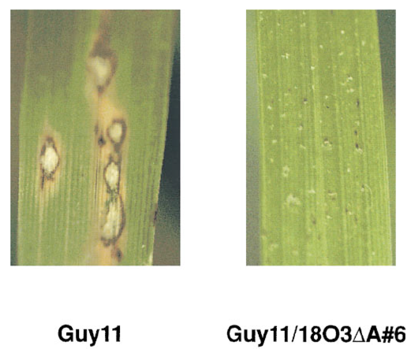
Gene identification – AVR1-CO39
A gene preventing certain strains of Magnaporthe oryzae from infecting rice (confers avirulence)
Using genetic complementation narrowed the gene down to a DNA segment 1,046 bp in length
Farman & Leong, 1998

Slide 3
Where is the AVR1-CO39 gene?
Find an ATG start codon
Start translating the sequence downstream
Finish when we reach a stop codon
Which ORF is the avirulence gene?

Slide 4
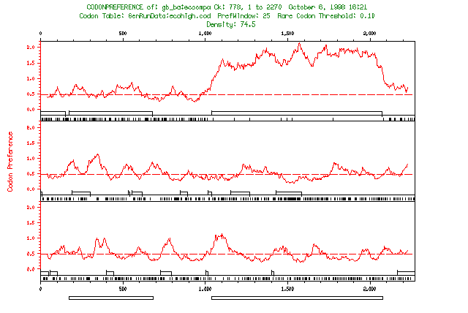
Computational Gene Prediction
Statistical properties of protein-coding genes differ from those of non-coding sequence
Long ORFs
On average stop codons should occur 3 times in every 64 codons (~1/21 amino acids)
Codon bias
Human Genes
1
codon | Amino acid | %
ACA | Thr | 28
ACC | Thr | 36
ACG | Thr | 12
ACU | Thr | 24
2
3

Slide 5
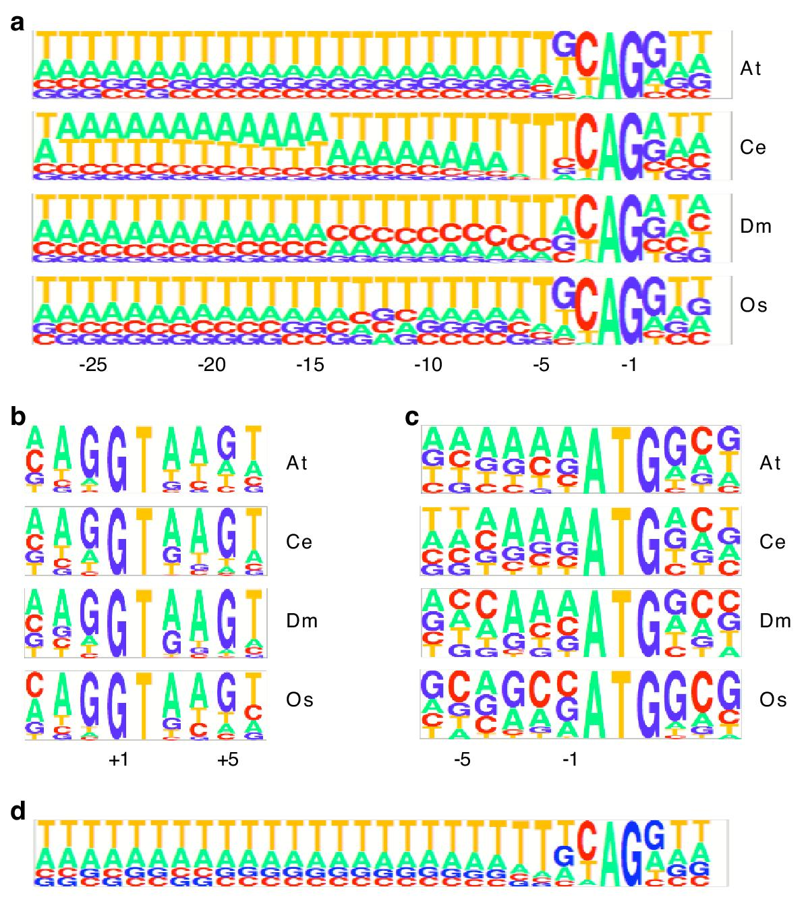
Base Composition Near Critical Gene Features
Splice acceptor sites
(3’ intron boundary)
Splice donor sites
(5’ intron boundary)
Translation start site
Splice acceptor sites for A. thaliana genes predicted using C. elegans parameters
from Korf (2004)

Slide 6
Model based gene prediction
Computational
Absolute rules:
start and stop codons
Statistical probabilities:
which ATG codon is the actual start?
Introns
splice junctions
codon usage
GC content
Develop training data
What do genes look like in our organism of interest?

Slide 7
Gene Prediction Programs
Most ab initio gene finding programs rely on Hidden Markov Models (HMMs) for their predictive power
“A Markov chain is a stochastic model describing a sequence of possible events in which the probability of each event depends only on the state attained in the previous event”
“Hidden Markov Model is a statistical Markov model in which the system being modeled is assumed to be a Markov process with unobserved states” Wikipedia

Slide 8
HMMs and Gene Prediction
TSS
ATG
stop
Intergenic promoter
Exon 1
Intron 1
Exon 2
Intron2
Exon 3
intergenic
Zhang, 2002
5’ UTR
3’ UTR
AAAAA
Open reading frame (ORF)
<STATE_TRANSITIONS>
Einit Intron 1
Esngl Inter 1
Eterm Inter 1
Exon Intron 1
Inter Einit 0.977636
Inter Esngl 0.022364
Inter Pro 1
Intron Eterm 0.160251
Intron Exon 0.839749
Intron ORF 1
ORF Inter 1
Hidden state: intergenic region, exon, intron
Observations: start codons, exon/intron boundaries, stop codons, etc.
Initial probabilities of starting in a given hidden state (intergenic region/exon/intron lengths).
Transition probabilities of going from one hidden state to another (feature length and order)
Emission probabilities of observing a certain motif given a hidden state (start codon unlikely if it has bad consensus and we are still in a coding region)

Slide 9
Viterbi algorithm
Find the most probable sequence of hidden states (gene features) that result in a series of observed events (sequence motifs)
Select an initial state (intergenic, 5’UTR, exon, intron, 3’ UTR) based on probability of being in that state
Start traversing the sequence and determine the probabilities of seeing different features assuming we are in that state
If we encounter a feature that defines a state boundary, switch states
E.g. a stop codon defines the boundary between an exon and a 3’UTR
Determine all possible paths through all possible states
Identify the path with the highest probability

Slide 10
Standard practice is to perform gene predictions with multiple programs
The two programs we will run in today’s exercise:
SNAP
Korf (2004) Gene finding in novel genomes BMC Bioinformatics 5:59
AUGUSTUS
Stanke et al (2004) AUGUSTUS: a web server for gene finding in eukaryotes. Nucl. Acids Research 32:W309

Slide 11
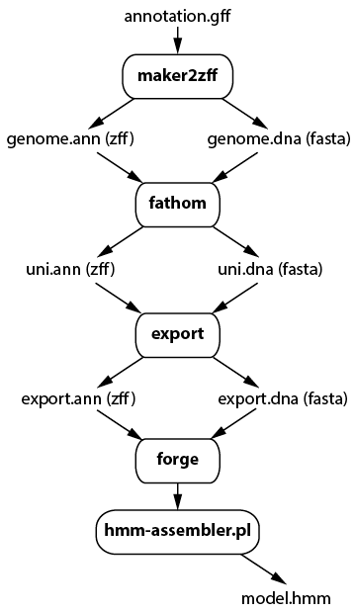
SNAP :Generate Training Data
Start with an annotation for a reference genome that lists the coordinates of known features
Convert reference annotation to .zff format (maker2zff)
Categorize and filter gene models, extracting only high-quality (complete) genic regions (fathom)
Generate training data (annotation and sequence) for model building (fathom -export)
Calculate transition and emission probabilities (forge)
Condense the HMMs into single file (hmm-assembler.pl)

Slide 12
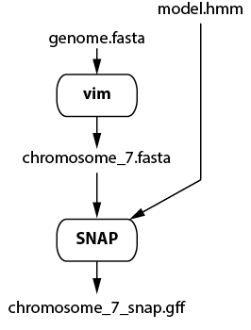
SNAP: predict Genes in a New Genome
nano
Extract sequence for a single chromosome from the Magnaporthe oryzae genome assembly
Use the HMM to predict genes

Slide 13
Gene annotation GTF/GFF format
1 | 2 | 3 | 4 | 5 | 6 | 7 | 8 | 9
seqid | source | feature | Start | End | Score | Strand | phase | attributes
Chromosome_8.5 MG8 start_codon 4470284 4470286 . - 0 gene_id "MGG_00005"; transcript_id "MGG_00005T0";
Chromosome_8.5 MG8 stop_codon 4469688 4469690 . - 0 gene_id "MGG_00005"; transcript_id "MGG_00005T0";
Chromosome_8.5 MG8 exon 4470173 4470286 . - . gene_id "MGG_00005"; transcript_id "MGG_00005T0";
Chromosome_8.5 MG8 CDS 4470173 4470286 . - 0 gene_id "MGG_00005"; transcript_id "MGG_00005T0";
Chromosome_8.5 MG8 exon 4470034 4470120 . - . gene_id "MGG_00005"; transcript_id "MGG_00005T0";
Chromosome_8.5 MG8 CDS 4470034 4470120 . - 0 gene_id "MGG_00005"; transcript_id "MGG_00005T0";
Chromosome_8.5 MG8 exon 4469273 4469969 . - . gene_id "MGG_00005"; transcript_id "MGG_00005T0";
Chromosome_8.5 MG8 CDS 4469691 4469969 . - 0 gene_id "MGG_00005"; transcript_id "MGG_00005T0";
Chromosome_8.5 MG8 start_codon 4455593 4455595 . - 0 gene_id "MGG_00010"; transcript_id "MGG_00010T0";
Chromosome_8.5 MG8 stop_codon 4453288 4453290 . - 0 gene_id "MGG_00010"; transcript_id "MGG_00010T0";
Chromosome_8.5 MG8 exon 4455560 4455595 . - . gene_id "MGG_00010"; transcript_id "MGG_00010T0";
Chromosome_8.5 MG8 CDS 4455560 4455595 . - 0 gene_id "MGG_00010"; transcript_id "MGG_00010T0";
Chromosome_8.5 MG8 exon 4455321 4455372 . - . gene_id "MGG_00010"; transcript_id "MGG_00010T0";
Chromosome_8.5 MG8 CDS 4455321 4455372 . - 0 gene_id "MGG_00010"; transcript_id "MGG_00010T0";
Chromosome_8.5 MG8 exon 4454682 4455003 . - . gene_id "MGG_00010"; transcript_id "MGG_00010T0";
Chromosome_8.5 MG8 CDS 4454682 4455003 . - 2 gene_id "MGG_00010"; transcript_id "MGG_00010T0";
Chromosome_8.5 MG8 exon 4454473 4454620 . - . gene_id "MGG_00010"; transcript_id "MGG_00010T0";
Chromosome_8.5 MG8 CDS 4454473 4454620 . - 1 gene_id "MGG_00010"; transcript_id "MGG_00010T0";
Chromosome_8.5 MG8 exon 4453288 4454397 . - . gene_id "MGG_00010"; transcript_id "MGG_00010T0";
Chromosome_8.5 MG8 CDS 4453291 4454397 . - 0 gene_id "MGG_00010"; transcript_id "MGG_00010T0";

Slide 14
AUGUSTUS
Contains its own comprehensive set of HMMs for a number of model organisms
We are working with data from a model plant pathogen so AUGUSTUS comes with a suitable HMM (magnaporthe_grisea)
AUGUSTUS
Chromosome7.fasta
Chromosome7.gff3

Slide 15
Gene validation
Independent evidence that our candidate (predicted) gene is, in fact, a gene
Conserved protein motifs
Blast matches to known proteins
Blast matches to know genes
Expressed sequence evidence
cDNAs
RNAseq reads

Slide 16
Information overload!!!
Results from:
SNAP
AUGUSTUS
Magnaporthe genes (NCBI)
Magnaporthe proteins (NCBI)
BLAST matches –
RNAseq data
How are we going to make sense out of these highly redundant datasets?

Slide 17
Enter…MAKER
Synthesizes multiple forms of gene prediction data
Predictions and evidences
Outputs a single, consistent set of genes and gene models, including quality values
Uses a standard gene annotation format
GFF3
Results can be imported into a genome browser for visualization/exploration of important features

Slide 18
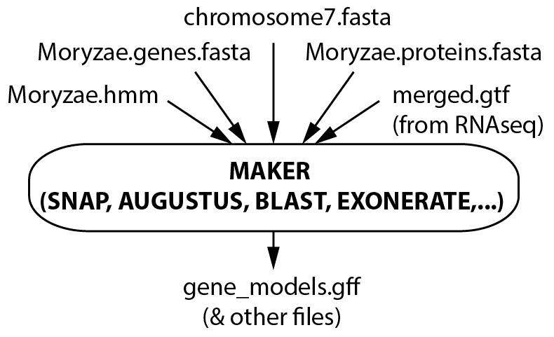
MAKER

Slide 19
Gene finding is an iterative process
HMM
SNAP
AUGUSTUS
BLAST
matches
GENE
MODELS
MAKER
ESTs

Slide 20
Module 5 exercises
Extract sequence for a single chromosome from the Magnaporthe oryzae genome
Use a well-characterized set of Mo genes to train gene-finding programs to identify genes in new genome sequences
Build a Hidden Markov Model file
Run SNAP using the HMM
Run AUGUSTUS using its own HMM
Use MAKER to compare gene predictions with evidences (Mo protein sequences, RNAseq data) and produce a set of gene “models”
(View GFF files in the Genome Browser - see Module 8)

