Slide 1



KY-INBRE Essential Bioinformatics Skills Workshop 2026
University of Kentucky
June, 15th – 18th

Slide 2
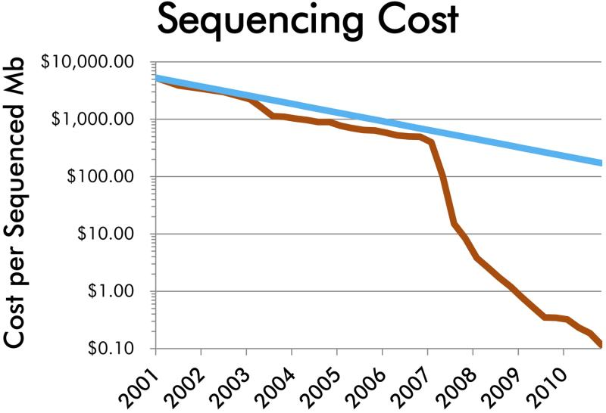
NGS Data Are Accumulating Faster Than They Can Be Analyzed
Next Generation
Sequencing
Sequencing is accessible to, and affordable for, everyone
NGS is almost expected in all fields of biological study
Many researchers are generating NGS data
But few have the knowledge required to analyze it

Slide 3
Why is This?
Bioinformatics
“…an interdisciplinary field that develops methods and software tools for understanding biological data. As an interdisciplinary field of science, bioinformatics combines biology, computer science, information engineering, mathematics and statistics to analyze and interpret biological data”
Wikipedia

Slide 4
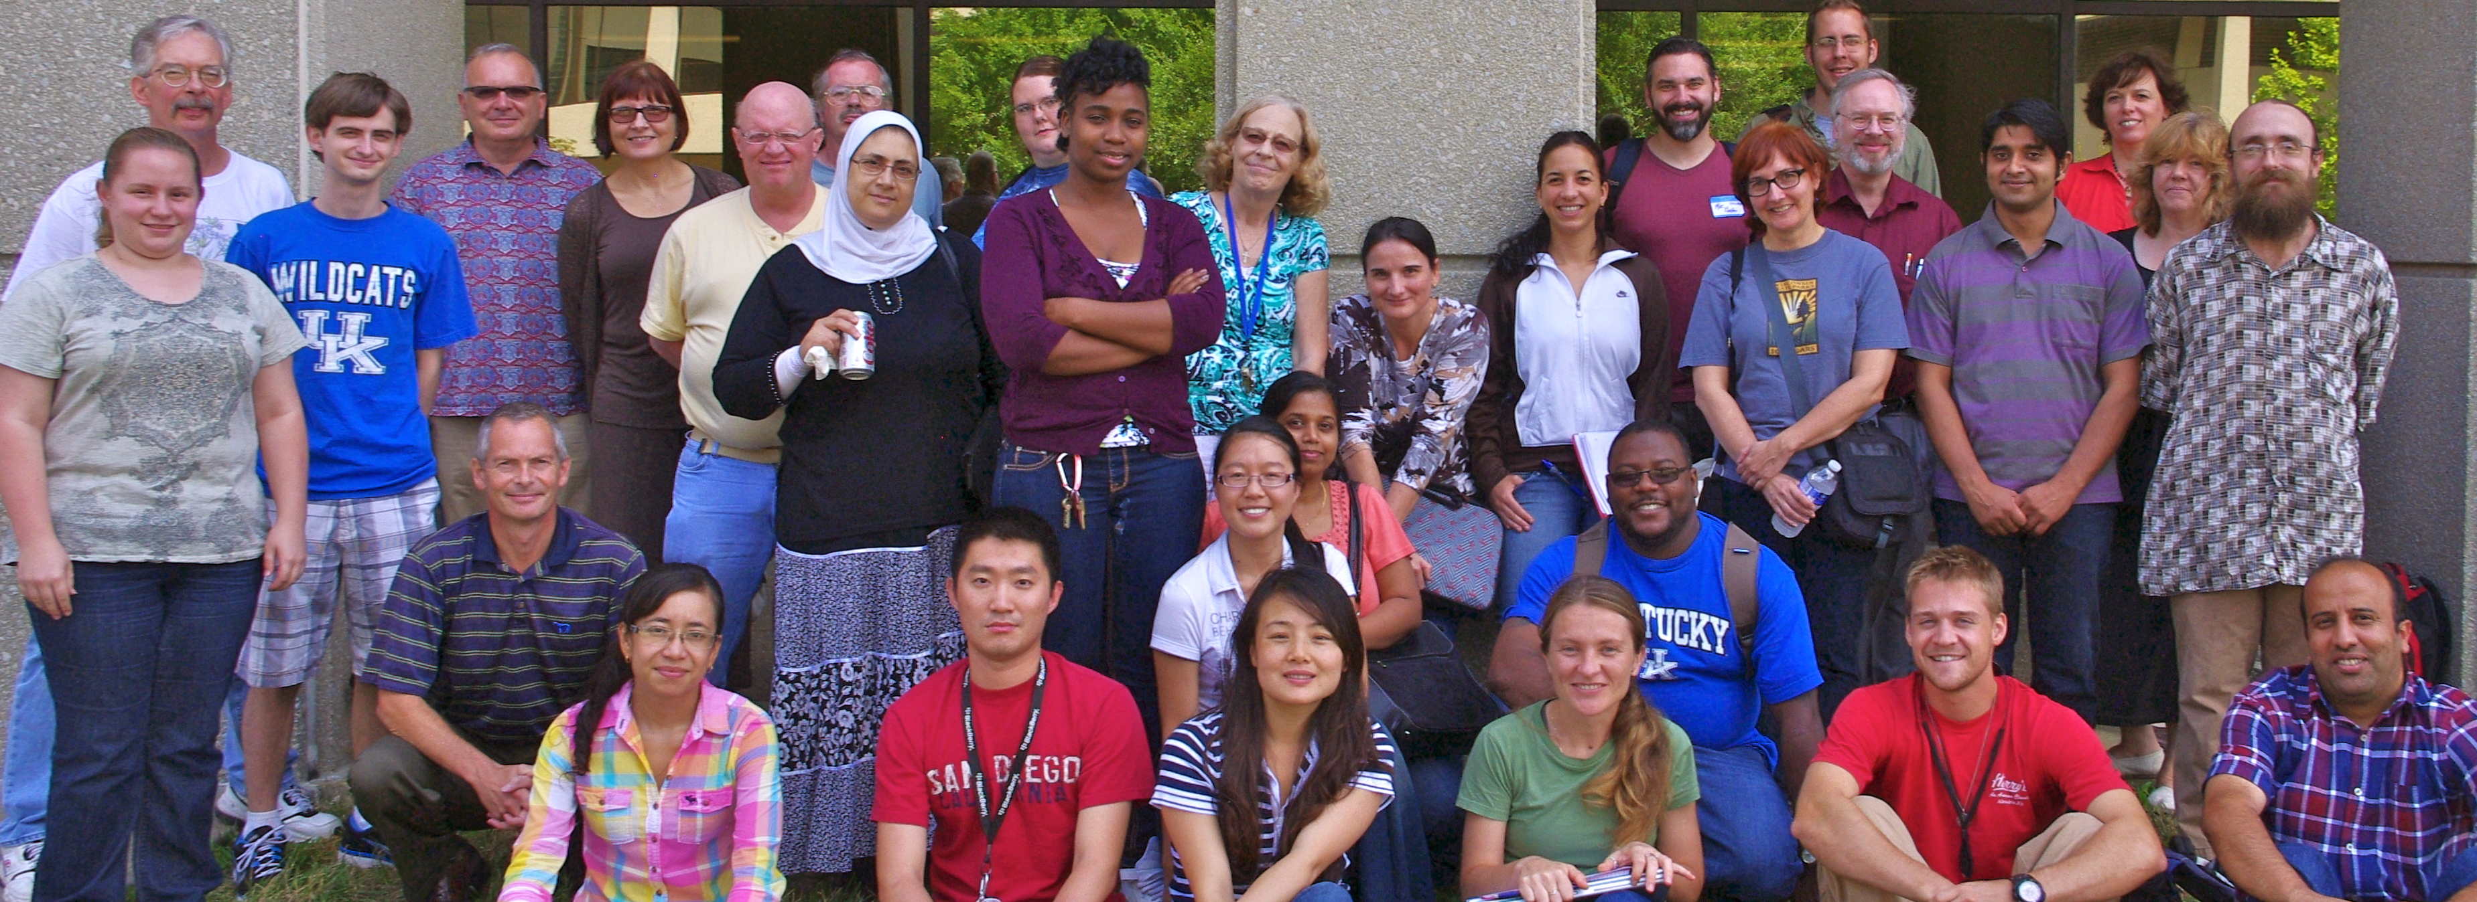
Essentials Bioinformatics Skills Workshop

Slide 5
Goals
Provide basic training in sequence data analysis
Build confidence in using the UNIX command line interface
Introduce commonly-used tools and key concepts for analyzing large sequence datasets
Establish a solid foundation for building further bioinformatics expertise
Participants with different backgrounds
Undergraduate students to postdocs
Novice… to expert
Take your time please provide assistance

Slide 6
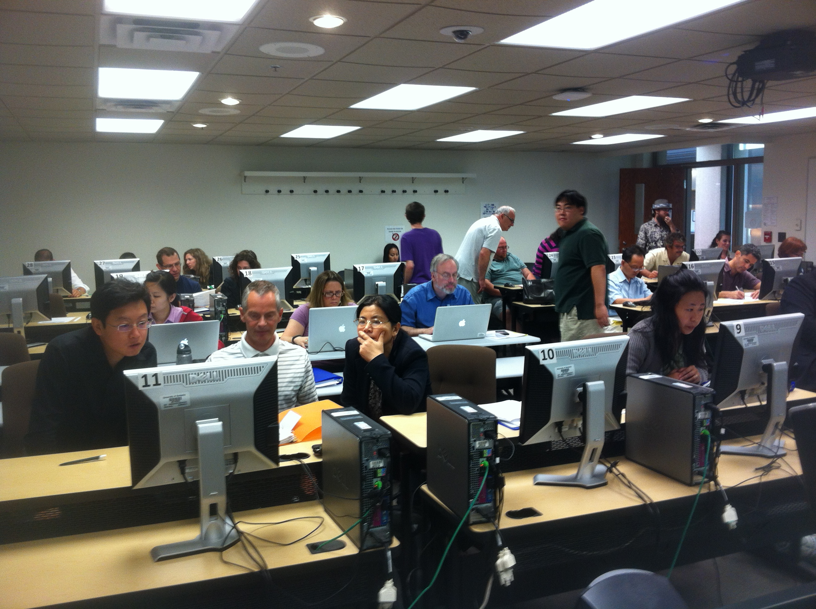
Workshop format
Hands on activities
Sequence data → biological insight
Introductory, bare bones bioinformatics (B³)
Data formats
Workflows
Sequence quality assessment and trimming
Sequence assembly
Comparing assembled sequences using blast
Gene Prediction
Data visualization (Genome Browsers)
Aligning RNAseq reads to a reference genome
Reference-based transcript assembly and quantification
Gene expression analysis
Identification of sequence variants

Slide 7
Workshop format (cont.)
Open source, industry standard software
Familiarize – not frighten
Understand the task at hand
What the software does
Minimal options required to run
Default settings
Build confidence and understanding
Input(s) → output(s) → biological insight(s)
Explore the output file(s)
Use the guide questions
Try and connect the results to the biology of the system

Slide 8
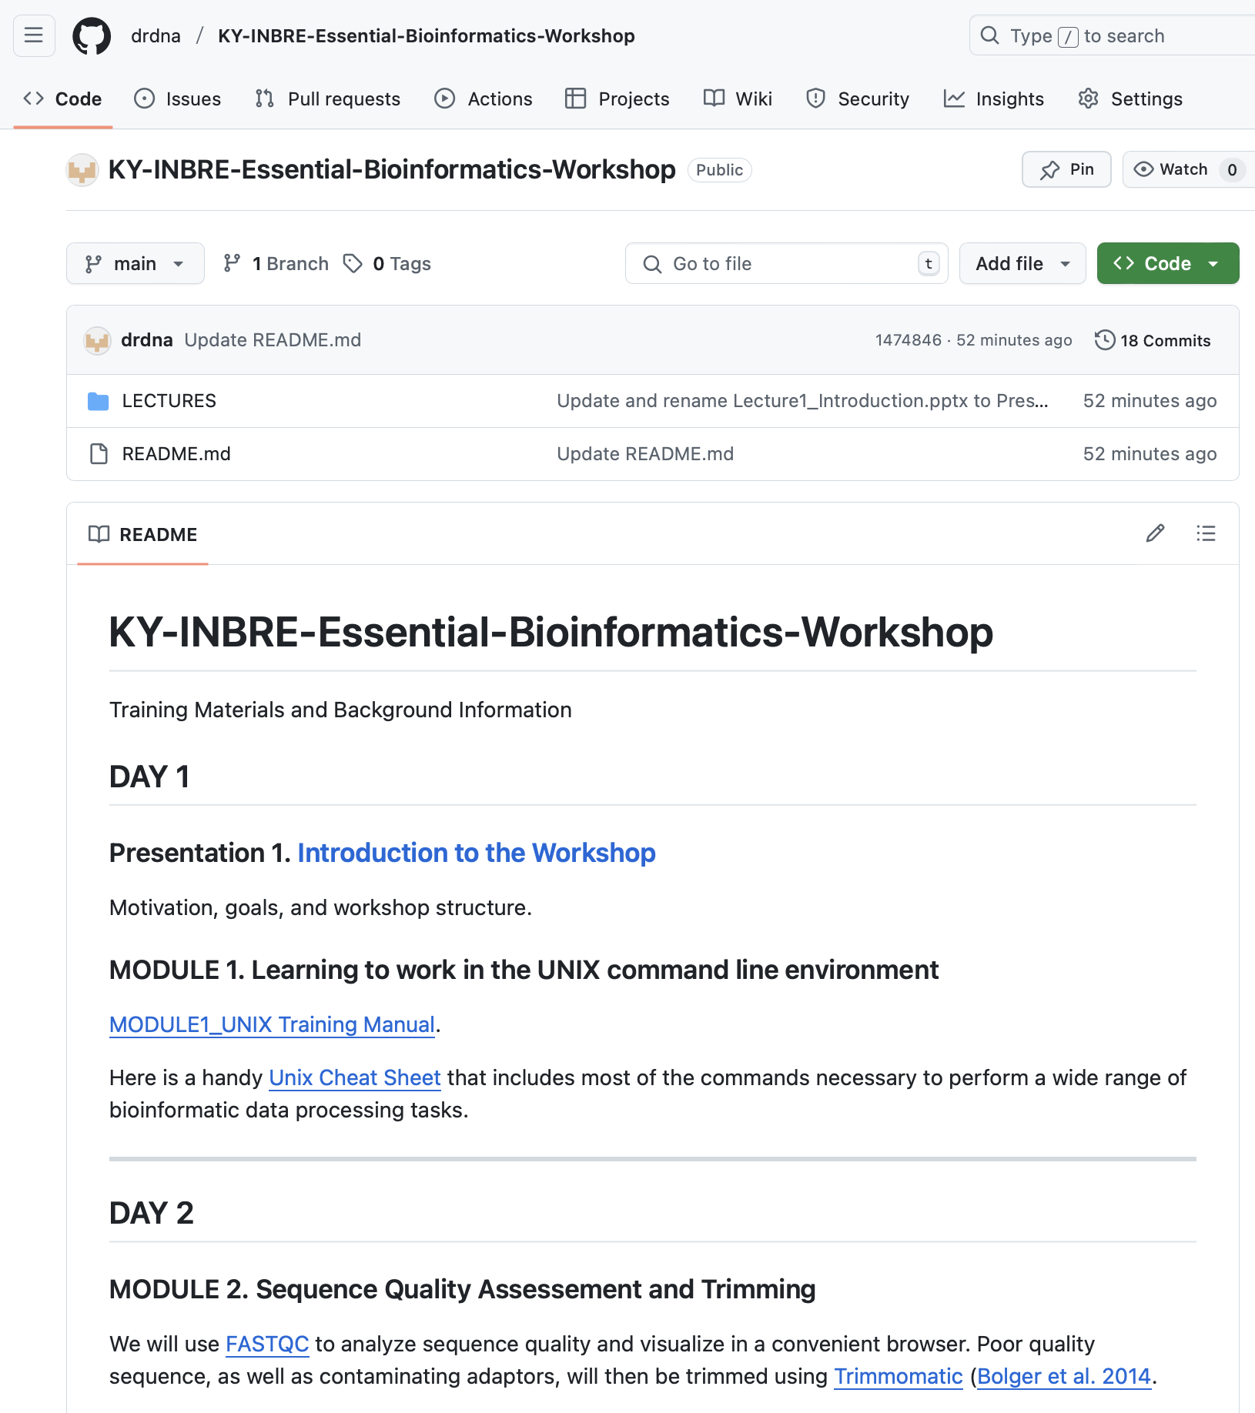
Workshop Resources
https://github.com/drdna/KY-INBRE-Essential-Bioinformatics-Workshop/
Outlines of activities
Exercise Modules
Presentation Slides
Links to software tools
Relevant Citations
Other Useful Resources

Slide 9
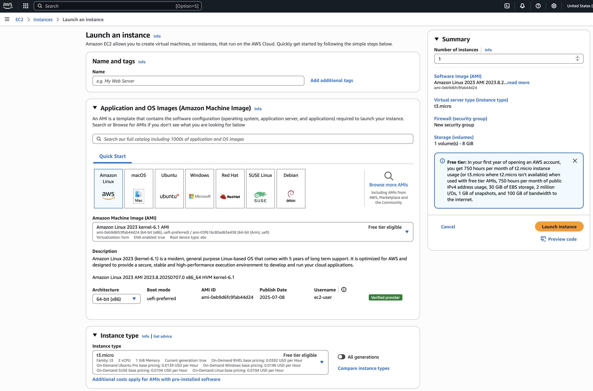
Computing in the Cloud
We will be using cloud computing to complete the workshop
Virtual Machines provided by Amazon Web Services
Identical training environment can be set up from anywhere
Instructions at:
https://github.com/actapia/uky-ngs-workshop-user-install

Slide 10
Today’s activity: Learning UNIX
Operating System with a modular design
Set of simple tools - each having a simple, well-defined function
Inter-process communication mechanism known as “pipes”
Unified filesystem
“Shells” that allows the user to communicate with the operating system to connect tools and build complex workflows
Text-based interface – command line
Graphical interface

Slide 11
Command Line Interface (CLI)
A way to interact with the operating system using commands issued by typing lines of text:
program –options directory/file
Manipulate, navigate and query the filesystem:
mkdir directory-name – make a directory
cd directory-name – change into named directory
ls directory-name – list a directory’s contents
Create and operate on files:
cat filename – read the named file
grep pattern filename – search for pattern in named file
awk – works with files having a tabular format
sed – a greatly extended find and replace program
And MANY more…
“Your bioinformatics class actually has been one of the most useful classes in my job, the power of grep, sed and awk has turned me into a scripting wizard at my job, dealing with complex problems”

Slide 12
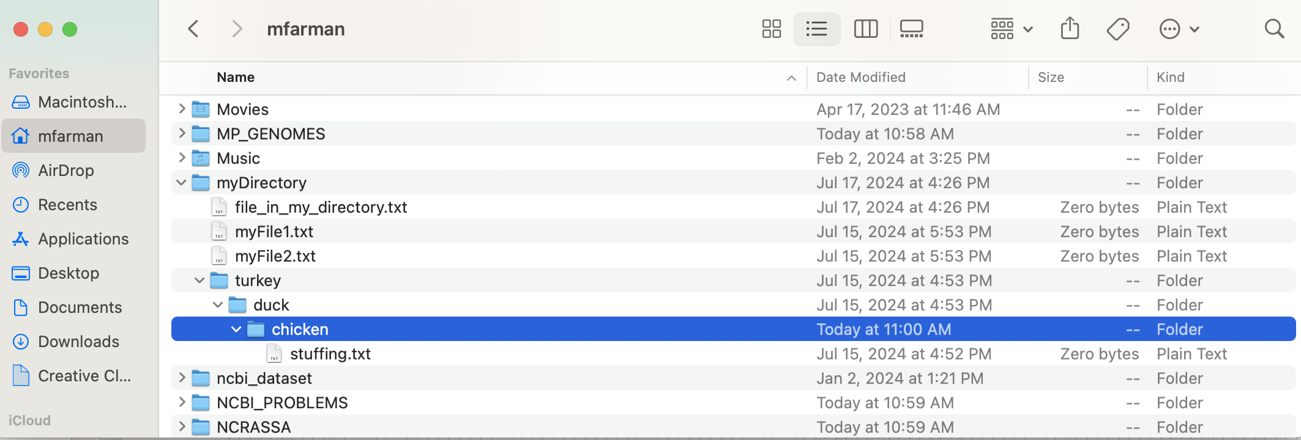
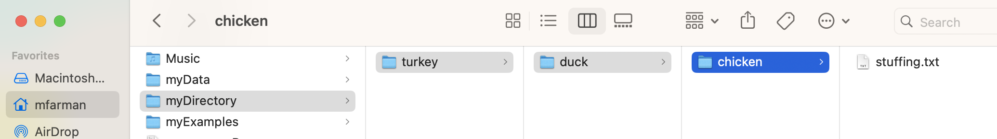
Navigating the CLI environment
GOAL: Build a mental map of directory structure and file paths
Path to chicken = /Users/mfarman/myDirectory/turkey/duck/chicken/

Slide 13
Mastering Directory and File Paths
It is important to develop a habit of staying in the same directory for a specific task
We will use task-specific directories
unix, sequences, assembly, etc.
Stay in the top-level directory for each task
Opening stuffing.txt file while working in the home directory:
MacBook-Pro:~ mfarman$ nano myDirectory/turkey/duck/chicken/stuffing.txt

Slide 14
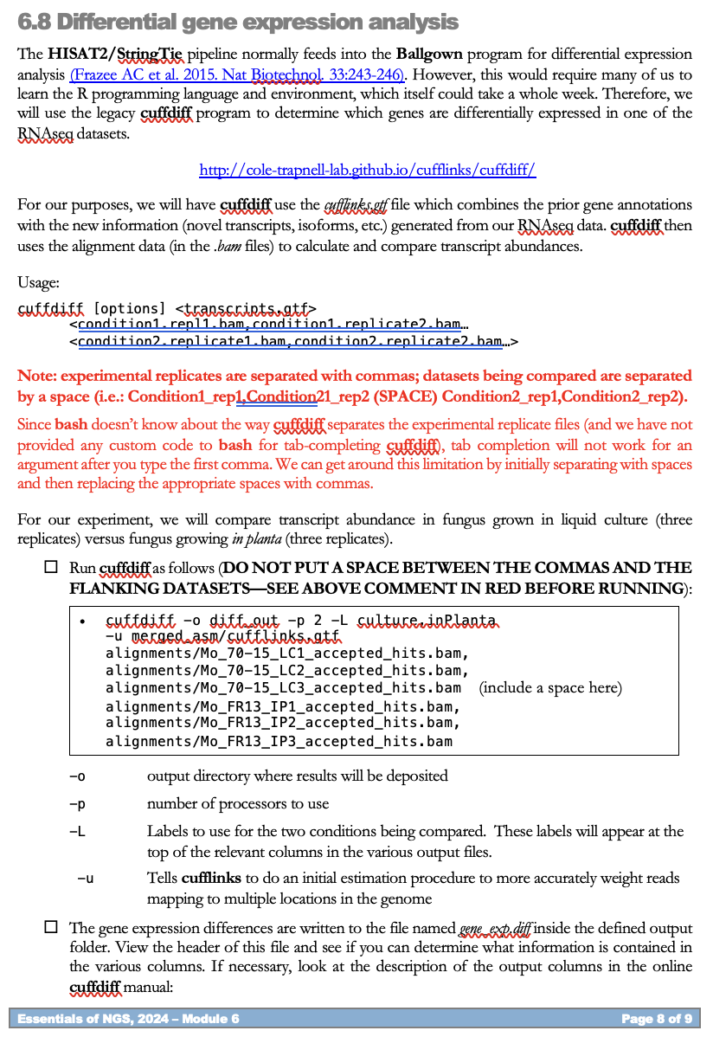
Hints for a Productive Time
Check boxes identify tasks that must be completed
Commands for running the various programs are provided in boxes
Enter all commands that appear in a box on a single line and only hit return at the end
Take your time to read the text between the tasks
It explains what you are doing and why
It explains the options used for the different programs

Slide 15

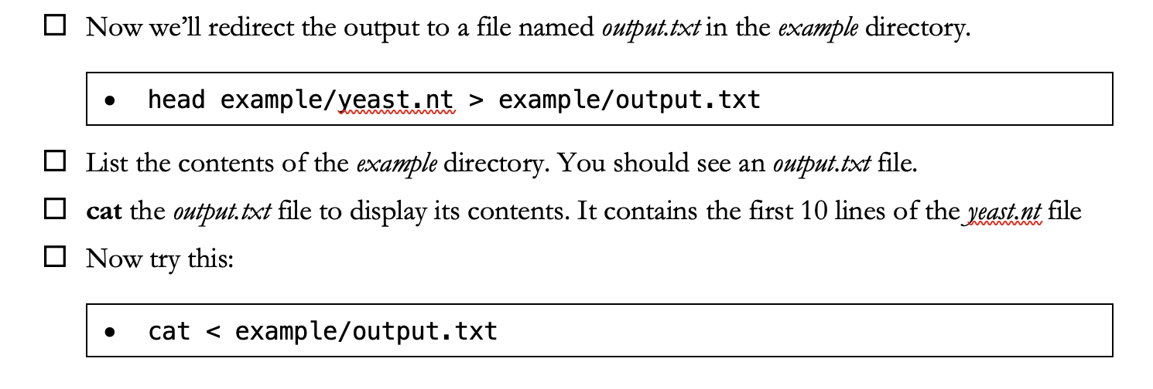
Controlling chaos
Day 1 is always chaotic:
Students with different experience levels
By Day 3, most students should be navigating the CLI with confidence
Hints for a productive time:
Complete all tasks with check boxes

Slide 16
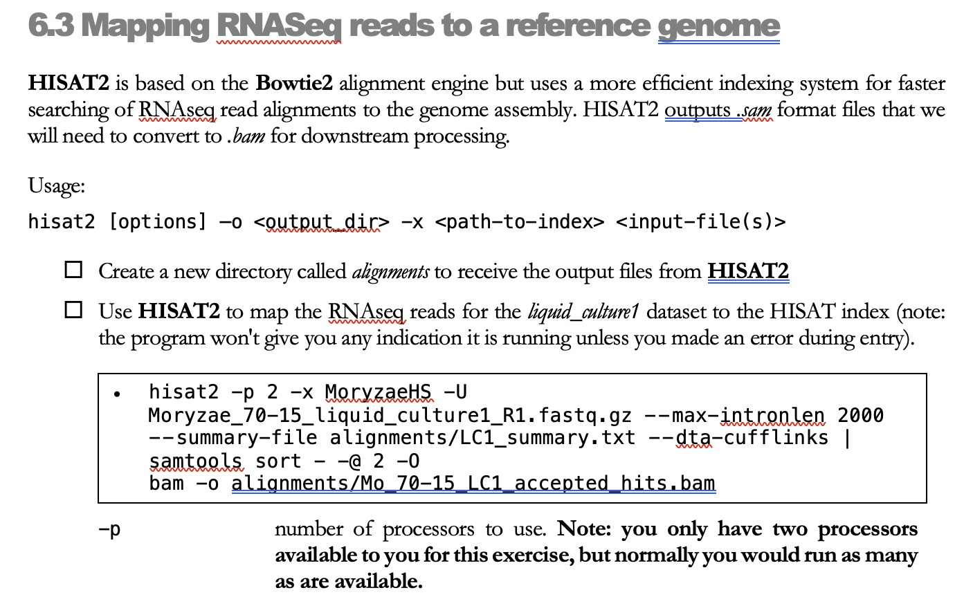
Check Boxes Help Troubleshooting

Slide 17
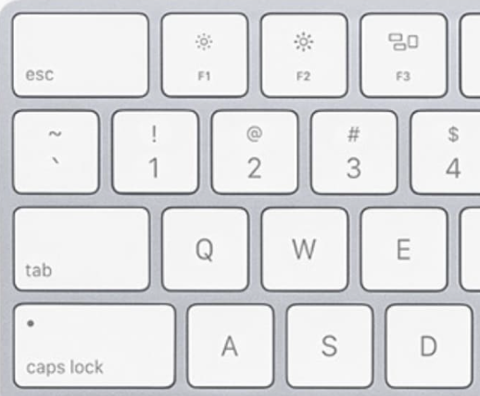
Use TAB Completion
It speeds up your work rate
You do not need to type out full commands or directory and file names
It helps you avoid spelling errors
Tab completion will not work if you mistype a directory/file name
We purposefully use long file names to encourage you to use TAB completion
It helps you navigate the file system
Tab completion fails if you, or a directory/file, are not in the location where you think you/they are

Slide 18

Use the Up/Down Arrows
The UNIX CLI keeps track of the commands that you run in a session
You can scroll through past commands by using the up and down arrows on your keyboard
This saves time when you need to repeat a command or run another command that is very similar to a previous one

