Slide 1
RNA-Seq/Variant Calling

Slide 2
Key concepts
RNA-Seq
RNA-Seq gives insight into the portion of the genome that is transcribed (genes)
NGS allows profiling of global gene expression
Genes with higher expression level → more RNA-Seq reads
Variant discovery
Identified by sequencing genomes (or RNA) from different individuals
Or by sequencing different tissues within an individual (somaclonal variation – e.g. cancer research)

Slide 3
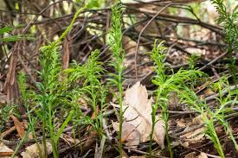
RNA-Seq
Gene discovery
Gene validation
training gene prediction programs
Gene expression studies
Understanding physiological processes
Dissecting signal/response pathways
Understanding disease causation and symptomatology
Tmesipteris oblanceolate
(160 Gb mega-genome)

Slide 4
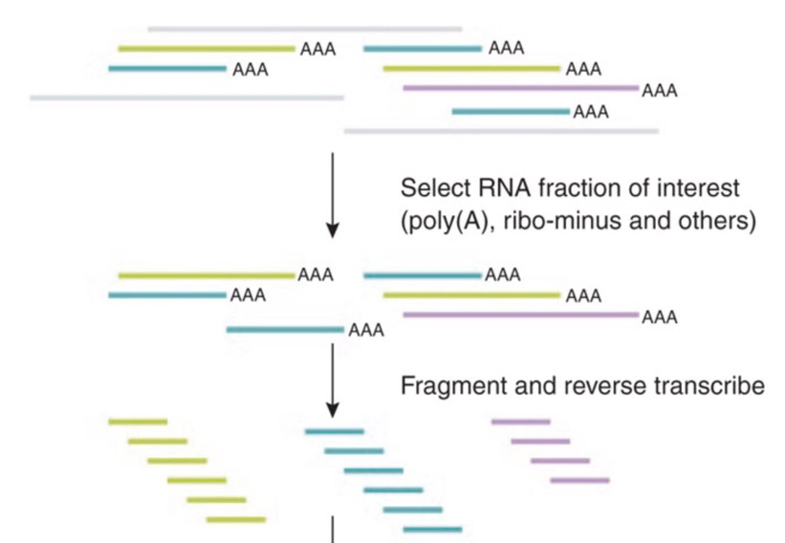
RNA-Seq library production
Chromosome
expression
rRNA +
mRNA +
others
mRNA
DNA
Add adaptors and sequence

Slide 5
RNA-Seq data – what next?
No reference genome
De novo transcript assembly: rnaSPAdes, Trinity, etc. (contigs/isotigs)
Annotation: BLAST, BLAST2GO (functions?)
Reference genome available
Map RNAseq reads to reference: HISAT2, STAR, Tophat2
Generate a genome annotation
Improve an existing genome annotation: stringtie, cufflinks
Confirm gene predictions, identify novel variants, discover new genes
Compare gene expression levels: Ballgown, cuffdiff

Slide 6
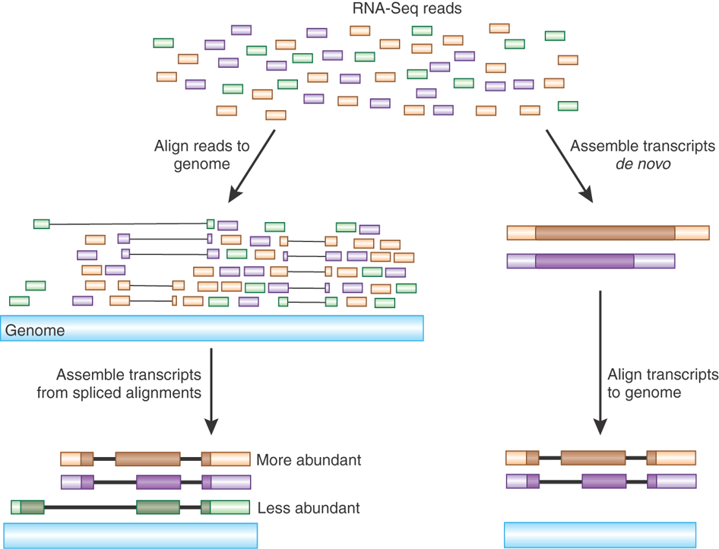
Reference-based assembly vs. de novo assembly
http://www.nature.com/nbt/journal/v28/n5/images/nbt0510-421-F1.gif

Slide 7
BLAST – a common alignment tool
TOO SLOW ! (designed for accurate alignment of long sequences, with accompanying statistics)
Different alignment algorithms are necessary
Burrows Wheeler Alignment
Genome sequence is transformed to produce an index that allows fast lookup (Burrows Wheeler Transformation)
Individual sequence reads are searched against this index
HISAT2/STAR/Tophat2

Slide 8
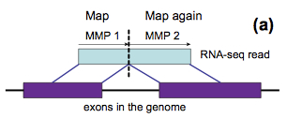
Gapped alignments
Start at the first base of sequence read
Find Maximal Mappable Prefix (MMP)
Repeat process using unmapped portion of read
STAR aligner

Slide 9
Storing alignment information
.sam (sequence alignment/map)
.bam (binary alignment/map)
HISAT2, STAR, Tophat2, bowtie, (blast)
Single .sam file entry:
M01478:116:000000000-AB84U:1:2101:18669:27082 409 Chromosome_8.1 36 0 148M * 0 0 TGTGGAAGTCG
TCAAGGGCTGTCGCTGAATTCTTGAAGTTTTCAGCCGGGTACCACGTGTCGTCTGGATCACATCCTTGCCATGCGACCTGGTATTGCAATGTCTTACTCCGGCCAAATAATCGGGACGCT
AAAACTTTATCGACCAC HHHHHGGGGGHHHGHGHHF@BBDHHHHHHHHHGHG3HGHHGHGECFDHHHHHEHHGGGGGGGHHHHHHHHHHHHGGHGHHGGGGGGFGHHHFHEHHGGHH
HHHHHHGGGGGGHHHHHHGGGGGGEEFGGGGGGGFGFAABCBFBBAAA AS:i:0 XN:i:0 XM:i:0 XO:i:0 X G:i:0 NM:i:0 MD:Z:4GC143 YT:Z:UU NH:i:11 CC:Z:Chromosome_8.2 CP:i:6379007 HI:i:0

Slide 10
.sam fields
I8MVR:53:837 0 17_dna:chromosome 14090858 255 21M * 0 0 TAACTACGAATACCTGTCGAT **%-**,00%-*-%---*-*- NM:i:7 XX:Z:C5T3C2T2CT2C XM:Z:h..H......h.H...x...h XR:Z:CT XG:Z:CT

Slide 11
.sam (bitwise) flags
Decimal Description
1 template having multiple segments in sequencing
2 each segment properly aligned according to the aligner
4 segment unmapped
8 next segment in the template unmapped
16 SEQ being reverse complemented
32 SEQ of the next segment in the template being reversed
64 the first segment in the template
128 the last segment in the template
256 secondary alignment
512 not passing quality controls
1024 PCR or optical duplicate
2048 supplementary alignment
1
2
1+2
4
1+4
2+4
1+2+4
8
1+8
2+8
1+2+8
4+8
1+4+8
2+4+8
1+2+4+8
…etc.

Slide 12
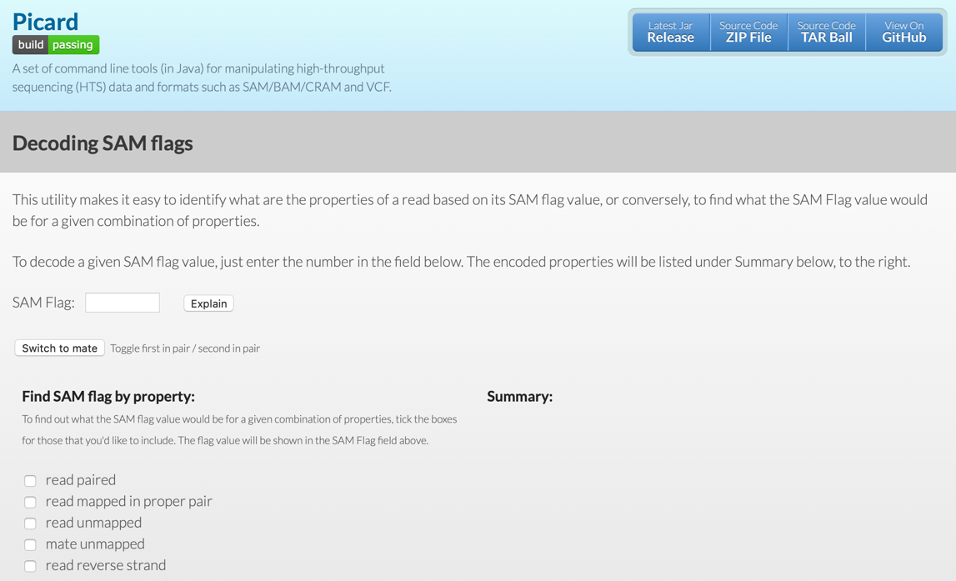
.sam flag decoded
M01478:116:000000000-AB84U:1:2101:18669:27082 409 Chromosome_8.1 36 0 148M * 0 0 TGTGGAAGTCGTCAAGGGCTGTCGCTGAATTCTTGAAGTTTTCAGCCGGGTACCACGTGTCGTCTGGATCACATCC
TTGCCATGCGACCTGGTATTGCAATGTCTTACTCCGGCCAAATAATCGGGACGCTAAAACTTTATCGACCAC HHHHHGGGGGHHHGHG
HHF@BBDHHHHHHHHHGHG3HGHHGHGECFDHHHHHEHHGGGGGGGHHHHHHHHHHHHGGHGHHGGGGGGFGHHHFHEHHGGHHHHHHHHGGGGGGHHHHHHGGGGGGEEFGGGGGGGFGFAABCBFBBAAA AS:i:0 XN:i:0 XM:i:0 XO:i:0 X
G:i:0 NM:i:0 MD:Z:4GC143 YT:Z:UU NH:i:11 CC:Z:Chromosome_8.2 CP:i:6379007 HI:i:0
409 = 1 + 8 + 16 + 128 + 256
read paired; mate unmapped; read reverse strand; second in pair; not primary alignment

Slide 13
Concise Idiosyncratic Gapped Alignment Report (CIGAR)
A00609:213:HWHHJDSXY:3:1660:27823:24032 163 chr1 25791 1 75M1I74M = 25929 288 CAACCAGGTAACTACCGTAACGCCGGCTAGGCCGGCCACCACCCGTTTTACGGGGCGGAGAGTTTGTTACTGGAAGGGGGCCTTCAGGTCTGCCATTTTTCGGTGGCTCGCCCTCTGGACCCGGCCGCCGGGGGATTCCTTCGGCTCACG FFFFFFFFFFFFFFFFFFFFFFFFFFFF,FFFFFFFFFFFFFFFFFFFFFFFFFFFFFFFFFFFFFFFFFFFFFFFF:FFFFFFFFFFFFFFFFFFF,FF,FFFFFFFFFFFF:FFFFFFFFFFFFFFFFFFFF:FFFFFFFFFFFFFFF MD:Z:99A49 RG:Z:Br127.11 XG:i:1NM:i:2 XM:i:1 XN:i:0 XO:i:1 AS:i:285 XS:i:295 YS:i:300 YT:Z:CP
CIGAR string

Slide 14
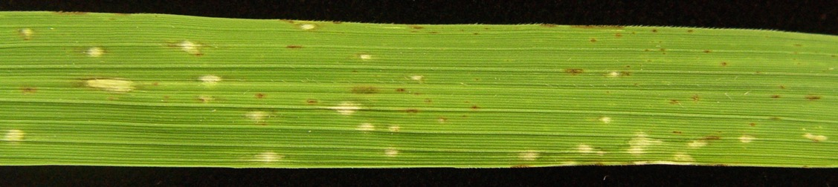
Today’s Goal
Perform a reference-based assembly of transcripts from the fungus Magnaporthe oryzae using reads from fungus grown in culture versus in planta
Identify new genes
Perform differential expression analysis
Identify genetic variants (70-15 vs. FR13)
70-15
FR13

Slide 15
Datasets
RNASeq reads (.fastq.gz files):
mRNA from Magnaporthe oryzae grown in liquid culture (3 replicates)
mRNA from M. oryzae growing in rice plants (3 reps) Reference genome:
M. oryzae genome sequence (.fasta file)
Genome annotation:
List of known genes and their genomic coordinates (.gtf file)

Slide 16
Map Reads to the Indexed Reference Genome
Resequencing studies (DNA)
Guiding genome assembly
Variant discovery (SNPs, indels)
Structural variation
Insertions, deletions, duplications, inversions, translocations
RNA-Seq, ChIPseq, MeDIPseq, bisulfite sequencing

Slide 17
Module 6 Overview
Create a searchable index of the genome sequence (hisat2-build)
Align RNAseq reads with the index (hisat2)
Compare mappings with known gene locations (.gtf file → stringtie)
Dataset 1
?
?
reference genome

Slide 18
Collate transcript alignment info
Merge transcript assemblies (stringtie --merge) → merged.gtf
Dataset 3
Dataset 2
Dataset 1
new gene
reference genome

Slide 19
Comparing transcript abundance
Identify genes that are differentially expressed in liquid-grown mycelium versus in planta
Previously known genes & novel ones
alignment files (.bam) + merged.gtf → cuffdiff
Count transcripts (reads/fragments per kilobase per million mapped reads, RPKM/FPKM)
Compare transcript abundance between experimental groups
Liquid culture (3 reps) vs. in planta (3 reps)
Use command line to interrogate diff_out files

Slide 20
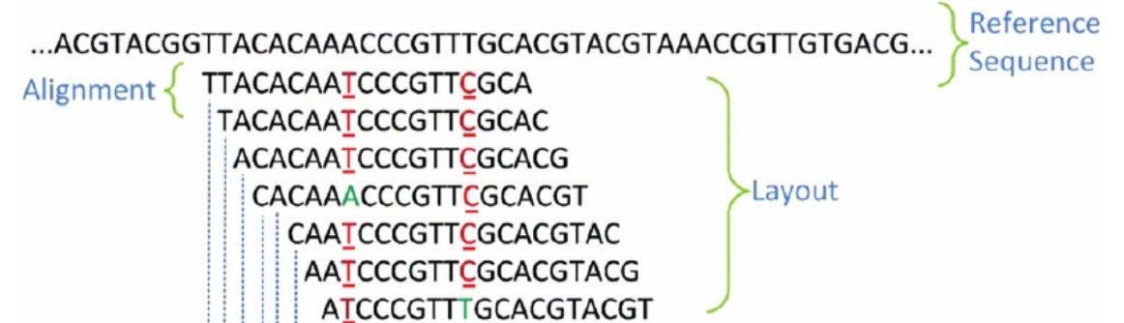
Module 7 Overview
Align RNAseq reads from P. oryzae strain FR13 with the 70-15 reference genome
Identify positions where there are nucleotide differences (SNPs)/insertions/deletions (indels)
Call genotypes based on read depths (#ref v. #alt.)
Interrogate VCF files with command line
(70-15)
FR13 RNAseq Reads

Slide 21
.sam/.bam File Format
.bam/.sam file contains all of the information required to identify SNPs
The variant calls can be extracted from the .bam file
CIGAR
A00821:50:HKYGKDSXX:1:1452:12599:31172 99 chr5 10218 44 150M = 10360 291 ATCATTGGCCCGGAATGGCGCCGGCATCTGGTGACCTCTGAAGAATGTT
CTTCCGGATTACGCCCACAAACTTGAGATCCGTGGGCGGCCTGAACATTATTCTGCAGAATCACGCACACGAATTTCAGATGGCATTTTTCATGCATTATC FFFFFFFFFFFFFF,FFFFF
FFFFFFFFFFFFFFFFFFFFFFFFFFF:FFFFFFFFFFFFFFFFF:F:FFFFFFFFFFFFFFFFFFFFFFFFFFFFFFFFFFFF:FFFFFFFFFFFFFFF:FFFFFFFFFFFFFFFFFFFFF
:FFFFFFF MD:Z:138C11 RG:Z:ATCC64557 XG:i:0 NM:i:1 XM:i:1 XN:i:0 XO:i:0 AS:i:293 YS:i:283 YT:Z:CP

Slide 22
Understanding VCF Files
VCF – variant call format
:##fileformat=VCFv4.1
##samtoolsVersion=0.1.18 (r982:295)
##INFO=<ID=DP,Number=1,Type=Integer,Description="Raw read depth">
##INFO=<ID=DP4,Number=4,Type=Integer,Description="# high-quality ref-forward bases, ref-reverse, alt-forward and alt-reverse bases">
##INFO=<ID=MQ,Number=1,Type=Integer,Description="Root-mean-square mapping quality of covering reads">
##INFO=<ID=FQ,Number=1,Type=Float,Description="Phred probability of all samples being the same">
##INFO=<ID=AF1,Number=1,Type=Float,Description="Max-likelihood estimate of the first ALT allele frequency (assuming HWE)">
##INFO=<ID=AC1,Number=1,Type=Float,Description="Max-likelihood estimate of the first ALT allele count (no HWE assumption)">
##INFO=<ID=INDEL,Number=0,Type=Flag,Description="Indicates that the variant is an INDEL.">
##INFO=<ID=VDB,Number=1,Type=Float,Description="Variant Distance Bias (v2) for filtering splice-site artefacts in RNA-seq data. Note: this version may be broken.">
##FORMAT=<ID=GT,Number=1,Type=String,Description="Genotype">
##FORMAT=<ID=GQ,Number=1,Type=Integer,Description="Genotype Quality">
##FORMAT=<ID=PL,Number=G,Type=Integer,Description="List of Phred-scaled genotype likelihoods">
#CHROM POS ID REF ALT QUAL FILTER INFO FORMAT
chr5 9082 . C G 5978.01 . AC=1;AF=1.00;AN=1;DP=162;FS=0.000;MLEAC=1;MLEAF=1.00;MQ=44.00;QD=33.27;SOR=0.693 GT:AD:DP:GQ:PL 1:0,162:162:99:5988,0
chr5 9185 . T C 6304.01 . AC=1;AF=1.00;AN=1;DP=142;FS=0.000;MLEAC=1;MLEAF=1.00;MQ=44.00;QD=27.76;SOR=0.780 GT:AD:DP:GQ:PL 1:0,142:142:99:6314,0
chr5 9270 . T C 6104.01 . AC=1;AF=1.00;AN=1;DP=159;FS=0.000;MLEAC=1;MLEAF=1.00;MQ=44.00;QD=29.09;SOR=0.784 GT:AD:DP:GQ:PL 1:0,159:159:99:6114,0
chr5 9525 . T G 6404.01 . AC=1;AF=1.00;AN=1;DP=172;FS=0.000;MLEAC=1;MLEAF=1.00;MQ=44.00;QD=26.08;SOR=0.716 GT:AD:DP:GQ:PL 1:0,172:172:99:6414,0
chr5 9590 . A G 6016.01 . AC=1;AF=1.00;AN=1;DP=160;FS=0.000;MLEAC=1;MLEAF=1.00;MQ=44.00;QD=33.85;SOR=0.881 GT:AD:DP:GQ:PL 1:0,160:160:99:6026,0
chr5 9662 . C T 6576.01 . AC=1;AF=1.00;AN=1;DP=175;FS=0.000;MLEAC=1;MLEAF=1.00;MQ=43.98;QD=27.08;SOR=0.800 GT:AD:DP:GQ:PL 1:0,175:175:99:6586,0
GT:AD:DP:GQ:PL 1:0,162:162:99:5988,0

Slide 23
Schema for Today’s Activities
RNA -Seq workflow
Variant discovery
hisat2-build
1. Index the reference genome
.ht2 files
hisat2
.bam
1. Identify sequence variants
2. Align reads to the reference
stringtie
3. Assemble transcripts
.gtf files
.vcf
stringtie --merge
4. Merge assemblies
merged.gtf
IGV
cuffdiff
4. Count reads & compare expression levels
diff_out
maker-annotations.gff3

