Slide 1
Lecture 2
Bioinfo
Sequence Data :
Acquisition and Processing

Slide 2
Key Concepts
Bioinfo
Relationship between sequence reads, DNA fragments and original DNA samples
DNA sequences can be acquired by different methods
The principle of flow cycle sequencing
Fastq data format
PHRED quality values
Sequence trimming – why and how

Slide 3
The Two Main Flavors of NGS
Bioinfo
Sequencing by Synthesis (SBS)
Read the sequence of nucleotides as DNA is synthesized in vitro
https://www.khanacademy.org
Single molecule sequencing
SBS (PacBio)
Read nucleotides directly (Nanopore)
https://www.nature.com/articles/550285a

Slide 4
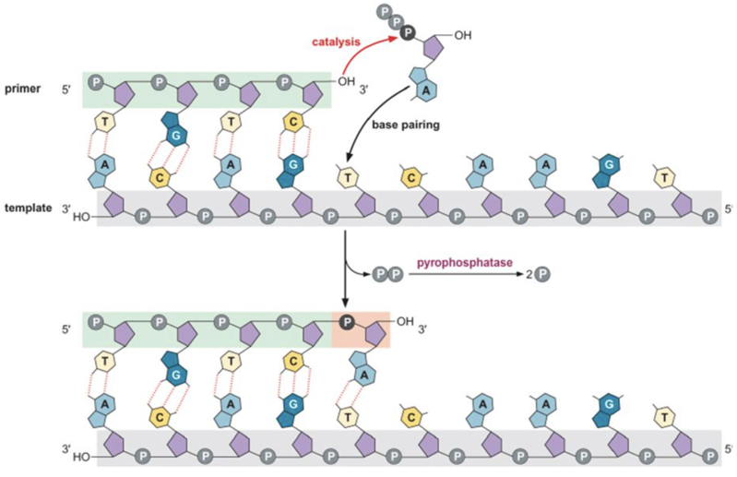
DNA synthesis – ingredients
Bioinfo
DNA polymerase
Salt, Mg²⁺, pH
Template DNA
Primer (3’-OH)
DNA polymerase
Nucleotides
dATP
dCTP
dGTP
dTTP
+ H⁺

Slide 5
Mechanics of Illumina Sequencing
Bioinfo
Isolate and purify DNA
Break DNA into pieces small enough to amplify by PCR (< 1500 bp)
Physical means (shearing)
Enyzmatically (nucleases, transposases)
primer
primer
?????
?????
Sequence?

Slide 6
Sequencing Adaptors
Bioinfo
Add double stranded DNA fragments with known sequence on to each DNA fragment
Adaptors
Ligation (T4 DNA ligase)
Transposition (transposase)
Barcodes – allow multiple samples to be sequenced in parallel
adaptor
adaptor
Flow cell/PCR
primer
primer
Flow cell/PCR
barcode
barcode
DNA fragment

Slide 7
Flow Cell Attachment
Bioinfo
Lawn of primers covalently attached to flow cell surface
FLOW CELL PLATE

Slide 8
Illumina Sequencing By Synthesis
Bioinfo
https://www.youtube.com/watch?v=fCd6B5HRaZ8

Slide 9
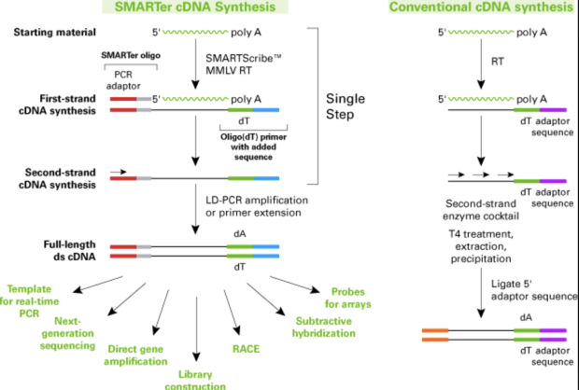
Sequencing RNA
Bioinfo
Convert RNA to DNA
Use DNA primers
Oligo dT
Random nonamers
Specific gene primers
Reverse transcriptase enzyme
Sequence the resulting DNA fragments

Slide 10
Sequence Data Formats
Bioinfo
Fasta format (.fasta, .fa, .mfa)
>Sequence1
CAATCATAGAGACAGCTGTTGTATCGTTACGTCATTCATGCAAGACCGCATTTAACGGCCAAGGCATTTCGCTACCTTAG
>Sequence2
ACCAGGAAGGTGGCCGACGCCAGCCGCTGATGCCACTCCACCCGCCGCGCACCGAGTCCAGGAGCGCGGACAAGGGGATT
>Sequence3
AATCCCCTTGTCCGCGCTCCTGGACTCGGTGCGCGGCGGGTGGAGTGGCATCAGCGGCTGGCGTCGGCCACCTTCCTGGT
>Sequence4
CTAAGGTAGCGAAATGCCTTGGCCGTTAAATGCGGTCTTGCATGAATGACGTAACGATACAACAGCTGTCTCTATGATTG

Slide 11
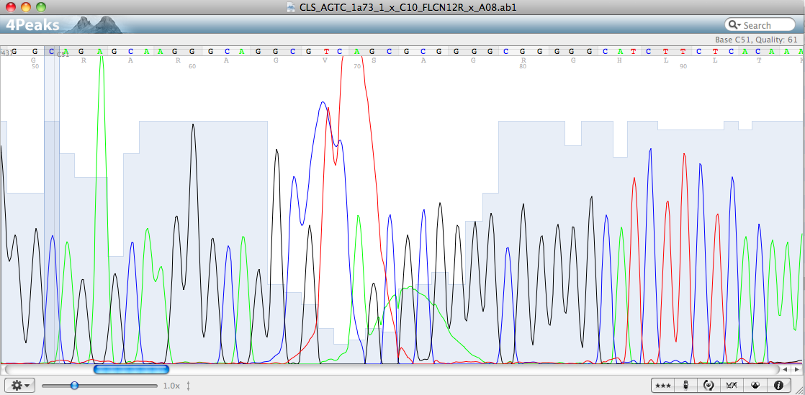
Sequence Quality
Bioinfo
Some sequence calls have better quality than others

Slide 12
Phred Quality Values
Bioinfo
Phil’s read editor (Green, 1998)
Q = -10 log₁₀P (Q = quality; P = probability of erroneous base call)
Phred quality score | Probability of incorrect call | Base call accuracy
10 | 1 in 10 | 90%
20 | 1 in 100 | 99%
30 | 1 in 1000 | 99.9%
40 | 1 in 10000 | 99.99%
50 | 1 in 100000 | 99.999%
Q = 20: Probability of error = 10^{(-20/10)} = 0.01

Slide 13
Quality Files from “Previous-Gen” Sequencing
Bioinfo
>contig00016 length=237 numreads=9
20 10 64 14 64 19 64 14 19 64 64 14 64 64 64 64 21 37 64 64 64 64 64 64 41 12 64 64 64 64 64 32 64 64 64 64 64 64 64 13 37 64 64 64 64 64 64 64 64 64 64 64 64 64 64 64 64 45 64 64 64 64 64 64 29 64 64 64 64 64 20 64 64 64 64 64 39 64 64 64 64 64 64 64 64 64 64 64 20 64 64 64 64 64 64 64 64 64 64 64 40 64 64 64 64 64 20 64 64 64 64 64 20 64 64 64 64 64 23 64 64 64 64 64 64 64 64 64 64 64 39 64 64 64 64 64 64 16 64 64 64 64 64 64 51 64 64 64 64 64 64 64 64 64 64 64 33 64 64 64 64 64 64 41 64 64 64 64 64 64 64 64 64 64 64 64 29 64 64 64 64 64 64 64 64 64 64 64 64 64 64 64 64 39 64 64 64 64 64 64 48 64 64 64 64 64 64 64 48 64 64 64 50 64 64 64 64 64 64 64 32 64 64 34 64 64 33 64 64 64 48 64 64 64 64
>contig00017 length=161 numreads=9
64 64 64 18 17 64 64 43 20 64 24 41 64 64 30 2 53 64 64 64 64 35 64 64 64 64 64 12 64 64 64 64 31 64 64 28 64 16 64 64 64 64 64 41 64 64 17 64 64 34 25 64 30 64 64 64 64 64 64 64 64 20 64 64 64 64 47 64 64 64 40 64 61 64 64 34 64 64 64 64 64 22 64 64 64 64 64 64 64 64 64 64 64 64 64 58 64 64 64 64 64 64 64 64 64 64 64 58 64 64 64 64 64 64 64 64 64 64 37 43 64 64 52 64 64 64 64 64 64 64 64 64 64 64 60 64 64 49 64 64 64 64 64 64 64 64 20 29 64 64 64 64 64 64 51 64 64 64 64 64 64 64 64 64 64 64 33 64 64 64 64 64 64 41 64 64 64 64 64 64 64 64 64 64 64 64 29 64 64 64 64 64 64 64 64 64 64 64 64 64 64 64 64 39 64 64 64 64 64 64 48 64 64 64 64 64 64 64 48 64 64 64 50 64 64 64 64 64 64 64 32 64 64 34 64 64 33 64 64 64 48 64 64 64 64 17 24 21 13 21 21 3
.qual files follow .fasta format convention
Each nucleotide in the .fasta file has a corresponding Phred score
Problem!
Storing quality values take up too much disk space (2-3 characters for every nucleotide)

Slide 14
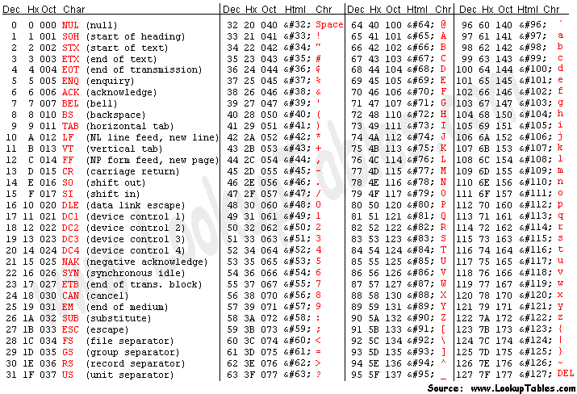
Enter the ASCII “Scale”
Bioinfo
ASCI values of 0 to 32 are un-printable” control” characters
E.g. 13 represents carriage return
First printable character is (!)
has the value 33
We use this to represent Phred value 0
Dec Hx Oct Html Chr
33 20 040 &#33; !

Slide 15
The .fastq File Format (also .fq, .fsq)
Bioinfo
Incorporates sequence calls and quality values into a single file
Each record contains the read ID, sequence, “spacer” and quality
@E00440:461:H3VM3CCX2:2:1101:12865:1766 2:N:0:CGTACT+TCTTAC
NTATAAATATAGTGCCAATGTCTTCTCATGTGAGTGATCCCGCCGGCAAGCCTGACTTGAGAAATCAAATTGAAAGAGACAGAGAGAAGGAGAGAAAGGGAAATTGCCTCAACACTCATCCTGTCTGTTATACATATCTGCCGCTGCTGA
+
#AAFFJJJJJJJJJJJJJJJJJJJJJJJJJJJJJJJJJJJJJJJJJJJJJJJJJJJJJJJJJJJJJJJJJJJJJJJJJFJJJJJJ-FJ-AJJ-JFJJFJJJJFJFF7-AF---7FJ
FJAFJF<AFA--AA<--7--77FF-))-)--)<-

Slide 16
Illumina Sequence Headers
Bioinfo
@E00440:461:H3VM3CCX2:2:1101:11667:1766 1:N:0:TAGGCATG+TACTCCTT
GACTGAGAGGAGTTATAGGTAATCCATCGCTTGATTTTGCTAGTCGTGACATAGGAAAGTTCCTAGCCACCCGTTTTGTTATGGGTTTCAAATCCAGAGGAATCATCACAATGAGCGAATCGTTCATACAATCCTTAGAAACGCCTTTTT
+
AAFFFJJJJJJJJJJJJJJJJJJJJJJJJJJJJJJJJJJJJJJJJJJJJJJJJJJJJJJJJFJJJJJJJJJJJJJJJJJJJJJJJJJJJJJ-FJJJJJJJJJJJJJJJJJJJJJJ<F-<--AF-<<FJF-AF-7-<<--<<F-<7)7FFJ
Machine name
Run number
Flowcell ID
Flowcell lane
Tile in flowcell
X-coordinate in tile
Y-coordinate in tile
Member of read pair (1/2)
Read filtered? (Y/N)
Control bits on (0 or even number)
Barcode(s) when multiplexed

Slide 17
Illumina sequence file naming convention
Bioinfo
SampleName_S1_L001_R1_001.fastq.gz
S1 - sample number (as listed in sample sheet)
L001 - lane number
always L001 for MiSeq; L001 – L008 for HiSeq
R1 - read number
R1 (forward) or R2 (reverse)
001 – usually has the same value
5’ GGGATGCCGTAGTGGGATGAAAATGATTGACGATGCCCGGTGTAGGACGA 3’
3’ CCCTACGGCATCACCCTACTTTTACTAACTGCTACGGGCCACATCCTGCT 5’
R1 read: GGGATGCCGTAGTGGGATGAAAATGATTGACGATGCCCGG
ATCACCCTACTTTTACTAACTGCTACGGGCCACATCCTGCT R2 read
R2 read: TCGTCCTACACCGGGCATCGTCAATCATTTTCATCCCACT
Notes:
It’s always important to consider the relationship between sequence reads and the original fragment that was sequenced.
Do the R1 and R2 reads overlap?

Slide 18
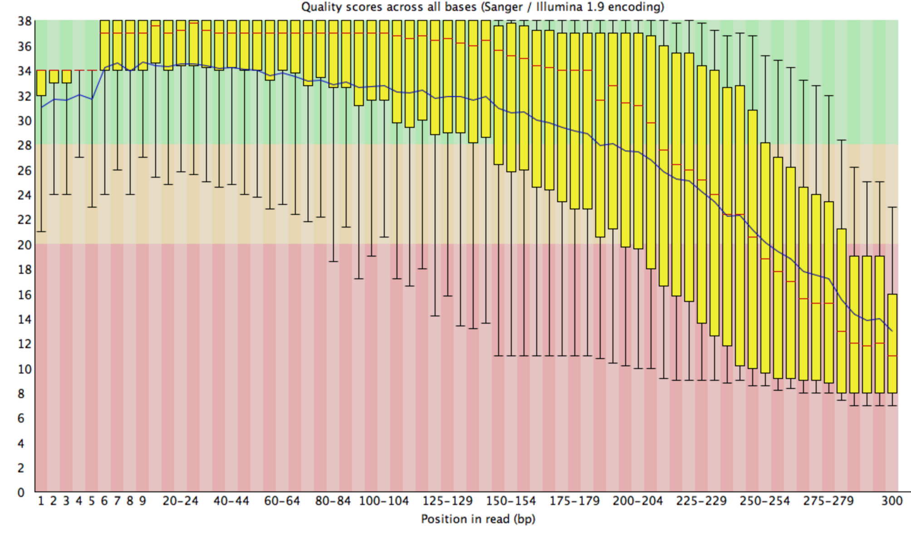
Assessing Sequence Quality
Bioinfo
FASTQC
How many reads?
Read lengths
Read quality distribution
Flow cell issues
GC content
Overrepresented sequences
Adaptor contamination

Slide 19
Quality Trimming
Bioinfo
Trimmomatic
Uses a sliding window approach
Calculates average Phred score in a window of a specified size
Slides the window along the sequence to the next nucleotide
Trims the sequence read when the average score drops below a specified threshold:
SLIDINGWINDOW:20:20
Trim the sequence when the average Phred score in a 20 nt window drops below 20

Slide 20
Adaptor Trimming…
Bioinfo
Trimmomatic
150 bp paired-end reads:
250 bp DNA fragment
125 bp DNA fragment
500 bp DNA fragment
adaptor
adaptor
R1
R1
R1
R2
R2
R2
Adapter contamination is common
Excessive adaptor contamination causes poor sequence assembly
We must search for and remove adaptor sequences

Slide 21
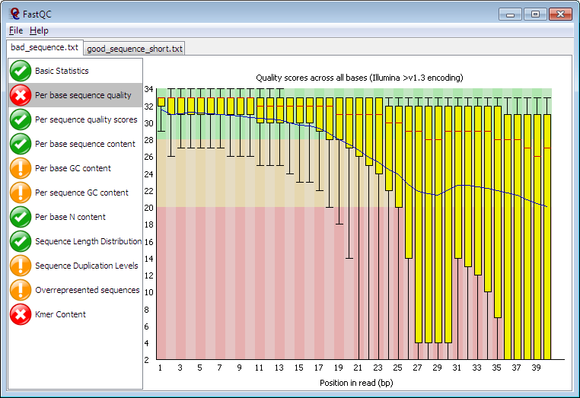
This morning’s Exercises
Bioinfo
Spend some time practicing your UNIX skills to interrogate raw sequence datasets
Use command line tools to explore/count sequence records
Examine sequence files and use ASCI tables to decode a few quality values (identify upper and lower thresholds)
Assess quality using FastQC
Trim poor quality/adaptor sequences (Trimmomatic)
Re-assess quality using FastQC

Slide 22
Tips For a Productive Time
Bioinfo
Practice using tab-completion wherever possible
Make sure you execute all of the steps preceded by check boxes
Fill-in the check boxes after you have (successfully) completed each command
Do not skip over the text between the check boxes
It provides information designed to aid your understanding of what you are doing
ASK QUESTIONS

