Slide 1
Lecture 3
Genome (Transcriptome) Assembly

Slide 2
Key Concepts
Why sequence assembly is needed
Relationship between sequence reads, DNA fragments and original DNA samples
The use of paired-end reads for error correction and scaffolding
Principles of genome assembly
Overlap layout consensus
De Bruijn graphs
Reference-based assembly
Metrics for assessing assembly quality

Slide 3
Goal of Genome Assembly
To reconstruct long DNA/RNA sequences from short sequence reads
Do novo genome sequencing
Metagenomic sequencing
RNA sequencing for gene discovery
But not strictly necessary for
Transcript quantification
Variant discovery

Slide 4
Shear the DNA Sample
Physical force (shearing, sonication)
Enzymatically (nucleases, transposases)
Tens to millions of copies of each chromosome/transcript in the sample
Shearing is (quasi-)random
Original molecules are represented by a population of overlapping sub-fragments
chromosome/transcript

Slide 5
Sequence both Ends of Each Fragment
Paired-ends
Paired-ends
Remember, the F and R sequences are read in two distinct phases:
Amplify F strand, read F strand sequence, read F barcode
Synthesize R strand, cleave off F strand
Amplify R strand, read R barcode, read R strand sequence

Slide 6
Collect the Sequence Read Data

Slide 7
Align Overlapping Reads to Form Contigs
Contig: a stretch of contiguous sequence information that contains no missing nucleotides

Slide 8
Paired ends allow contigs to be linked together to make scaffolds
captured gaps
scaffold
In the sequence file, gaps
are represented with Ns
…AGTCCCCTGGGAGATACGNNNNNNNNNNNNNNGATGATCAGCCGCATGAGCAG…

Slide 9
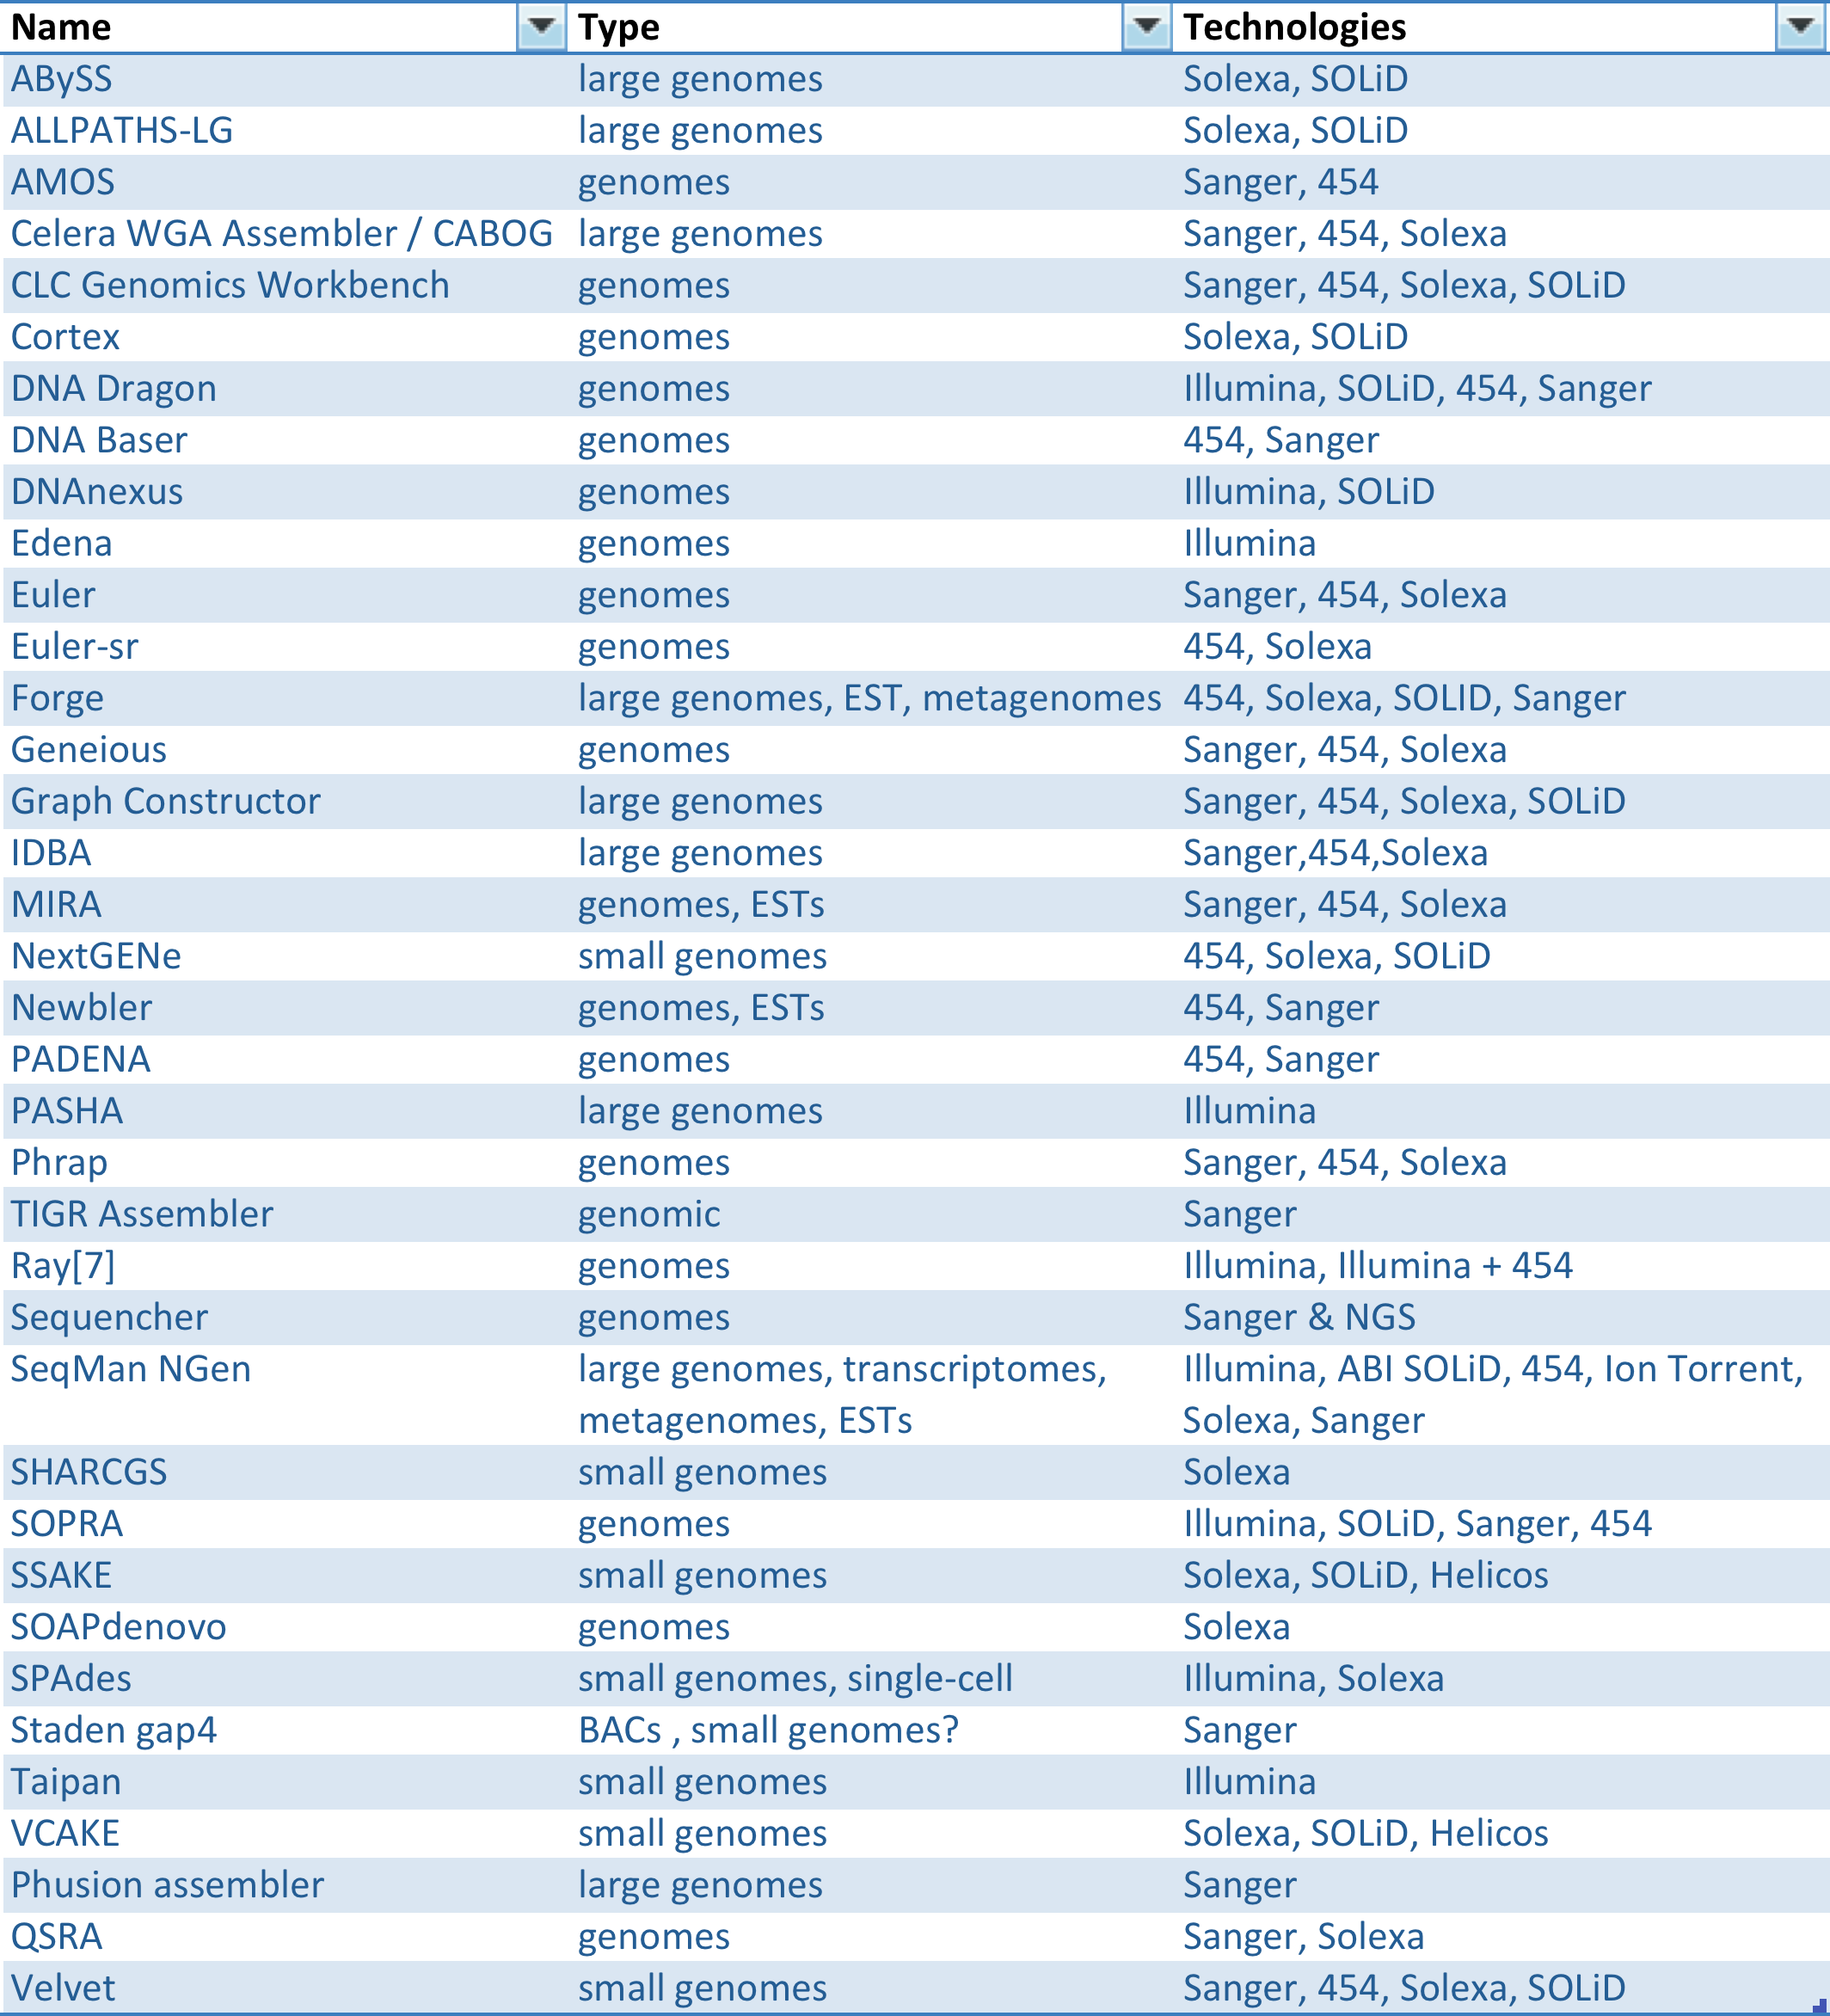
Genome Assemblers Galore

Slide 10
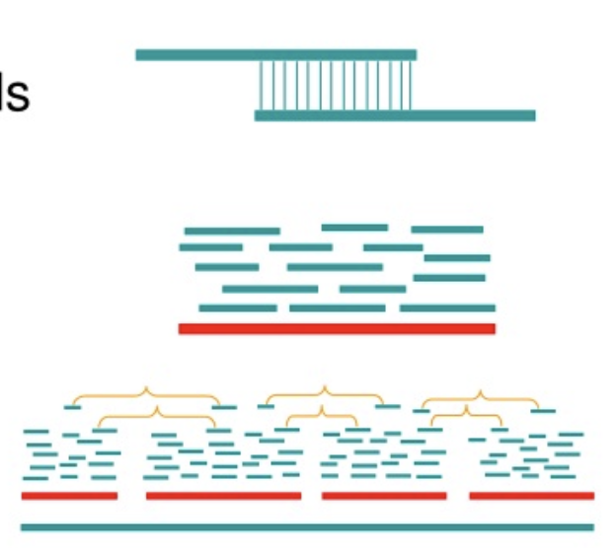
De Novo Genome Assembly
Two major strategies:
Overlap Layout Consensus
Long reads ≥ 250 bp
Pairwise comparison of reads to identify overlaps
Eulerian paths/de Bruin graphs
Short reads ≤ 250 bp
Cataloging of subsequences (k-mers)
Reconstruction of paths through the k-mers
https://www.slideserve.com/nmaddox/csci2950-c-lecture-3-dna-sequencing-and-fragment-assembly-powerpoint-ppt-presentation#google_vignette
Overlap Layout Consensus
https://en.wikipedia.org/wiki/De_Bruijn_graph#/media/File:De_Bruijn_binary_graph.svg
Debruin Graphs

Slide 11

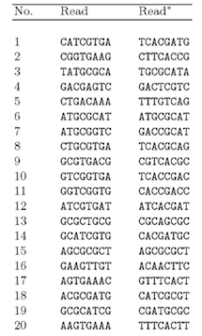
Overlap Layout Consensus From: Computational Genome Analysis: An Introduction; Deonier et al.
Fragment DNA
Sequence fragments
Compare all sequence reads in pairwise fashion
Calculate number of overlapping bases
Build a matrix

Slide 12
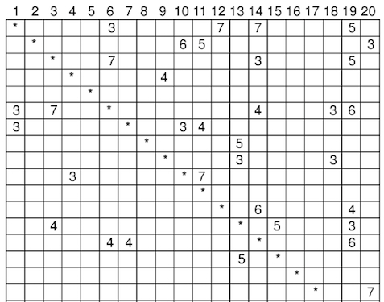

Overlap Matrix
1
2
3
4
5
6
7
8
9
10
11
12
13
14
15
16
17
18
19
20

Slide 13
Determine Layout of Overlaps From: Computational Genome Analysis: An Introduction; Deonier et al.
Examine best overlaps
Determine their layout
14.
GCATCGTG
CATCGTGA
ATCGTGAT
20.
AAGTGAAA
1.
17.
AGTGAAAC
12.

Slide 14
Add “Weaker” Overlaps and Write Consensus Sequence
GACCGCAT
ATGCGCAT
GCATCGTG
CATCGTGA
ATCGTGAT
GCGCATCG
CGCAGCGC
Consensus:
GCGCATCGTGAT
From: Computational Genome Analysis: An Introduction; Deonier et al.

Slide 15
OLC is computationally expensive
20 reads requires (20 x 20) – 20 = 380 comparisons
What about a “small” assembly with 10 million reads?

Slide 16
De Bruin graphs
“A directed graph representing overlaps between sequences of symbols” (Wikipedia)
Visit each vertex once
Visit each edge once
Hamiltonian
path (hard)
Eulerian path
(“easy”)

Slide 17
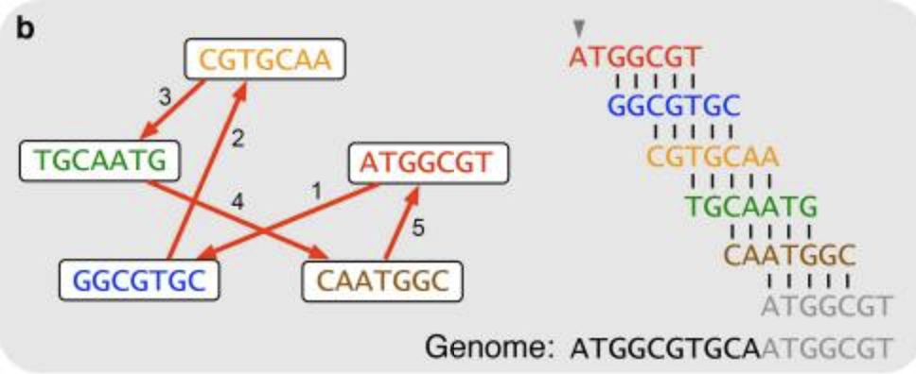
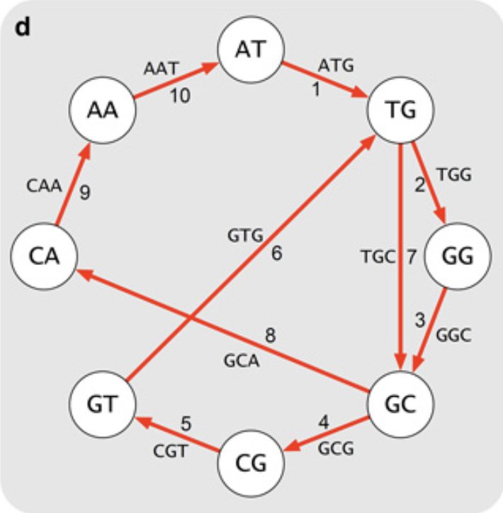
Eulerian Paths
5 x 7 nt reads
OLC
Break reads into all possible 3-mers
e.g. CGT, GTG, TGC, GCA, CAA, etc.
Place unique k-1 mers at nodes in a graph
e.g. CG, GT, GT, TG, TG, GC, GC, CA, CA, AA
nodes = CG, GT, TG, GC, CA, AA
Join nodes if they overlap by k-2 && the resulting edge forms a known k-mer
Visit all nodes using each edge only once

Slide 18
Eulerian Cycle with Repeats
Some k-mers may occur at higher frequencies
Probably repeated sequences in the genome
Allow repeated traversal of edges that form high abundance k-mers
From Compeau et al., Nature Biotech, 2011

Slide 19
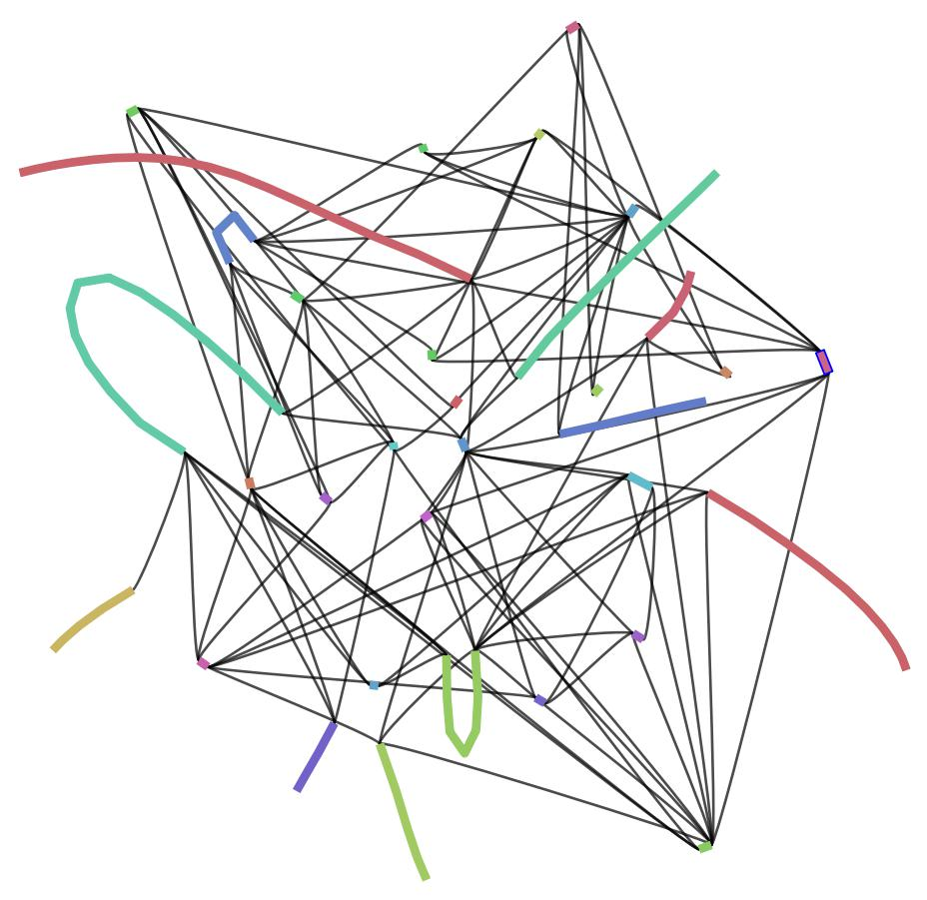
Unresolvable Repeats
k-mer length < repeat length
The order of flanking motifs will be unclear
Contigs will be terminated at unresolvable repeat boundaries
With k-mer = 12
First contig for above “sequence” will be:
“It was the best of times, it was the ”
But there are two possible paths forward…
Most assemblers will record potential connections in a graph to retain this information
This graph was visualized using Bandage

Slide 20
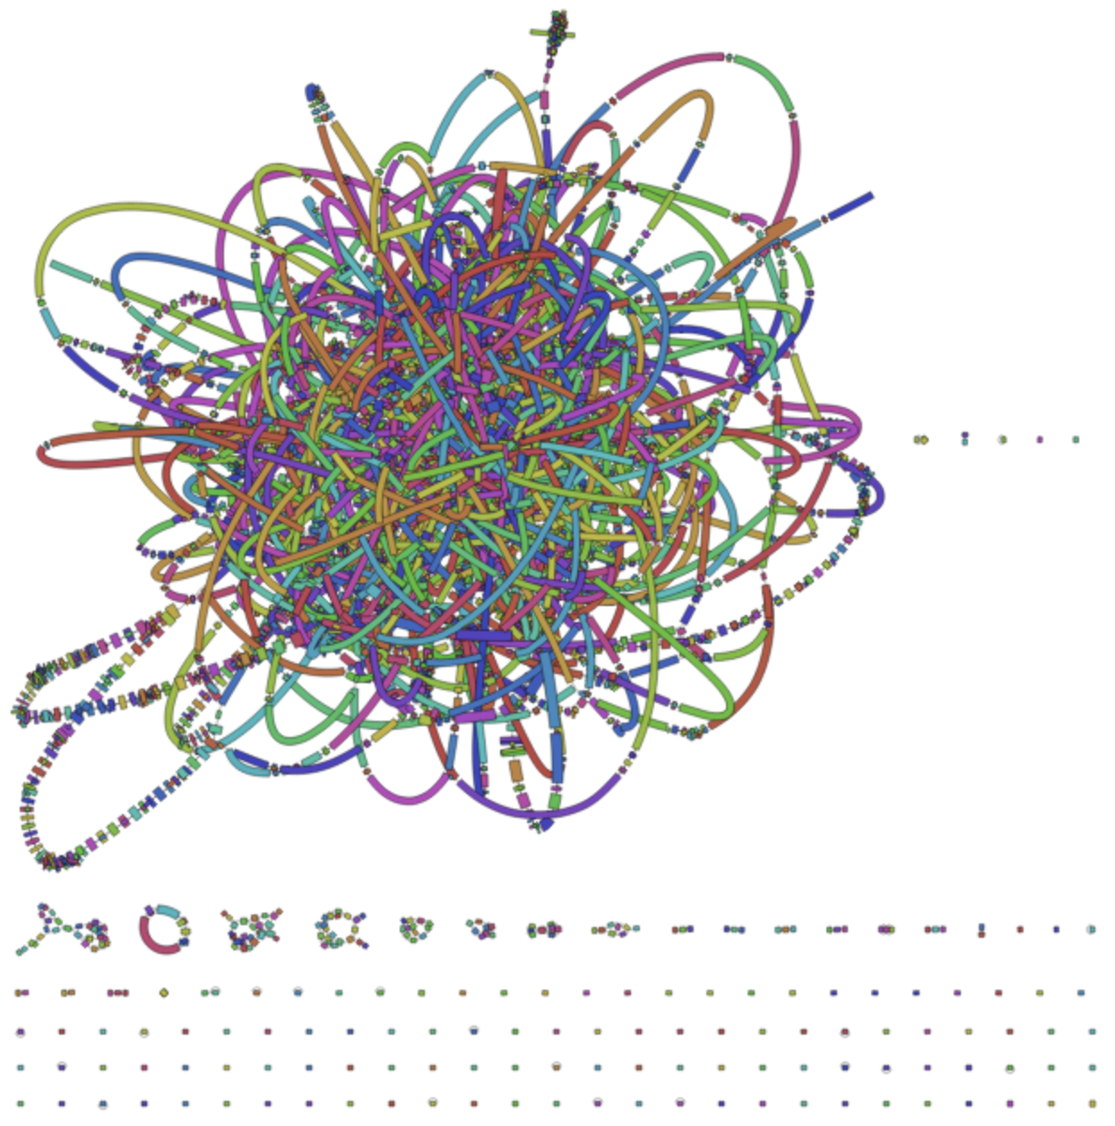
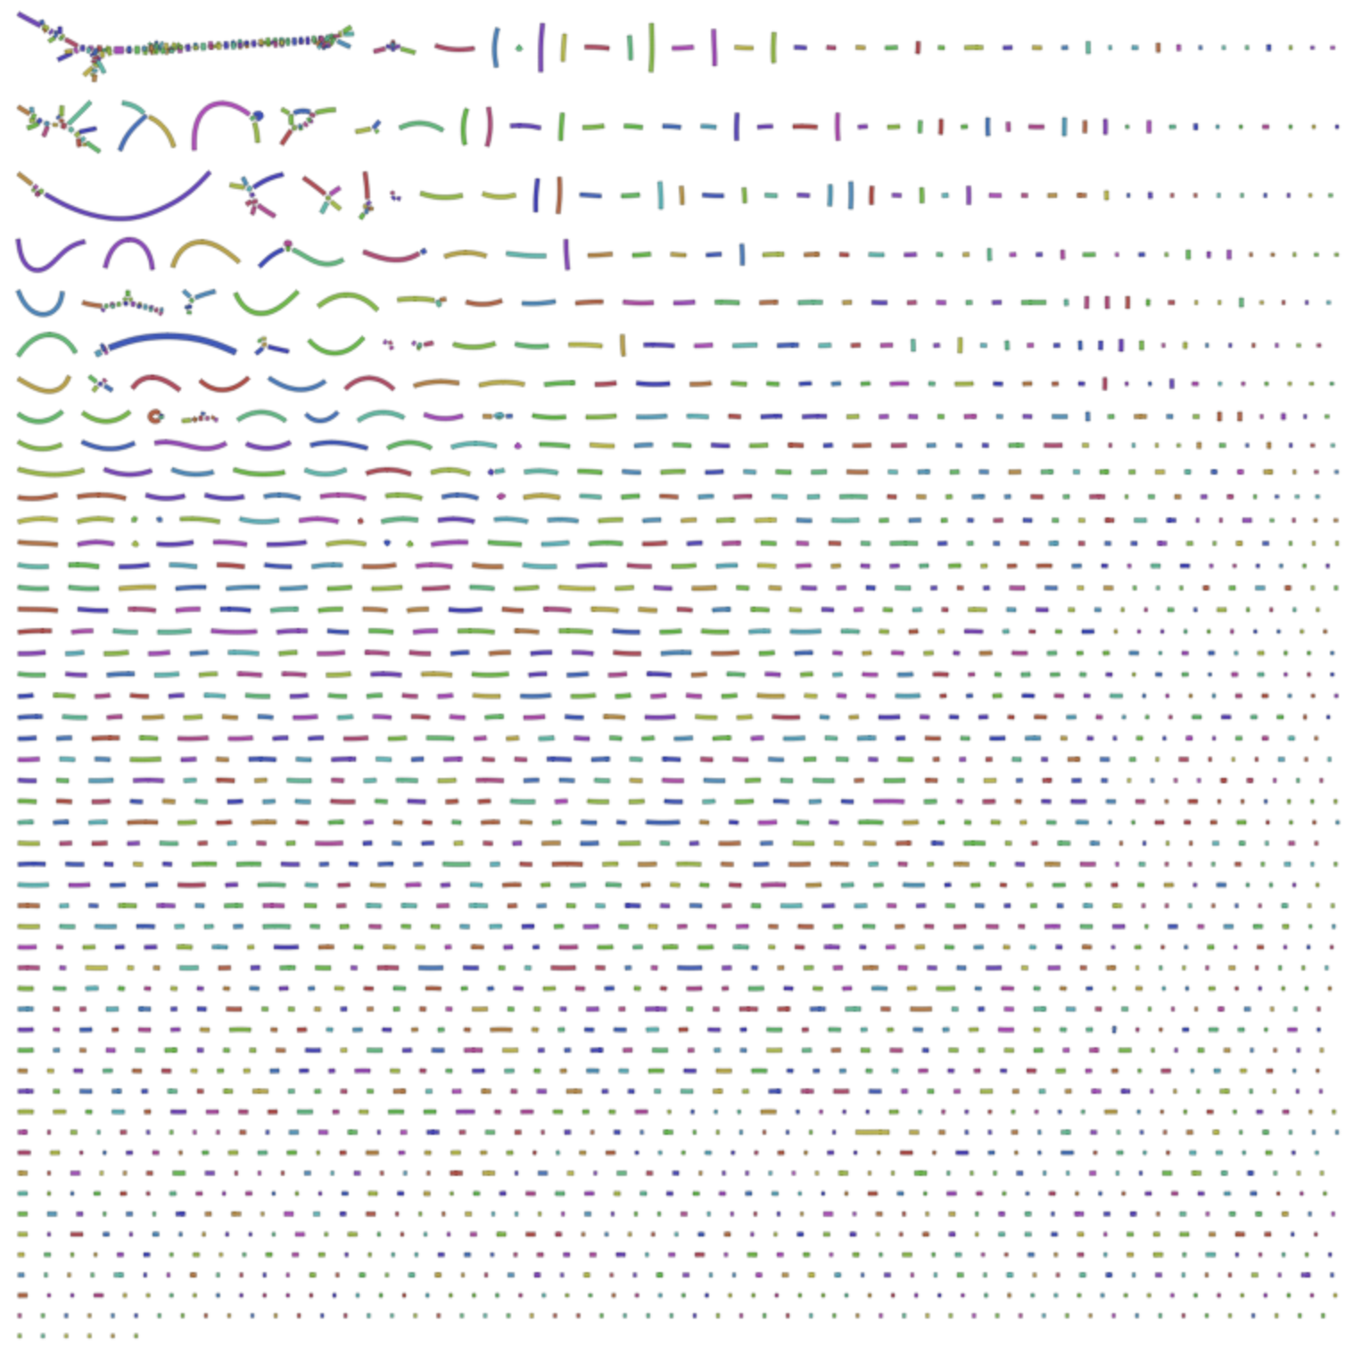
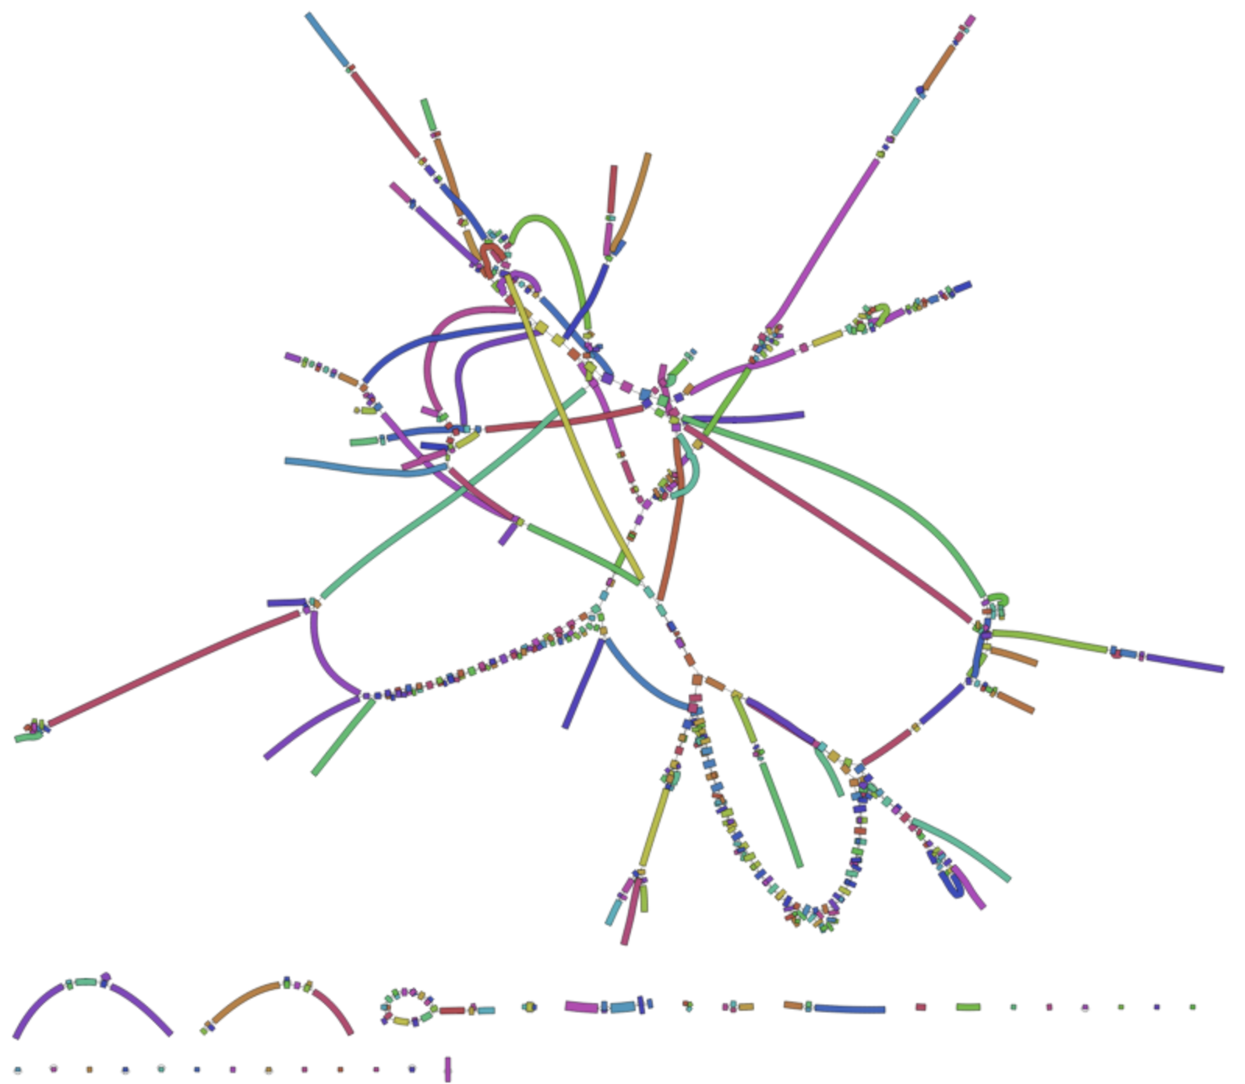
K-mer size
Must be shorter than read lengths
Too short → many spurious overlaps
Too long → fragmented assembly
K-mers contain sequencing errors
Bandage assembly graph
K = 51
K = 91
K = 71

Slide 21
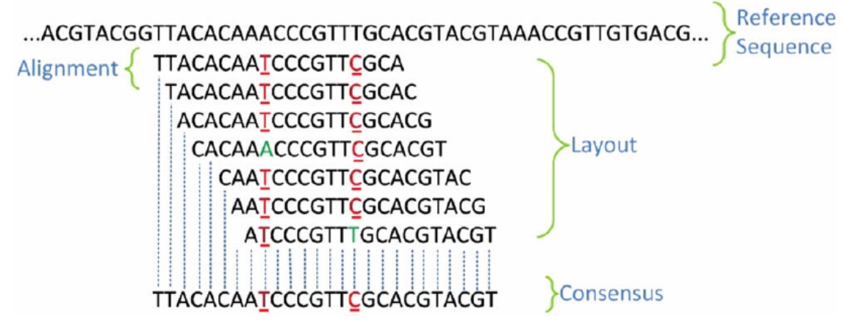
Reference-based genome assembly
Useful when a high-quality reference genome sequence is available
Align sequence reads with the reference
Examine the layout
Call a consensus sequence (helps eliminate errors)

Slide 22
Transcriptome Assembly
Alternative spliced transcripts
Alternative assembly paths
rnaSPAdes, Trinity, rna-Bloom, etc.
https://en.wikipedia.org/wiki/Alternative_splicing#/media/File:DNA_alternative_splicing.gif

Slide 23
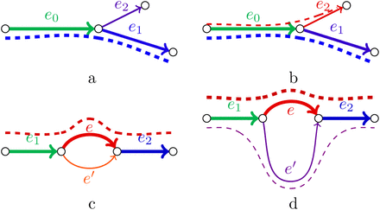
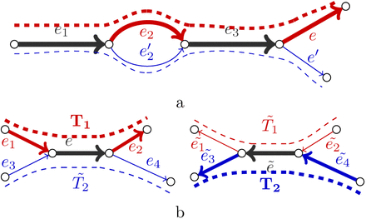
Transcriptome Assembly Using rnaSPAdes
https://doi.org/10.1093/gigascience/giz100
Adapts SPAdes genome assembler strategy:
Uses multiple k-mer sizes simultaneously
Constructs series of graphs across k values
Merges information across graphs
Applies transcript-specific graph simplification
Uses read support to infer transcript paths

Slide 24
This afternoon’s exercises
Inspect sequence data quality (FASTQC)
(Experts) trim poor quality data (trimmomatic)
Assemble a bacterial genome (velvet)
Run velvet using a range of different k-mer values (velvetoptimiser)
Examine and interpret assembly metrics (command line)
(Experts) Find precise k-mer length giving optimal assembly
Explore the assembly graph using a browsable graphical interface – Bandage
Assemble transcriptomic data from tall fescue grass using rnaSPAdes

