Slide 1
BLAST
Basic Local Alignment Search Tool
(Altschul et al. 1990)

Slide 2
Key concepts
What is BLAST?
Why do we need BLAST (and related programs)?
How does blast work?
Differences between remote vs. local BLAST
How to interpret BLAST outputs
How to re-organize BLAST outputs
Filtering results to answer biologically interesting questions

Slide 3
What is blast?
BLAST ⬄ DNA/protein databases
GOOGLE ⬄ internet
D. Fristrom, Boston U.
An extremely fast string searching and alignment algorithm
grep on steroids
Genome database: 1.6 billion sequences
Other sequences: 228 million
Protein: 338 million

Slide 4
Main Blast flavors
Because BLAST is a string searching algorithm:
It can compare DNA sequences:
A, G, T, C
And proteins:
A, R, N, D, C, Q, N, G, H, I, L, K, M, F, P, S, T, W, Y, V
In all possible permutations (D x D, D x P, P x P, P x D)
Program | Query | Database | Limitations
blastn | nucleotide | nucleotide | within genus/species searches
blastp | protein | protein | annotated proteins
blastx | translated nucleotide | protein | annotated proteins
tblastn | protein | translated nucleotide | none
tblastx | translated nucleotide | translated nucleotide | none

Slide 5
How Blast Works
The query is broken up into short words (11−mers)
These short words are used to search the database
When a match is identified, blast tries to extend the match using gapped or non-gapped alignments
Alignment extension
reward for a match
penalty for a mismatch
larger penalty for gaps
Alignment termination
alignment “score” falls off by the quantity X from its maximum achieved value
score goes to zero or below, due to the accumulation of one or more negative-scoring residue alignments
end of either sequence (query/subject) is reached

Slide 6
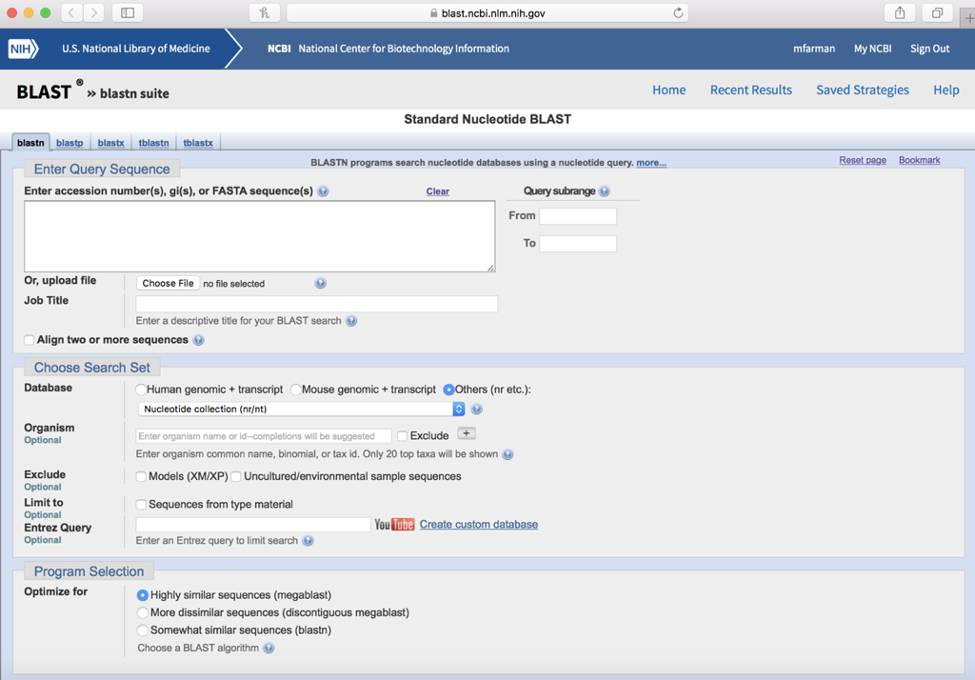
Web-based Blast

Slide 7
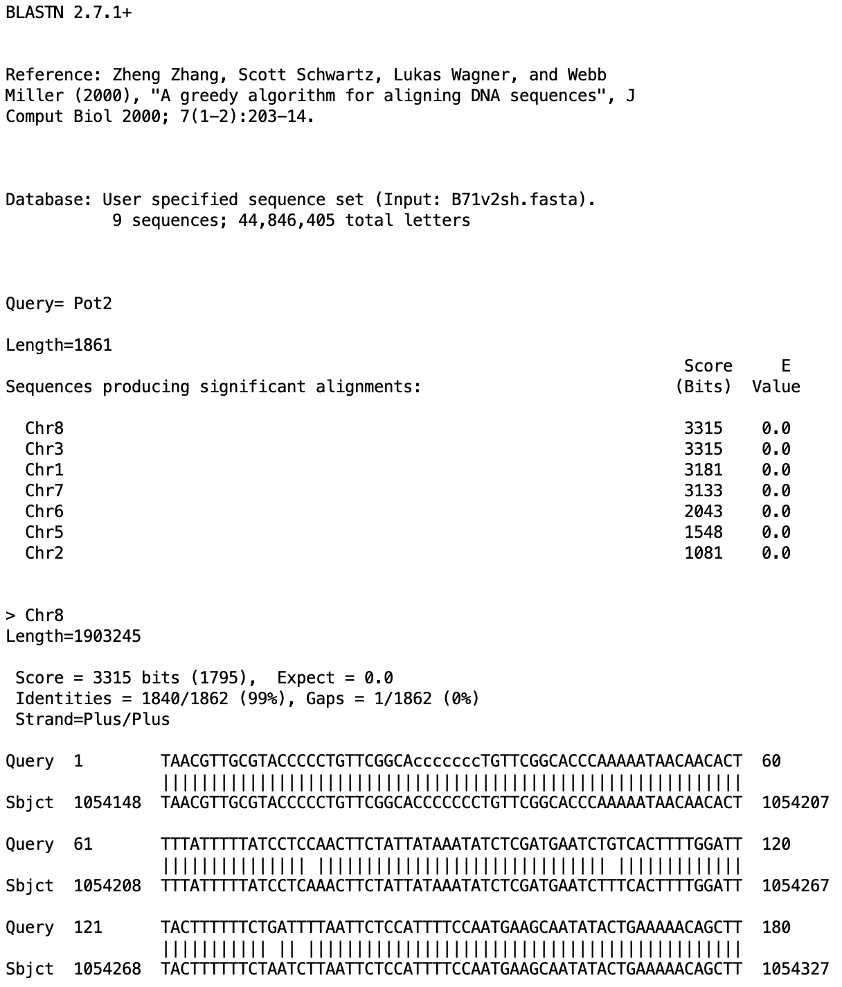
BLAST Alignment Anatomy
Database:
Sequence being searched
Query
Length
List of matching sequences
Alignment summary
Alignment

Slide 8
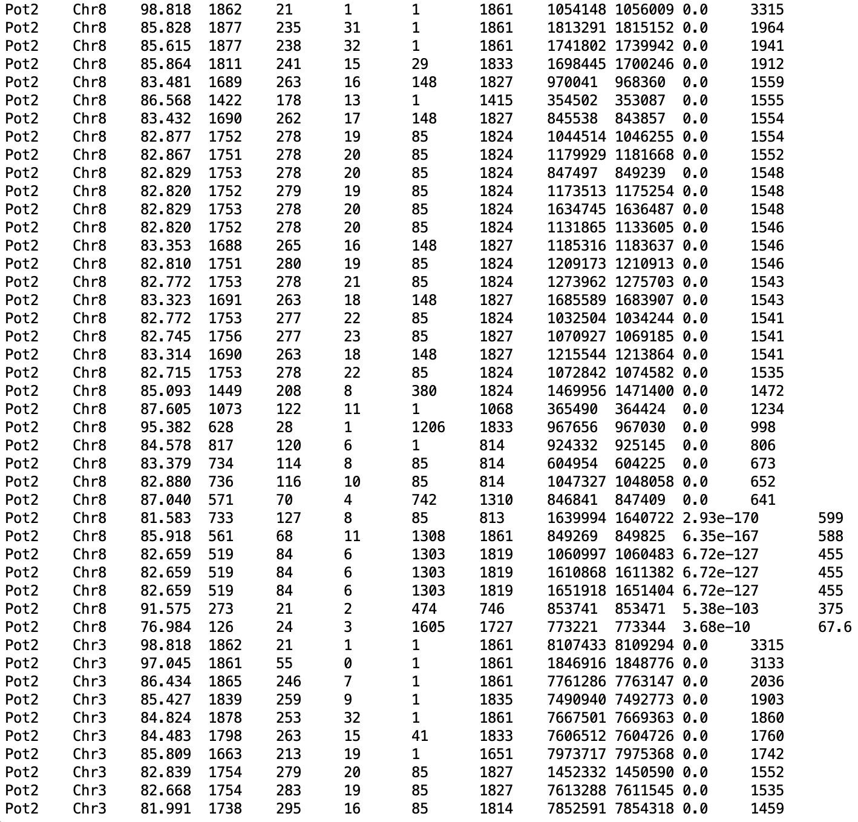
“Compact” output
blastn -query MoRepeats.fasta -subject B71v2sh.fasta -outfmt 6
Columns (abbr.)
Query id (qseqid)
Subject id (sseqid)
% identity (mm+gap)/length (pident)
Length (length)
Mismatch (mismatch)
Gaps (gapopen)
Query start (qstart)
Query end (qend)
Subject start (sstart)
subject end (send)
E-value (evalue)
Score (score)

Slide 9
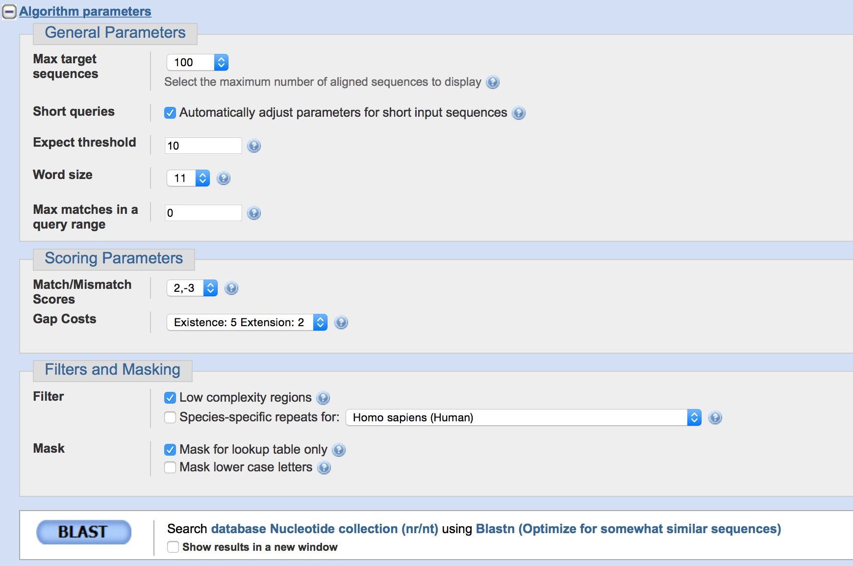
Disadvantages to Web Blast
Limited options
Results are stored on the NCBI server
Must be downloaded
Cap on query length
Difficult to batch process
SEARCHES ARE LIMITED TO THE SEQUENCES THAT ARE AVAILABLE IN GENBANK
What about your own sequences?
Are they in Genbank?

Slide 10
Locally-installed Blast
Impressive selection of search/output options
Results saved directly to local machine
Possible to search NCBI and local databases
No strict limit on query length
Amenable to batch processing
blastn [-h] [-help] [-import_search_strategy filename]
[-export_search_strategy filename] [-task task_name] [-db database_name]
[-dbsize num_letters] [-gilist filename] [-seqidlist filename]
[-negative_gilist filename] [-entrez_query entrez_query]
[-db_soft_mask filtering_algorithm] [-db_hard_mask filtering_algorithm]
[-subject subject_input_file] [-subject_loc range] [-query input_file]
[-out output_file] [-evalue evalue] [-word_size int_value]
[-gapopen open_penalty] [-gapextend extend_penalty]
[-perc_identity float_value] [-xdrop_ungap float_value]
[-xdrop_gap float_value] [-xdrop_gap_final float_value]
[-searchsp int_value] [-max_hsps int_value] [-sum_statistics]
[-penalty penalty] [-reward reward] [-no_greedy]
[-min_raw_gapped_score int_value] [-template_type type]
[-template_length int_value] [-dust DUST_options]
[-filtering_db filtering_database]
[-window_masker_taxid window_masker_taxid]
[-window_masker_db window_masker_db] [-soft_masking soft_masking]
[-ungapped] [-culling_limit int_value] [-best_hit_overhang float_value]
[-best_hit_score_edge float_value] [-window_size int_value]
[-off_diagonal_range int_value] [-use_index boolean] [-index_name string]
[-lcase_masking] [-query_loc range] [-strand strand] [-parse_deflines]
[-outfmt format] [-show_gis] [-num_descriptions int_value]
[-num_alignments int_value] [-html] [-max_target_seqs num_sequences]
[-num_threads int_value] [-remote] [-version]

Slide 11
Compact, information-rich format
-outfmt 0
full alignment information
-outfmt 6
compact alignment summary
Information-poor
- outfmt ‘6 qseqid sseqid pident length qstart qend sstart send evalue score btop’
Pot2 Chr8 1 98.818 1862 21 1861 1054148 1056009 0.0 1795 75CA30GT24GA2TC188CT329CT11TC5AG35AG17TG56CT41CG13CT21TC27CG133TC298TC109AG5CT56-T103TC174CT88

Slide 12
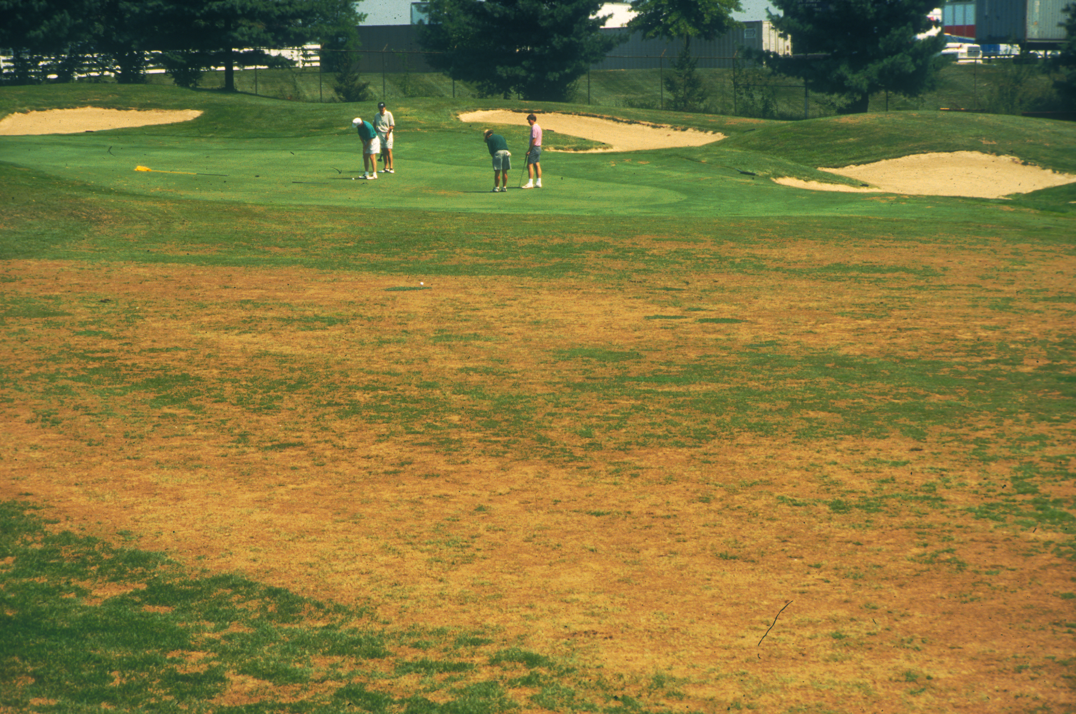

Today’s exercise
Run WEB blast to explore its capabilities
Use a locally installed program to search the NCBI database remotely
Use the locally installed program to search local sequences against one another
Query sequences:
Magnaporthe oryzae Telomeric Retrotransposons (MoTeR_retrotransposons.fasta)
Repetitive sequences existing in multiple copies per genome
Copy themselves and insert into telomere repeats that occur at the ends of chromosomes
MoRepeats.fasta
Most of the known transposons and other repeated sequences in the M. oryzae genome
Use command line tools to interrogate the BLAST output files and gain insights into the repetitive DNA content of the M. oryzae genome
M. oryzae on tall fescue

