Slide 1
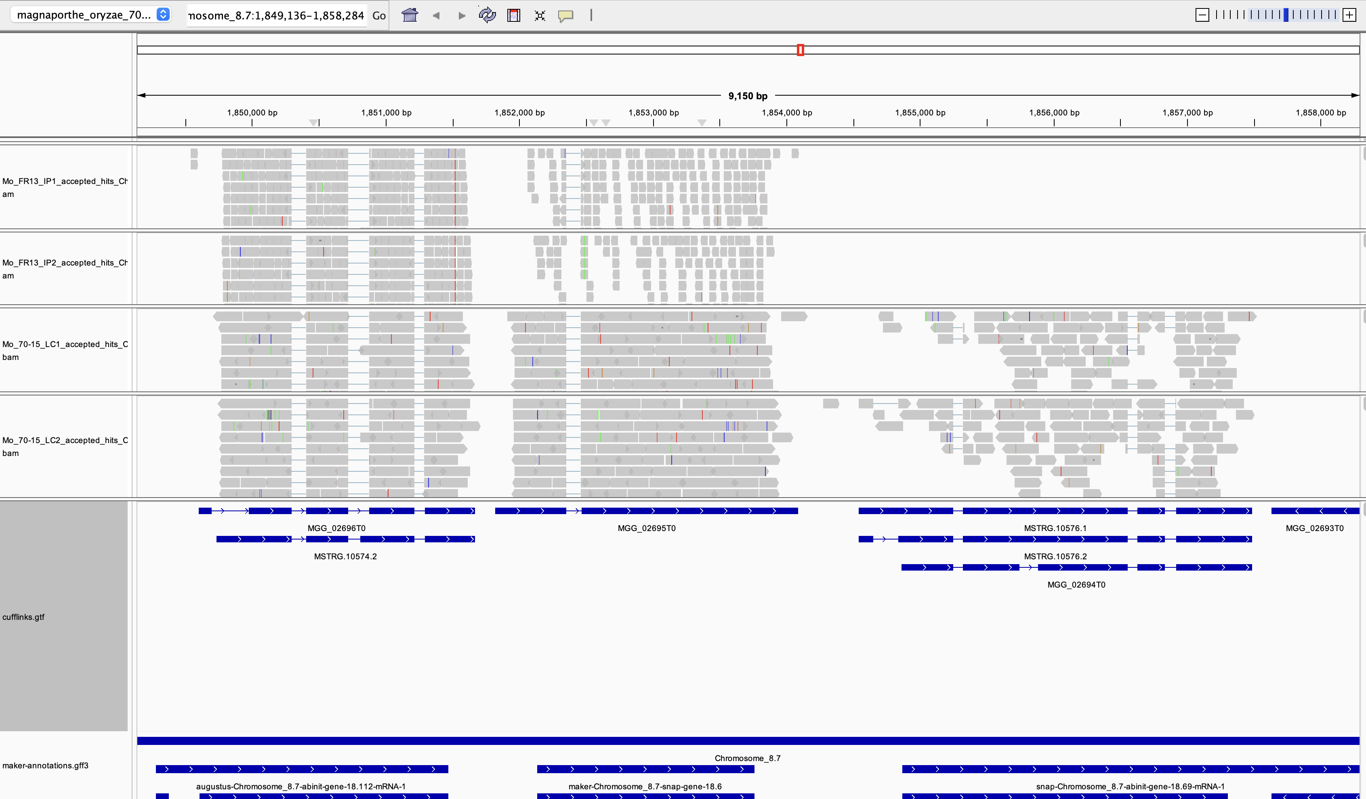
Lecture 7: Genome Browsers

Slide 2
Genome Browsers
A genome sequence database combined with interactive web pages
Allows the user to retrieve and interrogate database records through a graphical user interface (GUI)
Different types of information are displayed in an intuitive fashion in user-configurable “tracks”

Slide 3
Genome annotation files are hard to interpret

Slide 4
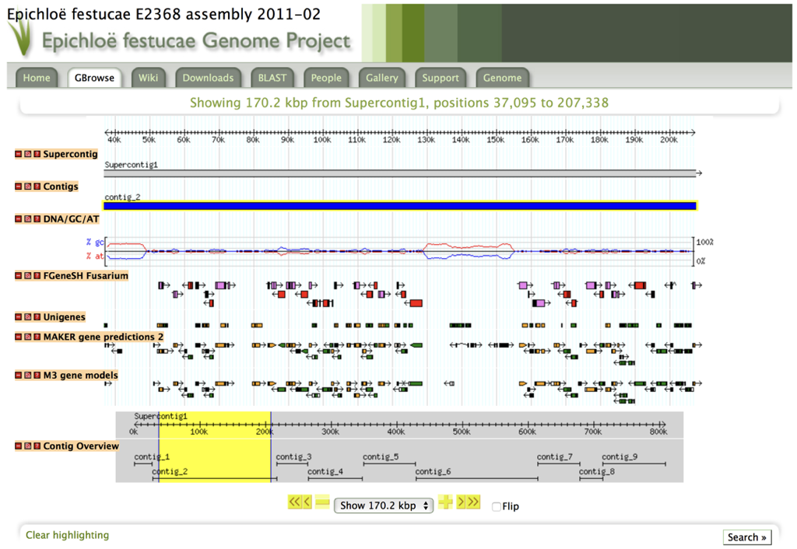
Visualizing Genomic Features
Scaffolds/contigs
GC-content
Predicted genes
RNA-Seq reads
Variant calls, etc.

Slide 5
Getting Feature Information
Mouse-over: lists ID

Slide 6
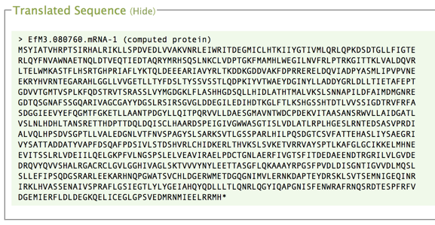
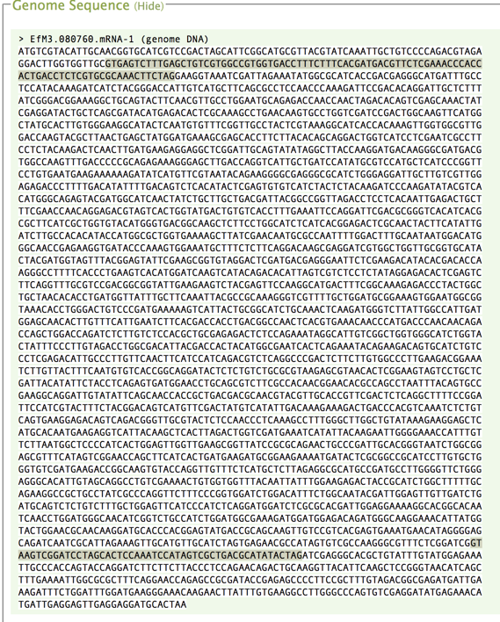
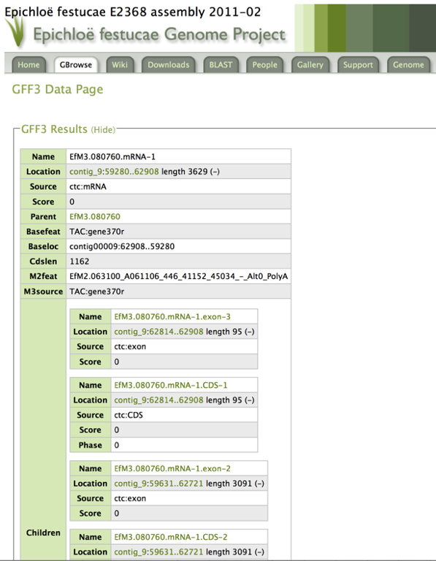
Click to Retrieve Database Records

Slide 7
A Plethora of Genome Browsers
Annmap
Apollo Genome Annotation Curation Tool
Argo Genome Browser
Avadis NGS
BugView
Celera Genome Browser
Dalliance
DiProGB
DNAnexus
Ensembl
Gaggle Genome Browser
GBrowse
The Genomic HyperBrowser
Genostar GenoBrowser
GenPlay
Integrated Genome Browser (IGB)
Integrated Genomics Viewer (IGV)
Integrated Microbial Genomes (IMG)
JBrowse (a JavaScript browser )
MGV - Microbial Genome Viewer
MochiView Genome Browser
NextBio Genome Browser
Pathway Tools Genome Browser
Savant Genome Browser
SEED viewer
UCSC Genome Bioinformatics Genome Browser
Viral Genome Organizer (VGO)
VISTA genome browser

Slide 8
This Afternoon’s Activities
Overall goal: Learn how to set up, navigate and interpret the Integrative Genomics Viewer
Populate the browser with data and visualize:
A Magnaporthe sequence contig
Predicted genes on that contig
Corresponding MAKER annotations
RNA-Seq reads
Variant calls
Explore the browser to get an idea of how it works and how the tracks can be manipulated/activated/de-activated
Identify key gene features (start codons, intron/exon boundaries, etc.)
Search for “interesting” expression patterns

Slide 9
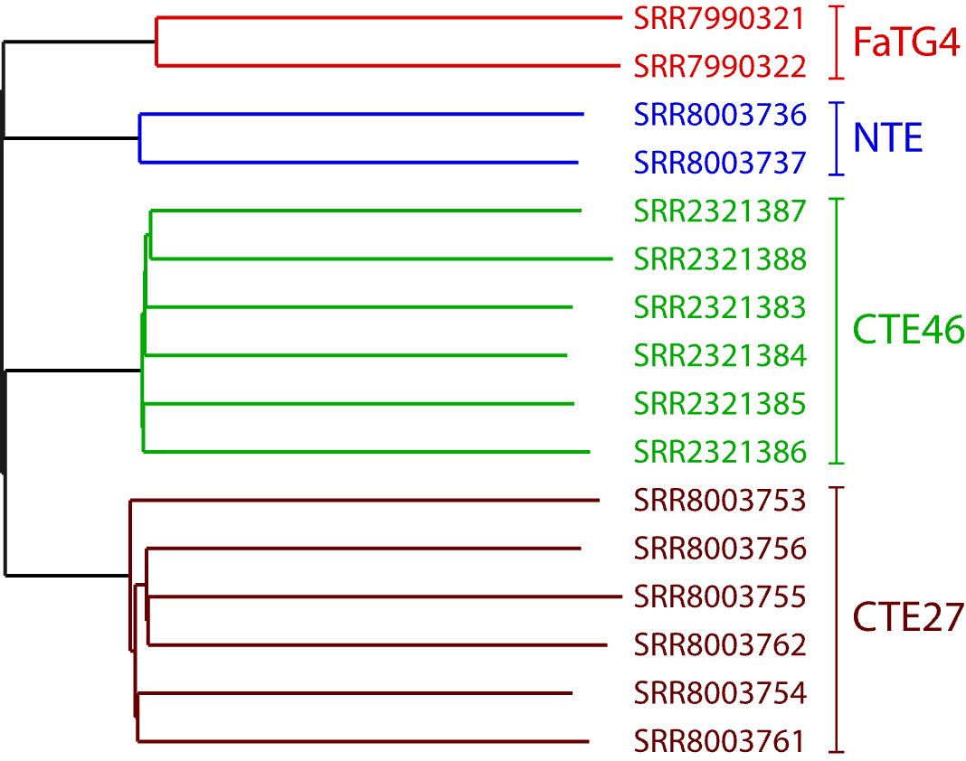
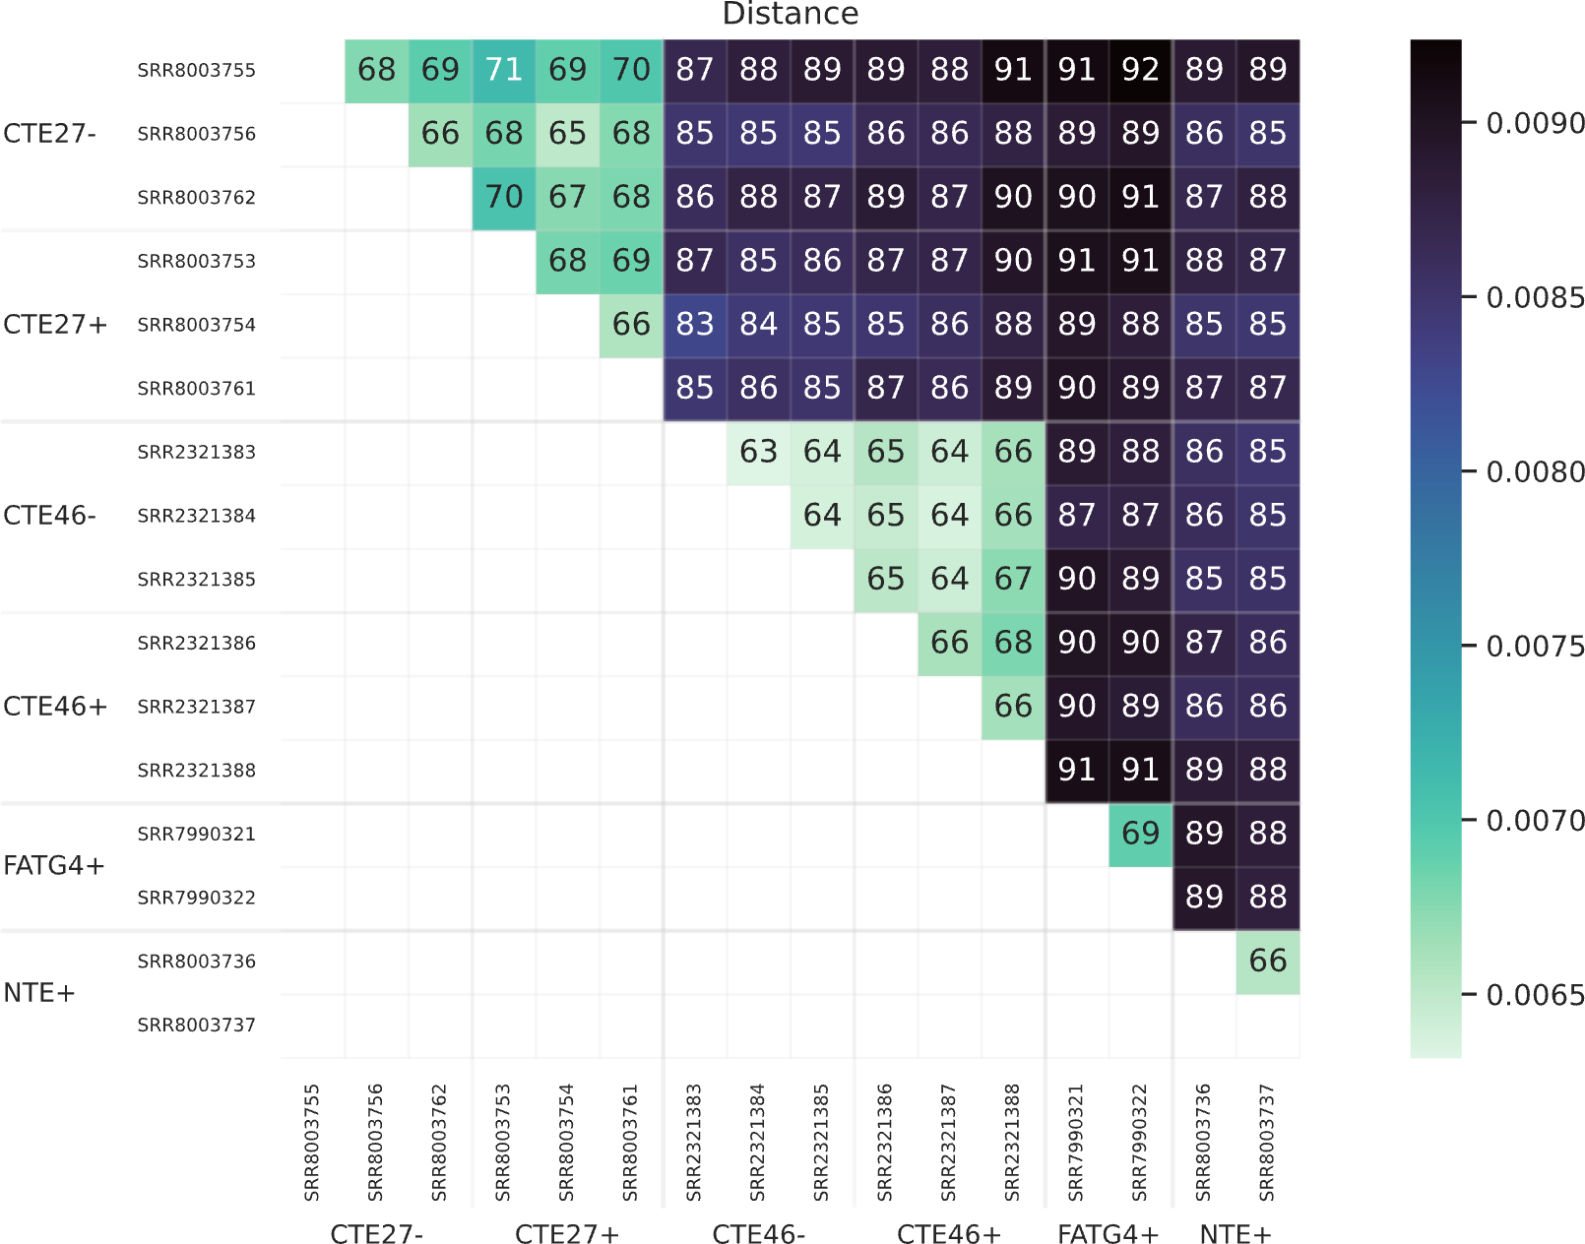
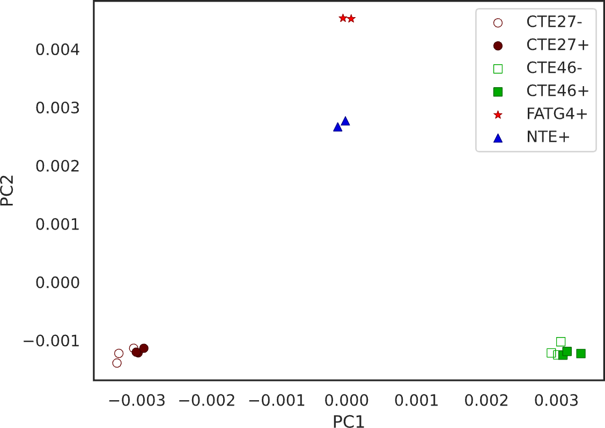
RNA-clique Overview
RNA-clique computes genetic distances from assembled transcriptomes.
Tells us the extent to which a set of samples’ (e.g., individuals) genomes differ from one other.
We can use genetic distances to generate:
Phylogenetic trees
Visualizations
Heatmaps
PCoA plots

Slide 10
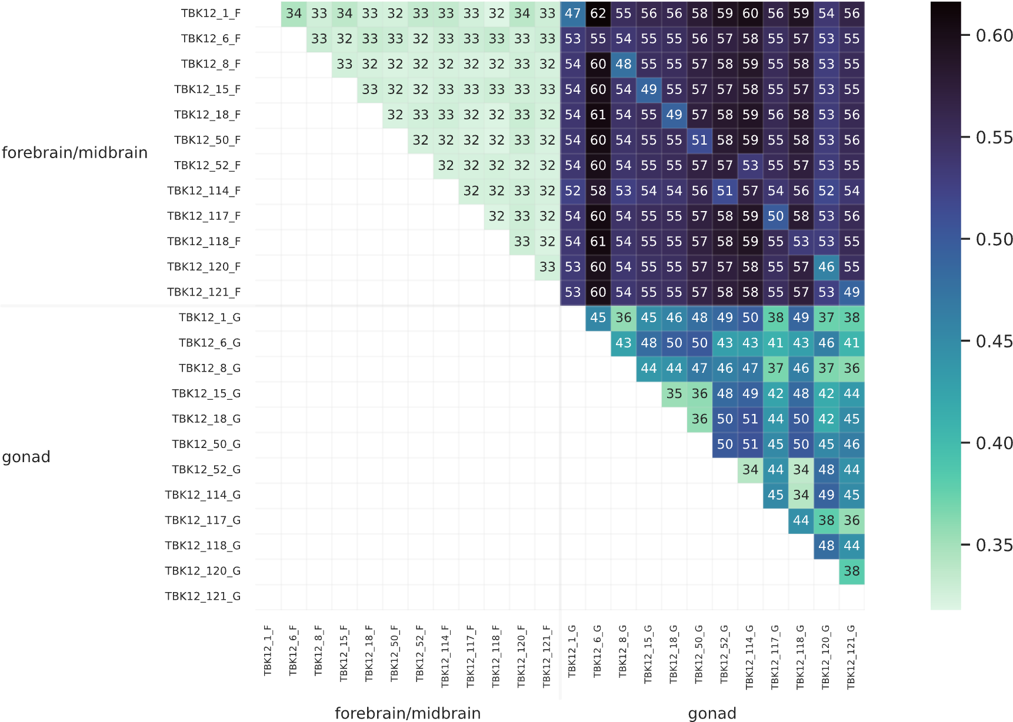
Genetic Distances from RNA-Seq Data
Genetic distances should not account for differences in gene expression.
Could be a problem when we have:
RNA-Seq data from two different tissue types.
RNA-Seq data from two different conditions.
It’s easy to inadvertently pick up on differences in expression.
RNA-clique explicitly compares orthologs present in all samples to avoid this problem.
With other software, samples might group neatly by tissue type.

Slide 11
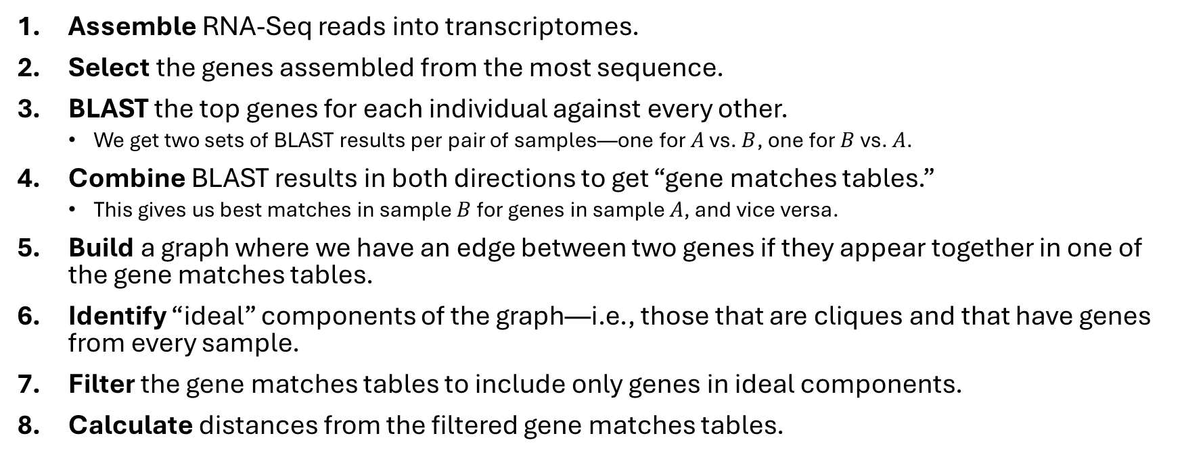
RNA-clique Method Steps
Assemble RNA-Seq reads into transcriptomes.
Select the genes assembled from the most sequence.
BLAST the top genes for each individual against every other.
We get two sets of BLAST results per pair of samples—one for $A$ vs. $B$, one for $B$ vs. $A$.
Combine BLAST results in both directions to get “gene matches tables.”
This gives us best matches in sample $B$ for genes in sample $A$, and vice versa.
Build a graph where we have an edge between two genes if they appear together in one of the gene matches tables.
Identify “ideal” components of the graph—i.e., those that are cliques and that have genes from every sample.
Filter the gene matches tables to include only genes in ideal components.
Calculate distances from the filtered gene matches tables.

Slide 12
RNA-clique Command-line Interface
rna-clique -O rna_clique_out
-n 50000
sample_1
sample_2
sample_3
-O | Output directory
-n | Number of top genes to select for each sample.
sample_1 sample_2 ... | Paths to samples’ transcriptomes

