Slide 1
Anomaly Detection in Streaming Nonstationary Temporal Data (review)
David Starkey

Slide 2
Review Contents
Concept review:
Types of timeseries observations (single/multi variate, batch, streams)
Types of anomalies (single contextual anomalous points, clusters of anomalies within single time series, or entire anomalous time series in multivariate data)
Review of extreme value distributions
draw backs of previous models
New algorithm for multivariate anomaly detection for time series streams:
Mathematical framework.
Performance testing on synthetic observations

Slide 3
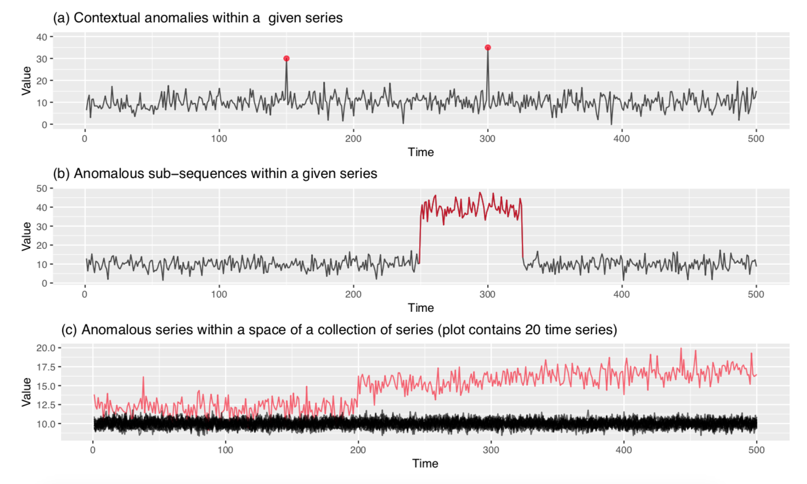
Types of time series data and anomalies

Slide 4
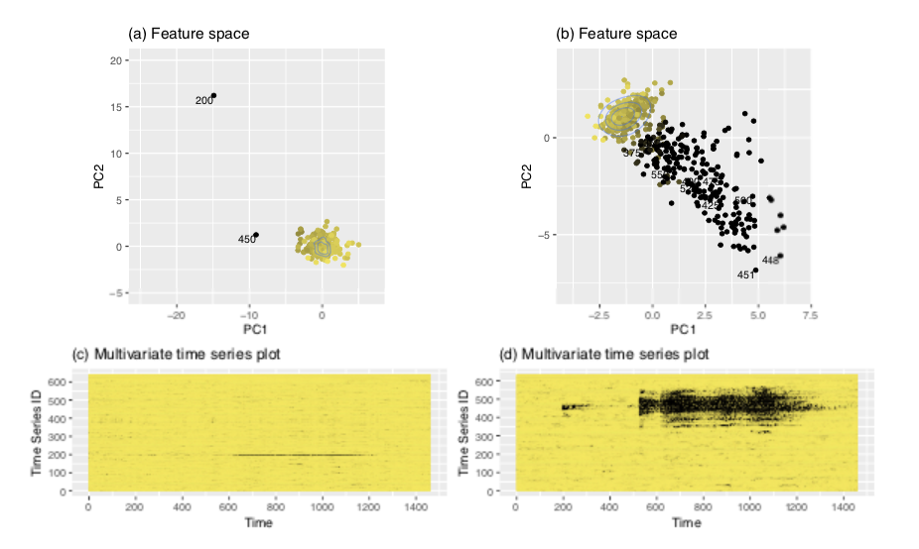
A new method to identify anomalous time-series use a feature space representation
Previous methods detect sudden changes of a single time-series relative to its nearest neighbors. This is ok in the lower left picture but not in the lower right where anomalies are correlated across adjacent time series and evolve gradually.

Slide 5
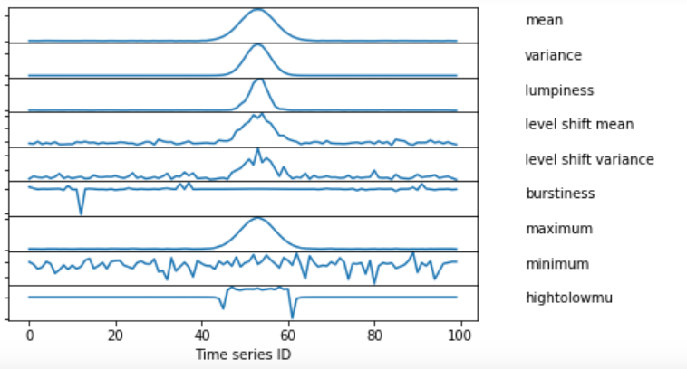
Feature Space
A feature is a quantity measured for a single light curve that returns a single number (examples include the mean, variance, max/min, high-to-low-mean,lumpiness etc)
Computing M unique features for each time series in multivariate data returns an N x M matrix called a ‘feature matrix’.
Example 100 x 8 feature matrix obtained from 100 time series using 9 features.
uses ‘outrej_smooth’ routine

Slide 6
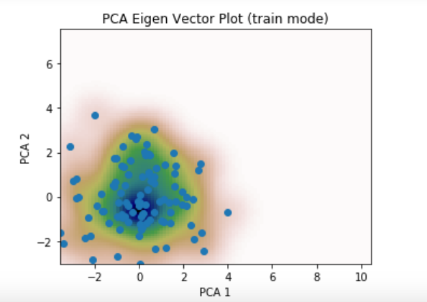
Recipe
Obtain a set of N training timeseries free from anomalies.
Compute the N x M feature matrix and normalize (mean / rms).
The next step involves using kernal density estimation (KDE) to compute the most likely region in the feature space to find ‘good data’. This is difficult to do in an M dimensional sub-space, so Principal Component Analysis (PCA) is used to collapse this to a 2D problem.
Example PCA 2D feature space obtained from 100 time series using 9 features.
Uses ‘outrej_smooth’ routine

Slide 7
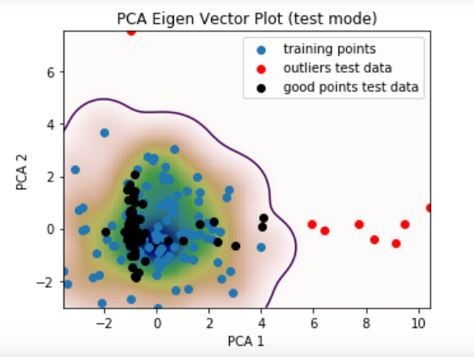
Recipe… continued
Identify a desired confidence interval (e.g F_{C} = 0.99) as the region encompassing a fraction F_{c} of good points assuming the training data is representative of the true feature space behavior).
New data is then transformed into the same 2D PCA feature space and a timeseries is flagged as ‘outlying’ if it is outside the F_{c} confidence region.
New streamed data is transformed into the PCA sapce and time series outside the confidence region are flagged as outliers
Uses ‘outrej_smooth’ routine

Slide 8
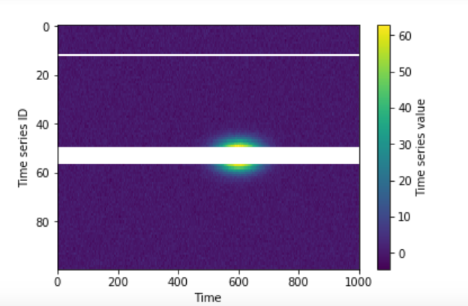
“outrej _smooth” full example
Test time series
Gaussian background with 2D Gaussian ‘hump’ at 600 days
PCA feature space

Slide 9
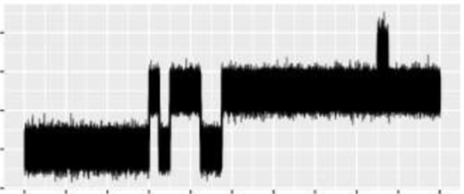
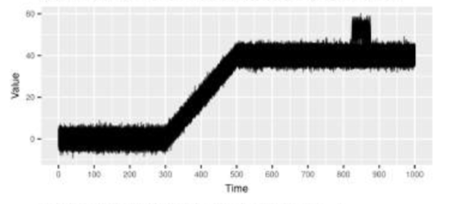
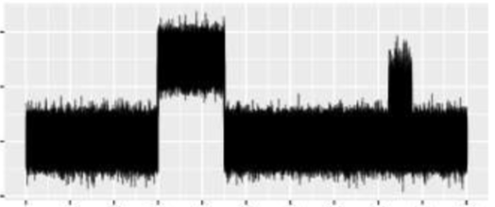
Accounting for Non-stationarity
Gradual
Small anomalies introduce themselves periodically and gradually increase in duration
Incremental
Non-stationarity develops gradually over time
Recurring
Sudden jumps occur before returning to the background level

Slide 10
Recipee Non-stationarity
Define a window length w.
Input the latest w epochs of training time series that are known to be free of outliers.
Compare with the latest test set of new streamed time series (also w epochs).
If more that ~50% of the new points in the 2D feature space lie outside the confidence region, we determine the model to have evolved and define a new background level based on the test time series.
If less than 50% of points lie outside the confidence region, flag these as outliers and do not update the background behavior.

Slide 11
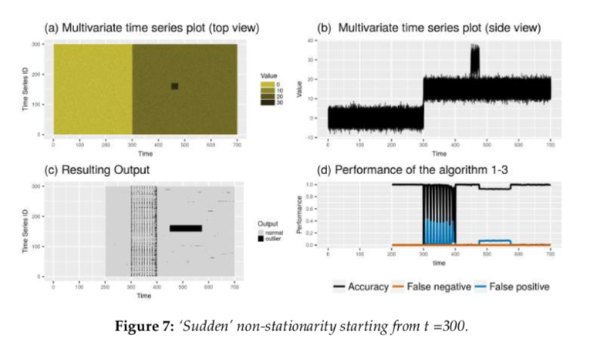
Performance testing – Sudden non-stationarity
The sliding window requires sometime to ‘teach’ the model the new background state. A number of false positives are therefore identified at the beginning o fa period of new behavior.

Slide 12
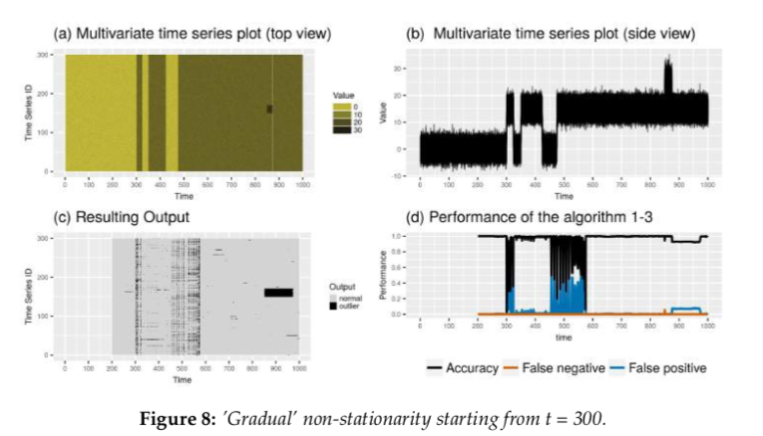
Performance testing – Gradual non-stationarity

Slide 13
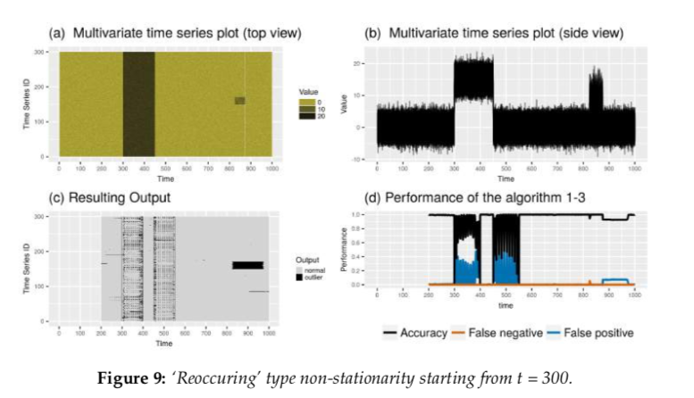
Reoccurring non-stationarity

Slide 14
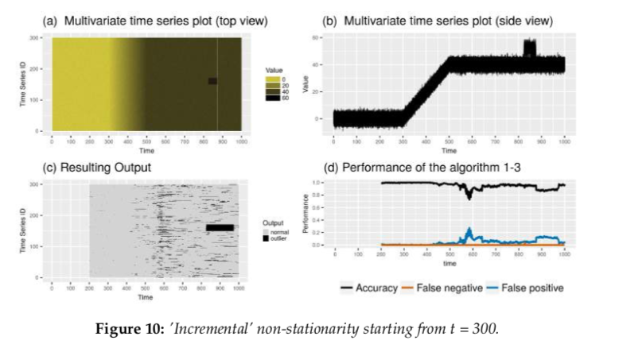
Reoccurring non-stationarity
For recurring non-stationarity the false detection positive period peaks after the rise when the model has reached its new background position (t = 500). The has identified the rising gradient as the new ‘norm’ and expects this pattern to continue.

Slide 15
Application
Any situation requiring outlier identification from multivariate time series data.
Talgala + 18 suggests fiber optic cables attached to a system but does not elaborate on their purpose.
Astrophysical examples include a spectrum measured at many different times to observe the chemical abundance and gas dynamics of distant galaxies.
Industrial examples include tracking data use across a network, measuring power consumption as a function of position and time across the country, weather forecasting.

Slide 16
Conclusion
New algorithm proposed to detect anomalies in time series data using a ‘feature space approach’
Concept review:
Types of timeseries observations (single/multi variate, batch, streams)
Types of anomalies (single contextual anomalous points, clusters of anomalies within single time series, or entire anomalous time series in multivariate data)
Review of extreme value distributions
draw backs of previous models
New algorithm for multivariate anomaly detection for time series streams:
Mathematical framework.
Performance testing on synthetic observations correctly identify outliers in evolving timeseries (non-stationarity) but with a time delay corresponding to the size of the window that flags some false positive detections.

