Slide 1

MediLab Diagnostics
Diagnostic Performance & Revenue Analytics

Slide 2
How this presentation addresses the Project Task
Task Approach
Answer each business question with the most relevant dashboard visual.
Explain what the visual says using the numbers visible in the final dashboard.
Explain why the finding matters to MediLab's diagnostic, operational and financial performance.
Provide practical recommendations backed by the observed evidence.

Slide 3
Executive Summary
Headline performance
91.16M total revenue, 53.08M total profit and 58.22% profit margin.
3.79K patients and 12K tests during the period under review.
The Patient/Financial dashboard reports 90.13% completion, 24.06K revenue per patient and 3.17 tests per patient.
Demand & service mix
Clinical Chemistry, Molecular Diagnostics and Hormonal Assay generate about 73.5% of total revenue.
Walk-in customers contribute 33.0M, the largest customer-type revenue stream.
Histopathology has the highest average turnaround time at 3.0 days.
Operational signals
90.13% of requests are completed; 6.46% are inconclusive and 3.42% are cancelled.
Monthly test volume ranges from 623 to 1,403 in the displayed period.
Regional test volume is concentrated in South West, Lagos and South.

Slide 4
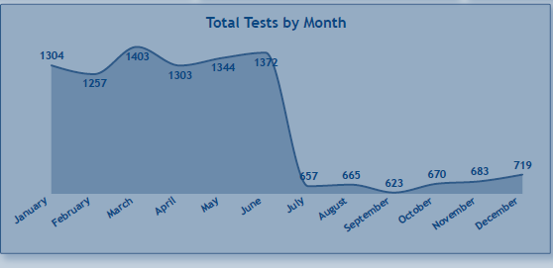
Q1. How active has MediLab's diagnostic network been during the period under review?
Answer
The network processed 12K tests for 3.79K patients and generated 91.16M in revenue. The 3.17 tests-per-patient KPI on the financial page also indicates repeat diagnostic activity.
Key insights
12K total tests is the clearest measure of diagnostic activity shown on the Executive dashboard.
3.79K patients generated 12K tests, indicating multiple tests per patient rather than one test per patient.
The activity base is financially material: 91.16M revenue and 53.08M profit are reported.
Recommendations
Use total tests, unique patients and tests per patient as the core activity KPIs.
Monitor activity by month, region and customer type to identify where growth is coming from.
Use volume and financial KPIs together so growth is assessed for both scale and value.
Align staffing and consumables with expected demand peaks and troughs.

Slide 5
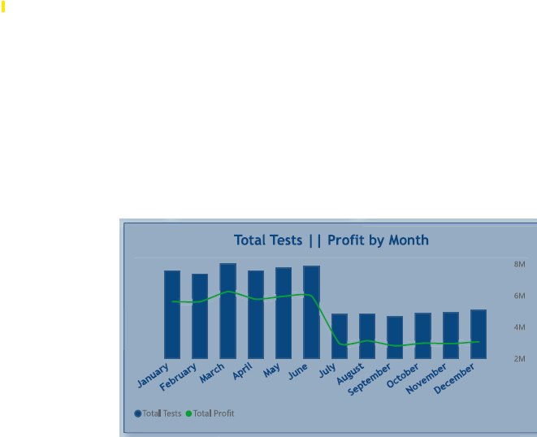
Q2. How has diagnostic activity and its financial contribution evolved over time?
Answer
Diagnostic volume and profit move together. Tests are high from January–June, fall sharply in July, remain low through November, and rise slightly in December; the profit line follows the same broad pattern.
Key insights
Monthly tests peak at 1,403 in March and remain above 1,250 through June.
Volume drops to 657 in July and reaches a low of 623 in September.
The profit line also falls materially after June, indicating that lower diagnostic activity is associated with lower financial contribution.
Recommendations
Investigate the July volume break and the sustained lower activity through December.
Align staffing, consumables and capacity with the observed demand cycle.
Add a prior-period or year-on-year comparison to distinguish seasonality from structural decline.
Use monthly volume and profit together for staffing, campaign and capacity planning.

Slide 6
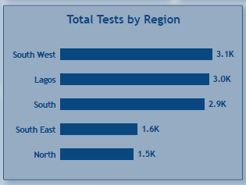
Q3. Where is the greatest concentration of diagnostic activity across MediLab's network?
Answer
Diagnostic activity is concentrated in South West, Lagos and South, while South East and North have materially lower volumes.
Key insights
South West leads with 3.1K tests, followed by Lagos at 3.0K and South at 2.9K.
South East records 1.6K and North 1.5K, approximately half the volume of the leading regions.
The top three areas therefore account for roughly three quarters of the regional test volume shown.
Recommendations
Protect capacity and service quality in the three highest-volume areas.
Investigate lower activity in North and South East: referral reach, branch capacity, accessibility and demand.
Use regional volume trends to guide equipment, staffing and commercial investment.

Slide 7
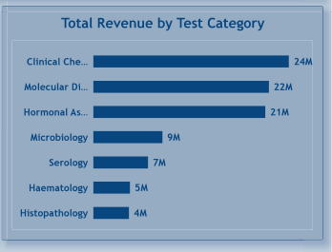
Q4. Which diagnostic services are contributing most significantly to the company's revenue?
Answer
Clinical Chemistry, Molecular Diagnostics and Hormonal Assay are the leading revenue-generating test categories.
Key insights
Clinical Chemistry generates 24M, Molecular Diagnostics 22M and Hormonal Assay 21M.
Together, these three categories generate about 67M, approximately 73% of the 91.16M total revenue.
The remaining categories contribute materially less revenue individually.
Recommendations
Protect capacity, quality and uptime in the three leading revenue categories.
Review growth opportunities in the lower-revenue categories before committing additional capacity.
Evaluate revenue alongside profit margin and turnaround time before making service-mix decisions.

Slide 8
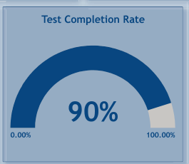
Q5. How efficiently is MediLab turning test requests into completed diagnostic services?
Answer
90.1% of all test requests are completed,
6.5% cancelled,
3.4% pending
Key insights
While 90% is a good score, the remaining 10% represents a significant amount of lost business.
This 10% is lost revenue and wasted resources.
Recommendations
Implement a system for logging the specific reason every time a test is cancelled. such as: "Patient No-Show," "Incorrect Test Ordered," "Payment Declined," "Sample Rejected," "Patient Cancelled.“
Identify bottlenecks in the workflow of Pending tests and review the workflow for those tests. E.g. operational capacity or training needs.

Slide 9
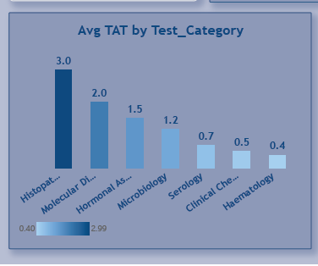
Q6. Where are operational delays most evident across the branch network?
Answer
Histopathology has the longest average turnaround time, followed by Molecular Diagnostics and Hormonal Assay.
Key insights
Histopathology averages 3.0 days, the highest turnaround time shown.
Molecular Diagnostics averages 2.0 days and Hormonal Assay 1.5 days.
Haematology is fastest at 0.4 days, with Clinical Chemistry at 0.5 days.
Recommendations
Prioritise workflow analysis for Histopathology and Molecular Diagnostics.
Break turnaround time into collection, processing, analysis and reporting stages to find bottlenecks.
Set category-specific turnaround targets rather than relying only on the overall 1.04-day average.

Slide 10
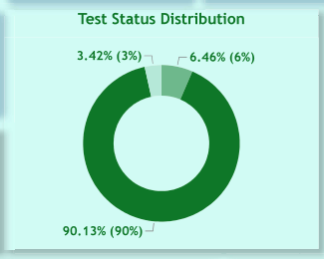
Q7. What does the distribution of completed, cancelled and pending requests tell us about operational performance?
Answer
Completed requests dominate at 90.13%. The remaining 9.87% consists of 6.46% inconclusive and 3.42% cancelled requests.
Key insights
Completion is strong at 90.13% of requests.
Inconclusive results are the largest non-completed component at 6.46%.
Cancelled requests account for 3.42%, making them a smaller but still measurable source of lost throughput.
Recommendations
Investigate why tests become inconclusive, particularly by test category and branch.
Analyse cancellation reasons and identify preventable cancellations.
Monitor completed, inconclusive and cancelled rates as an operational quality dashboard.
MediLab Diagnostics | Data Analytics Capstone

Slide 11
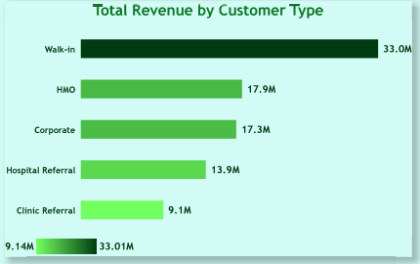
Q8. Which customer groups are driving the greatest demand for MediLab's services?
Answer
The customer-type revenue view shows Walk-in customers as the largest displayed segment, followed by HMO and Corporate customers. In this dashboard, revenue is being used as the practical proxy for demand.
Key insights
Walk-in customers generate 33.0M, clearly ahead of HMO at 17.9M and Corporate at 17.3M.
Hospital Referral contributes 13.9M and Clinic Referral 9.1M.
The top three customer types contribute about 68.2M, roughly 75% of total revenue.
Recommendations
Protect the walk-in customer base while reducing over-dependence on one demand channel.
Strengthen HMO and Corporate relationships because both already generate substantial revenue.
Add patient-count and test-count views by customer type so demand can be measured directly rather than inferred from revenue.
10

Slide 12
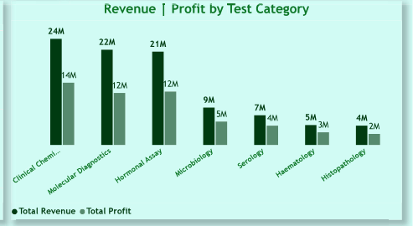
Q9. Which diagnostic services are making the greatest contribution to MediLab's business?
Answer
Clinical Chemistry, Molecular Diagnostics and Hormonal Assay are the strongest combined revenue and profit contributors.
Key insights
Clinical Chemistry produces 24M revenue and 14M profit.
Molecular Diagnostics produces 22M revenue and 12M profit; Hormonal Assay produces 21M revenue and 12M profit.
The three leading categories therefore drive both scale and a large share of profit.
Recommendations
Prioritise these categories for capacity planning, quality control and equipment uptime.
Monitor cost inflation closely because margin changes in high-volume categories can materially affect total profit.
Use revenue and profit together as service-portfolio KPIs.

Slide 13
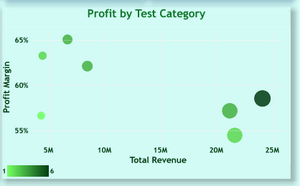
Q10. Which areas of MediLab's service portfolio are delivering both strong profitability and healthy margins?
Answer
The scatter shows the strongest revenue categories also operating at relatively healthy margins, with the leading services around the upper-right of the portfolio.
Key insights
Clinical Chemistry sits at approximately 24M revenue and about 58% margin.
Molecular Diagnostics and Hormonal Assay are also high-revenue services with margins in the mid-to-high 50% range.
Some smaller categories show higher margins but much lower revenue, so margin alone does not determine commercial priority.
Recommendations
Prioritise high-revenue/high-margin categories for capacity and quality investment.
Review lower-revenue services for targeted growth opportunities where margins are attractive.
Use revenue, profit margin and turnaround time together when deciding where to invest.

Slide 14
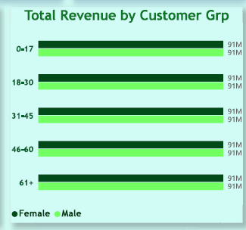
Q11. Which customer groups are generating the greatest financial value for MediLab relative to the patients they serve?
Answer
The final dashboard's 'Total Revenue by Customer Grp' visual does not reliably answer this question: it displays the same 0.09bn value repeatedly across age/gender cells. The evidence therefore supports a dashboard-quality finding rather than a customer-value ranking.
Key insights
The visual is broken into age groups and gender, not clearly into customer types.
The repeated 0.09bn labels do not provide meaningful differentiation between segments.
The project brief asks for financial value relative to patients served, which requires at least revenue and patient count by customer group.
Recommendations
Validate the measure, field mapping and aggregation used in this visual.
Replace it with Revenue, Patients and Revenue per Patient by Customer Type.
Do not make commercial allocation decisions from this visual until the calculation is validated.

Slide 15
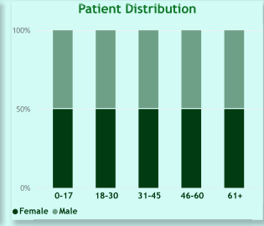
Q12. What does the composition of MediLab's patient population look like, and are there notable differences across demographic groups?
Answer
The patient distribution is broadly balanced by gender within each displayed age group.
Key insights
The five age bands shown are 0–17, 18–30, 31–45, 46–60 and 61+.
Each age band is approximately split 50/50 between female and male patients in the visual.
No single age/gender segment visibly dominates the population.
Recommendations
Use this balanced demographic profile as the baseline for service planning.
Cross demographic groups with test category and customer type to uncover more actionable demand patterns.
Monitor demographic mix over time to detect changes in the patient base.

Slide 16
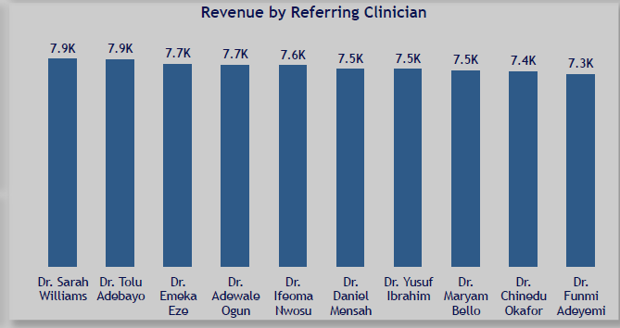
Q13. Which referring clinicians are driving the greatest volume of diagnostic activity, and which are contributing most to revenue?
Answer
The displayed revenue ranking is relatively concentrated among the leading clinicians, with the top clinician at 7.9K and the lowest of the displayed top ten at 7.3K.
Key insights
Dr. Sarah Williams and Dr. Tolu Adebayo are the highest displayed at 7.9K.
The remaining leading clinicians are tightly grouped between about 7.3K and 7.7K.
The visual is explicitly a revenue chart, so it supports revenue contribution more directly than referral volume.
Recommendations
Maintain relationships with the leading referring clinicians.
Develop the next tier of referrers rather than relying on a small number of sources.
Track clinician revenue alongside patient count and test mix to understand referral quality and value.
Add patient count and test volume by clinician to separate referral volume from revenue value.

Slide 17
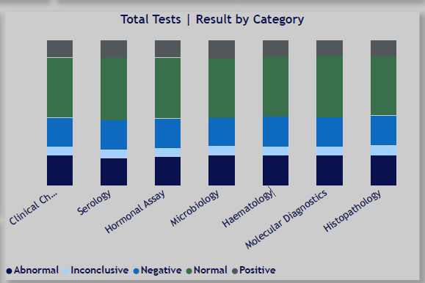
Q14. What patterns can be observed in diagnostic results across the different test categories?
Answer
Normal results form the largest component across all displayed test categories. Abnormal, inconclusive, negative and positive outcomes form smaller components.
Key insights
The stacked bars show a consistently large Normal segment across categories.
Non-normal outcomes are present in every category, with visible differences in the relative composition.
The visual is most useful as a quality-monitoring view; exact rates should be calculated from the underlying data.
Recommendations
Track abnormal and inconclusive rates by test category as quality indicators.
Investigate categories with unusually high non-normal or inconclusive proportions.
Combine result patterns with turnaround time and cancellation rates to identify process issues.

Slide 18
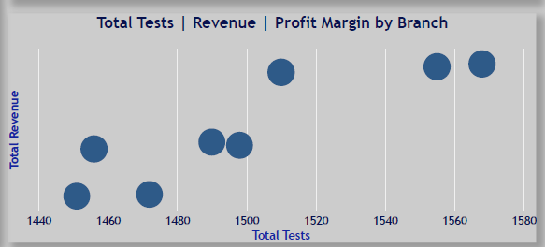
Q15. Which branches are successfully balancing diagnostic volume with financial performance?
Answer
Branch performance is spread across roughly 1,445–1,580 tests in the displayed scatter. The chart shows that similar test volumes can correspond to different revenue levels, so volume alone is not sufficient for branch evaluation.
Key insights
The branch points span roughly 1.45K to 1.58K tests.
Some branches at similar test volumes sit at noticeably different revenue levels.
The visual therefore supports a combined volume-and-revenue assessment rather than a volume-only ranking.
Recommendations
Create a branch performance matrix using tests, revenue and profit margin.
Investigate high-volume branches with comparatively weaker revenue or margin.
Share operating practices from high-volume/high-value branches with lower-performing locations.

Slide 19
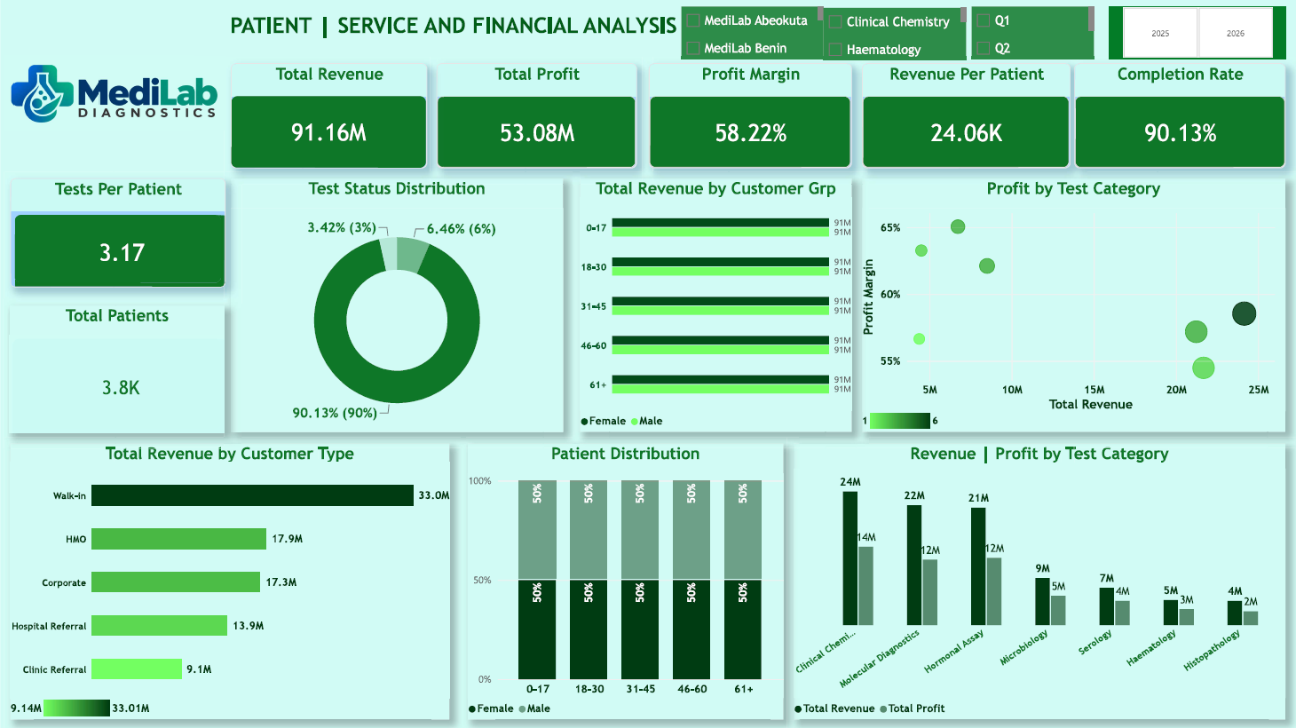
Q16. Which areas of the business appear to require management attention, and what evidence supports your conclusion?
Answer
Management attention should focus on operational delays, lower-volume regions, non-completed tests and dashboard/data-quality controls rather than a single weak-margin region.
Key insights
Regional profit margins are tightly grouped at approximately 58.16%–58.49%, so margin does not reveal a major regional outlier.
Histopathology has the highest turnaround time at 3.0 days, creating a clear operational improvement opportunity.
North and South East have the lowest regional test volumes, while 9.87% of requests are non-completed.
Recommendations
Prioritise Histopathology turnaround-time improvement and investigate its process bottlenecks.
Review demand and referral strategy in North and South East.
Reduce inconclusive and cancelled requests through root-cause analysis.
Continue validating dashboard measures so management decisions are based on reliable KPIs.

Slide 20
Executive Synthesis
Demand & revenue
12K tests and 3.79K patients underpin 91.16M revenue.
South West, Lagos and South are the main regional demand centres.
Clinical Chemistry, Molecular Diagnostics and Hormonal Assay generate about 73% of total revenue.
Operational performance
Completion is 90.13%, with 6.46% inconclusive and 3.42% cancelled.
Average turnaround time is 1.04 days overall.
Histopathology is the slowest category at 3.0 days.
Commercial opportunities
Walk-in customers generate the largest displayed revenue at 33.0M.
HMO and Corporate are meaningful secondary revenue streams.
Leading referring clinicians are closely grouped in the displayed revenue ranking.
Priority actions
Improve long-turnaround services and reduce inconclusive/cancelled tests.
Protect high-revenue/high-profit service categories.
Investigate lower-volume regions and validate dashboard measures where visuals do not answer the business question reliably.

Slide 21
Overall Recommendations
1. Protect the core revenue engine
Maintain capacity, quality and uptime in Clinical Chemistry, Molecular Diagnostics and Hormonal Assay—the three largest revenue categories.
2. Reduce operational delays
Prioritise Histopathology and Molecular Diagnostics for turnaround-time root-cause analysis and category-specific service targets.
3. Improve completion and quality
Analyse the 6.46% inconclusive and 3.42% cancelled shares by branch, category and customer type.
4. Strengthen demand channels
Protect Walk-in demand while expanding HMO and Corporate relationships and strengthening referral networks.
5. Investigate regional demand gaps
Review North and South East for referral coverage, accessibility, branch capacity and local demand.
6. Strengthen branch management
Use tests, revenue and profit margin together to identify high-volume/high-value branches and performance gaps.

Slide 22
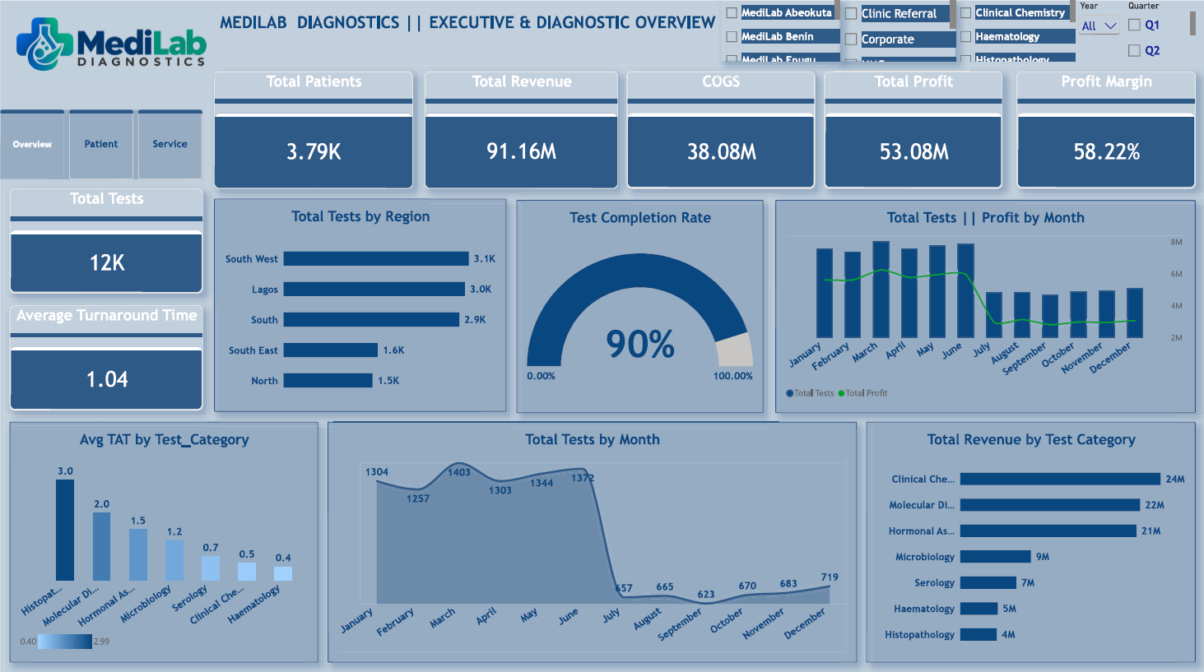
Final Dashboard — Page 1

Slide 23
Final Dashboard — Page 2

Slide 24
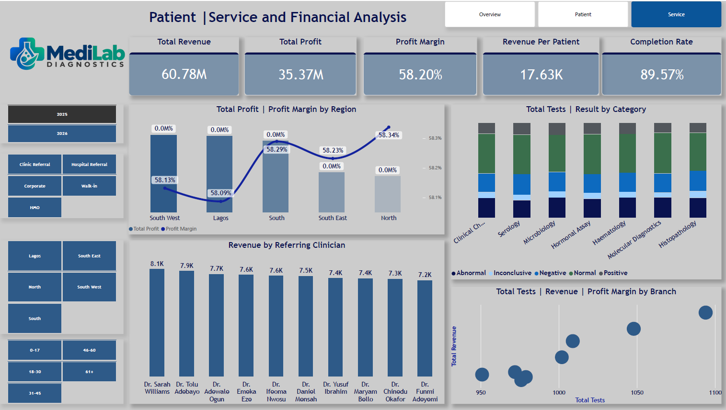
Final Dashboard — Page 3

