Slide 1
[ S.M.E.S. // BAILOUT ]
STRATEGIC MEETING EXTRACTION SYSTEM
WORKING MVP
BAILOUT
ESC
Finally, the Escape key
does what it says.
A one-key fake incoming call with hands-free audio coaching for the exit.
PANIC BUTTON
PRESS TO EXTRACT
TEAM EXIT ROW // DUM DUBER & DUMBER 2026
SYSTEM STATUS // READY
01

Slide 2
[ S.M.E.S. // BAILOUT ]
PROBLEM // SOCIAL FRICTION
THE PROBLEM
The agenda ended. The meeting did not.
01
02
03
04
AGENDA COMPLETE
SECOND RECAP
THIRD RECAP
STILL TRAPPED
Useful work ends
'One last thing'
Same point. New words.
No graceful exit
THE REAL PROBLEM IS NOT THE DOOR.
Leaving honestly creates friction.
Staying quietly wastes time.
IT IS THE EXCUSE.
SYSTEM STATUS // READY
02

Slide 3
[ S.M.E.S. // BAILOUT ]
DIFFERENCE // COMPLETE PROTOCOL
WHY BAILOUT
A fake ring is a feature. An extraction protocol is a product.
GENERIC FAKE-CALL APP
BAILOUT
RING
EXIT
Fake caller
>
Phone rings
>
01
Choose caller + scenario
The story is ready before the ring.
02
Check confidence
Timing and details are scored.
YOU IMPROVISE
03
Press Esc
The call starts instantly.
04
Repeat the audio coach
No screen-reading under pressure.
The sound works. The story is your problem.
SYSTEM STATUS // READY
03

Slide 4
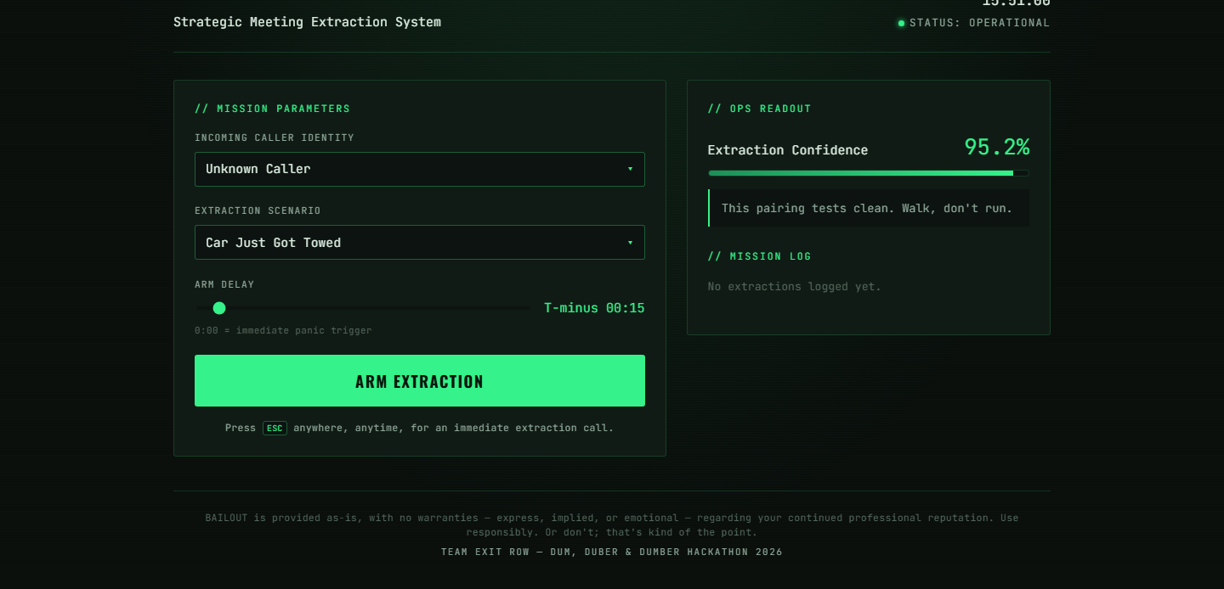
[ S.M.E.S. // BAILOUT ]
PRODUCT // WORKING BROWSER MVP
LIVE PRODUCT
Press Esc. BAILOUT handles the rest.
01
SELECT
Choose caller and scenario.
02
TRIGGER
Arm a delay or press Esc.
03
REPEAT
Hear each cue through audio.
20 LOCAL AUDIO PROMPTS
SYSTEM STATUS // LIVE MVP
04

Slide 5
[ S.M.E.S. // BAILOUT ]
CLOSE // BUILT TO ESCAPE
STUPID ENOUGH TO SHARE.
USEFUL ENOUGH TO KEEP.
For students, workers, and anyone trapped in a meeting that should have been an email.
1
20
0
KEYPRESS
AUDIO PROMPTS
ACCOUNTS
to trigger the bailout
stored locally in the app
installs, servers, or API keys
PRESS ESC
BAILOUT // FINALLY, THE ESCAPE KEY WORKS
SYSTEM STATUS // READY
05

