Slide 1
The Forest
Text-based Fantasy Game

Slide 2
Story
Choose race and name
Play through 3 encounters with different outcomes
Recieve Items that help you in certain encounters
Framework: Add as many encounters as you want

Slide 3
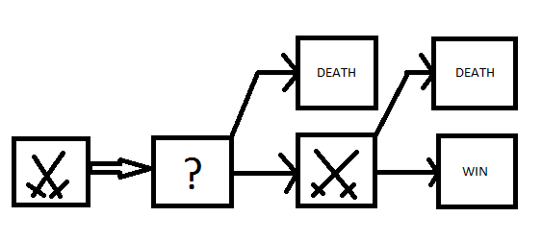

Slide 4
Choose your race:
Enter your race: [Dwarf, Elf, Orc, Troll]
Elf
Enter your name, elf:
Sepp
Welcome to the forest, Sepp the Elf
You are Sepp, a strong Elf warrior, striving through the kingdom of Hagenburg on your journey to find a maiden and treasures beyond your imagination. On this very day you are in a dark forest, where you wander around
After wandering through the woods for hours, you encounter a big, sleeping dragon. What will you do?
[Press A] You try to slay the beast
[Press B] You try to sneak past it
[Press C] You try to tame the dragon
Please enter a, b or c
A
You try to cut of the dragons head with a single blow but the dragon awakes and a furious combat starts. You barely make it out alive and can escape from the dragon.
After leaving the dragon behind and travelling for some more hours, you find a Dwarf resting beside the path

