Slide 1
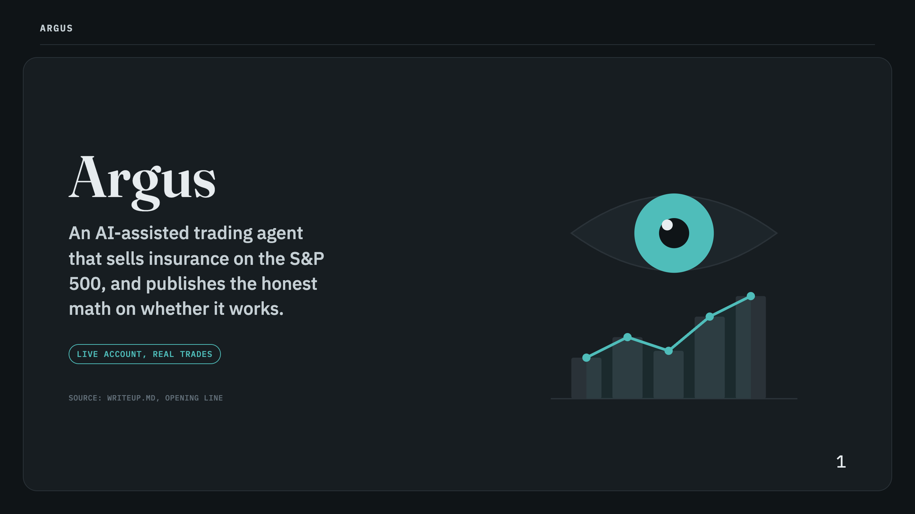
Notes:
Asset sources, each downloaded and recolored to this deck's exact palette: - assets/icons/clipboard-check.svg, shield.svg, eye.svg, send.svg, circle-dollar-sign.svg -- Lucide (lucide.dev), MIT/ISC license - assets/illustrations/watching-the-market.svg -- hand-authored for this deck (round 6/7): the Argus "watchful eye" over a rising market chart, flat two-tone fills only (accent teal + muted grays), no gradients, used on the two hero slides so the cover/close illustration is unambiguously about trading, not generic stargazing Speaker notes: Argus, the many-eyed guardian of Greek myth (also Odysseus's loyal dog), maps to the system's 15 backtested guards, covered later in the Evaluation section. It places real, defined-risk options trades on a live paper account, on a schedule, with no person clicking anything, and prints the corrected number even when the correction makes it worse.

Slide 2
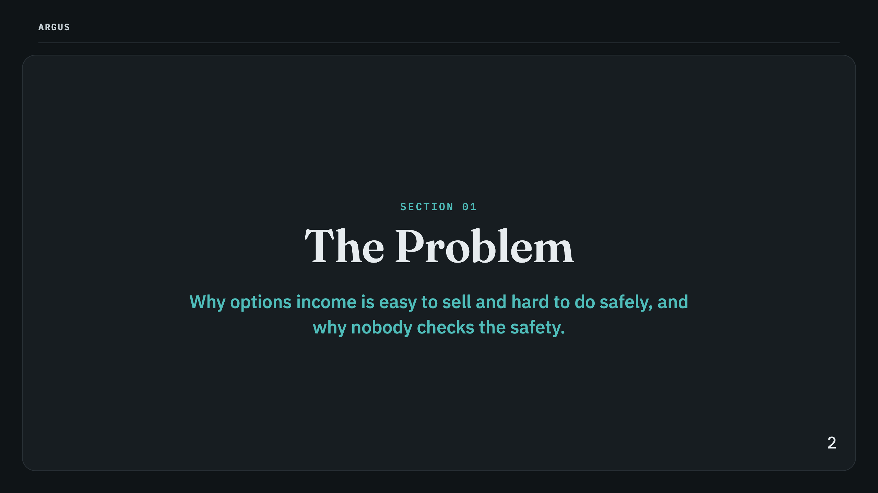

Slide 3
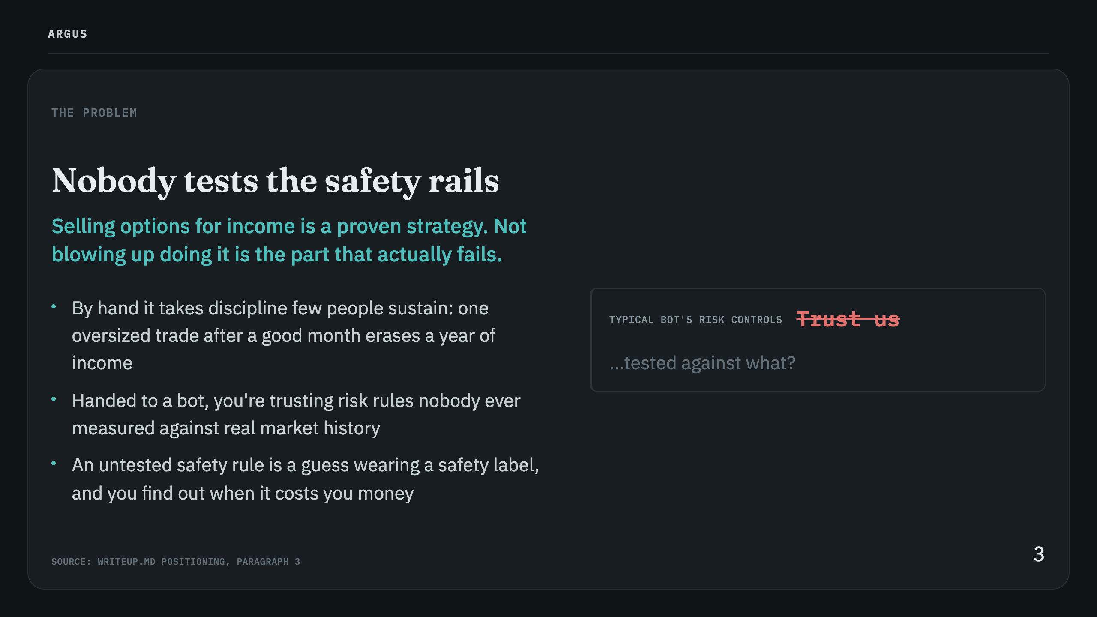

Slide 4
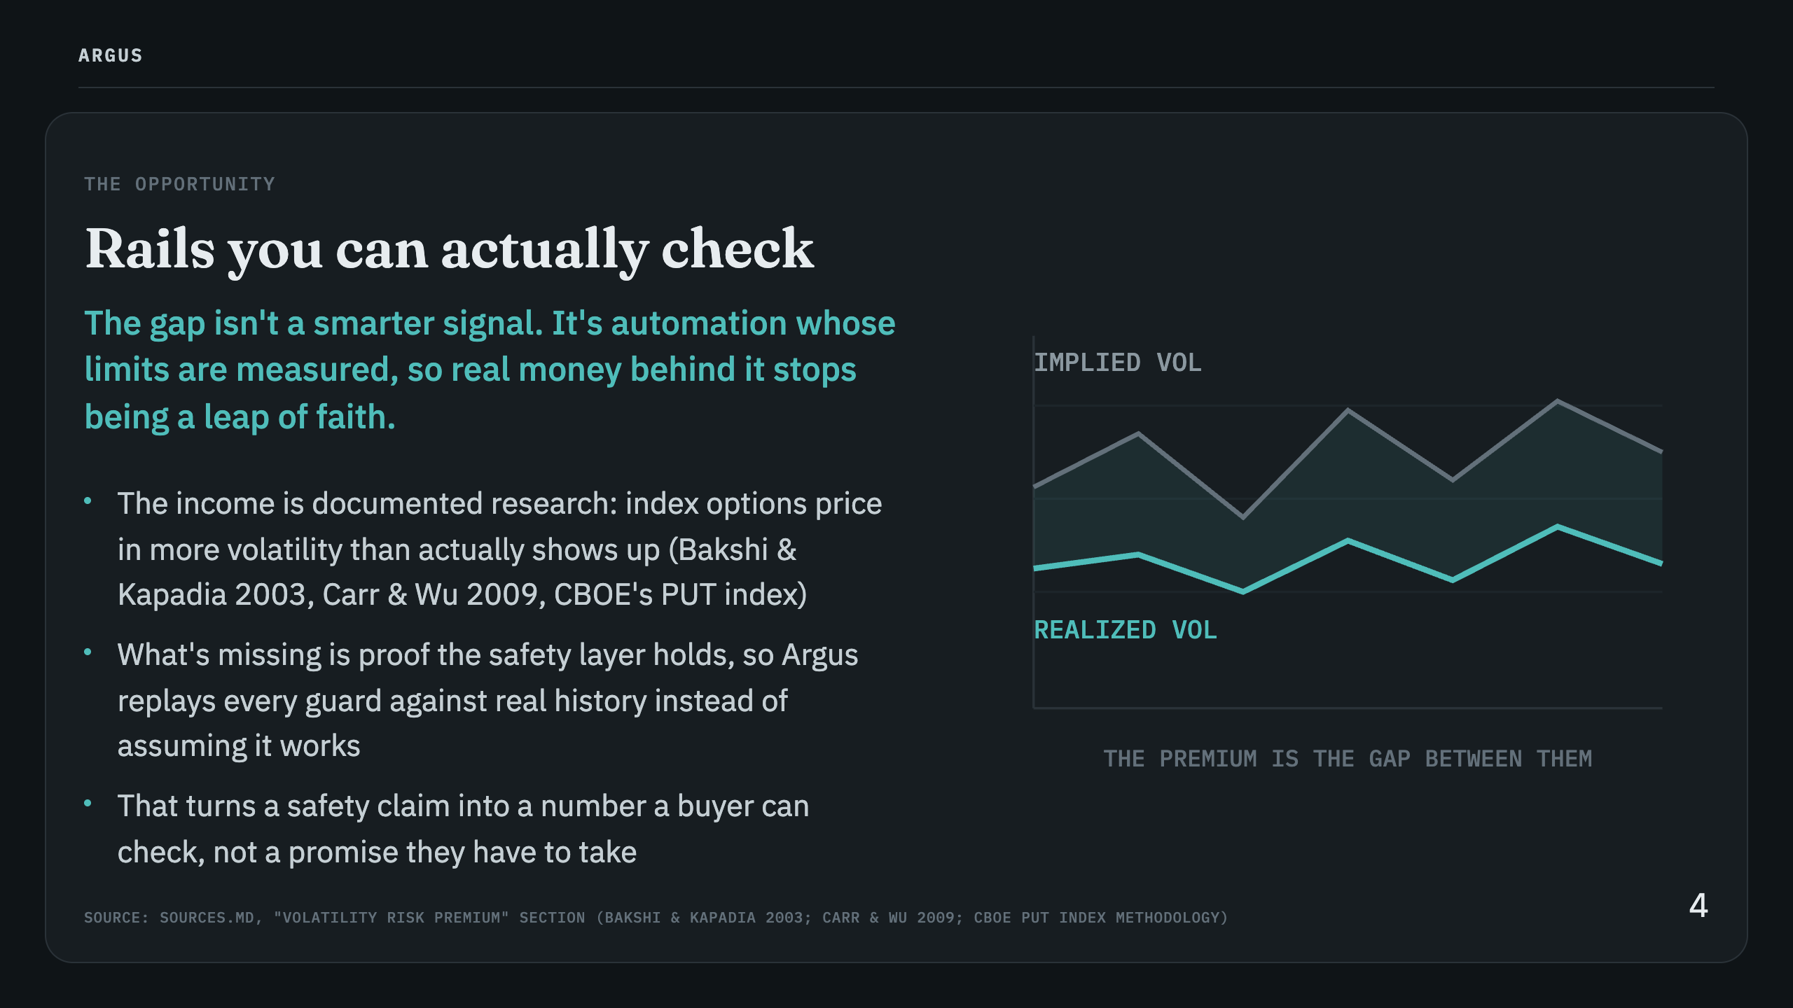

Slide 5
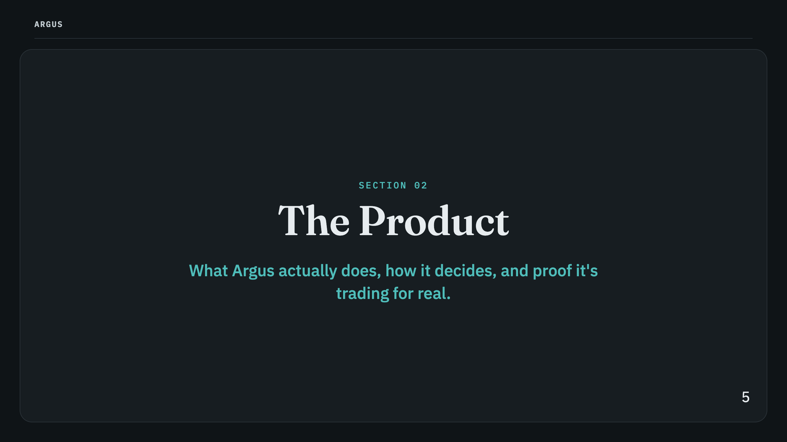

Slide 6
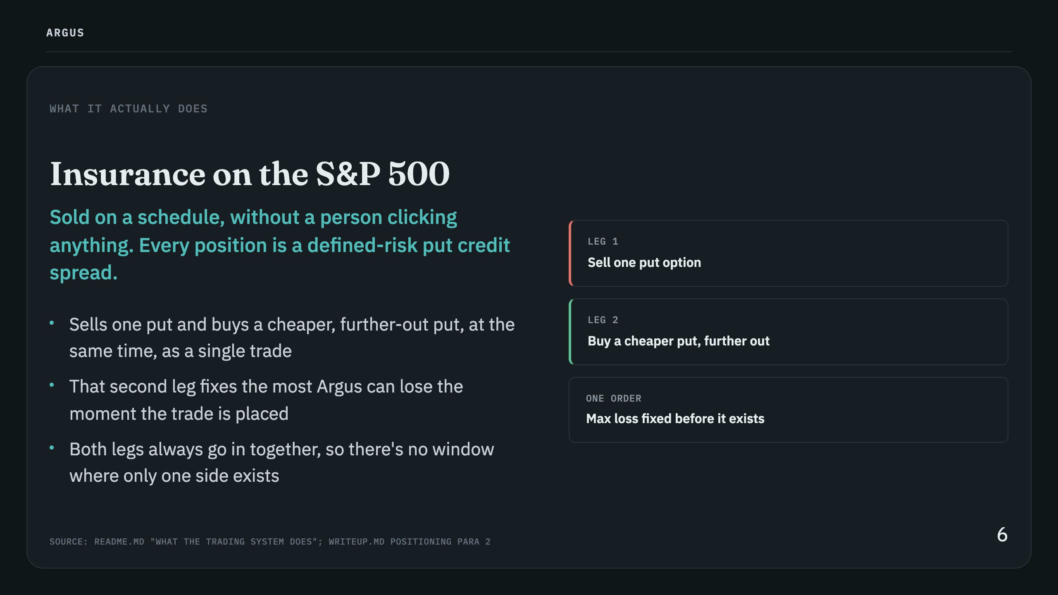

Slide 7
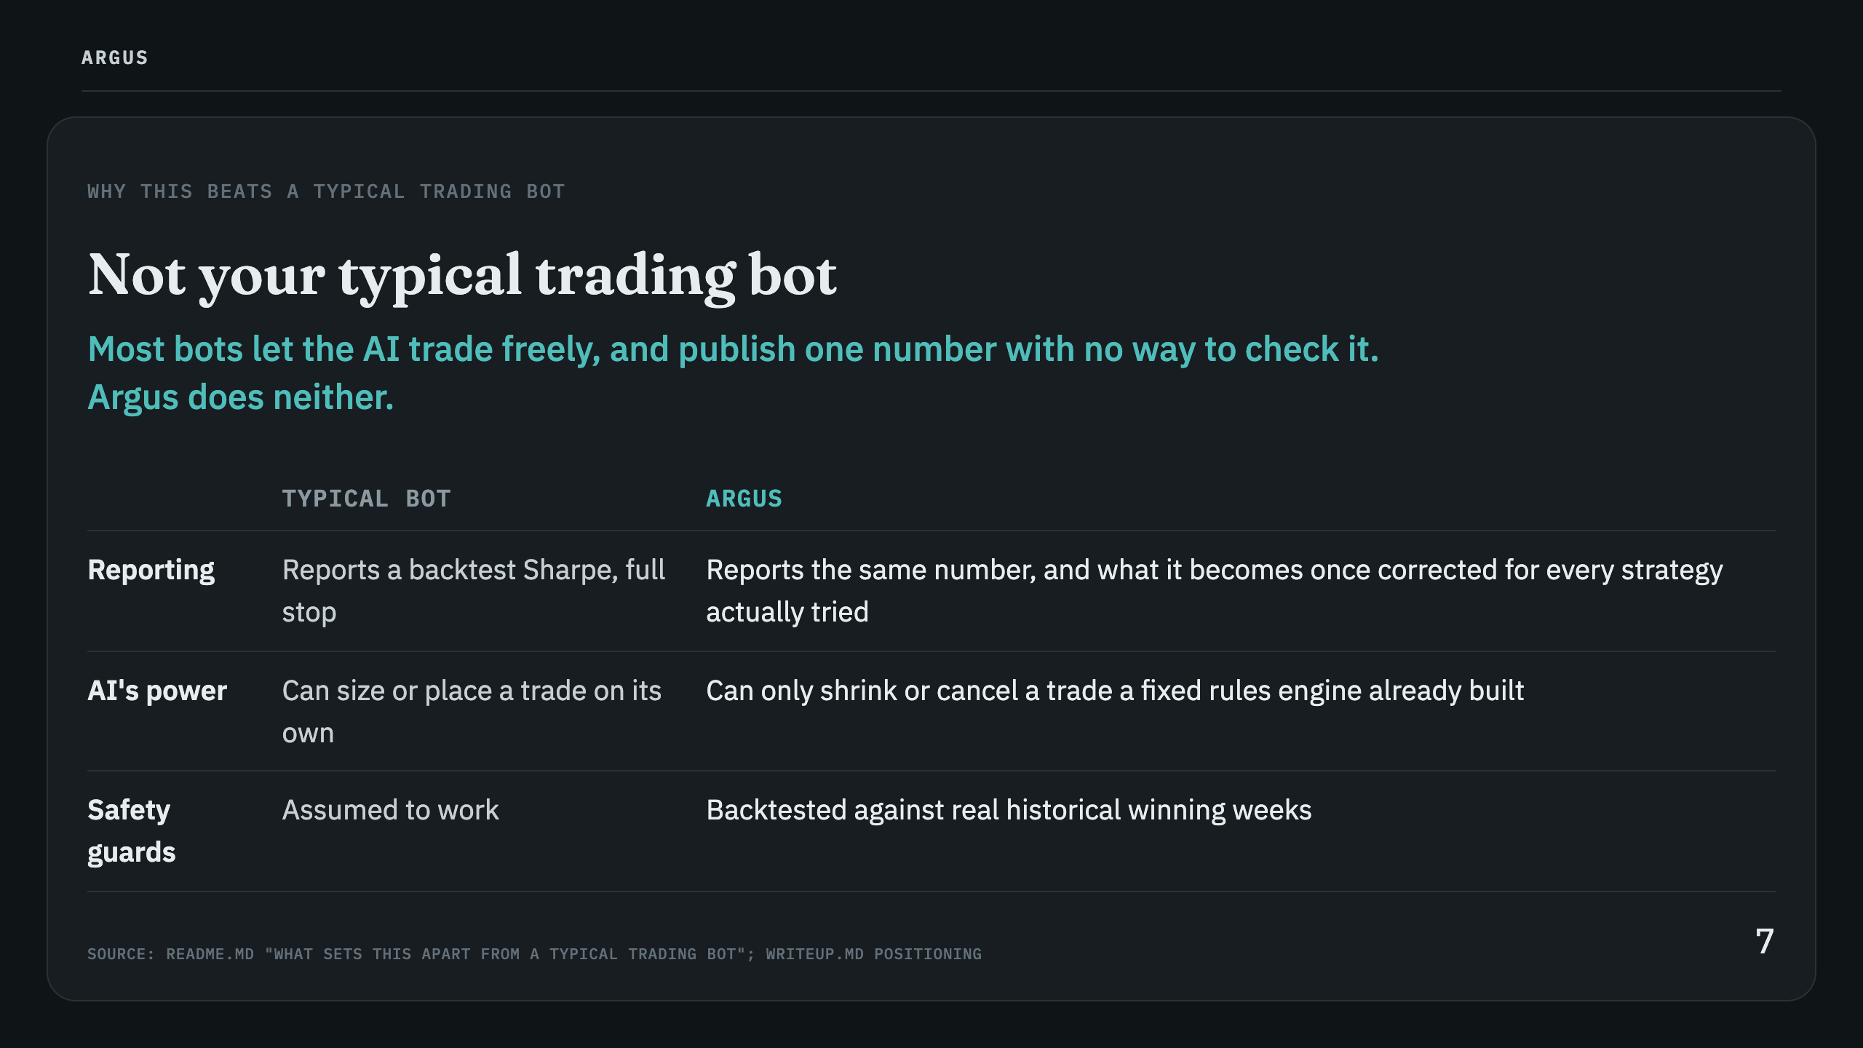
Notes:
Speaker notes: framed against the category of trading bots generally, never against other hackathon entries, matching this project's established positioning style.

Slide 8
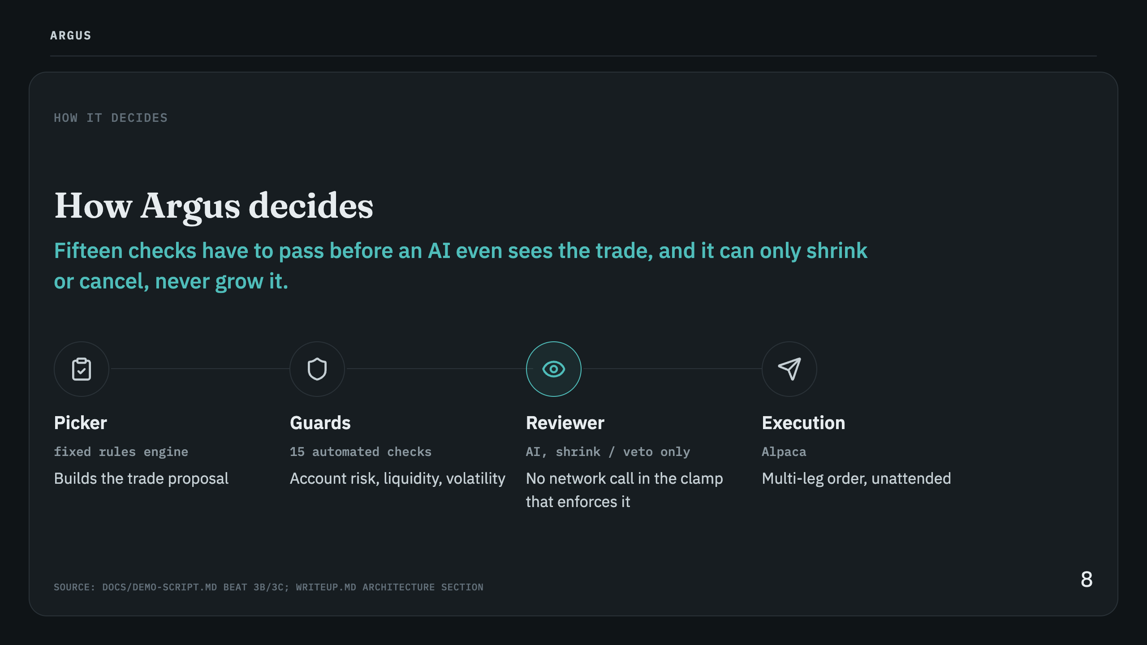
Notes:
Speaker notes: the limit that stops the AI from ever increasing a trade is not an instruction the model could ignore, it's a plain function with no network call in it, so the limit holds regardless of what the model outputs.

Slide 9
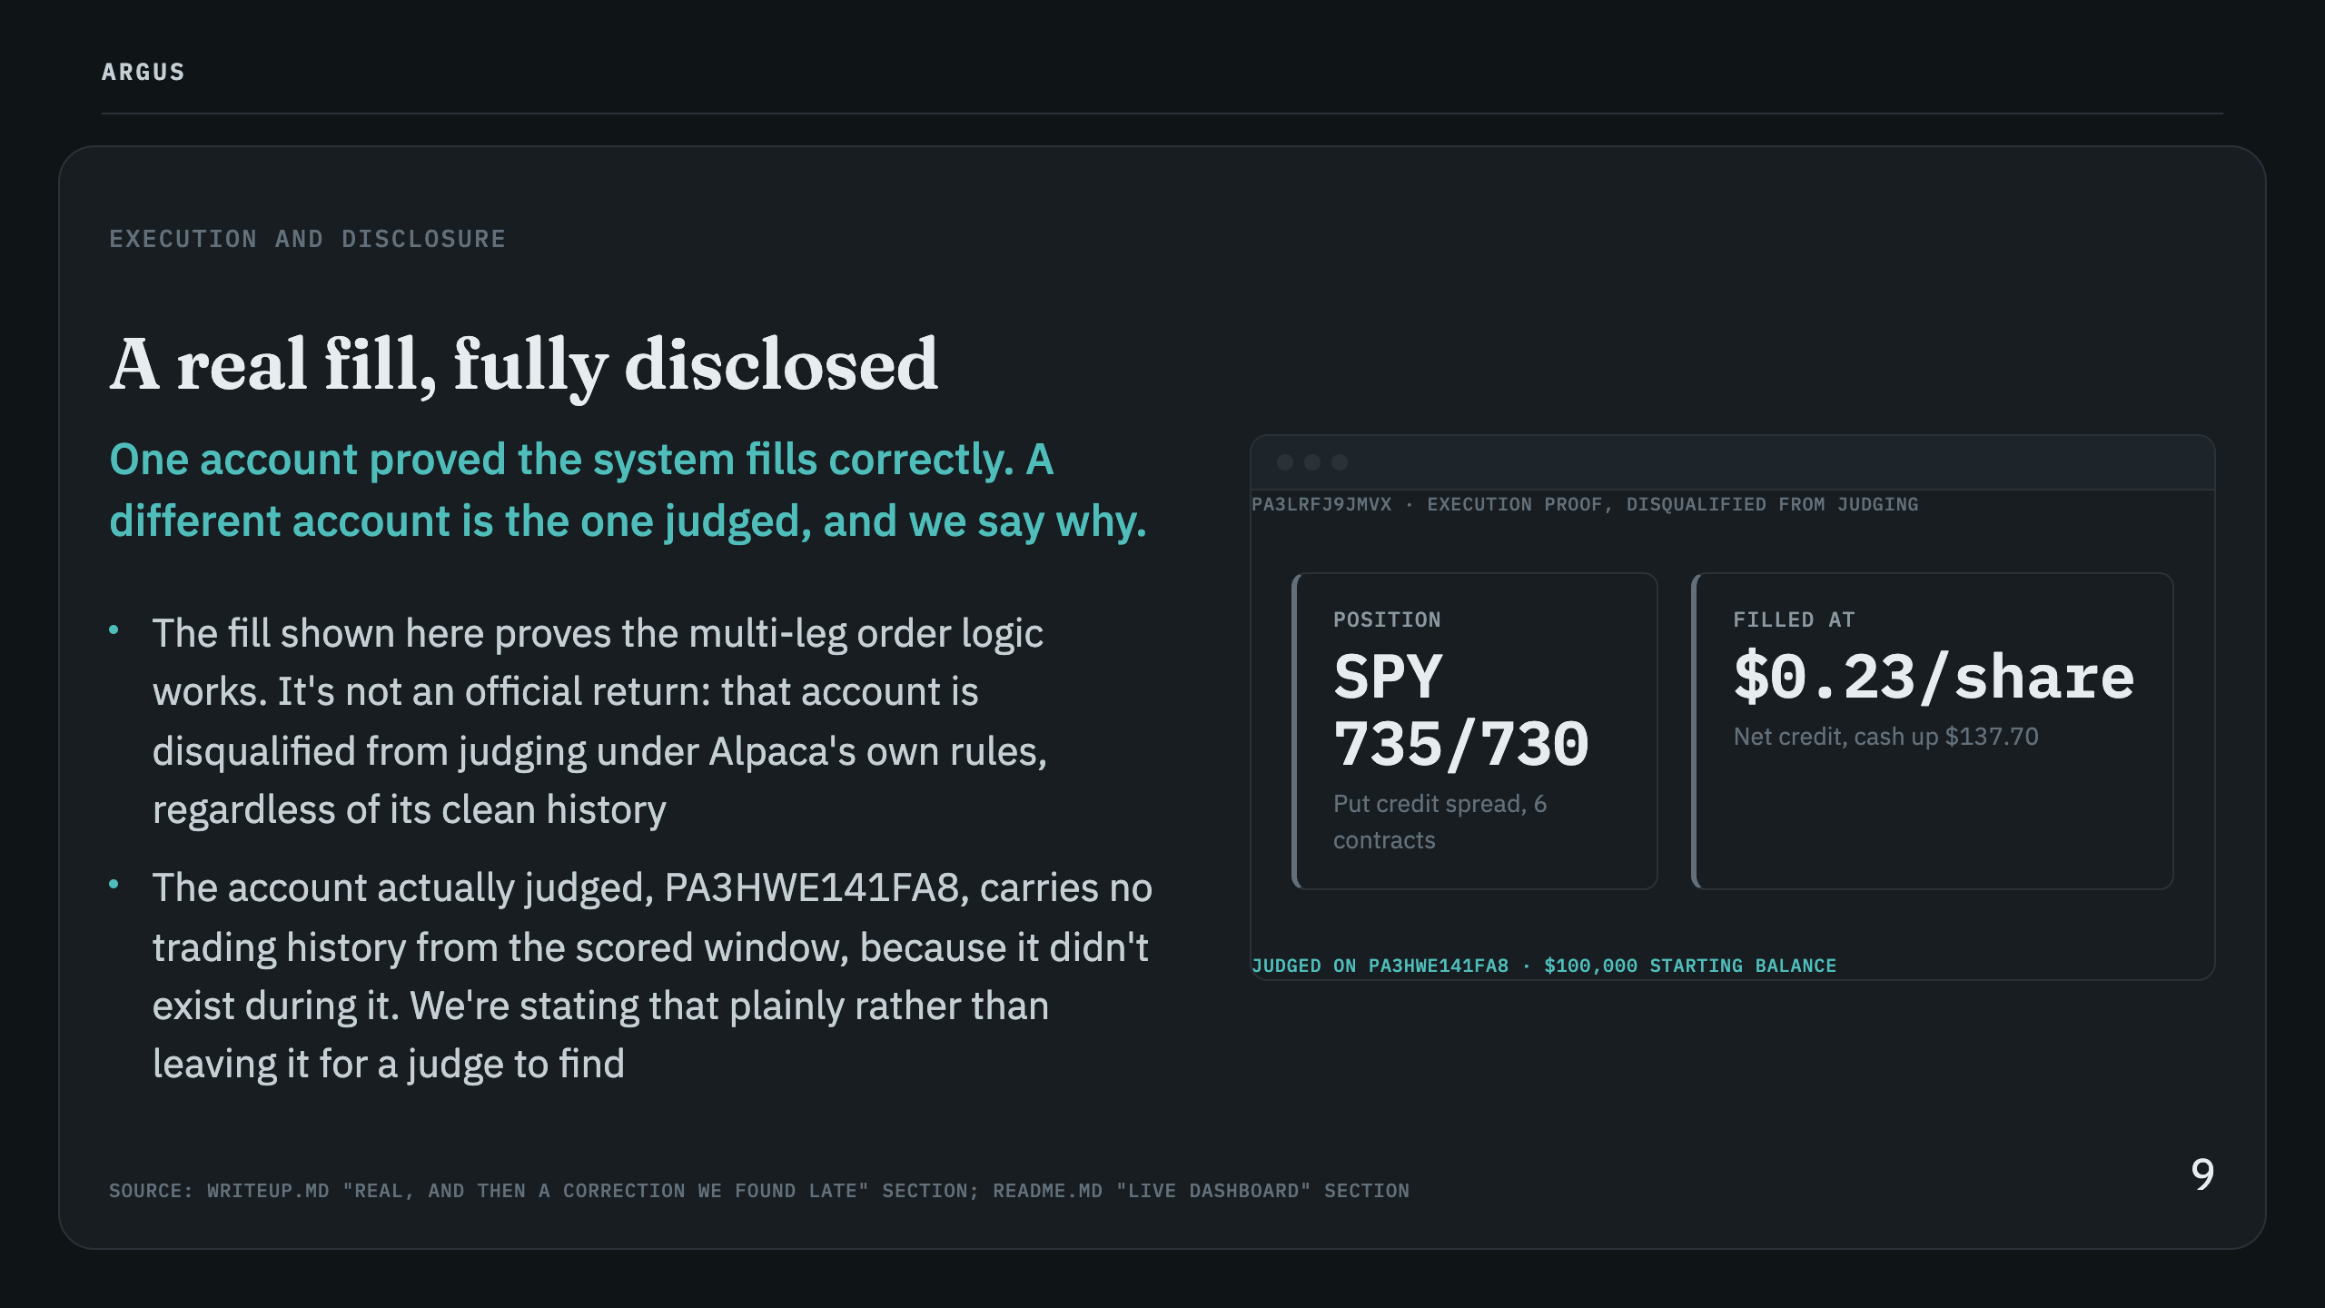

Slide 10
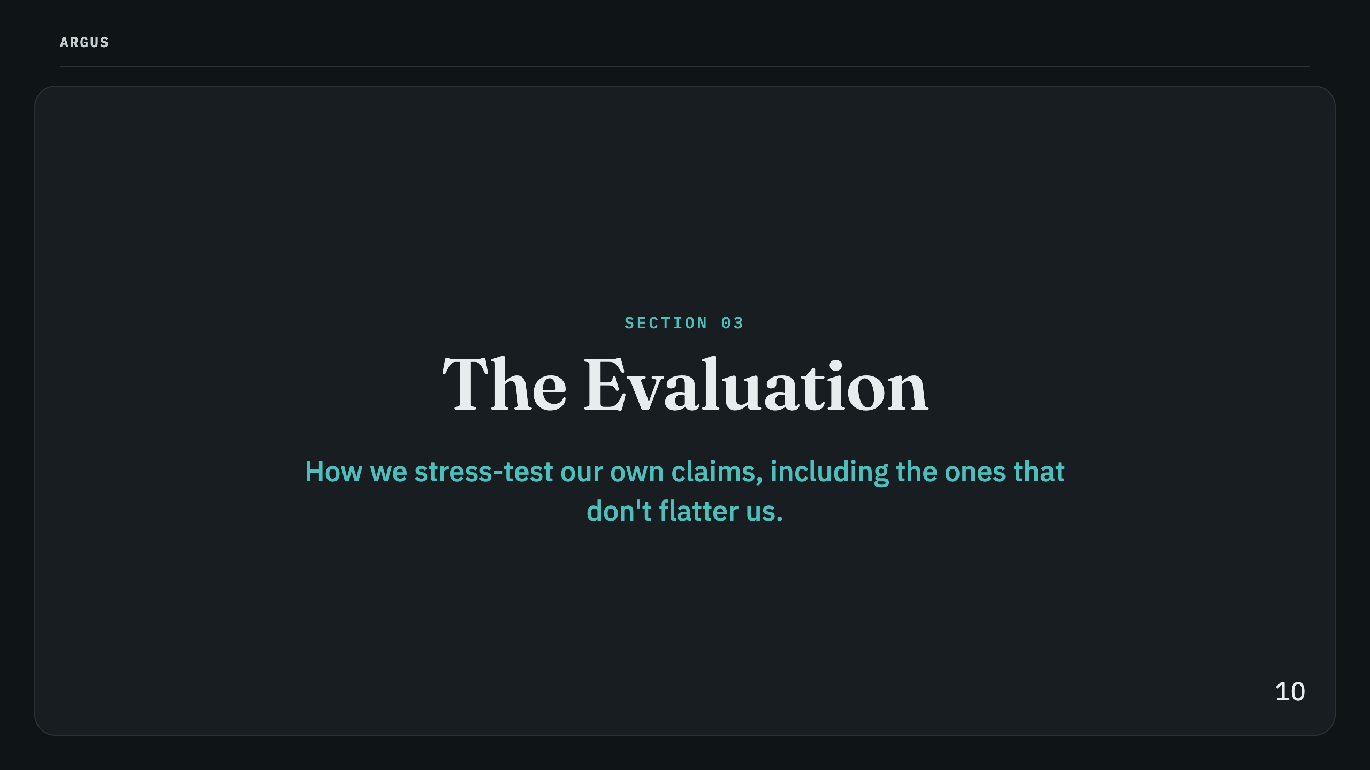

Slide 11
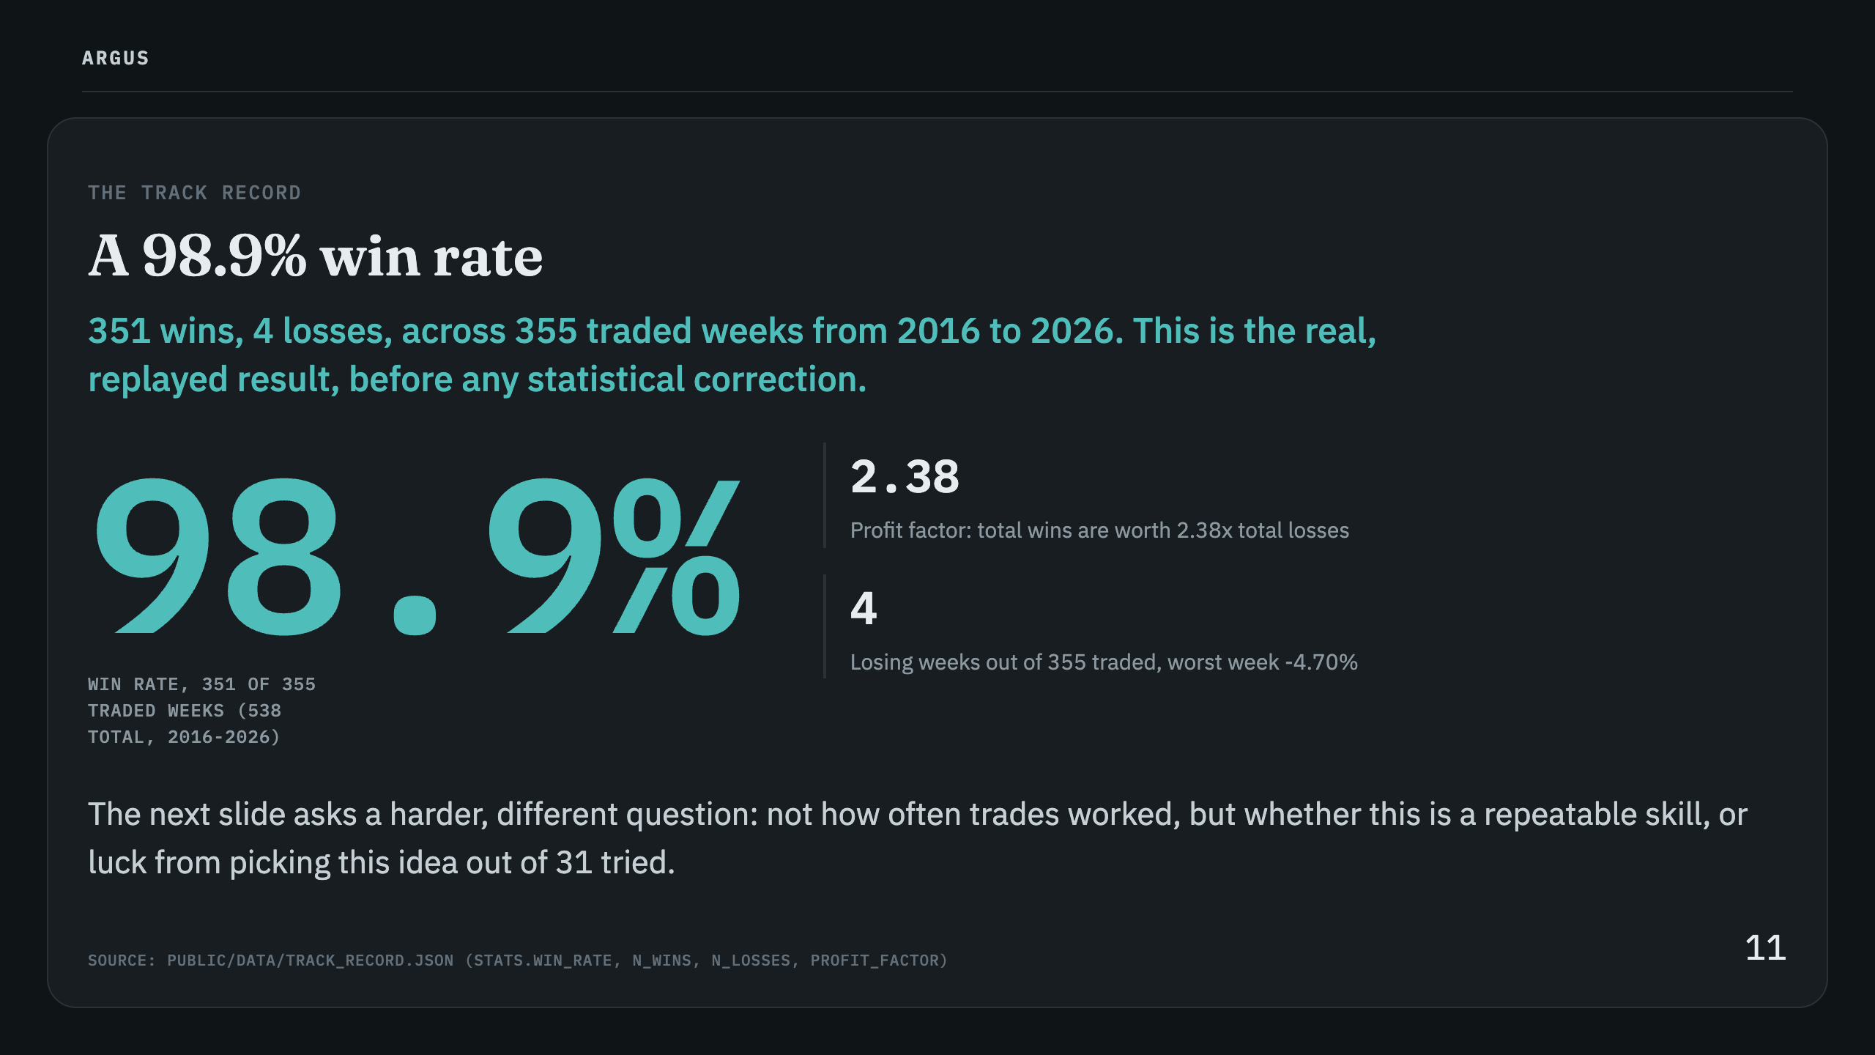

Slide 12
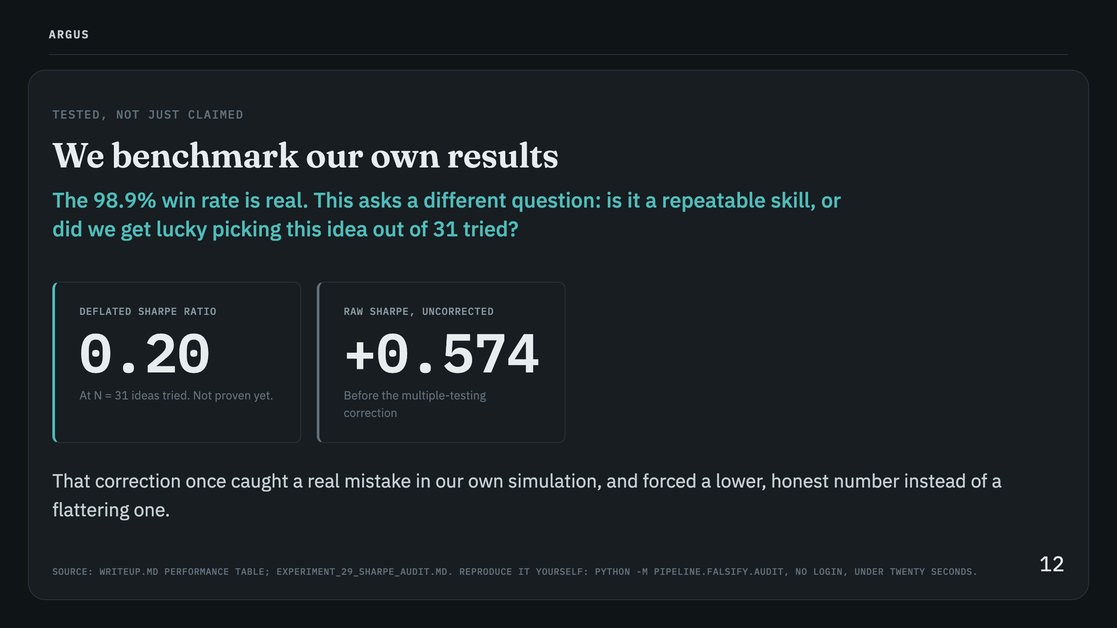
Notes:
Speaker notes: 0.20 is not a failing grade, it's an honest one, it says the edge hasn't cleared the bar for statistical proof yet and states exactly how far short it falls.

Slide 13
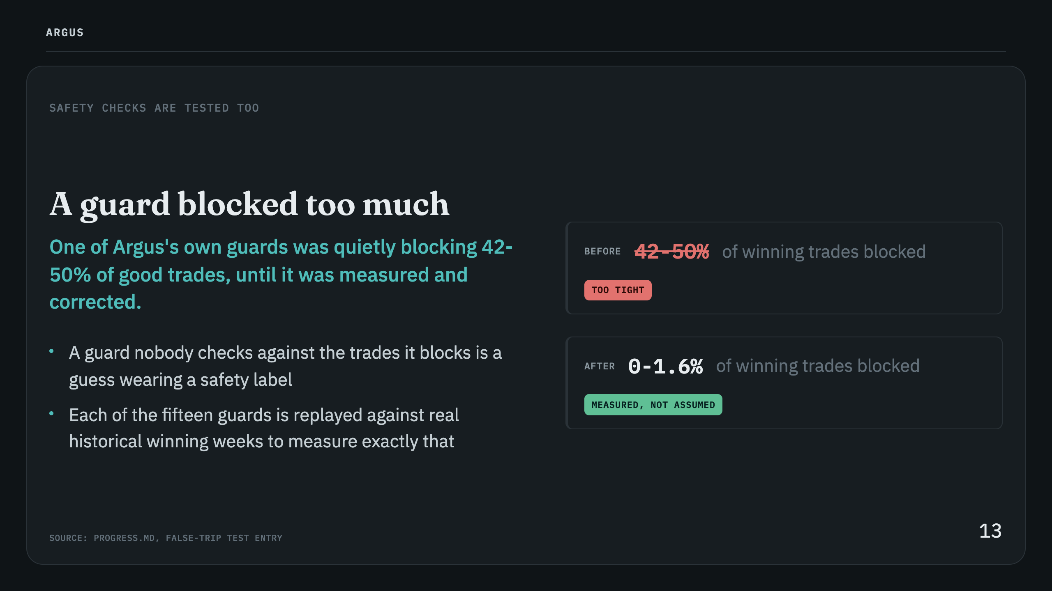

Slide 14
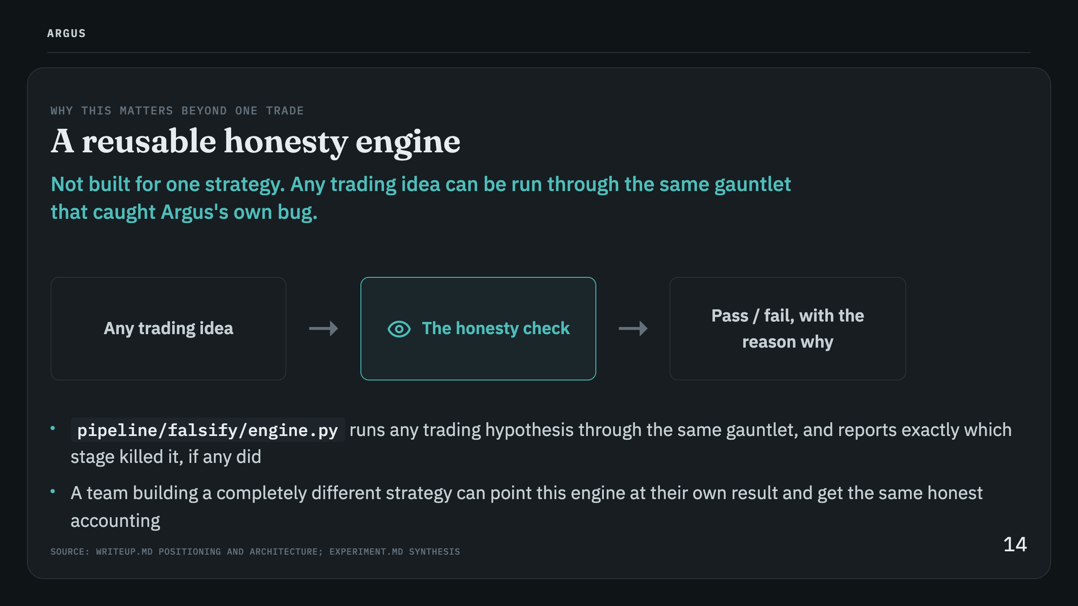

Slide 15
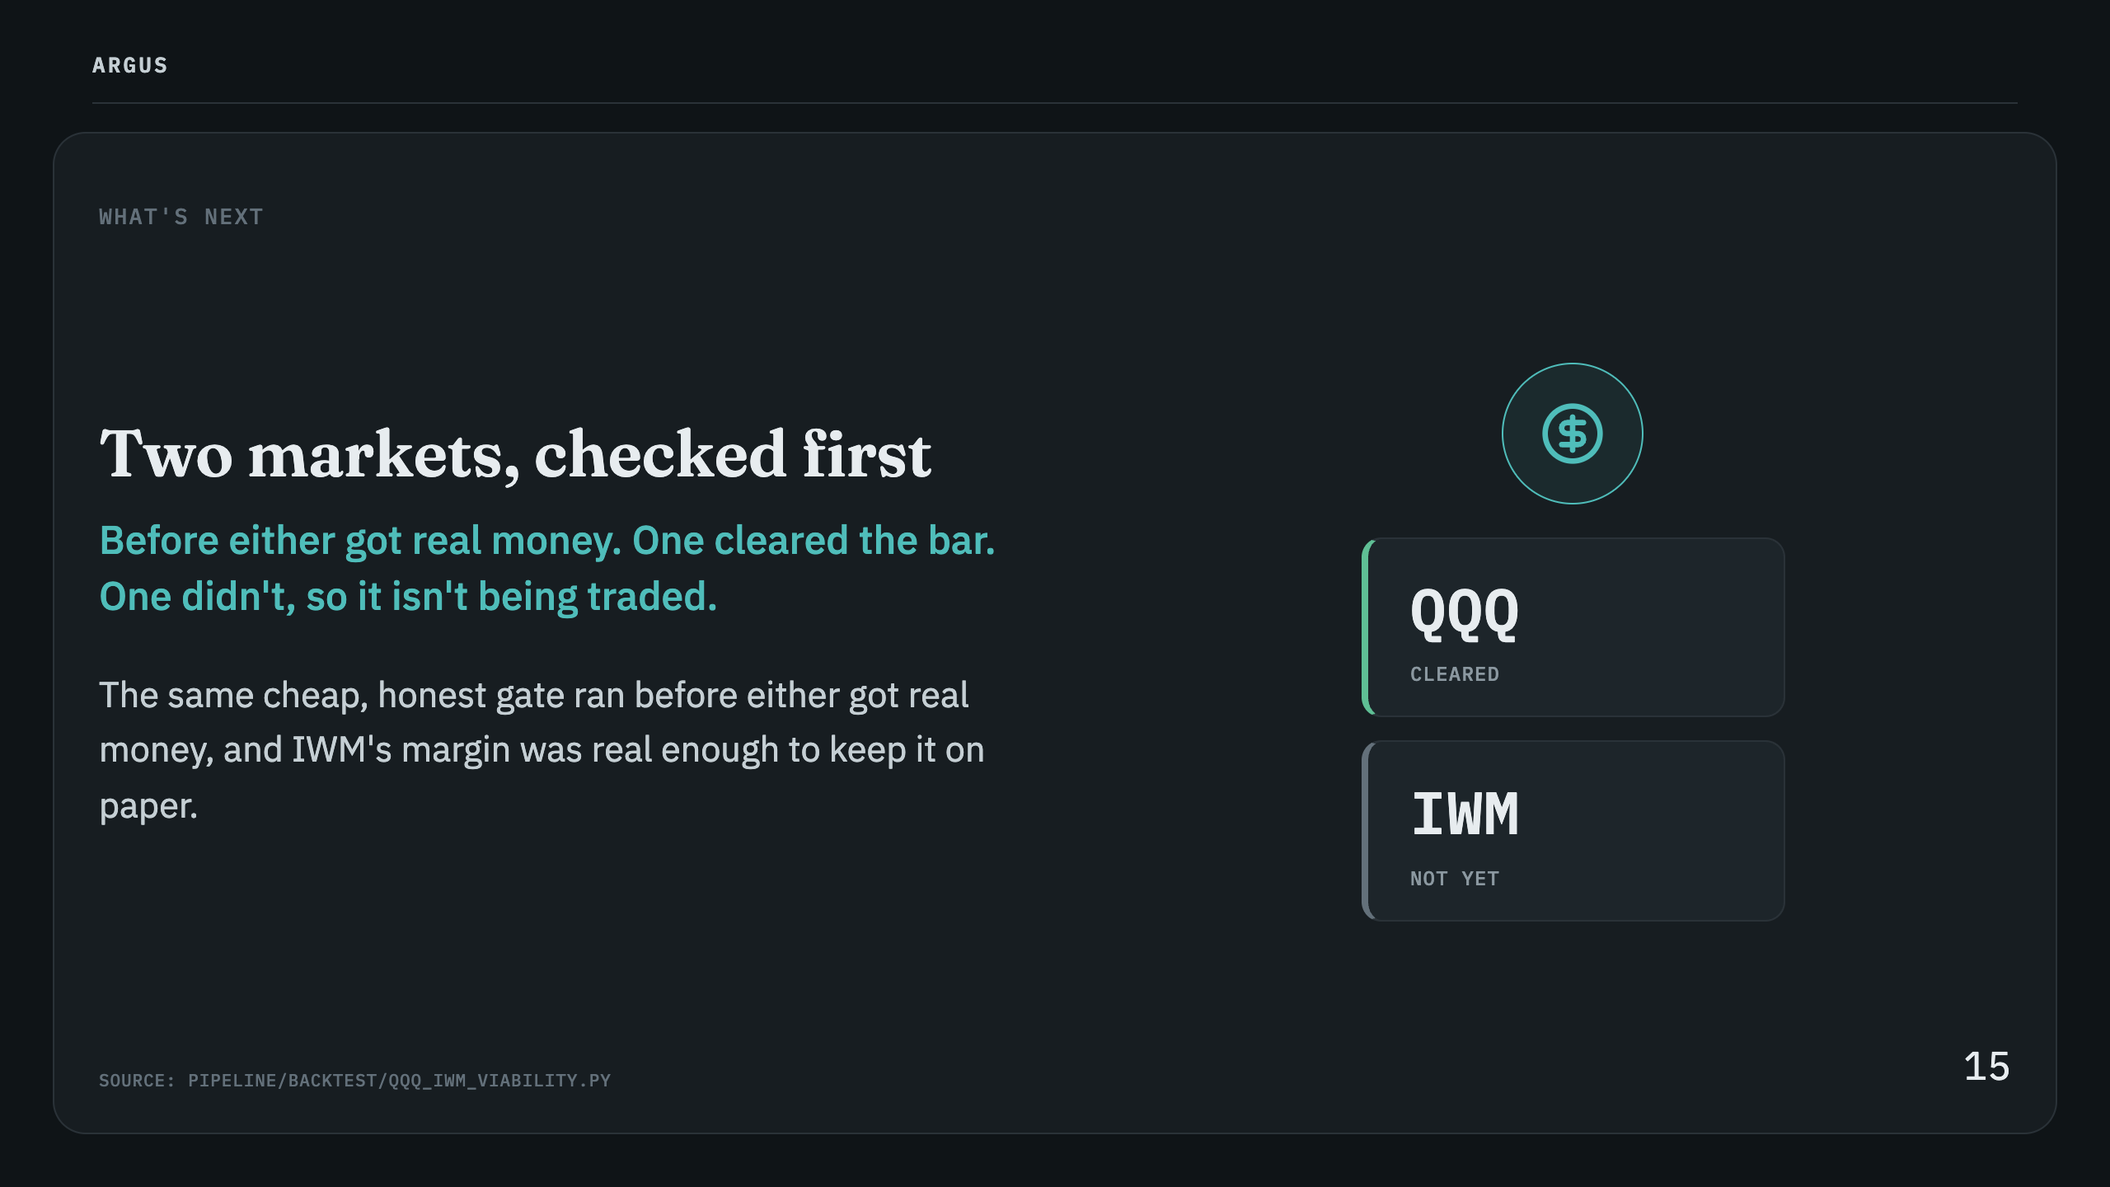

Slide 16
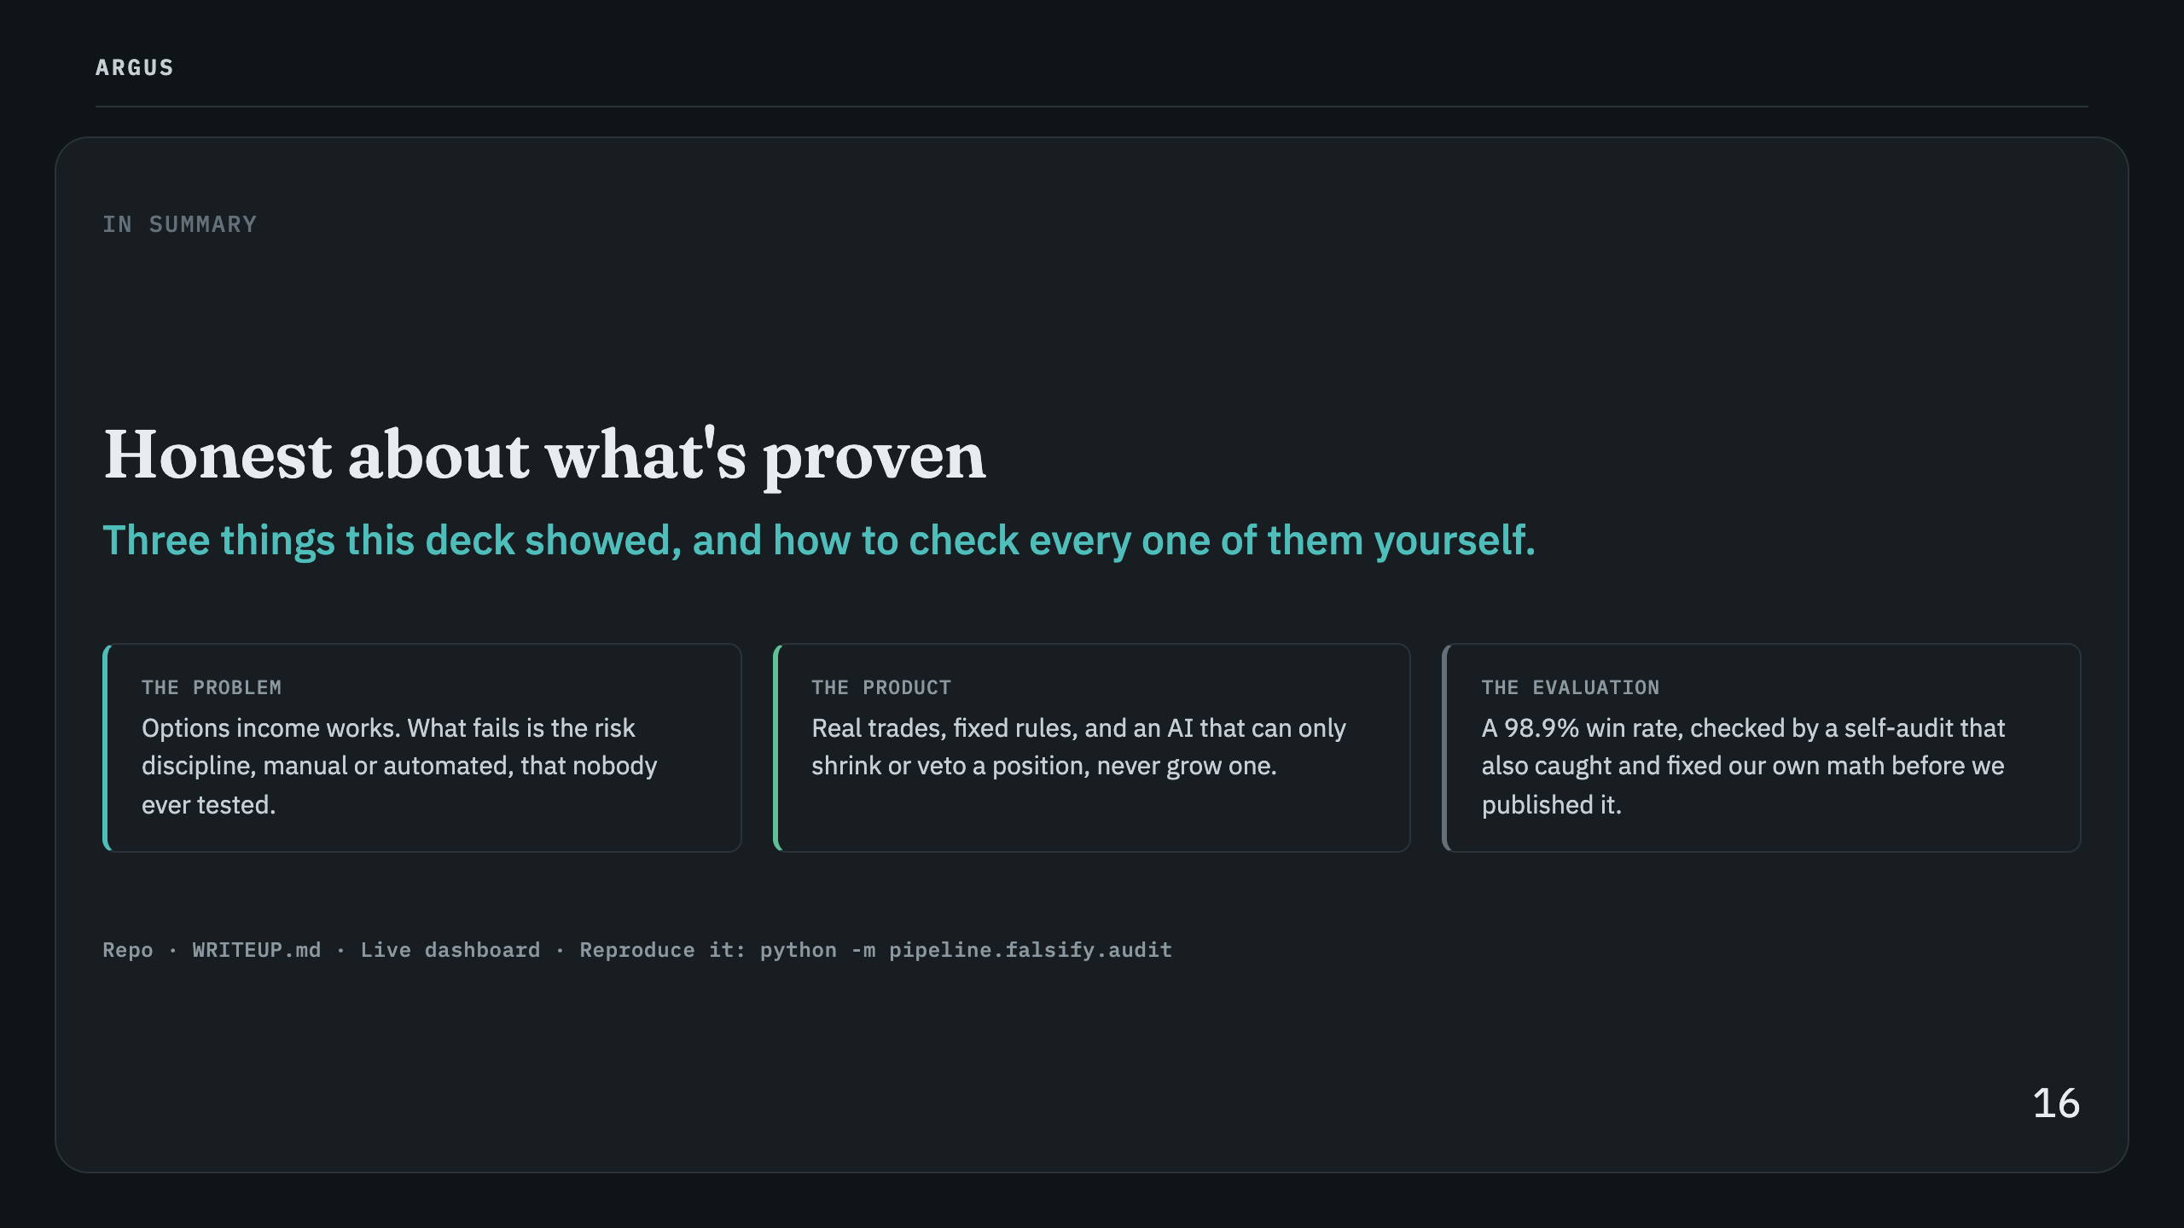

Slide 17
