Slide 1




Comic Stock Pitch
Nathan Hugo
Business Analyst
Tshiamo Seitshiro
Software Engineer
Choosing Entelect
Banele Mkhize
Software Engineer
Liam Abbott
Software Engineer
Notes:
Goodmorning everyone. We are Entelect, and we are here this morning to help you understand why choosing Entelect is the best decision you can make. To start off, getting to who we are… We understand your primary goal as a Comic Stock, is to become South Africa’s premier online comic retail business. We’ve looked at the system you want to build, we understand the requirements --- a working, frictionless, trustworthy, secure purchase process, to name a few --- and we know that we can bring your vision to life, ultimately moving you closer to your goal.

Slide 2



Who Is Entelect?
Relationships
Growth
Get Things Done
Notes:
There’s a few reasons why we know we can achieve this, all of which will be discussed during the duration of this presentation, but for now, we want to continue on the theme of getting to know Entelect.. Because we believe that simply getting to know to know Entelect and what we value, will make you understand the value in choosing us. On that note…

Slide 3










Our Clients
Notes:
Don’t take it from us, take it from our many satisfied clients. Entelect is proud to announce its recognition in the rankings of Africa’s Fastest Growing Companies for the second year in a row by the Financial Times for 2023.

Slide 4
Market Analysis
Based on a market research report, South African comic sales are expected to grow exponentially.
South Africa's current market is considered small, with limited locations and stores that sell comic-books.
The IMARC Group report that online comic platforms are growing globally due to convenience and accessibility.

Slide 5
Competitive Landscape
Current market opposition includes large comic stores such as Comic Warehouse, Cosmic Comics and Smallville Comics.
These competitors provide services nationwide and have a huge customer base.
These stores prioritize both online and in-store experiences, with many having online platforms that do not require users to have profiles, which results in lower customer retention.

Slide 6
Market Opportunity
Firstly, since Comic Stock only provides comics, it is a suitable product for customers that want to be immersed purely in the comic space.
Based off the requirement for an account-based system, user retention can grow and data collected from users can result in a more personalized experience.
From there we determined the requirements based on Comic Stocks vision, to structure our thought process.

Slide 7
Business Process
Customer
Adds item to cart
Selects cart
Views cart overview
Modify cart
Proceed to checkout
Enter address and shipping details
Continue to payment
Enter payment details
View order confirmation

Slide 8
Business process continued
System
Validate voucher
Add delivery fees
Send confirmation of order
Send delivery details to courier.
Payment Gateway
Verify payment details
Confirm payment
Delivery
View order details
Package order
Deliver order

Slide 9
UX research method
Guerilla testing used to identify feedback on the potential product usability.
The following was identified by potential users:
Button layout consistency.
Make visuals clearer.
Provide descriptions of the comics before adding to cart.
Simplified checkout process.
Users could follow the key process flow.
Users wanted multiple delivery options.
Allow users to save delivery and credential as part of their account.

Slide 10
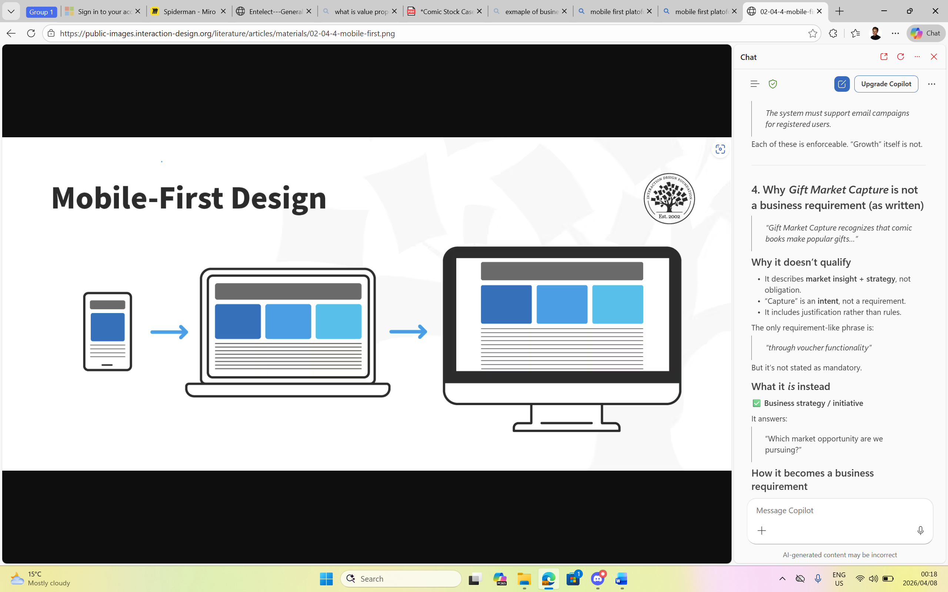

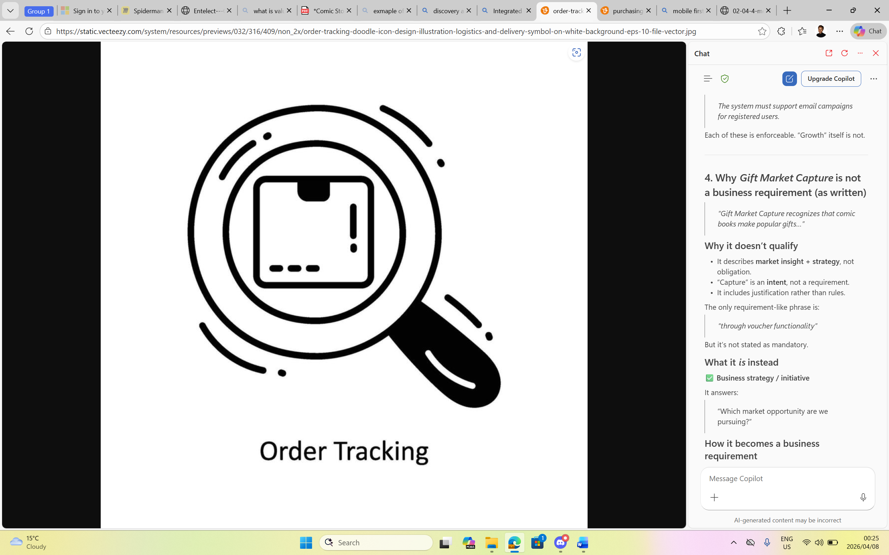
Proposed solution
Mobile first approach
Seamless comic discovery and purchasing
Integrated order tracking and delivery support

Slide 11
Specialised platform for comic book enthusiasts
Designed to scale long-term
Simple intuitive user experience
Fast and reliable purchasing
Value We Deliver

Slide 12
What will our solution look like?
Miro Wireframe mockups

Slide 13
Future Recommendations
Personalized recommendations
Community driven features.

Slide 14
Thank you!
Any Questions ?

