Slide 1
Web Design Principles
5th Edition
Chapter One
Writing HTML for the Modern Web

Slide 2
Objectives
In this chapter, you will learn about:
• Creating Web pages with HTML
• The history of HTML
• Working with HTML5
• Choosing an HTML editor
• Using good coding practices
Web Design Principles 5th Ed.

Slide 3
Creating Web Pages with HTML

Slide 4
Creating Web Pages with HTML
HTML is a markup language that lets you identify common sections of a Web page
Markup elements define each section
This <h1> element defines text as a first-level heading:
<h1>What is HTML?</h1>
Web Design Principles 5th Ed.

Slide 5
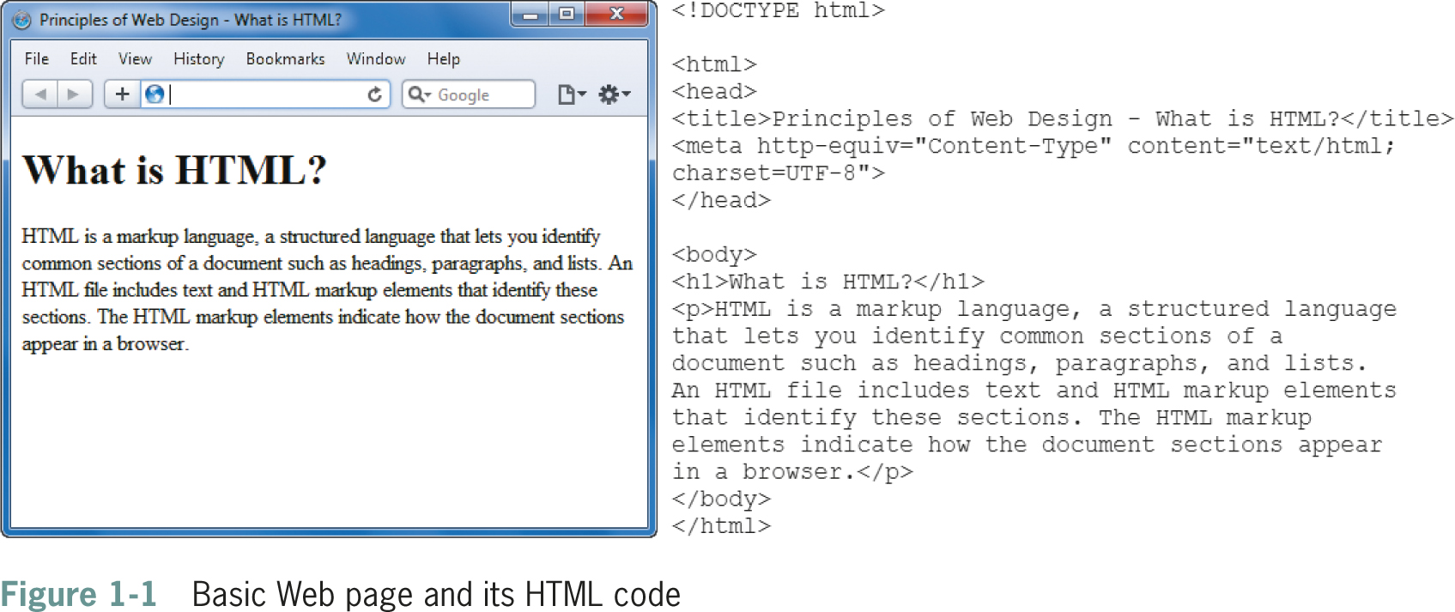
Creating Web Pages with HTML
Web Design Principles 5th Ed.

Slide 6
Structure of a Basic Web Page
The HTML file contains content text and HTML markup
The HTML markup does not appear in the browser
The browser interprets the code and displays the results
Web Design Principles 5th Ed.

Slide 7
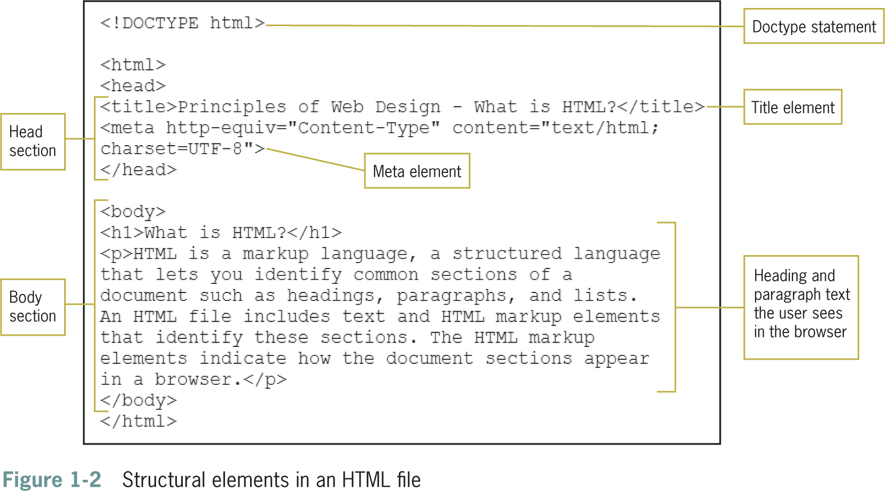
Web Design Principles 5th Ed.

Slide 8
Structure of a Basic Web Page
The document type, or doctype for short, specifies the rules for the document language
The <html> tag is the root element
The two main sections are the <head> and <body> elements
The head section is the container for all of the descriptive information about the document
The <body> section includes the content that the user sees in the browser window
Web Design Principles 5th Ed.

Slide 9
Structure of a Basic Web Page
The body of the document can contain:
  Text
  Images
  Video content
  Audio content
  Forms for gathering information
  Interactive content
  Links to other Web resources
Web Design Principles 5th Ed.

Slide 10
HTML in the Browser
The browser interprets the HTML markup elements and displays the results, hiding the actual markup from the user
Each browser interprets HTML in its own way, based on its rendering engine
It is essential that you test your work in different Web browsers
Web Design Principles 5th Ed.

Slide 11
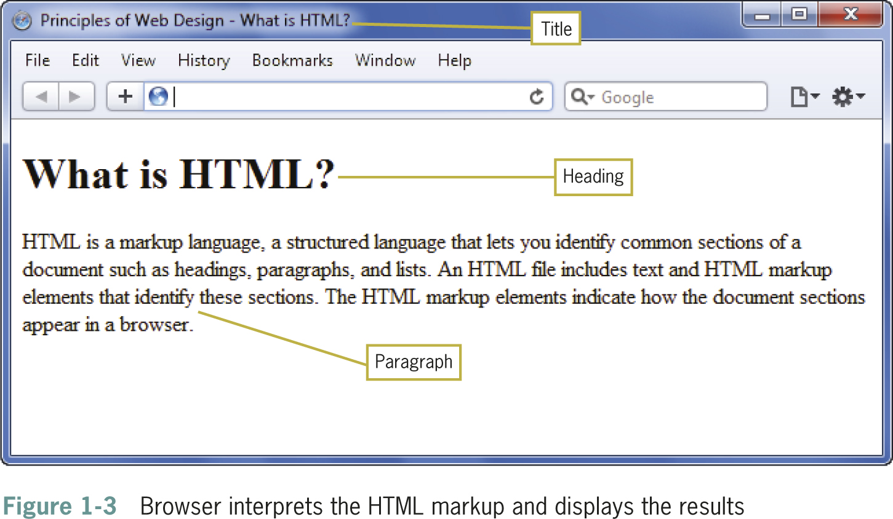
Web Design Principles 5th Ed.

Slide 12
Adding Style with CSS
Web designers use Cascading Style Sheets (CSS) to add presentation information to Web pages
With CSS you can display information for different devices
With style sheets, the presentation properties are separate from the content
CSS lets you control the presentation characteristics of an entire Web site with a single style sheet
Web Design Principles 5th Ed.

Slide 13
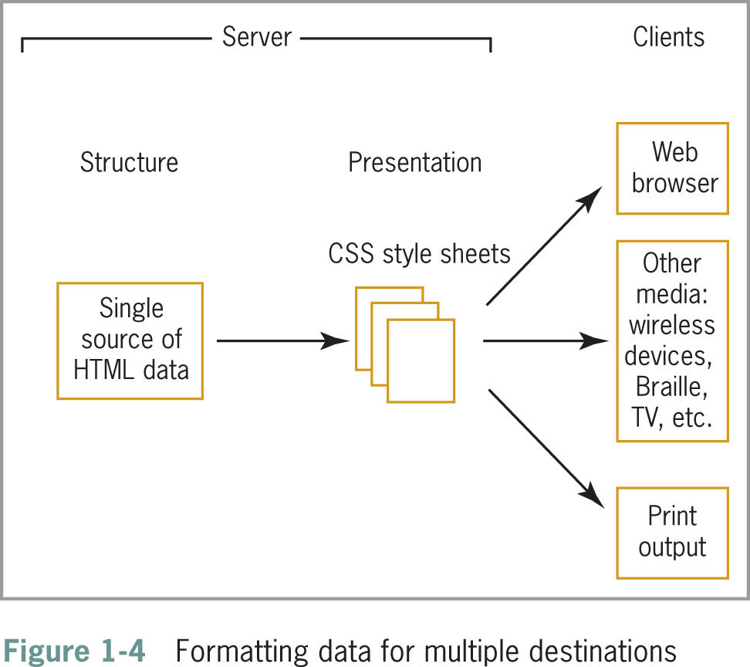
Web Design Principles 5th Ed.

Slide 14
Adding Style with CSS
The next two figures show CSS style rules and the result in the browser
The style rules in Figure 1-5 specify that the body text for the page will be Arial, the h1 will have a bottom border, and the paragraph will have a 30-pixel left margin.
Figure 1-6 shows the results in Firefox
Web Design Principles 5th Ed.

Slide 15
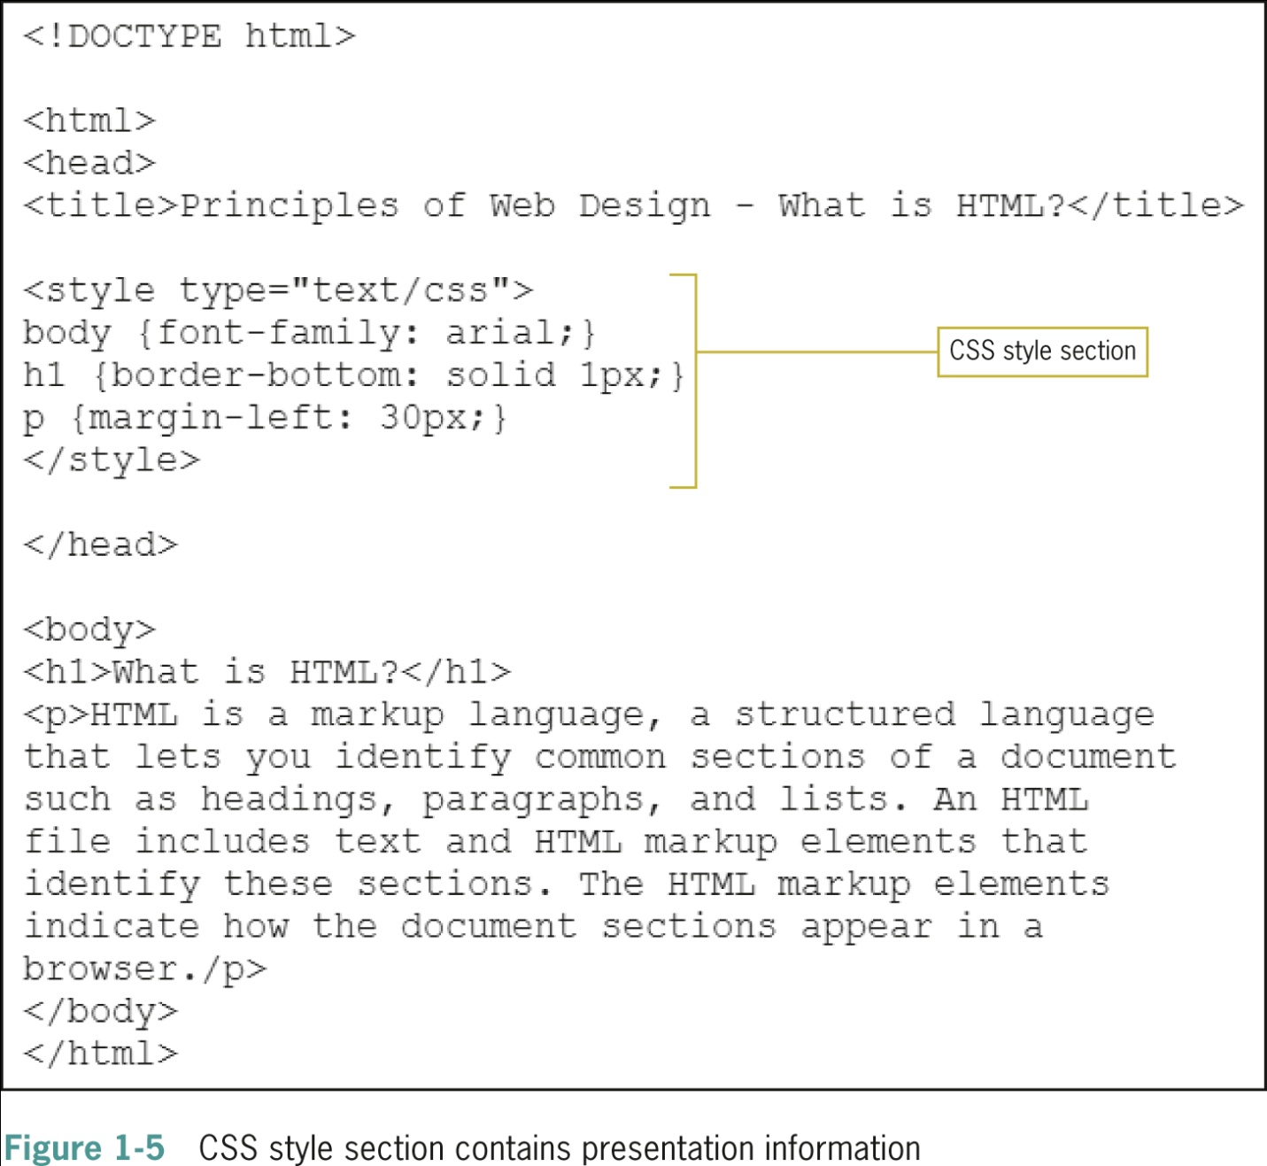
Web Design Principles 5th Ed.

Slide 16
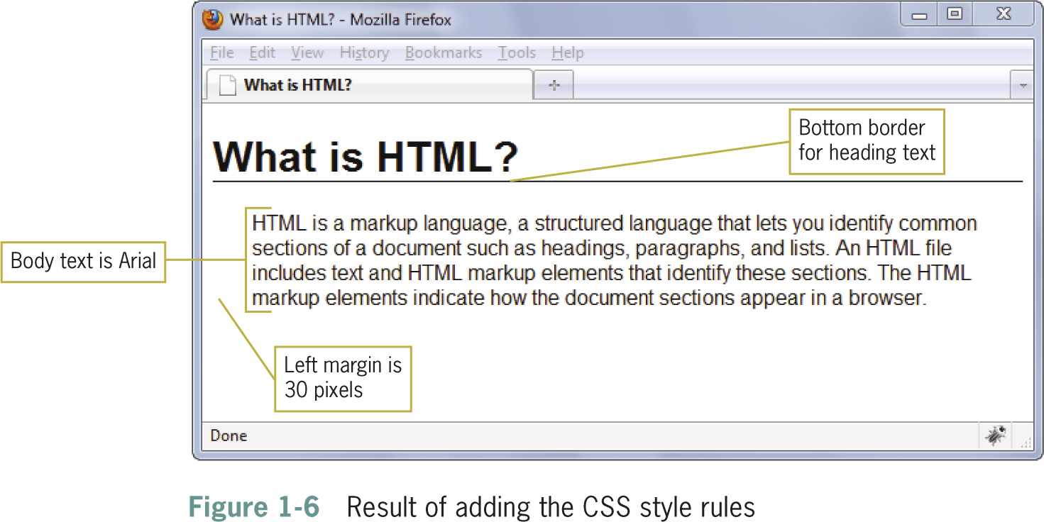
Web Design Principles 5th Ed.

Slide 17
Organizing Information with Hypertext
The World Wide Web links information on related topics using hypertext
You determine which terms to create as hypertext links and where users end up when they click a link
The different types of linked content and media continually evolve
Web Design Principles 5th Ed.

Slide 18
The History of HTML

Slide 19
The History of HTML
As a Web designer, you will encounter all types of HTML coding practices
Understanding the evolution of HTML will help you understand various Web design methods
To be a successful Web designer, you need to understand the past, present, and future directions of HTML, coding standards, and common practices
Web Design Principles 5th Ed.

Slide 20
The History of HTML
Tim Berners-Lee first proposed HTML at the European Laboratory for Particle Physics (CERN) in 1989
Berners-Lee joined the ideas of the browser, a markup language (HTML), and a communications protocol that allowed hypertext linking
Not only could people read documents, they could easily create them using HTML
Web Design Principles 5th Ed.

Slide 21
The History of HTML
HTML is an application of the Standard Generalized Markup Language (SGML), a standard system for specifying document structure
Berners-Lee joined the ideas of the user interface (browser), a markup language (HTML), and a communications protocol (http:) that allowed hypertext linking
Web Design Principles 5th Ed.

Slide 22
A Need for Standards
The World Wide Web Consortium (W3C) was founded in 1994 MIT
The World Wide Web Consortium sets standards for HTML and other markup languages
Jointly developed standards, rather than ones dictated by one vendor, benefit everyone
Web Design Principles 5th Ed.

Slide 23
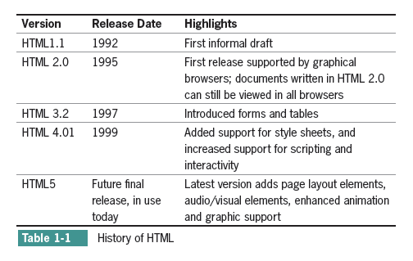
A Need for Standards
Web Design Principles 5th Ed.

Slide 24
XML and XHTML – A New Direction
In 1997, the W3C released XML, the Extensible Markup Language
XML is essential to creating applications for the Web
XML lets developers define their own markup language
XML has a stricter syntax than HTML
Web Design Principles 5th Ed.

Slide 25
XML Syntax Rules
Documents must be well-formed
All tags must nest properly and not overlap
Use all lowercase for element names
Always use closing tags
Empty elements are signified by a closing slash
Attribute values must be contained in quotation marks
Web Design Principles 5th Ed.

Slide 26
Sample XML
<poem>
<title>An Ode to the Web</title>
<stanza>
<line>So many Web sites</line>
<line>So little time</line>
<line>And all I want to do</line>
<line>Is critique their design!</line>
</stanza>
</poem>
Web Design Principles 5th Ed.

Slide 27
XML and XHTML – A New Direction
XML syntax provides a solution to the problem of widely varying HTML coding standards
The W3C combined XML and HTML to create XHTML
XHTML follows the rules of XML
Web developers readily adopted XHTML and CSS to standardize coding
Many Web sites benefited from leaner standardized code
Web Design Principles 5th Ed.

Slide 28
Problems with XHTML
Relaxed syntax rules still must be applied because of legacy code
Newer versions of XHTML moved too far away from existing Web development
XHTML was not well received by the development community
Web Design Principles 5th Ed.

Slide 29
A Proposal for HTML5
The Web Hypertext Application Technology Working Group (WHATWG) proposed HTML5
HTML5:
  Supports standards-based coding
  Compatible with HTML and XHTML
  Compatible with CSS
  Supports new page layout elements
  Application and media compatible
Web Design Principles 5th Ed.

Slide 30
Working with HTML5

Slide 31
Working with HTML5
HTML5 attempts to address shortcomings of HTML
Addresses needs of modern Web design
Offers new features:
  Logical layout elements
  Rich media
  Support for applications
Removes old features:
  All display elements have been removed in favor of CSS
  Framesets are gone
Web Design Principles 5th Ed.

Slide 32
Working with HTML5
HTML5 offers two syntaxes:
  An HTML-compatible syntax
  An XML-compatible syntax
HTML-compatible syntax
  More relaxed syntax
  Code shortcuts allowed
XML-compatible syntax
  Consistent with XHTML
  Uses XML syntax rules
Web Design Principles 5th Ed.

Slide 33
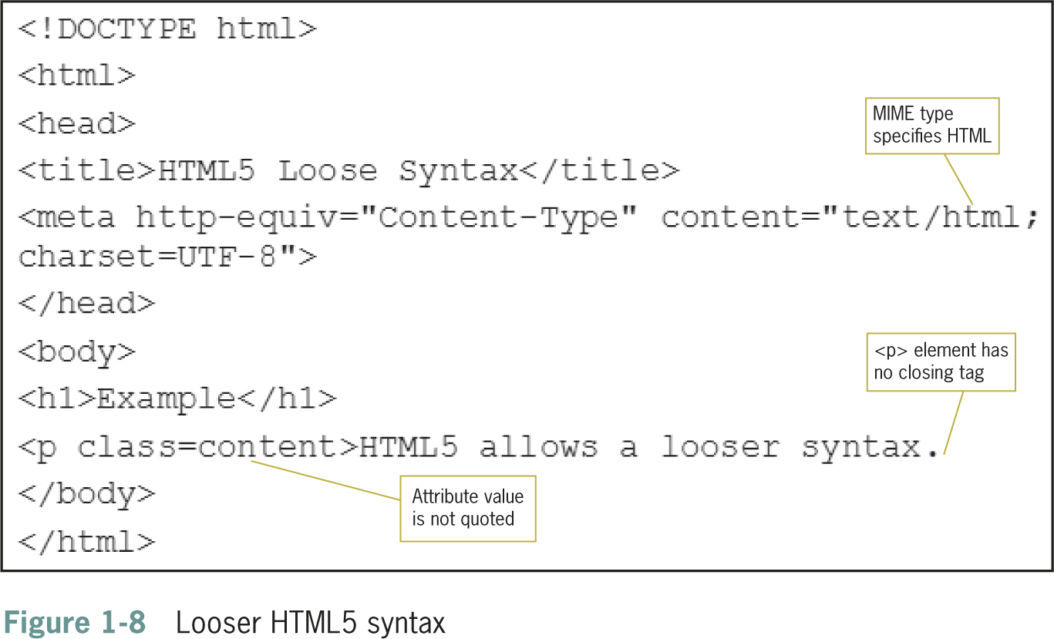
Working with HTML5
Web Design Principles 5th Ed.

Slide 34
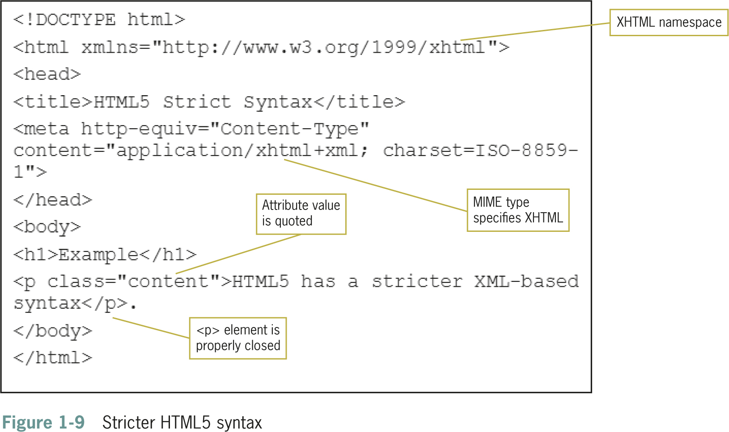
Working with HTML5
Web Design Principles 5th Ed.

Slide 35
Choosing the Correct Syntax
HTML5 allows a mixture of these two types of syntax into one document
A polyglot document: mixed language
Use XML coding standards in your HTML documents
Lets you create standardized, compatible code
Web Design Principles 5th Ed.

Slide 36
Choosing the Correct doctype
Always use a doctype statement
Using a doctype forces the browser to display in standards mode
The standard doctype statement for HTML5:
<!DOCTYPE html>
Web Design Principles 5th Ed.

Slide 37
Choosing the Correct MIME type
Multipurpose Internet Mail Extensions (MIME) defines content types for the Web
Determines the type of document
Declared in a <meta> element in the <head> section
Also contains a character set identifier
Your <meta> element should look like this:
<meta http-equiv="Content-Type" content="text/html; charset=utf-8">
Web Design Principles 5th Ed.

Slide 38
Creating Syntactically Correct Code
Documents must be well-formed
All tags must nest properly and not overlap
Use all lowercase for element names
Always use closing tags
Empty elements are marked with a closing slash
Attribute values must be contained in quotation marks
Web Design Principles 5th Ed.

Slide 39
HTML5 Element Categories
Metadata content
Flow content
Sectioning root
Sectioning content
Heading content
Phrasing content
Embedded content
Interactive content
Transparent
Web Design Principles 5th Ed.

Slide 40
New Elements in HTML5
HTML5 has a number of new elements; see Table 1-2 in the text
Not all elements are supported by current browsers
Test new elements carefully
Web Design Principles 5th Ed.

Slide 41
Attributes in HTML5
Elements can contain attributes that set properties
Earlier versions of HTML had more attributes
HTML5 has less attributes because of CSS
Global attributes can be applied to any element
Web Design Principles 5th Ed.

Slide 42
Obsolete Elements in HTML5
Many elements have been removed in HTML, mostly involving presentation effects
Framesets are no longer available
Web Design Principles 5th Ed.

Slide 43
Using HTML5 Elements for
Page Structure
Most Web pages contain common characteristics:
  Header
  Navigation
  Articles
  Figures
  Footers
  Sidebars
These are currently marked up with <div> elements and id or class names
Web Design Principles 5th Ed.

Slide 44
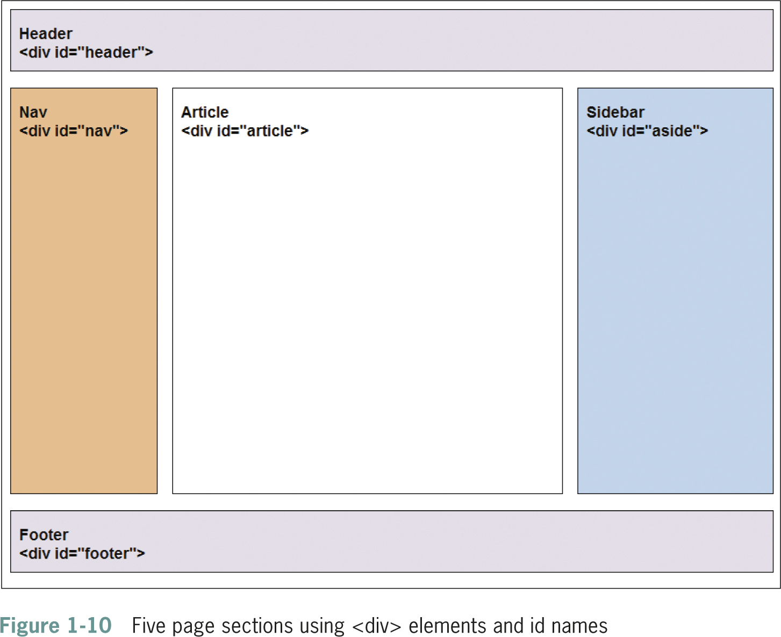
Web Design Principles 5th Ed.

Slide 45
Using HTML5 Elements for
Page Structure
HTML5 offers a new set of elements for describing document structure
HTML5 replaces the use of <div> with named elements to structure the page
The <article> element can be used instead of the <div> element, for example:
<article>This is the main content of the Web page</article>
Web Design Principles 5th Ed.

Slide 46
Using HTML5 Elements for
Page Structure
The HTML5 elements for page layout include:
  <header> Contains the page header content
  <nav> Contains the navigation elements for the page
  <article> Contains the primary page content
  <section> Defines sections or groupings of page content
  <aside> Contains additional content such as a quote or sidebar
  <figure> Contains images for the article content
  <footer> Contains page footer content
Web Design Principles 5th Ed.

Slide 47
Interactive Capabilities in HTML5
Audio and video
Drawing canvas
Background application processing
Local data storage
Web Design Principles 5th Ed.

Slide 48
Choosing an HTML Editor

Slide 49
Choosing an HTML Editor
Editors are either code-based or WYSIWYG (What You See is What You Get)
Some editors offer both methods
Many editors offer built-in code validators and FTP clients
You can find low-cost freeware or shareware editors
You can also use a text editor to create Web pages
Web Design Principles 5th Ed.

Slide 50
Choosing an HTML Editor
HTML editors contain their own logic for interpreting code
Make sure to check your work in multiple browsers
Some editors create overly complex code
Web Design Principles 5th Ed.

Slide 51
Using Good Coding Practices

Slide 52
Using Good Coding Practices
Creating code that ensures the greatest standards-compliance, presentation, and usefulness of your content
  Stick to the standards
  Use semantic markup
  Validate your code
Web Design Principles 5th Ed.

Slide 53
Stick to the Standards
Stick to the W3C standards
Separate content from presentation
Plan to be accessible to different devices
Standardized design is more accessible
Web Design Principles 5th Ed.

Slide 54
Use Semantic Markup
Semantic markup identifies the intended use of document sections
Accurately describes each piece of content
Until recently, this logical use of the HTML elements was largely ignored
Document elements match the meaning and usage of the document sections: <p> for paragraph, <h1> for top-level heading, and so on
Web Design Principles 5th Ed.

Slide 55
Validate Your Code
Valid code conforms to the usage rules of the W3C
The lack of valid code is a major problem
Valid code enhances browser compatibility, accessibility, and exchange of data
The most common mistakes include:
  No doctype declaration
  Missing closing tags
  Missing alt attributes in <img> elements
  Incorrect tag nesting
  Unquoted attributes
Web Design Principles 5th Ed.

Slide 56
Migrating from Legacy HTML to HTML5
The transition should be a gradual process
Clean up code on existing pages
Plan coding conventions for new pages, removing deprecated elements
Move display information to CSS
Test for backwards compatibility
Web Design Principles 5th Ed.

Slide 57
Summary
Make sure to check for support of new HTML5 elements, and test carefully before adding them to your Web site
Use the HTML5 naming conventions to name the content sections of your site even if only using them as class or id names
Use Cascading Style Sheets
Decide whether to code to the XML standard
Use good coding practices
Web Design Principles 5th Ed.

