Slide 1

1.3 Positioning & Layouts.
FRONTEND MENTORING PROGRAM, BREST
MARCH 16, 2015

Slide 2
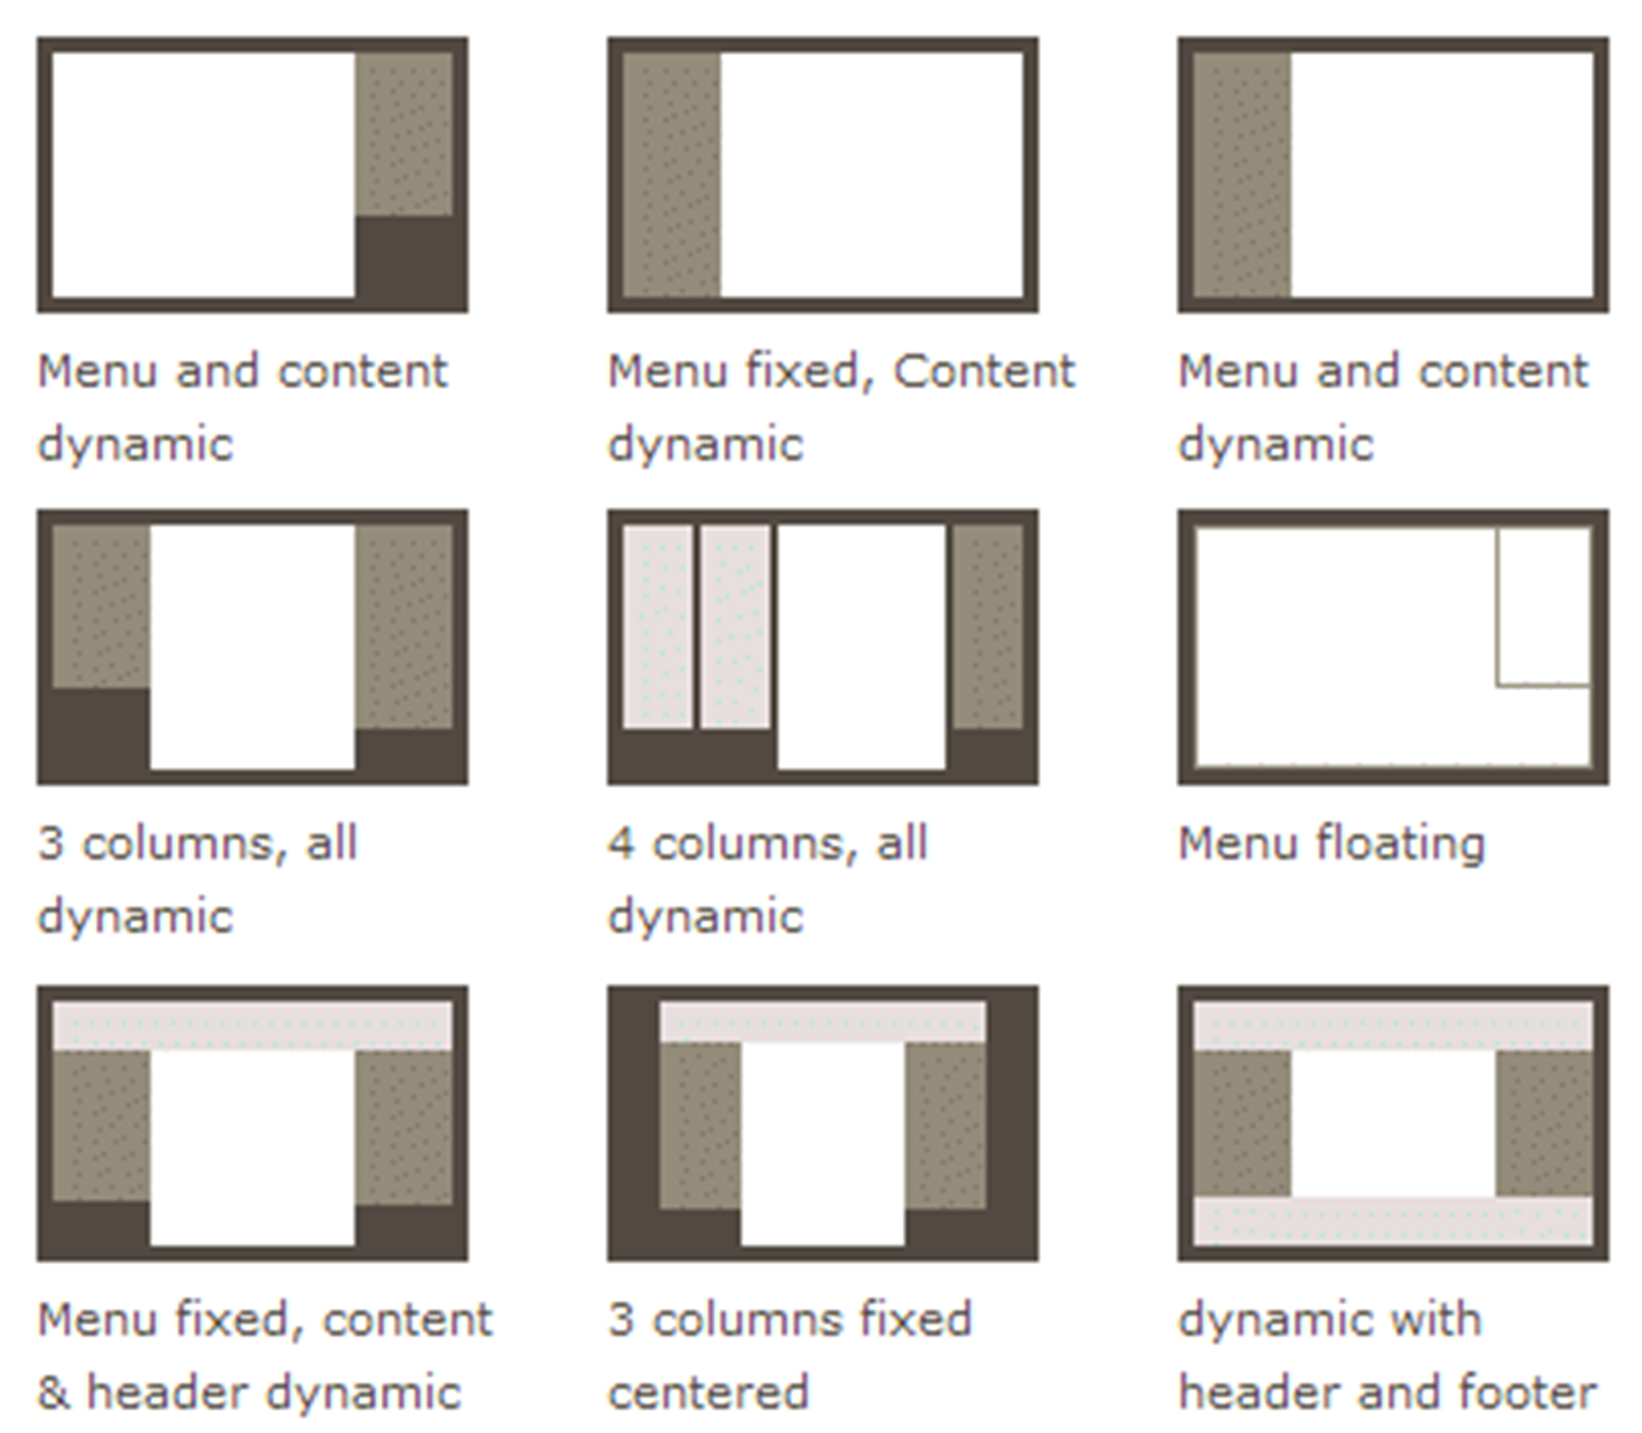
LAYOUTS

Slide 3
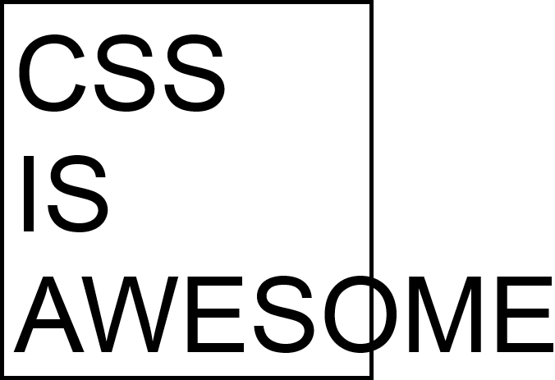
CSS IS AWESOME

Slide 4
Visual formatting
model

Slide 5
VISUAL FORMATTING MODEL
The CSS visual formatting model is the algorithm used to process a document and display it on a visual media.
The visual formatting model will transform each element of the document and generate zero, one or several boxes conforming to the CSS box model.

Slide 6
VISUAL FORMATTING MODEL
The layout of each box will be defined by
box dimensions and type
positioning scheme (normal flow, float, and absolute positioning)
relationships between elements in the document tree.
external information (e.g., viewport size, intrinsic dimensions of images, etc.)

Slide 7
BOX MODEL
BOX MODEL
All HTML elements can be considered as boxes. In CSS, the term "box model" is used when talking about design and layout.

Slide 8
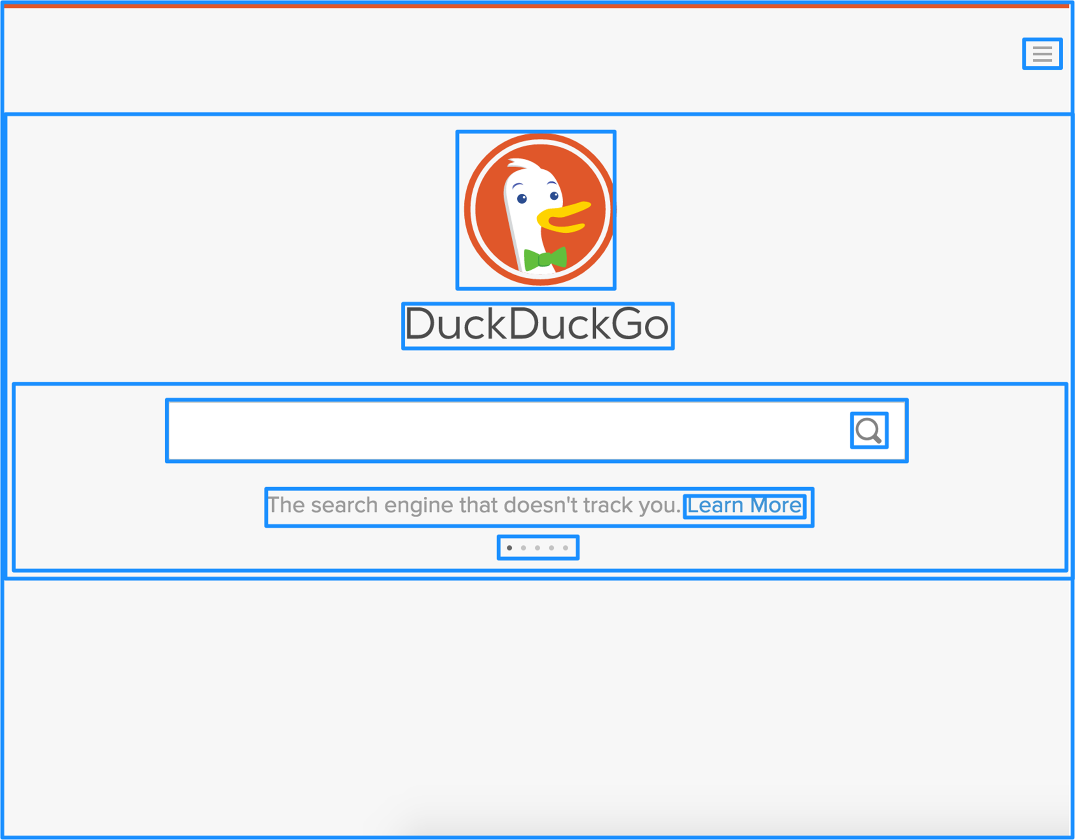
BOX MODEL

Slide 9
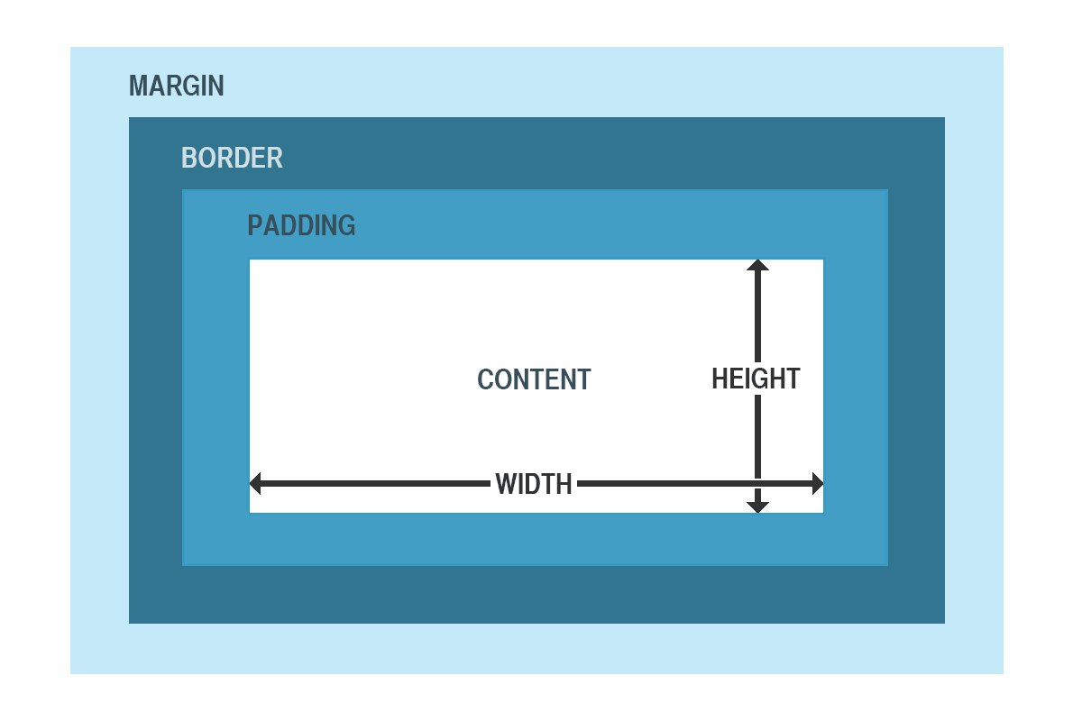
BOX MODEL

Slide 10
BOX MODEL - DEFINITIONS
Content - The content of the box, where text and images appear
Padding - Clears an area around the content. The padding is transparent
Border - A border that goes around the padding and content
Margin - Clears an area outside the border. The margin is transparent

Slide 11
BOX-SIZING
The box-sizing CSS property is used to alter the default CSS box model used to calculate widths and heights of elements. It is possible to use this property to emulate the behavior of browsers that do not correctly support the CSS box model specification.

Slide 12
BOX SIZING
content-box | padding-box | border-box
Examples:
box-sizing: content-box; box-sizing: padding-box; box-sizing: border-box; box-sizing: inherit;

Slide 13
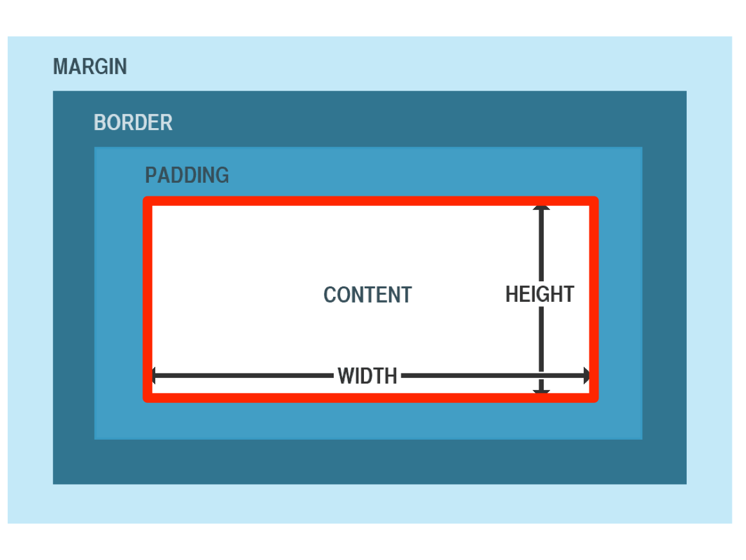
CONTENT-BOX
This is the default style as specified by the CSS standard. The width and height properties are measured including only the content, but not the padding, border or margin.

Slide 14
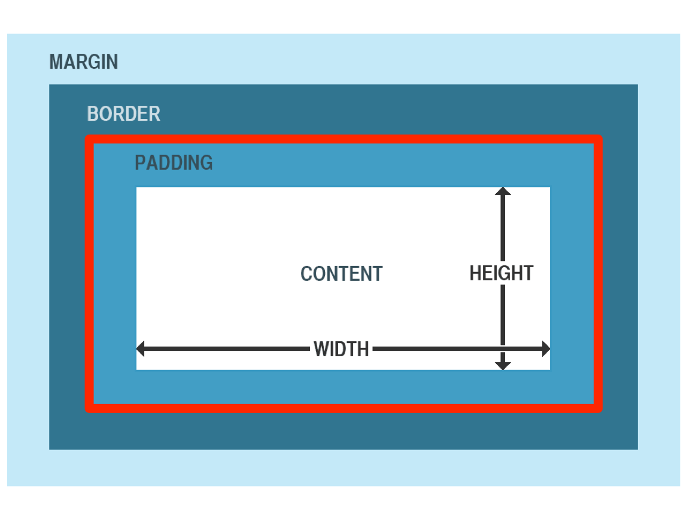
PADDING-BOX
The width and height properties include the padding size, and do not include the border or margin.
Experimental. Firefox only!

Slide 15
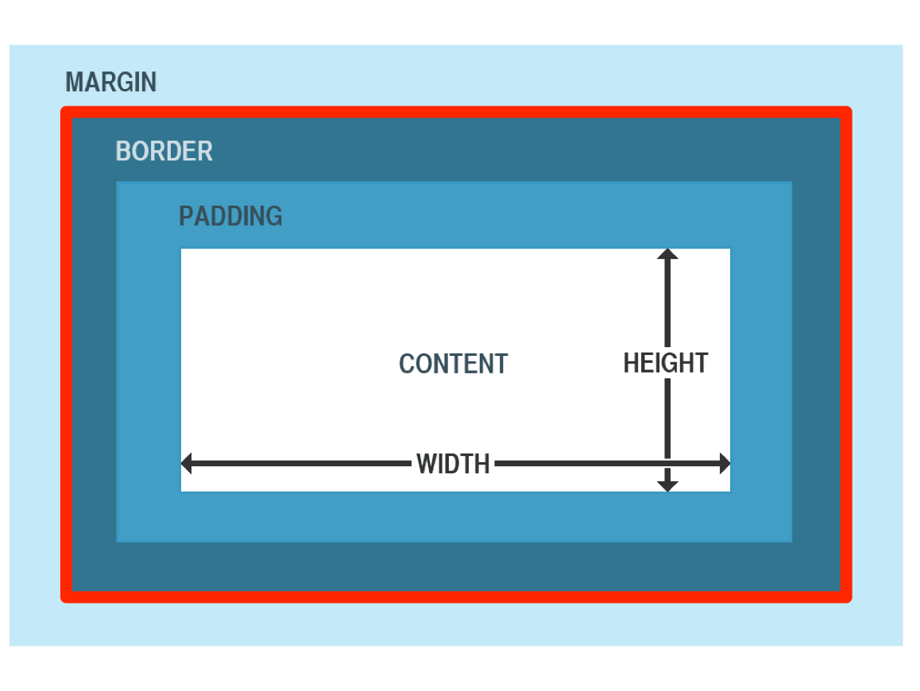
BORDER-BOX
The width and height properties include the padding and border, but not the margin.

Slide 16
Best practice (old)
*, *:before, *:after {
box-sizing: border-box;
}

Slide 17
Best practice (new)
html {
box-sizing: border-box;
}
*, *:before, *:after {
box-sizing: inherit;
}

Slide 18
Display types
Every element on a web page is a rectangular box. The display property in CSS determines just how that rectangular box behaves.

Slide 19
Display property
inline | inline-block | block | none*
Examples:
display: inline; display: inline-block; display: block; display: none;
* - table, flex and grid are omitted for simplicity

Slide 20
Inline elements
The default value for all elements is inline
Most "User Agent stylesheets" reset many elements to "block"
Think of elements like <span>, <em>, or <b>
An inline element will accept margin and padding
Margin and padding will only push other elements horizontally away, not vertically
An inline element will not accept height and width. It will just ignore it

Slide 21
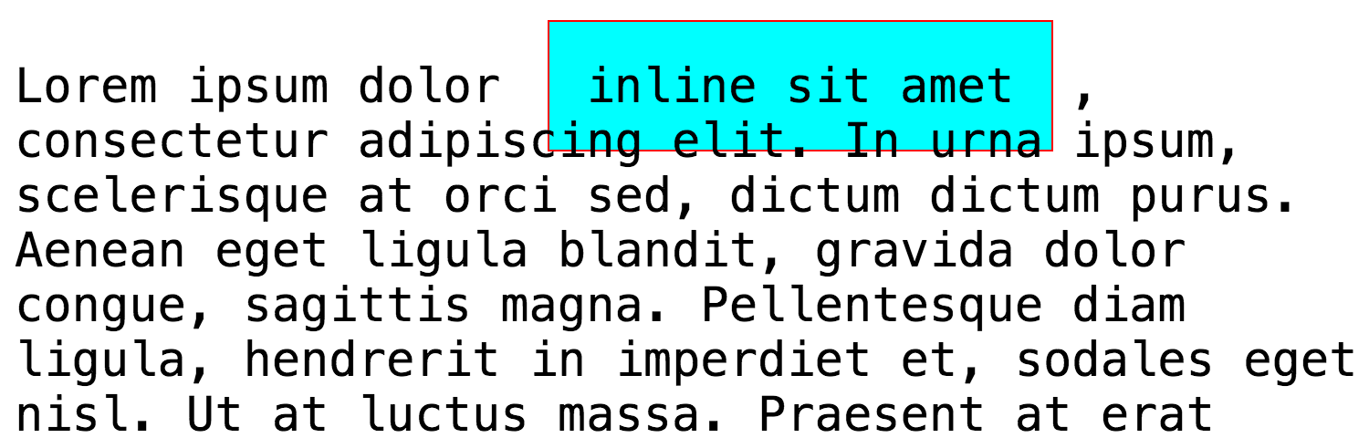
display : inline

Slide 22
Inline-block elements
Very similar to inline
Will set inline with the natural flow of text (on the "baseline")
Width and height will be respected

Slide 23
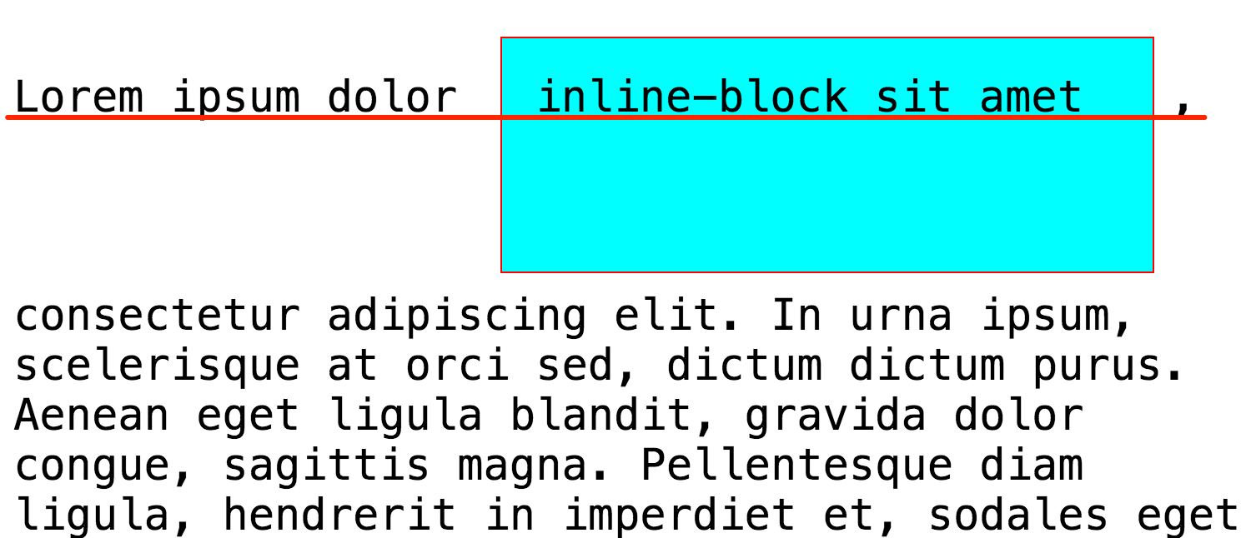
display: inline-block

Slide 24
Block elements
A number of elements are set to block by the browser UA stylesheet
Usually container elements
<div>, <section>, <ul>, <p> and <h1>
Do not sit inline but break past them
Take up as much horizontal space as they can
display:list-item or display:table are also block items

Slide 25
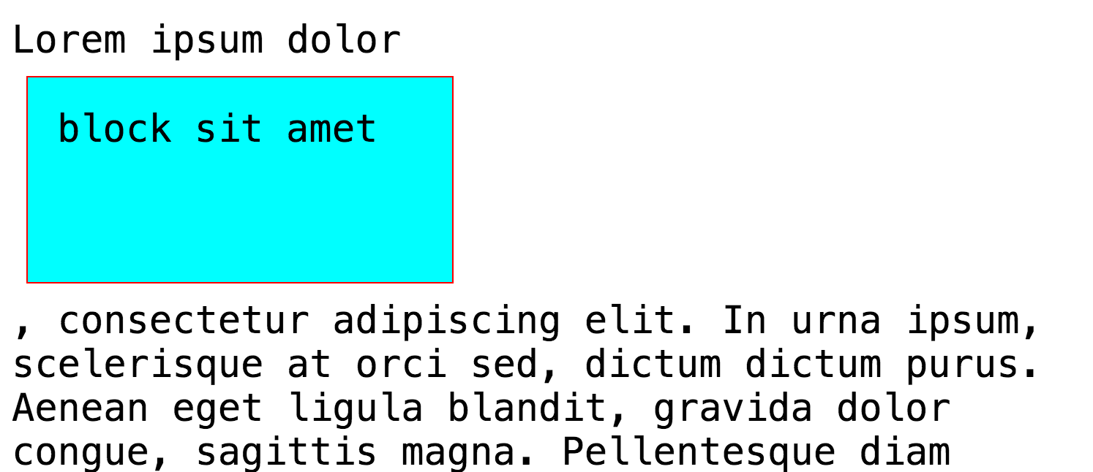
display: block

Slide 26
Box generation

Slide 27
BOX
A box is rendered relatively to the edge of its containing block. Usually a box establishes the containing block for its descendants. Note that a box is not constrained by its containing block; when its layout goes outside it, it is said to overflow.

Slide 28
Block-level elements and block boxes

Slide 29
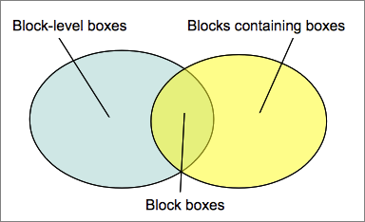
BOXES

Slide 30
Block-level elements and block boxes
An element is said to be block-level when the calculated value of its display CSS property is: block, list-item or table
A block-level element is visually formatted as a block (e.g. paragraph), intended to be vertically stacked
Each block-level element generates at least one block-level box, called the principal block-level box
Block-level boxes are boxes that participate in a block formatting context

Slide 31
Block-level elements and block boxes
Block-level box is also a block container box (except table boxes and replaced elements)
A block container box either contains only block-level boxes or establishes an inline formatting context and thus contains only inline-level boxes
Not all block container boxes are block-level boxes: non-replaced inline blocks and non-replaced table cells are block containers but not block-level boxes
Block-level boxes that are also block containers are called block boxes

Slide 32
The three terms "block-level box," "block container box," and "block box" are sometimes abbreviated as "block" where unambiguous

Slide 33
Anonymous
block boxes
Huh?

Slide 34
Anonymous block boxes
<div>
Some text
<p>More text</p>
Even more text
</div>

Slide 35
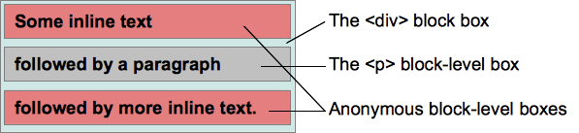
Anonymous block boxes

Slide 36
Anonymous block boxes
The properties of anonymous boxes are inherited from the enclosing non-anonymous box
Non-inherited properties have their initial value
Anonymous block boxes are ignored when resolving percentage values that would refer to it: the closest non-anonymous ancestor box is used instead
Properties set on elements that cause anonymous block boxes to be generated still apply to the boxes and content of that element

Slide 37
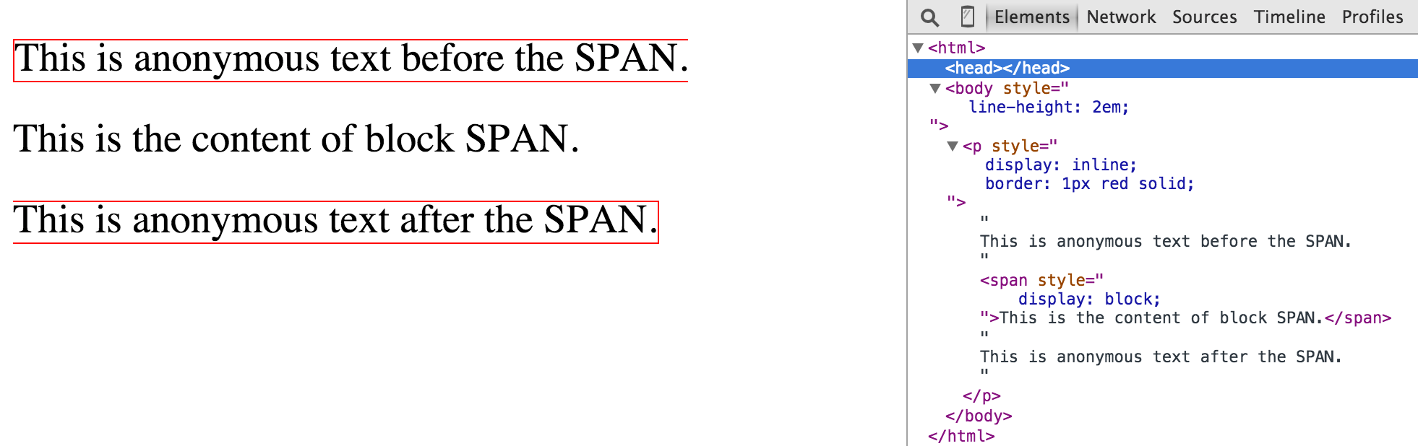

Slide 38
Inline-level elements and inline boxes

Slide 39
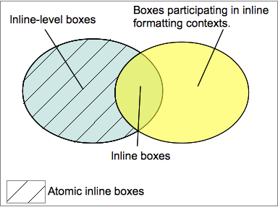
Inline-level elements and inline boxes

Slide 40
Inline-level elements and inline boxes
Inline-level elements are those elements of the source document that do not form new blocks of content
The content is distributed in lines
The following values of the 'display' property make an element inline-level: 'inline', 'inline-table', and 'inline-block'
Inline-level elements generate inline-level boxes, which are boxes that participate in an inline formatting context
An inline box is one that is both inline-level and whose contents participate in its containing inline formatting context

Slide 41
Anonymous
inline boxes
Kill me plz..

Slide 42
Anonymous inline boxes
Any text that is directly contained inside a block container element (not inside an inline element) must be treated as an anonymous inline element
Anonymous inline boxes inherit inheritable properties from their block parent box
Non-inherited properties have their initial value
White space content that would subsequently be collapsed away according to the 'white-space' property does not generate any anonymous inline boxes
There are more types of anonymous boxes that arise when formatting tables :)

Slide 43
Positioning schemes

Slide 44
Box may be laid out according to three positioning schemes
Normal flow. In CSS 2.1, normal flow includes block formatting of block-level boxes, inline formatting of inline-level boxes, and relative and sticky positioning of block-level and inline-level boxes
Floats. In the float model, a box is first laid out according to the normal flow, then taken out of the flow and shifted to the left or right as far as possible. Content may flow along the side of a float
Absolute positioning. In the absolute positioning model, a box is removed from the normal flow entirely (it has no impact on later siblings) and assigned a position with respect to a containing block

Slide 45
An element is called out of flow if it is floated, absolutely positioned, or is the root element.
An element is called in-flow if it is not out-of-flow.

Slide 46
Position property
static | relative | absolute | fixed | inherit
Examples:
position: static; position: relative; position: absolute; position: fixed; position: sticky; position: inherit;

Slide 47
Relative positioning
The box's position is calculated according to the normal flow
Then the box is offset relative to its normal position
When a box B is relatively positioned, the position of the following box is calculated as though B were not offset.

Slide 48
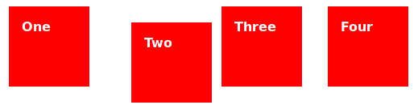
position: relative

Slide 49
Absolute positioning
The box's position is specified with the 'top', 'right', 'bottom', and 'left' properties
These properties specify offsets with respect to the box's containing block
Absolutely positioned boxes are taken out of the normal flow
They have no impact on the layout of later siblings

Slide 50
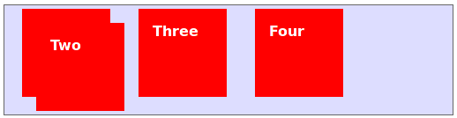
position: absolute

Slide 51
Fixed positioning
The box's position is calculated according to the 'absolute' model, but in addition, the box is fixed with respect to some reference
In the case of handheld, projection, screen, tty, and tv media types, the box is fixed with respect to the viewport and does not move when scrolled
In the case of the print media type, the box is rendered on every page, and is fixed with respect to the page box, even if the page is seen through a viewport

Slide 52
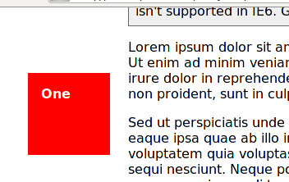
position: fixed

Slide 53
Sticky positioning
A stickily positioned box is positioned similarly to a relatively positioned box until it crosses a specified threshold, at which point it is treated as fixed positioned
The offset is computed with reference to the nearest ancestor with a scrolling box, or the viewport if no ancestor has a scrolling box
A stickily positioned box keeps its normal flow size, including line breaks and the space originally reserved for it
A stickily positioned box establishes a new containing block for absolutely positioned descendants, just as relative positioning does

Slide 54
Normal flow

Slide 55
Normal flow
Boxes in the normal flow belong to a formatting context, which may be block or inline, but not both simultaneously.
Block-level boxes participate in a block formatting context.
Inline-level boxes participate in an inline formatting context.

Slide 56
Block formatting context
Floats, absolutely positioned elements, block containers that are not block boxes, and block boxes with 'overflow' other than 'visible' establish new block formatting contexts for their contents
Boxes are laid out one after the other, vertically, beginning at the top of a containing block
The vertical distance between two sibling boxes is determined by the 'margin' properties
Vertical margins between adjacent block-level boxes in a block formatting context collapse

Slide 57
Inline formatting context
Boxes are laid out horizontally, one after the other, beginning at the top of a containing block
Horizontal margins, borders, and padding are respected between these boxes
The boxes may be aligned vertically in different ways
The rectangular area that contains the boxes that form a line is called a line box

Slide 58
Line box
The width of a line box is determined by a containing block and the presence of floats
The height of a line box is determined by the rules of line height calculations.
A line box is always tall enough for all of the boxes it contains
When several inline-level boxes cannot fit horizontally within a single line box, they are distributed among two or more vertically-stacked line boxes

Slide 59
Line box
When the total width of the inline-level boxes on a line is less than the width of the line box containing them, their horizontal distribution within the line box is determined by the 'text-align' property
When an inline box exceeds the width of a line box, it is split into several boxes and these boxes are distributed across several line boxes
If an inline box cannot be split then the inline box overflows the line box
When an inline box is split, margins, borders, and padding have no visual effect where the split occurs

Slide 60
Floats

Slide 61
Floats
A float is a box that is shifted to the left or right on the current line
Content may flow along its side
A floated box is shifted to the left or right until its outer edge touches the containing block edge or the outer edge of another float
If there is a line box, the outer top of the floated box is aligned with the top of the current line box
If there is not enough horizontal room for the float, it is shifted downward until either it fits or there are no more floats present

Slide 62
Floats
Since a float is not in the flow, non-positioned block boxes created before and after the float box flow vertically as if the float did not exist. However, the current and subsequent line boxes created next to the float are shortened as necessary to make room for the margin box of the float.
If a shortened line box is too small to contain any content, then the line box is shifted downward

Slide 63
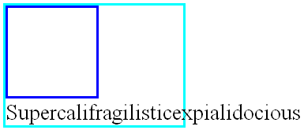

Slide 64
Floats
The contents of floats are stacked as if floats generated new stacking contexts, except that any positioned elements and elements that actually create new stacking contexts take part in the float's parent stacking context.
A float can overlap other boxes in the normal flow (e.g., when a normal flow box next to a float has negative margins). When this happens, floats are rendered in front of non-positioned in-flow blocks, but behind in-flow inlines

Slide 65
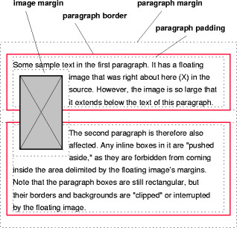
Floats

Slide 66
Clear property
Controlling flow next to floats: the 'clear' property
This property indicates which sides of an element's box(es) may not be adjacent to an earlier floating box
The 'clear' property does not consider floats inside the element itself or in other block formatting contexts
Values other than 'none' potentially introduce clearance

Slide 67
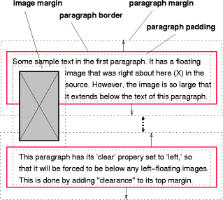

Slide 68
Layered presentation

Slide 69
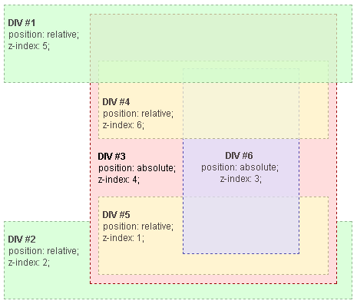
Layered presentation

Slide 70
Layered presentation
In CSS 2.1, each box has a position in three dimensions. In addition to their horizontal and vertical positions, boxes lie along a "z-axis" and are formatted one on top of the other.
Z-axis positions are particularly relevant when boxes overlap visually.
The order in which the rendering tree is painted onto the canvas is described in terms of stacking contexts

Slide 71
Stacking contexts

Slide 72
Stacking contexts
Stacking contexts can contain further stacking contexts.
A stacking context is atomic from the point of view of its parent stacking context
Each box belongs to one stacking context
Each positioned box in a given stacking context has an integer stack level
It is position on the z-axis relative other stack levels within the same stacking context
Boxes with the same stack level in a stacking context are stacked back-to-front according to document tree order

Slide 73
Stacking contexts
The root element forms the root stacking context
Other stacking contexts are generated by any positioned element (including relatively positioned elements) having a computed value of 'z-index' other than 'auto'
Stacking contexts are not necessarily related to containing blocks
Other properties may introduce stacking contexts, for example 'opacity'

Slide 74
Paint order
the background and borders of the element forming the stacking context.
the child stacking contexts with negative stack levels (most negative first).
the in-flow, non-inline-level, non-positioned descendants.
the non-positioned floats.
the in-flow, inline-level, non-positioned descendants, including inline tables and inline blocks.
the child stacking contexts with stack level 0 and the positioned descendants with stack level 0.
the child stacking contexts with positive stack levels (least positive first).

Slide 75
New stacking contexts
the root element (HTML),
positioned (absolutely or relatively) with a z-index value other than "auto",
a flex item with a z-index value other than "auto",
elements with an opacity value less than 1. (See the specification for opacity),
elements with a transform value other than "none",

Slide 76
New stacking contexts
elements with a mix-blend-mode value other than "normal",
elements with isolation set to "isolate",
on mobile WebKit and Chrome 22+, position: fixed always creates a new stacking context, even when z-index is "auto"
specifing any attribute above in will-change even you don't write themselves directly

Slide 77
Resources
http://www.w3.org/TR/CSS21/visuren.html
http://www.w3.org/TR/CSS21/visudet.html#containing-block-details
https://developer.mozilla.org/en-US/docs/Web/Guide/CSS/Visual_formatting_model
https://developer.mozilla.org/en-US/docs/Web/CSS/float
https://developer.mozilla.org/en-US/docs/Web/Guide/CSS/Understanding_z_index/The_stacking_context
https://css-tricks.com/all-about-floats/

Slide 78
Questions?

