Slide 1

API: Application Programming
Interface
Notes:
1

Slide 2
What is an API?
API stands for Application Programming Interface, it acts ass a bridge that enables two applications to communicate and exchange data seamlessly.
Think of an API like a waiter in a restaurant: you place your order (request), the waiter communicates with the kitchen (server), processes your request, and returns your meal (response).
Notes:
2

Slide 3
Why APIs Are Essential
System Integration
Code Reusability
Secure Data Exchange
Connect different applications and services to work together seamlessly without manual intervention.
Leverage existing functionality and services instead of rebuilding everything from scratch.
Control access and permissions while protecting sensitive information through authentication.
Real-world examples: Zomato integrates Google Maps API for location services, Spotify uses music streaming APIs, and "Login with Google" relies on authentication APIs.
Notes:
3

Slide 4
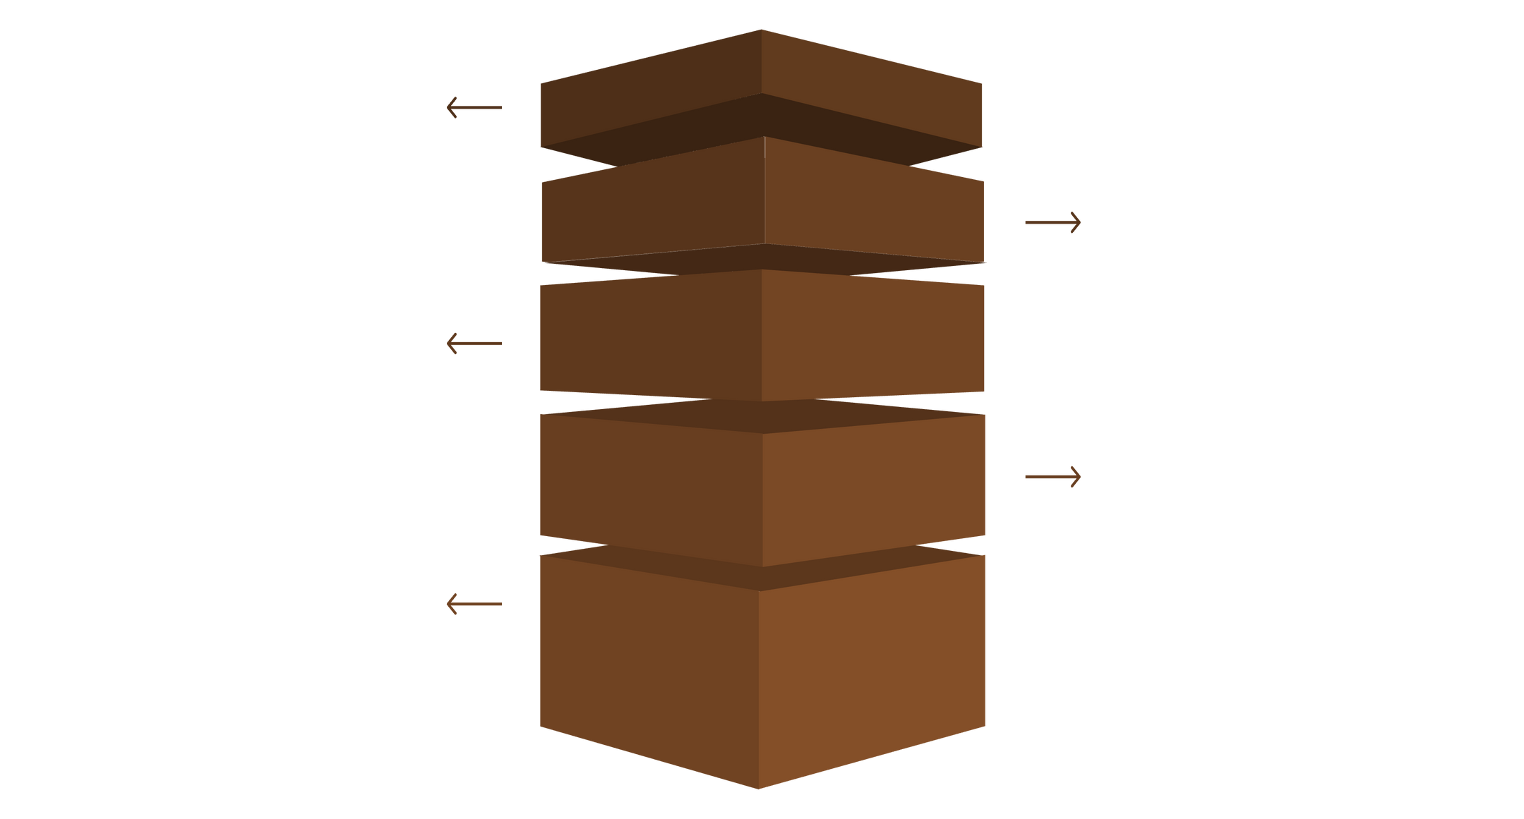
How APIs Work: Request-Response Model
APIs follow a predictable flow where the client makes a request, the server processes it, and returns a response.
Client Request
Initiates HTTP request to the API gateway.
API Gateway
Validates, routes, and forwards the request to server.
Server Processing
Handles logic, calls services, and queries the database.
Database
Retrieves or stores data and returns results to server.
Response Flow
Server returns response via gateway back to client.
Example Request:
GET https://api.github.com/users/octocat
Example Response:
{ "login": "octocat", "id": 1, "name": "The Octocat" }
Notes:
4

Slide 5
Endpoints
An endpoint is a specific URL that performs a particular function. Think of endpoints like different service counters at a bank, where each counter handles one specific task.
Endpoint Structure
Base URL:https://api.github.com
Path:/users/octocat
Complete Endpoint:https://api.github.com/users/octocat
Notes:
5

Slide 6
REST APIs
REST (Representational State Transfer) is an architectural style for designing networked applications. It leverages standard HTTP methods to enable communication between client and server, focusing on resources and their representation. REST APIs are stateless, scalable, and built on the principles of the web.
Core REST Principles
Client-Server Architecture
Statelessness
Separation of concerns between the client (UI) and the server (data storage), improving portability and scalability.
Each request from a client to a server must contain all the information needed to understand the request. The server will not store any client context between requests.
Cacheability
Uniform Interface
Responses must implicitly or explicitly define themselves as cacheable to prevent unnecessary requests, improving performance.
A single, uniform way of interacting with resources, simplifying the overall system architecture. Includes: Resource Identification,
Notes:
6

Slide 7
HTTP Methods in REST
GET
POST
PUT
Used to retrieve data from a specified resource. GET requests should only retrieve data and have no other effect on the data. They are safe and idempotent.
Used to submit data to the specified resource, often causing a change in state or a new resource to be created. Not idempotent.
Used to update or replace an entire resource with the data provided in the request body. If the resource does not exist, PUT may create it. Idempotent.
GET /users/123
POST /users
PUT /users/123
Retrieves details for user with ID 123.
Creates a new user resource.
Replaces the entire user with ID 123.
DELETE
Used to remove the specified resource. DELETE requests are idempotent.
DELETE /users/123
Deletes the user with ID 123.
Notes:
7

Slide 8
HTTP Status Codes Explained
Status codes tell you whether your API request succeeded, failed, or encountered an issue. Understanding these codes is crucial for debugging and troubleshooting.
Code
Meaning
Example Scenario
200
OK (Success)
Data retrieved successfully
201
Created
New resource successfully added
400
Bad Request
Invalid or malformed data sent
401
Unauthorized
Invalid or expired token
404
Not Found
Endpoint or resource doesn't exist
500
Server Error
Internal server processing failure
Notes:
8

Slide 9
Authentication and Headers
HTTP headers provide metadata about your API request. They include critical information like content type and authorization credentials that ensure secure, authorized access.
Content-Type Header
Authorization Header
API Keys & OAuth
Specifies data format, typically application/json for modern APIs.
Contains credentials like Bearer <token> to prove identity and permissions.
Methods to authenticate users and control access without exposing sensitive credentials.
Notes:
9

Slide 10
Using APIs with Axios:
import axios from 'axios';
async function getUserData(userId) {
try {
const response = await axios.get(`https://api.example.com/users/${userId}`);
console.log('User data:', response.data);
return response.data;
}
catch (error) {
console.error('Error fetching user data:', error);
throw error;
}
}
getUserData(123);
Making API Calls in JS:
Axios is a promise-based HTTP client for making API requests from a browser or Node.js. It simplifies sending asynchronous HTTP requests to REST endpoints and handling their responses.
  Request: The axios.get() method sends an HTTP GET request to the specified URL. For other HTTP methods like POST, PUT, or DELETE, you would use axios.post(), axios.put(), or axios.delete() respectively.
  Response Handling: The await keyword pauses execution until the promise returned by axios.get() is resolved, allowing us to process the response object. The actual data payload is typically found in response.data.
  Error Handling: The try...catch block is crucial for gracefully managing potential errors.
Notes:
10

Slide 11
APIs: The Foundation of Modern Development
APIs are the backbone of today's interconnected digital world. They enable seamless integration, efficient code reuse, and secure data exchange across applications and services.
1
Understand the request-response model
Master how clients and servers communicate through APIs.
2
Learn REST principles and HTTP methods
Build scalable, reliable, and maintainable APIs following industry standards.
3
Prioritize security with authentication
Protect data and control access through proper authentication mechanisms.
Notes:
11

Slide 12
REST vs. SOAP: Key Differences
REST (Representational State Transfer)
SOAP (Simple Object Access Protocol)
A flexible and lightweight architectural style that relies on standard HTTP methods. It's often preferred for web applications due to its simplicity and scalability.
A robust, XML-based messaging protocol. It offers extensive features for security, transactions, and error handling, often used in enterprise environments.
  Architectural Style: Not a protocol, but a set of guidelines.
  Protocol: A strict, XML-based messaging protocol.
  Communication: Can use various transport protocols (HTTP, SMTP, TCP, JMS).
  Communication: Uses standard HTTP methods (GET, POST, PUT, DELETE).
  Data Format: Primarily uses XML for all messaging.
  Data Format: Supports multiple formats (JSON, XML, plain text, HTML).
  Statefulness: Can be stateful or stateless.
  Complexity: More complex due to its rigid structure and WSDL.
  Statefulness: Typically stateless, making it scalable.
  Complexity: Generally simpler to implement and consume.
Notes:
12

