Slide 1
Insurance Premium Payment & Claims Portal
A Full-Stack Capstone Project Using React & ASP.NET Core

Slide 2
Project Team & Contributions
Team Member
Responsibilities
Krishi Y Antad
Designed and implemented ASP.NET Core Web API with Repository-Service-Controller pattern, JWT authentication, and Entity Framework Core integration
Adeeb Ahmed Khan
Built React components with React Router, implemented state management, created responsive UI with form validation and API integration
M Ranjitha
Designed relational database schema, wrote xUnit tests with Moq for service layer, implemented data validation and error handling
Lekhana K
Containerized application with Docker, configured Docker Compose for multi-container orchestration, managed deployment pipeline

Slide 3
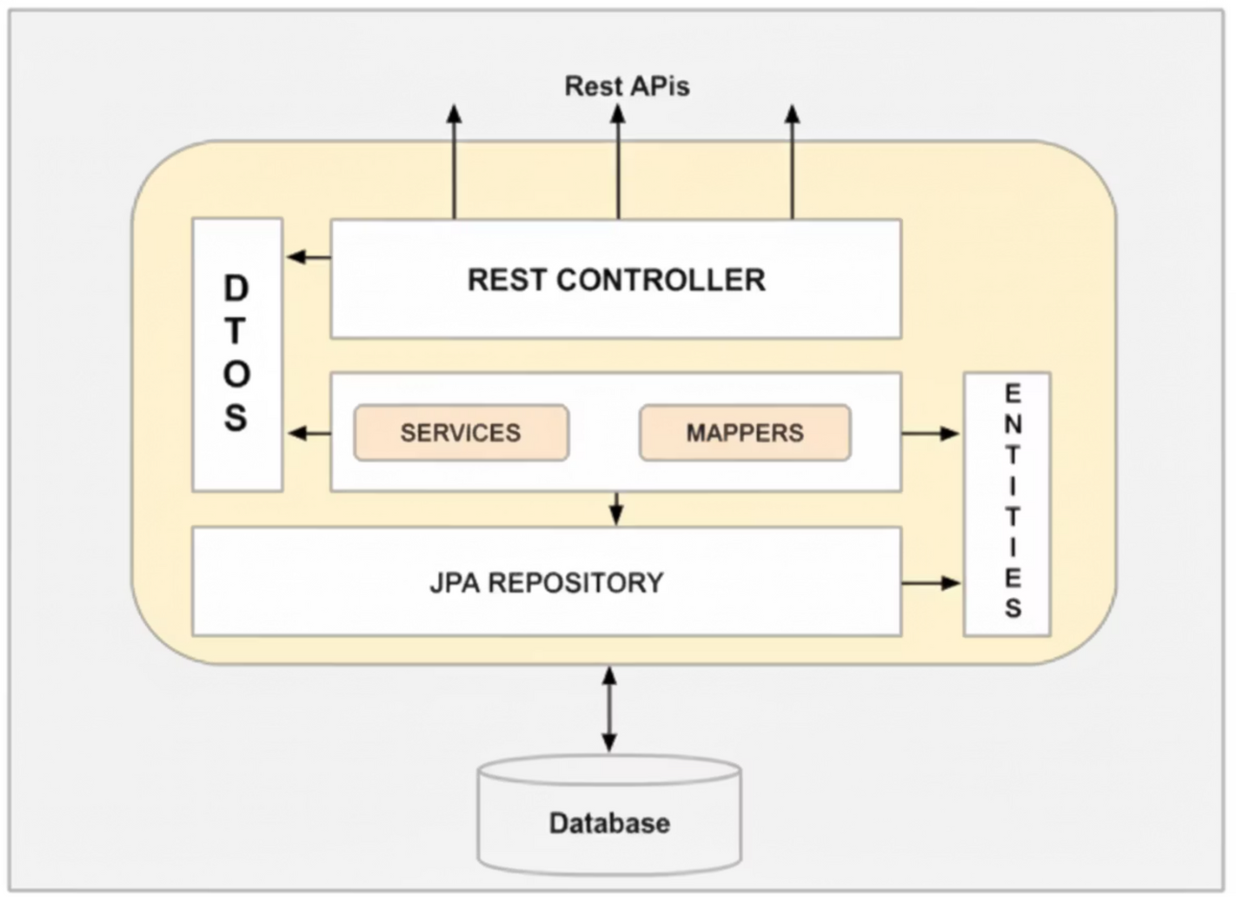

Slide 4

The Challenge
Problem Statement
Insurance brokers manage multiple clients across different insurance providers, but clients struggle to access their policy and claim information efficiently.
Key Pain Points:
  No centralized platform for policy management
  Manual broker contact required for updates
  Delayed claim processing and tracking
  Poor user experience and accessibility

Slide 5





Our Solution
Client Servicing Portal
Digital Experience
A modern, full-stack web application that provides clients with seamless self-service access to their insurance portfolio
Secure login, real-time policy viewing, and claim submission - all in one intuitive interface
Brokerage Efficiency
Reduces manual workload for brokers while empowering clients with instant access to critical information

Slide 6
Core Features
Secure Authentication
Policy Management
Claim Management
Input Validation
View, add, update, and renew insurance policies with complete details including insurer, premium, and expiry dates
Submit new claims, track status in real-time, and manage claim history with edit and delete capabilities
Comprehensive client-side and server-side validation ensuring data integrity and proper error handling
JWT-based user registration and login with role-based access control for protected endpoints

Slide 7







Backend Architecture
ASP.NET Core Web API
Key Technologies
  Authentication: JWT token-based security
Repository Layer
  ORM: Entity Framework Core
Entity Framework Core with relational database schema
  Validation: Data annotations
  Error Handling: Centralized middleware
Service Layer
  Testing: xUnit with Moq
Business logic for policies and claims with validation
Controller Layer
RESTful endpoints with JWT authorization

Slide 8


Frontend Development
1
React Router Navigation
Implemented seamless routing for Login, Dashboard, Policies, and Claims pages with protected routes
2
State Management
Utilized React hooks (useState, useEffect) for efficient component state and lifecycle management
3
API Integration
Axios for all CRUD operations with JWT tokens in headers, handling authentication and authorization
4
Form Controls & Validation
Controlled components with client-side validation for policy creation and claim submission forms

Slide 9

Application Flow
Track Claim Status
Registration / Login
Monitor progress
Secure user authentication
View All Policies
Submit Claim
User Dashboard
Browse existing coverage
Report an incident
Update / Renew Policy
Add New Policy
Enroll in a plan
Edit details or renew
Users authenticate securely, access their personalized dashboard, and seamlessly navigate between policy management and claim tracking features.

Slide 10



Technical Architecture & Containerization
Three-Tier Architecture
Docker Deployment
  Backend Container: insurance-api with environment variables for database connection
Presentation Layer
  Frontend Container: insurance-frontend serving built React app via Nginx
React frontend with Nginx in Docker container (port 3000)
  Docker Compose: Orchestrates multi-container setup for local testing
  Networking: Containers communicate through Docker bridge network
Application Layer
ASP.NET Core Web API in Docker container (port 5000)
Data Layer
Entity Framework Core with Oracle database

Slide 11
Project Summary & Conclusion
12
3
15+
REST API Endpoints
Database Tables
Unit Tests
Comprehensive CRUD operations for authentication, policies, and claims
Users, Policies, and Claims with proper relational mapping
xUnit tests covering service layer operations with Moq
Key Achievements
✓ Built a production-ready full-stack application with modern tech stack
✓ Containerized application using Docker for seamless deployment
✓ Implemented secure JWT authentication and authorization
✓ Followed industry best practices with testing and error handling
✓ Created intuitive UI with comprehensive form validation
✓ Delivered a solution that empowers clients and reduces broker workload
This capstone project successfully demonstrates our ability to design, develop, test, and deploy enterprise-grade web applications that solve real-world business problems.

Slide 12



Technology Stack & Learning Outcomes
Technologies Leveraged
Key Learning Outcomes
Full-Stack Development
Hands-on experience in integrating frontend and backend components seamlessly.
ASP.NET Core
Robust backend API with secure authentication and database integration.
Secure API Design
Mastered JWT authentication, role-based access, and robust data validation.
DevOps Principles
React.js
Understood the value of containerization and multi-container orchestration with Docker Compose.
Dynamic and responsive client-side application for intuitive user experience.
Agile Methodologies
Applied iterative development, testing, and continuous feedback for project success.
Docker
Containerization for consistent development, testing, and deployment environments.
Oracle DB
Reliable relational database management for policy and claims data.

Slide 13
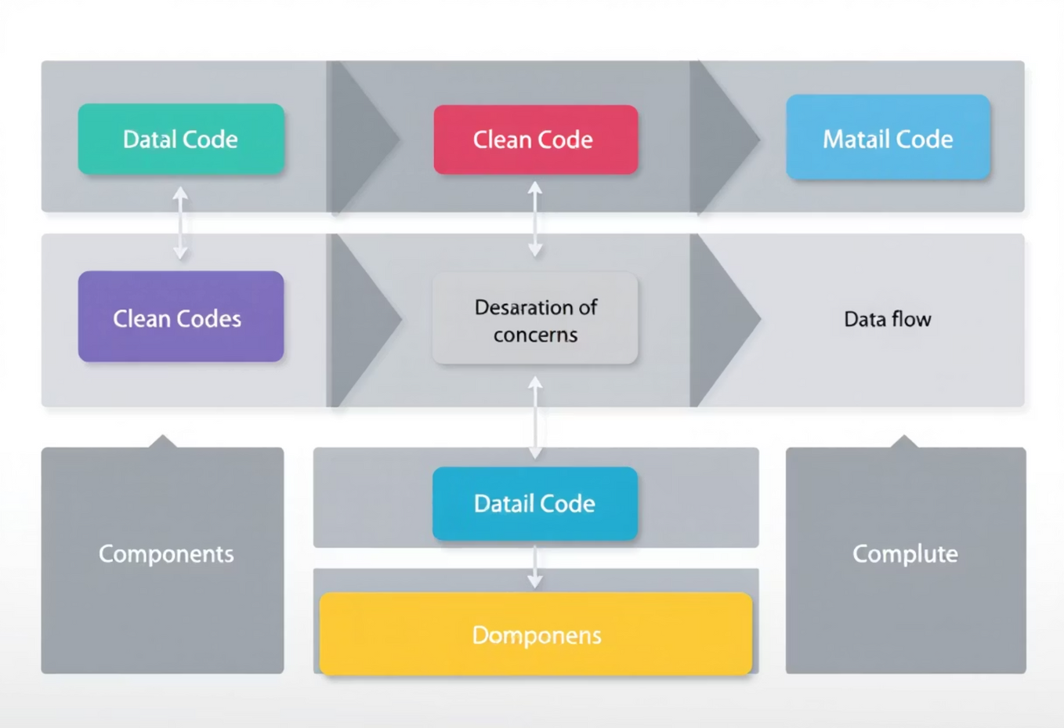
Coding Standards & Best Practices
Dependency Injection
Service-Repository Pattern
Data Transfer Objects (DTOs)
Promotes loose coupling and testability by providing dependencies to objects rather than having them create their own. Used for services and repositories.
Separates business logic (Service Layer) from data access (Repository Layer), improving maintainability and scalability.
Used to transfer data between layers, exposing only necessary information and protecting internal models from direct exposure.

Slide 14

Unit Testing with XUnit & Moq
Service Logic Validation
API Endpoint Verification
We use xUnit to rigorously test the business logic in our service layer. Moq creates mock objects for repository dependencies, ensuring isolation and focusing tests solely on service functionality.
xUnit is also used for controllers to verify API endpoint behavior. We mock the service layer to ensure controllers handle requests, data, and authorization correctly, returning appropriate HTTP responses.
Comprehensive unit tests ensure code reliability, simplify debugging, and facilitate future enhancements by providing a safety net against regressions.

Slide 15
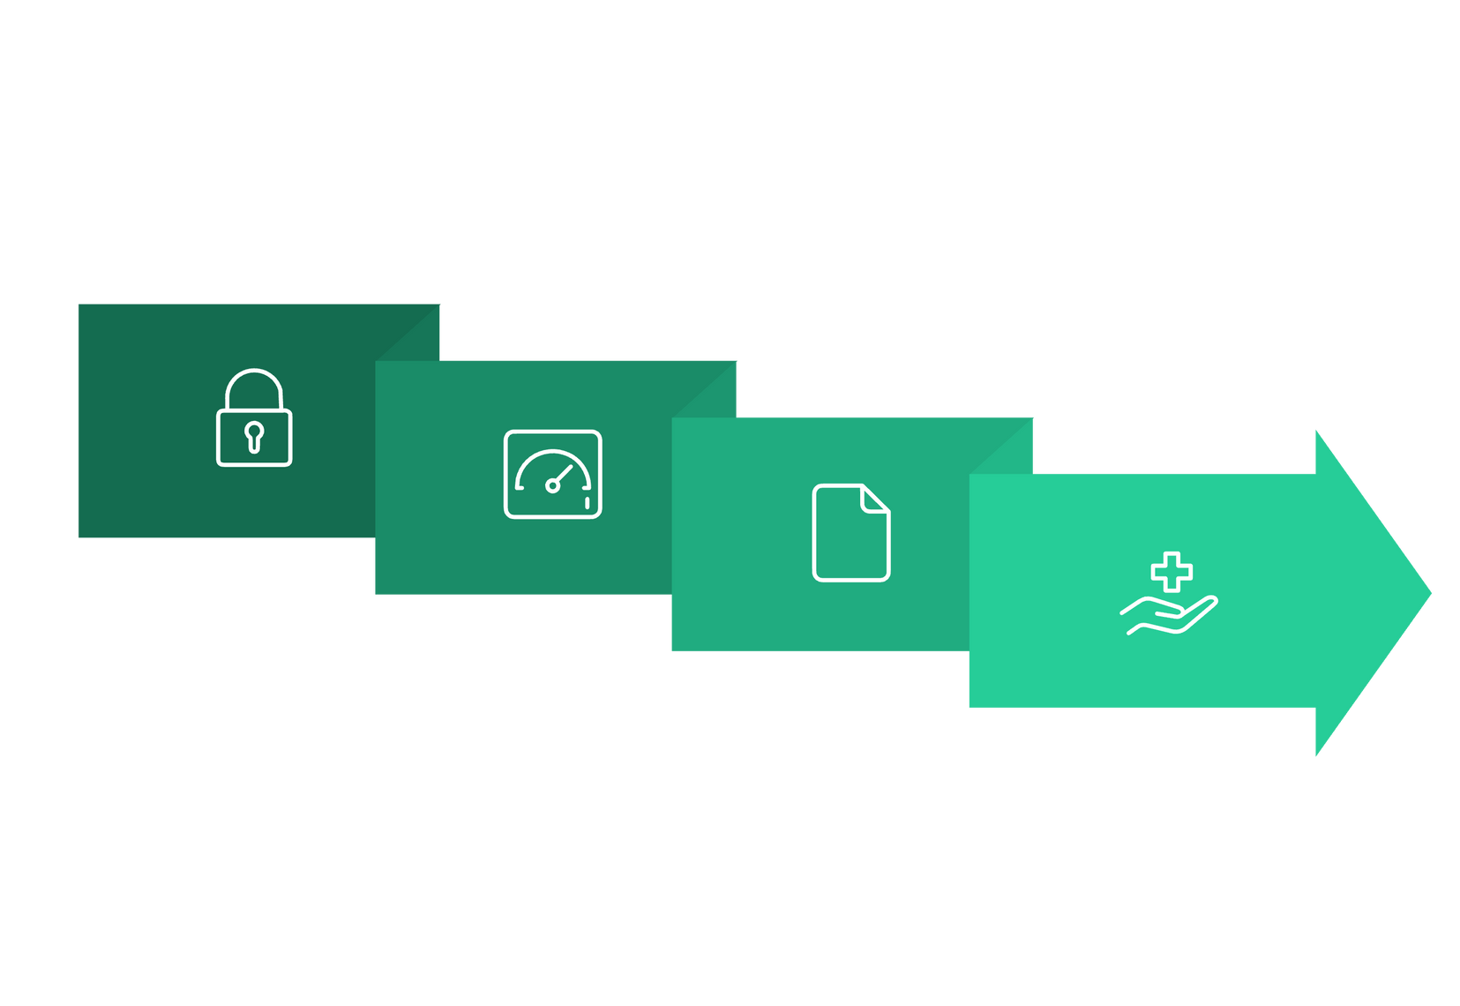




User Flow Sequence
The system is designed with a clear, logical flow, guiding users from authentication through essential policy and claims management functions. This sequence ensures a seamless and intuitive experience, minimizing complexity.
Dashboard
Claim Management
Authenticate
Policy Management
Each step is integrated with robust security measures and real-time data access, providing users with immediate control over their insurance needs.

