Slide 1

NAME : Mohan Biswas STUDENT CODE : BWU/BTA/22/191 SECTION : D1 DEPARTMENT : BTech CSE AIML SUBJECT : Design and Analysis of Algorithms COURSE CODE : PCC-CSM402

Slide 2
Introduction
Definition of Brute Force Techniques
Brute force techniques involve systematically trying all possible solutions to a problem, typically through exhaustive search.
These techniques are characterized by their simplicity and straightforward approach to problem-solving.
Importance in Algorithm Design
Brute force techniques serve as fundamental building blocks in algorithm design, providing a baseline for comparison with more sophisticated algorithms.
They are particularly useful for solving small-scale problems or as a benchmark for evaluating the efficiency of other algorithms.

Slide 3
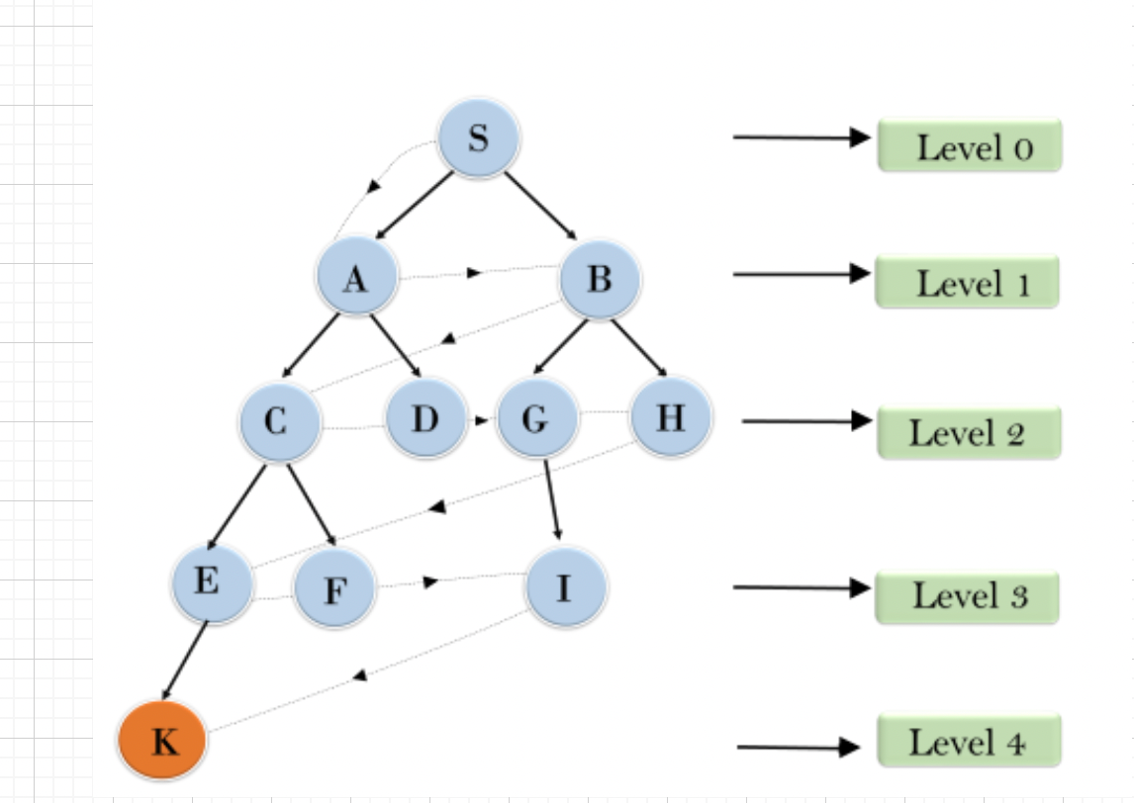
Brute Force Approach

Slide 4
Brute Force in Enumeration
Exhaustive Search
Exhaustive search involves systematically generating and evaluating all possible solutions to a problem.
While effective for small problem instances, exhaustive search becomes impractical for large problem sizes due to its exponential time complexity.
Generating all Possible Solutions
Brute force enumeration generates all possible combinations or permutations of elements, allowing for a comprehensive exploration of the solution space.
This approach ensures that no potential solution is overlooked, but it can be computationally intensive for problems with a large search space.
Example: Subset Sum Problem
In the subset sum problem, the goal is to find a subset of a given set of numbers that sums to a target value.
Brute force enumeration involves considering all possible subsets and checking their sum against the target value, leading to a time complexity of O(2^n).

Slide 5
Brute Force in Searching
Linear Search
Linear search, also known as sequential search, scans through a list of elements one by one until the target element is found or the list is exhausted.
While simple to implement, linear search has a time complexity of O(n), making it inefficient for large datasets.
Comparison with Other Searching Techniques
Brute force searching techniques like linear search are contrasted with more efficient algorithms such as binary search, which exploit specific properties of the data to achieve faster search times.
Brute force searching algorithms often exhibit linear time complexity, making them suitable for small datasets but impractical for large-scale applications.
Time Complexity Analysis
Analyzing the time complexity helps in understanding the scalability and efficiency of the algorithm.

Slide 6
Brute Force in String Matching
Naive String Matching Algorithm
The naive string matching algorithm compares each character of the pattern with each character of the text, shifting the pattern by one position if a mismatch occurs.
While simple to implement, this approach has a time complexity of O(m * n), where m is the length of the pattern and n is the length of the text.
Pattern Matching
Brute force string matching techniques extend beyond exact pattern matching to include more complex pattern recognition tasks such as regular expression matching.
Example: Finding Substrings in a Text
In text processing applications, brute force string matching algorithms are used to locate substrings within a larger text corpus.
By systematically comparing the pattern with substrings of the text, occurrences of the pattern can be identified.

Slide 7
Brute Force in Sorting
Bubble Sort
Bubble sort is a simple sorting algorithm that repeatedly steps through the list, compares adjacent elements, and swaps them if they are in the wrong order.
While easy to understand, bubble sort has a time complexity of O(n^2), making it inefficient for large datasets.
Selection Sort
Selection sort divides the input list into two parts: sorted and unsorted. It repeatedly selects the minimum element from the unsorted portion and places it at the beginning of the sorted portion.
Like bubble sort, selection sort also has a time complexity of O(n^2), making it suitable only for small datasets or as an educational tool.
Performance Comparison with Efficient Sorting Algorithms
Brute force sorting algorithms like bubble sort and selection sort are contrasted with more efficient algorithms such as merge sort and quicksort, which have better average and worst-case time complexities.

Slide 8
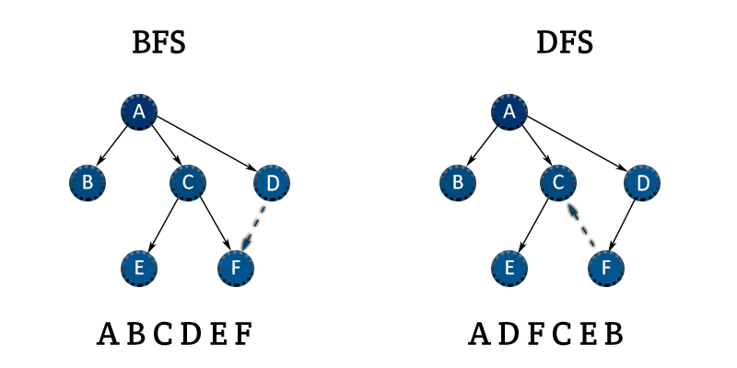
Brute Force in Graph Algorithms

Slide 9
Brute Force in Graph Algorithms
Depth-First Search (DFS)
DFS explores as far as possible along each branch before backtracking, typically implemented using recursion or a stack.
It is used for traversing or searching tree or graph data structures.
Breadth-First Search (BFS)
BFS systematically explores all neighbor nodes at the present depth before moving on to nodes at the next depth level.
It is particularly useful for finding the shortest path in unweighted graphs.
Applications in Graph Traversal
Brute force graph traversal algorithms are fundamental for various applications such as network routing, pathfinding, and graph analysis.

Slide 10
Brute Force in Cryptography
Exhaustive Key Search
Exhaustive key search, also known as brute force attack, involves trying every possible key until the correct one is found.
This technique is commonly used to crack weak cryptographic systems or recover lost passwords.
Breaking Cipher Systems
Brute force techniques can be applied to break various types of cipher systems, including substitution ciphers, Caesar ciphers, and simple cryptographic protocols.
Example: Brute Forcing Passwords
In cybersecurity, brute force attacks are frequently used to guess passwords by systematically trying all possible combinations until the correct one is found.
Defensive measures such as account lockouts and rate limiting are implemented to mitigate the risk of brute force attacks.

Slide 11
Limitations and Optimization
Time Complexity Issues
Brute force techniques often suffer from exponential time complexity, rendering them impractical for large problem sizes.
The scalability of brute force algorithms is limited by the exponential growth of the solution space.
Space Complexity Concerns
In addition to time complexity, brute force algorithms may also have significant space complexity requirements, particularly when storing all possible solutions or intermediate states.
Strategies for Optimizing Brute Force Algorithms
Various strategies can be employed to optimize brute force algorithms, including pruning techniques to reduce the search space, dynamic programming for memoization, and parallelization for distributed computing.

Slide 12
Reference
https://www.geeksforgeeks.org

Slide 13
END
THANK YOU

