Slide 1
Multi-drone systems
Multiple drones cooperate and communicate with each other.
Single drone is far less capable as an entity.
Applications
military missions (battlefield surveillance)
searching for survivors in disaster hit areas
delivery of payload
drone light shows
smart city, etc.
Complexity lies in the co-ordinated movement.

Slide 2
Why do we need simulators for UAV?
Resource requirement for experiments
UAVs
network devices
flight controllers
Precise evaluation of UAV’s mobility
Simulation environments: ROS, AirSim, Gazebo, PyBullet
Challenging integration for fleet deployment
Validate an UAV fleet deployment in a city
observing traffic at hot-spots during commute hours
status of building construction
Package delivery

Slide 3
Robot Operating System (ROS)
Robot application development
Development of autonomous vehicles
Architecture and communications
topics, services and actions
ideal to control a distributed network of sensor and actuator
common work frame
well-defined data structures
Scalable and suitable for a range of different platforms that can be easily integrated into a single environment.

Slide 4
ROS Framework
Flexible framework for writing robot software.
Collection of tools, libraries, and conventions
From the robot’s perspective, problems that seem trivial to humans often vary wildly
It has a Linux-like command tool, inter-process communication system, and numerous application-related packages

Slide 5
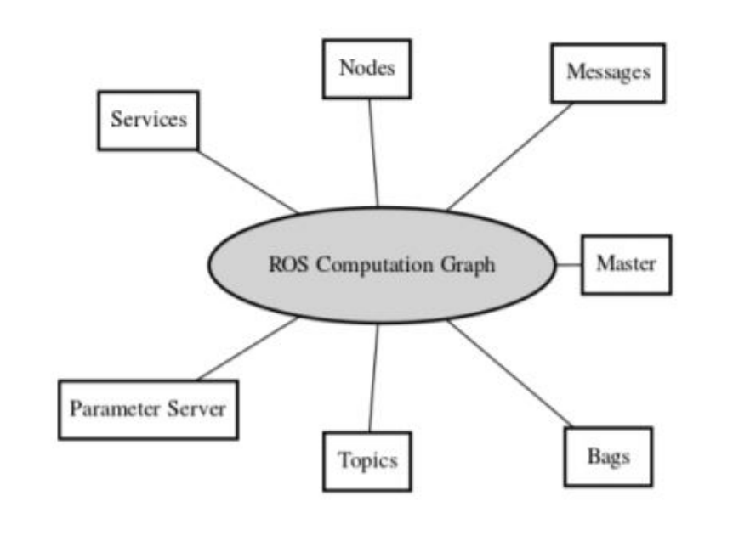
ROS Communication
System built using ROS
processes
different hosts
connected at runtime in a P2P topology
Nodes: processes that perform computation
Messages: Nodes communicate with each other by passing messages
Topics: Pub-Sub System
Nodes subscribe/publish to multiple topics
Multiple concurrent publishers and subscribers for a single topic
Services: analogous to web services
defined by URIs
request and response
Notes:
The peer-to-peer topology requires some sort of lookup mechanism to allow processes to find each other at runtime. The fundamental concepts that are used in our implementation are the nodes, messages, topics and services

Slide 6
Gazebo
Open-source multi-robot simulator
dynamic environments near to real scenarios
Flight controller integration
Software-In-The Loop (SITL) drone simulation (e.g. – Pixhawk, PX4)
Client/Server architecture with topic-based Pub/Sub model of inter-process communication
Gazebo clients access data through a shared memory
Inter-process communication
Simulation objects associated with controllers
process commands for controlling the object
generate the state of that object.

Slide 7
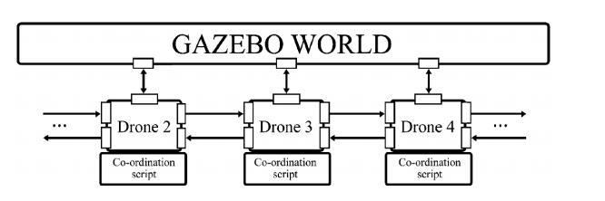
Client sends control data, simulated objects’ coordinates to the Server which performs the real-time control of the simulated drone

