Slide 1
Multi Session FL

Slide 2
Fairness-Aware Multi-Server Federated Learning Task Delegation Over Wireless Networks
2025- IEEE TNSE

Slide 3
Gaps Being Addressed
Existing contract-based methods for client selection assume that there is a single server in the FL system, which is unrealistic.
They don't address the challenge of FL in wireless systems where clients have limited communication coverage, making the server work with clients it can directly reach.
Fairness-Aware Multi-Server Federated Learning Task Delegation Over Wireless Networks

Slide 4
Paper Contributions
Combines
Contract Theory: to incentivize clients (decide participation + rewards)
Lyapunov Optimization: to make dynamic decision over time (handle fairness + cost)
Task Requester (TR)
TR is the central entity that creates tasks, assigns them to servers, manages costs, and ensures fairness in the system.
It generates FL task and decides which server gets which FL task.
Each server gets/manages a cluster of mobile clients which keeps on changing over time.
Since the system is dynamic due to mobile clients the use L.Optimization to manage this.
Tries to balance b/w performance (good accuracy and low cost) and fairness (all servers get fair access to all FL task over time)
Fairness-Aware Multi-Server Federated Learning Task Delegation Over Wireless Networks

Slide 5
Methodology
xxx
For each server a virtual queue is maintained that:
CASE I: Server is not selected
Unfair so the queue increases
Increases if the server is of high quality (low accuracy loss)
CASE II: Server is selected
Fair so the queue decreases
Fairness-Aware Multi-Server Federated Learning Task Delegation Over Wireless Networks

Slide 6
Experiment Setup
50m x 40m
100 m
Servers: 10; uniform dist
Clients: 200; random; indepnt; avg same density
Datasets: MNIST and CIFAR10;
heterogeneity in quantity
Global Epochs: 50
Local Epochs: 10
Each epoch consists of 10 batches; lr=0.01; SGD with momentum 0.5
Models:
MnistCNN consists of two convolutional layers with dropout, two fully connected layers, and employs ReLU activation and max pooling, outputting through a log softmax function.
CifarCNN features two convolutional layers followed by max pooling, three linear layers, and also uses ReLU activation, culminating in a log softmax output.
200 m
Fairness-Aware Multi-Server Federated Learning Task Delegation Over Wireless Networks

Slide 7
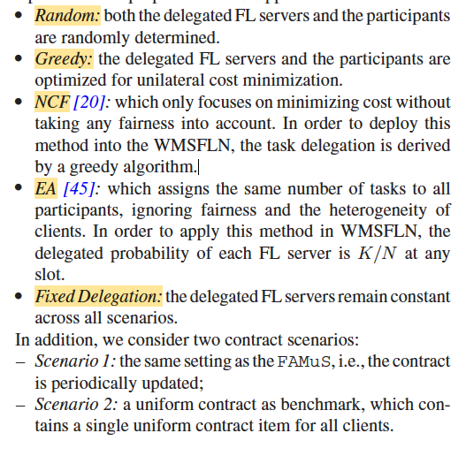
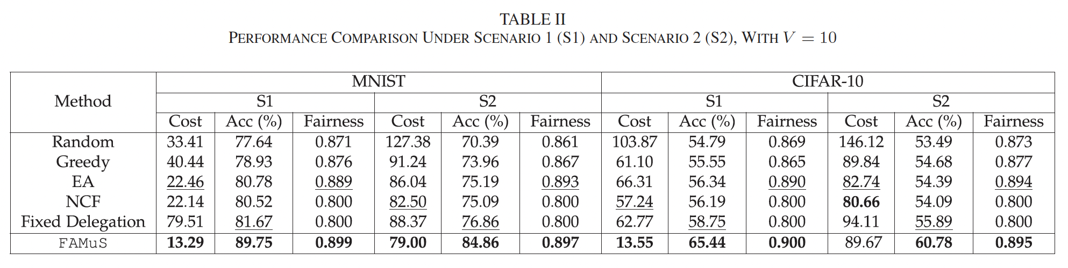
Results
Fairness-Aware Multi-Server Federated Learning Task Delegation Over Wireless Networks

Slide 8
Research Gaps
Fairness-Aware Multi-Server Federated Learning Task Delegation Over Wireless Networks

