Slide 1
Sensor Interfacing
Dr. Ashish V. Joglekar
Member of Technical Staff,
Robert Bosch Center for Cyber Physical Systems,
IISc

Slide 2
Agenda
Sensor Classification
Sensor Properties
Case Studies:
  Temperature
  3 axis Accelerometer
  Soil Moisture
  Heart Beat
  Humidity
  Gas sensor
Data Output Formats
ADCs
Sensor Installation
Demos

Slide 3
Sensor Classification
Primary Input quantity (Measurand)
Transduction Principle
Material type
Electrical property
Application
Output format / Protocol

Slide 4
How to select a specific sensor?
Sensor Datasheet
Sensor Properties

Slide 5
Sensor Properties
Dynamic Range : Max and Min values that can be measured
Transfer function : Functional relationship between input and output
Sensitivity : Slope of output characteristic curve
Linearity : Difference between actual transfer function and best straight line
Resolution : Smallest detectable incremental change
Accuracy : Max difference between actual and measured value
Precision: Degree of reproducibility of a measurement
Bandwidth : Finite Response time to an instantaneous change
Noise : All sensors produce some output noise in addition to the output signal
Drift : e.g. Temperature coefficient of a sensor
Cost

Slide 6
Sensor Analog Front-end
Sensor Biasing
Signal conditioning
  Filters
  Amplifiers
  Comparators
  Linearization circuit
  Compensation for drift
  Calibration

Slide 7
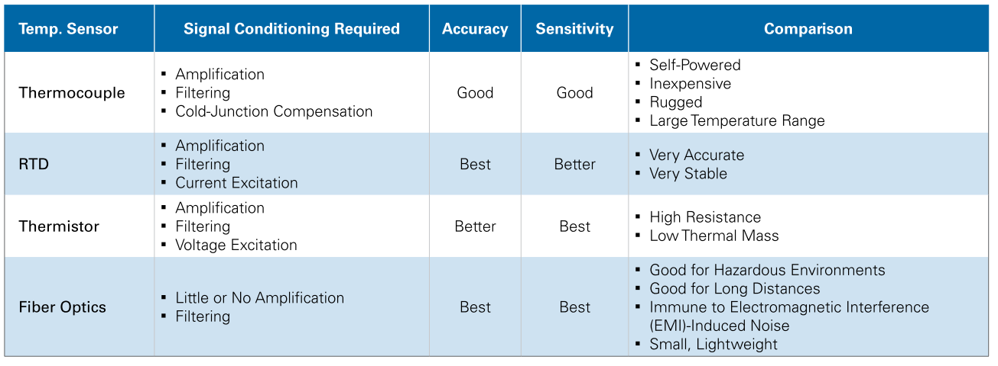
Example: Temperature sensors
Ref: National Instruments

Slide 8
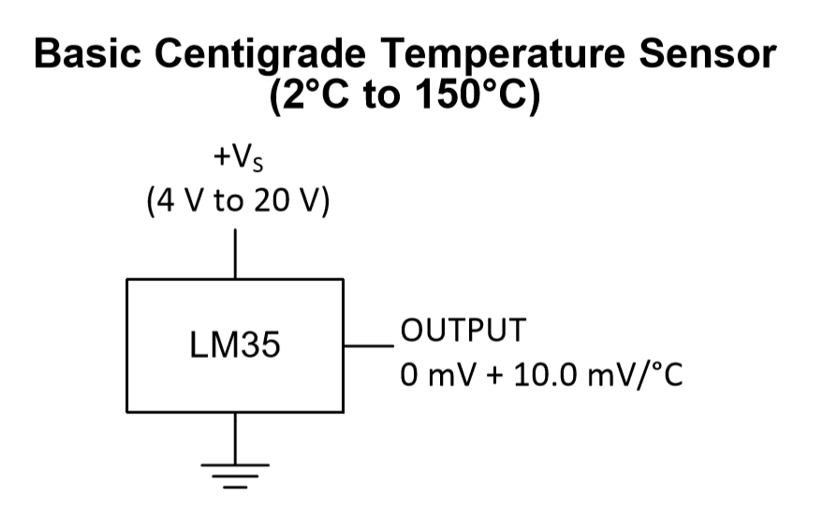
LM35 Temperature Sensor
Ref: LM35 Datasheet

Slide 9
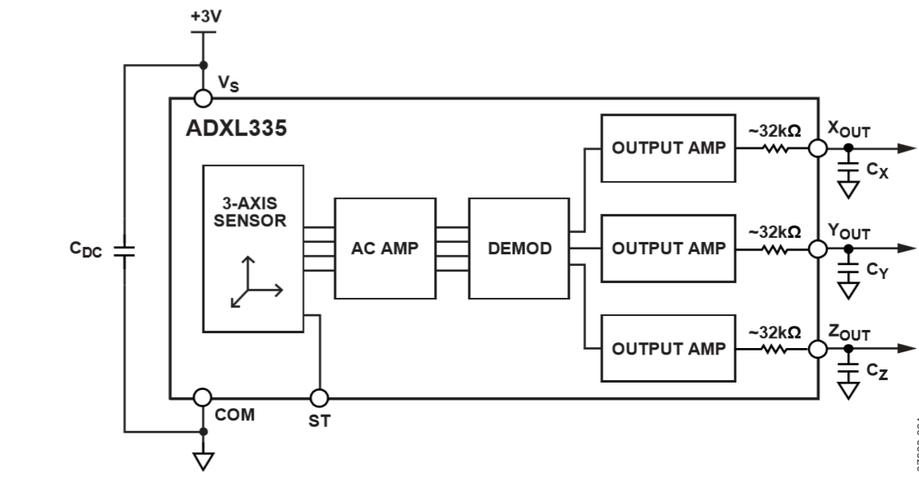
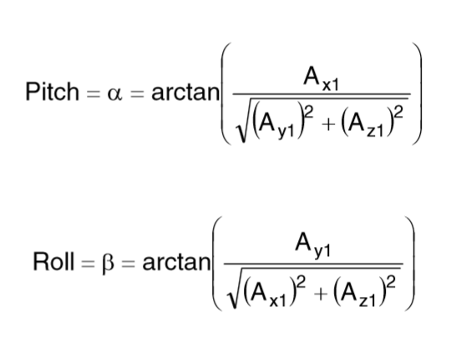
ADXL335 3 Axis Accelerometer
Ref: ADXL335 Datasheet

Slide 10
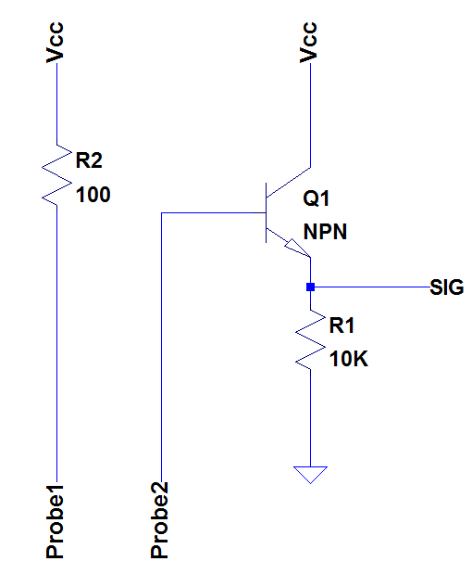
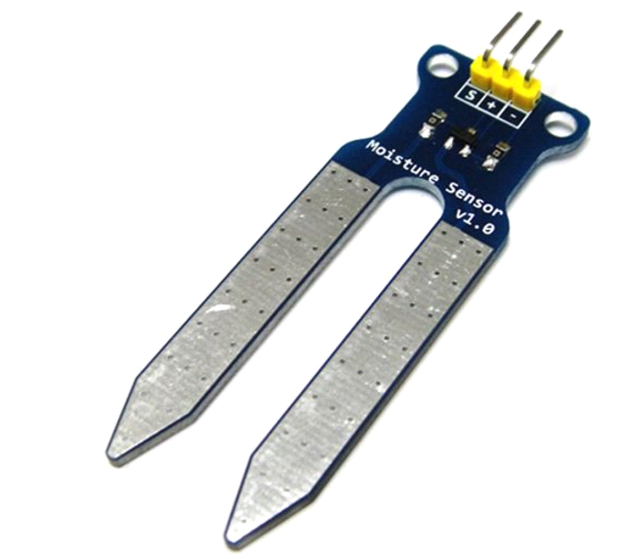
Soil Moisture Sensor

Slide 11
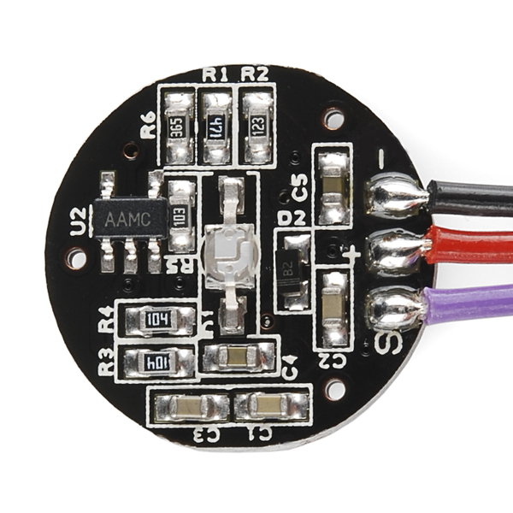
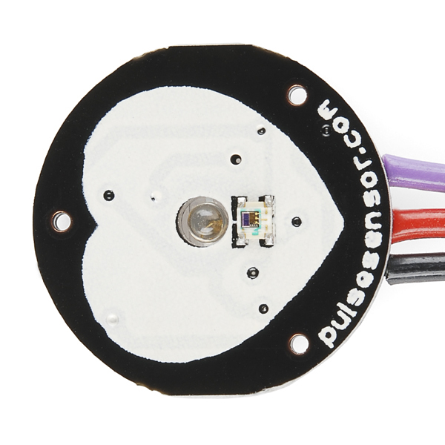
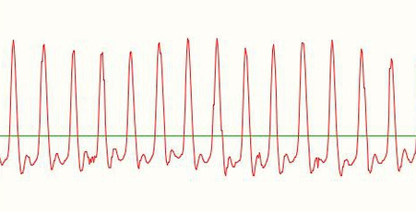
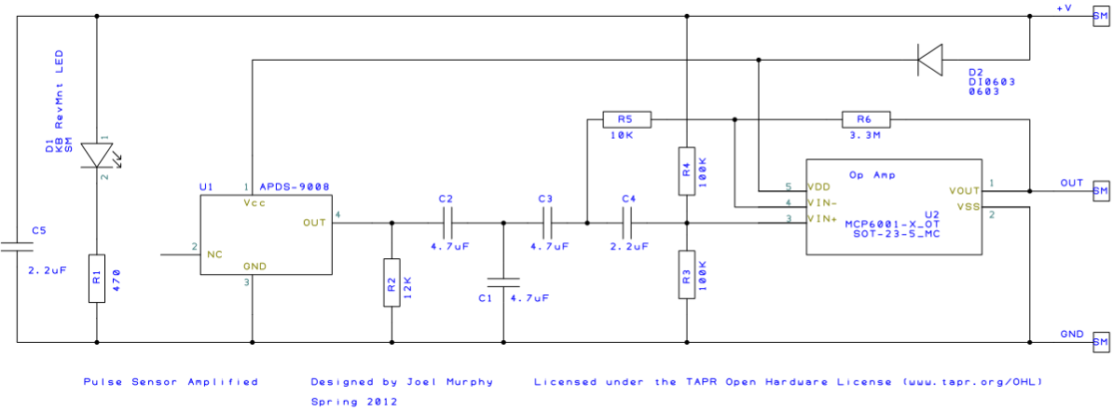
Pulse Sensor
Ref: http://pulsesensor.com/pages/open-hardware

Slide 12
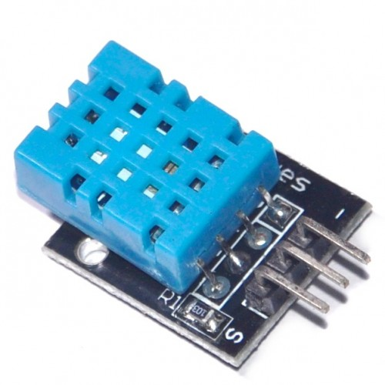
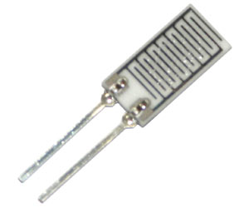
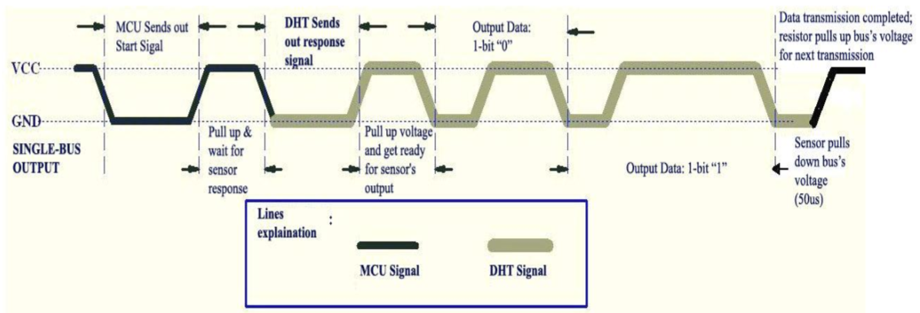
DHT11
Ref: DHT11 Datasheet

Slide 13
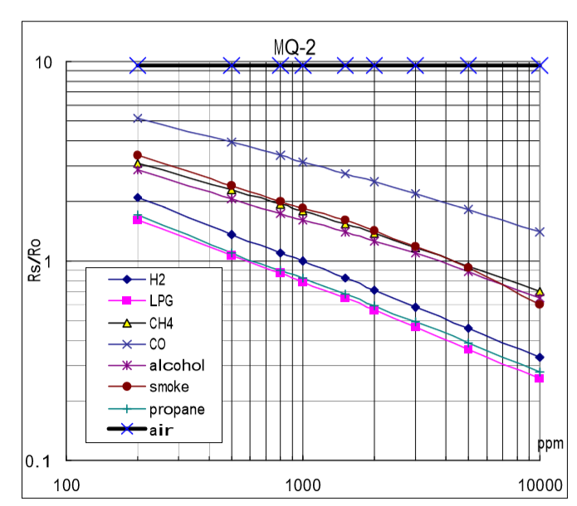
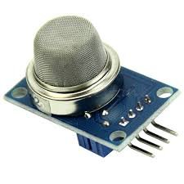
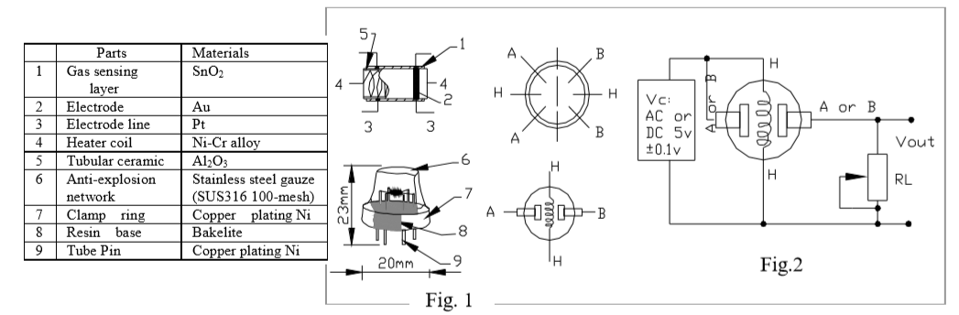
MQ2 Gas Sensor
Ref: MQ2 Datasheet

Slide 14
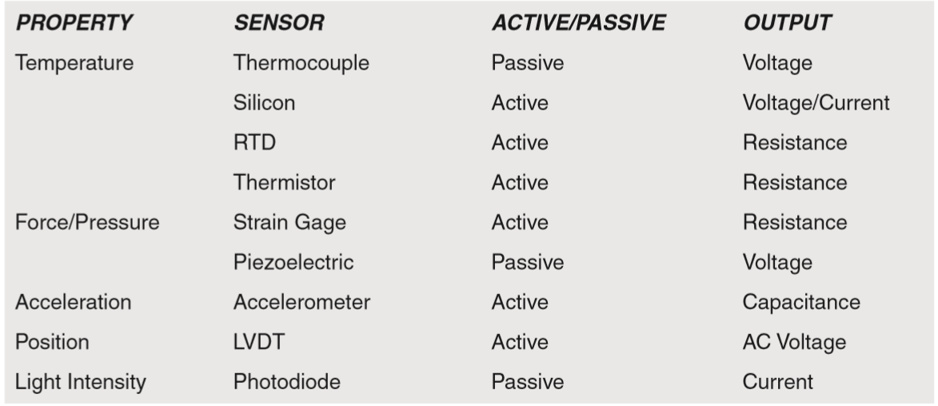
Typical sensors
Ref: Sensor Technology Handbook

Slide 15
Data output Formats
Analog Formats:
  Current (e.g. 4-20mA)
  Voltage
  Frequency
  Phase
Digital Formats:
  UART
  I²C
  Custom

Slide 16
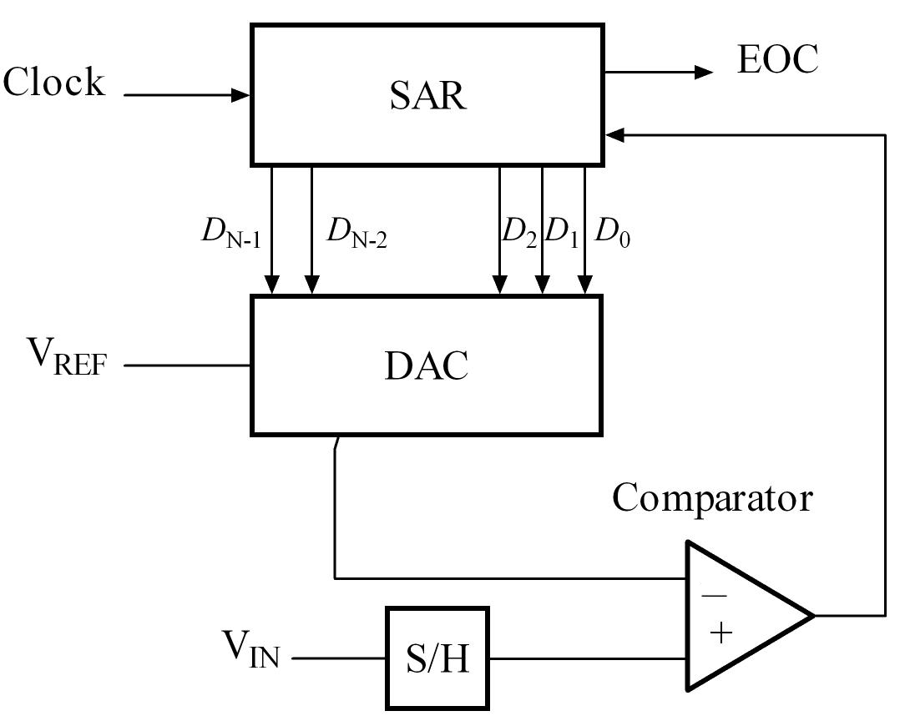
SAR ADC

Slide 17
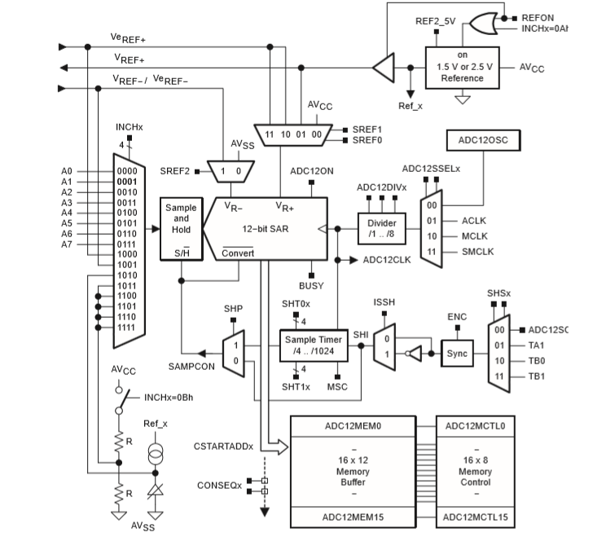
MSP430 ADC implementation
Ref: MSP430 User Manual

Slide 18
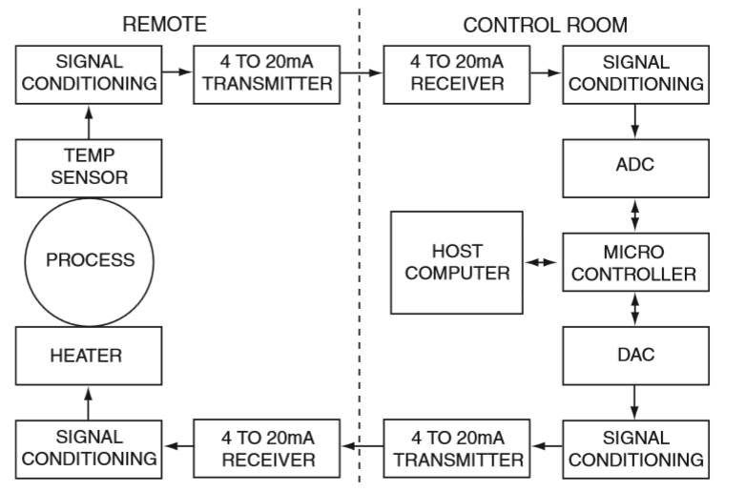
Industrial Process Control Loop
Ref: Sensor Technology Handbook

Slide 19
Sensor Installation
EMI/EMC issues
Cabling
Shielding
Enclosures

Slide 20
EMI Noise Path Model¹
Noise Source
Coupling Path
Victim
How to identify noise sources?
  Nodes with high dV/dt
  Loops with high di/dt
  HF wide band signals
  Incidental transmitters like electromechanical devices
  Long PCB traces/cables carrying HF signals, large loop areas
  External noise sources in intended EM environment
How to identify victim circuits?
  Long PCB traces/cables, large loop areas
  Critical signal traces
  Low power circuits where signals may hide below the noise floor
¹Henry Ott, Design for Electromagnetic Compatibility
Notes:
Question 4 Intra inter
Every EMI problem involves a ”source” of interference, a noise ”coupling path” and a victim [1]. EMI problem can be intrasystem with source and victim as part of same circuit (e.g. coupling between feedback control and switching circuits in an SMPS) or intersystem with distinct source circuits and victim circuits (e.g. coupling between systems sharing same power bus) [2]. Energy is radiated and/or conducted from source to victim in an EM environment
A device that generates radio frequency energy during the course of its operation although the device is not intentionally designed to generate or emit radio frequency energy. Examples of incidental radiators are dc motors, mechanical light switches, etc.

Slide 21
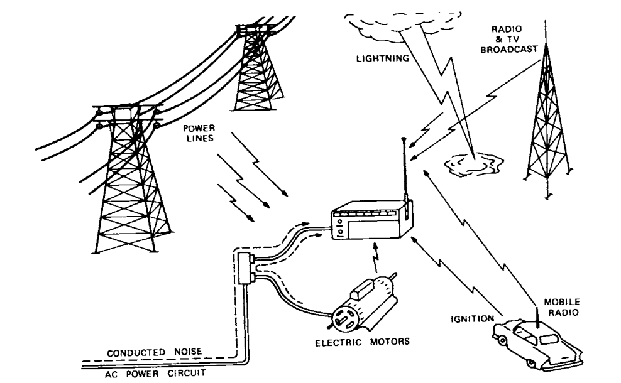
Noise Coupling Mechanisms
Which are the possible coupling mechanisms?
Noise may be conducted and/or radiated from source to victim
Capacitive, Inductive Coupling (Near Field)
E,H Coupling
(Far Field)
Common Impedance Coupling
Source: Deepak S, Applied Electromagnetics and Electromagnetic Compatibility
Notes:
Question 5
E ﬁeld coupling or H ﬁeld coupling when the victim is in the near ﬁeld. These modes may be represented by equivalent lumped circuit components if the circuits are electrically short (circuit dimensions are small compared to signal wavelength).

Slide 22

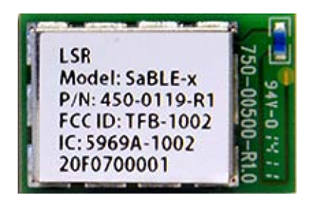


Applicable Regulatory Standards for Unlicensed RF Devices
FCC Part 15
(Unlicensed RF Devices)
Subpart B
(Unintentional Radiators)
Subpart C
(Intentional Radiators)
CISPR 22
Class A Device
(Commercial, Industrial)
Class B Device
(Residential)
Class B Limits are more stringent than Class A¹
¹CISPR 22 Standard Documentation
Notes:
Question 2
A lot of products that historically were not wireless in nature are going to be re-engineered to become “smart.”
“How do we successfully get our wireless product to market?
Unlicensed radio frequency transmissions, both intentional (like a Bluetooth Smart data transmission) and unintentional (like the EM noise that a motor emits).
Unintentional radiator. A device that intentionally generates radio frequency energy for use within the device, or that sends radio frequency signals by conduction to associated equipment via connecting wiring, but which is not intended to emit RF energy by
radiation or induction.
Incidental radiator. A device that generates radio frequency energy during the course of its operation although the device is not intentionally designed to generate or emit radio frequency energy. Examples of incidental radiators are dc motors, mechanical light switches, etc.
Any product that is utilizing a wireless technology such as Wi-Fi, Bluetooth, or Zigbee will need Product Certification under FCC part 15.
FCC testing for Product Certification can be broken into two parts: General Emissions testing and Intentional Radiation testing.
A product that utilizes a certified RF module, such as the Bluetooth Smart module from LSR, as opposed to a discrete circuit design can leverage the certification of the shelf module and avoid the Intentional Radiation testing portion of the FCC certification process
Let’s suppose your product application utilizes Bluetooth or Bluetooth Smart technologies. In addition to the regulatory requirements of the FCC to allow the sale of your product in the US, there is another regulatory body that also must be addressed: the Bluetooth Special Interest Group
Class B limits are more stringent compared to Class A

Slide 23
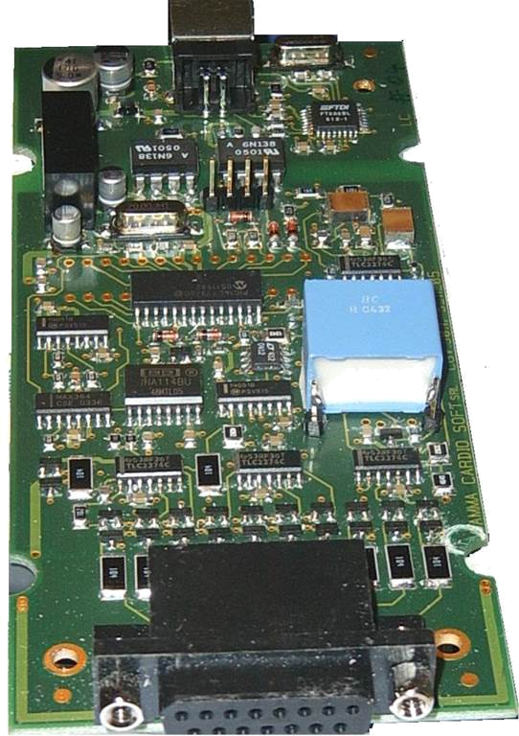
Typical Embedded System
Power Source
Regulator/Power Converter
Clock
Power Supply
Driver Circuits
Clock
Sensors
Analog
Front End
ADC
Digital
Circuits
RF/
Driver Circuits
Actuators
Micro
controller
Digi-tal
ADC
Analog
Front End
Sensors
Notes:
Question 6,7
Which of these blocks are most susceptible to EMI?
Sensors typically remotely placed sensors/ high impedance sensors.
AFE comprising of signal conditioning blocks, amplifiers
Data digitization block
Can you identify the possible sources of EMI in this system?
Clock circuitry is usually the biggest generator of wide-band noise
These are the intra system EMI sources. In a poorly designed system or a system with a poorly designed board layout, digital circuits too can act as a source of EMI.
One should also look at inter system EMI sources when the product is placed in its intended EM environment.
Power line cables, ambient noise sources like lightning strikes, RF broadcasts, power components such as power converters, electromechanical relays, motor drives…

Slide 24
Demos
ADC interfacing Examples

