Slide 1
Smart Room: Building Cooling System Using Nature
Senthil, Avinash, Akshay
(IIT Bombay)
Durgesh
(ISI Kolkata)

Slide 2
Idea
Season | Hypothesis
Summer | Temp(outdoor) > Temp(indoor)
Winter | Temp(outdoor) < Temp(indoor)
Can we infer #occupancy using the relationship between <indoor,outdoor> temperature?
Can we use this information to build a green cooling system for auditorium?

Slide 3
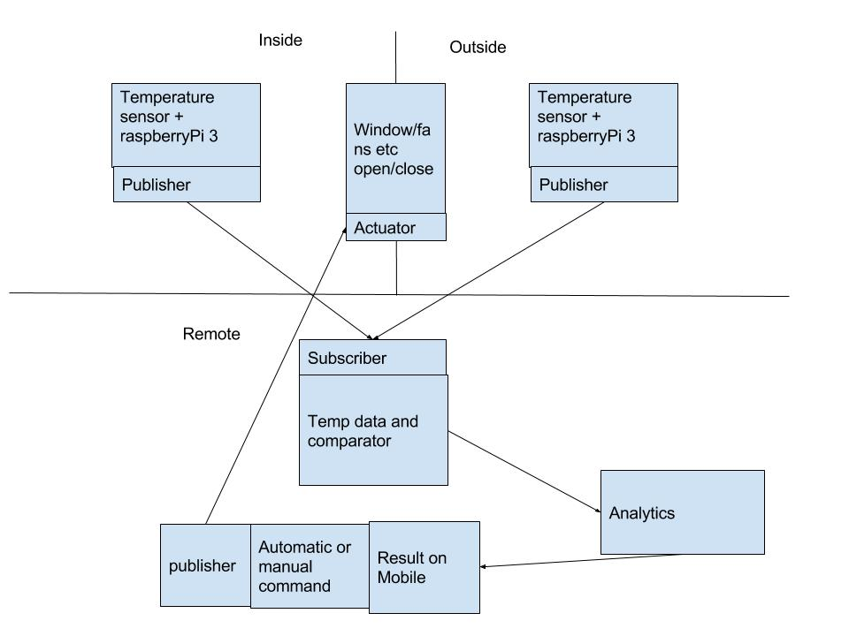
Realising the Idea

Slide 4
Value Impact
Energy is always a valuable commodity in our society
Using natural resouces to save power
Can reduce global warming

Slide 5
Sensor used
Sensor and communication unit: 2
  LM35 temperature sensors
  Raspberrypi 3
Mqtt program for communicating temp data to subscribe
  Publisher at raspberrypi3
  Subscriber at any high end machine

Slide 6
Results
Able to get all communication to work except pushing data at mobile

Slide 7
Future works
Analysis on the cooling pattern
Analysis of the outside temperature pattern
Analysis of the power save percentage with this setup

Slide 8
Thank you

