Slide 1

approximation
algorithm
By 熊浚丞

Slide 2
Agenda
Set Cover problem
Greedy method
0-1 knapsack
Greedy method

Slide 3
INTRODUCTION
Set Cover Problem (SCP)
INTRODUCTION

Slide 4
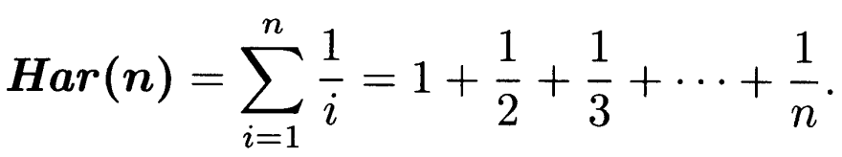
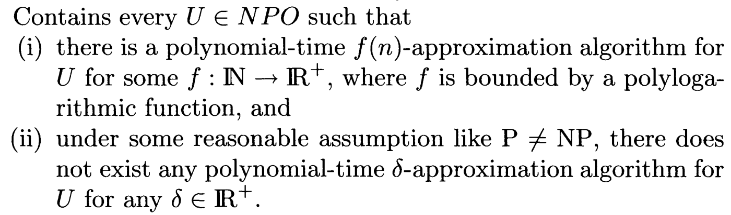
Pre required knowledge
The n-th harmonic number:
SCP is in the class NPO(IV), which is:

Slide 5

Set Cover Problem
Input:
Output: $C⊆ℱ \text{s}\text{.}\text{t}\text{. }X=\bigcup_{Q∈C}{Q}$
Cost: $|C|$
Goal: Minimize

Slide 6
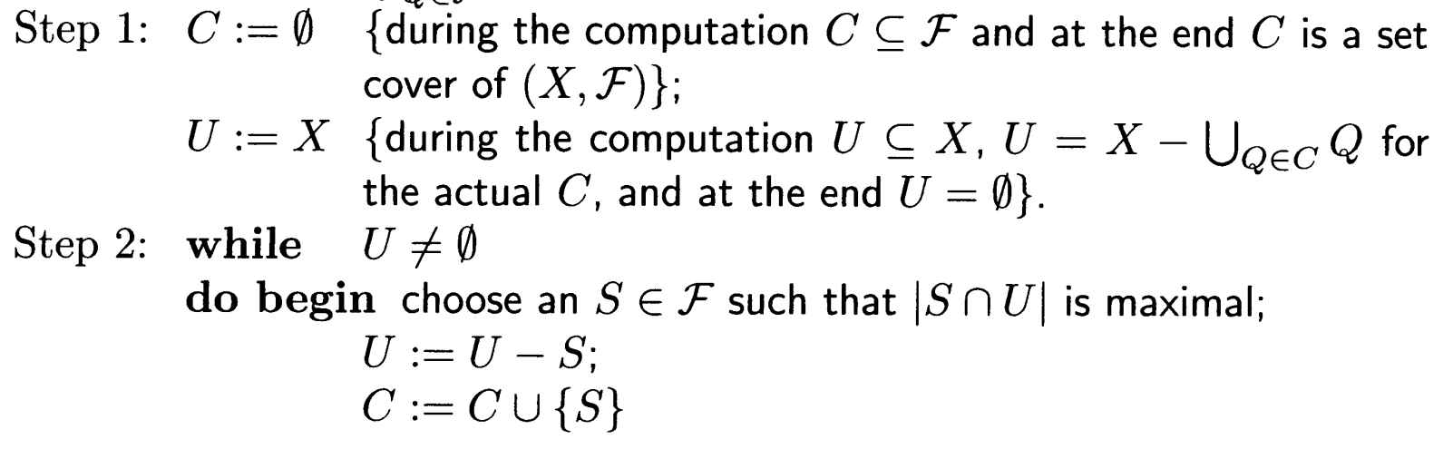
Greedy approach
The greedy approach chooses the set that “gains” the maximum number of items that haven’t been covered.

Slide 7
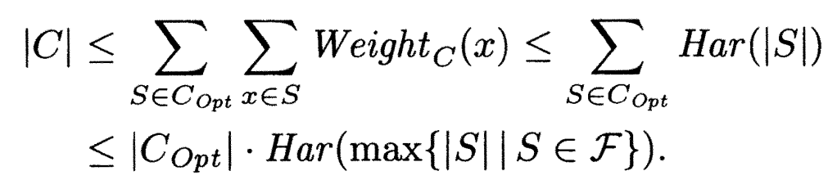
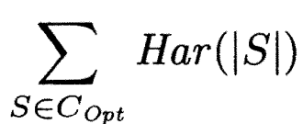
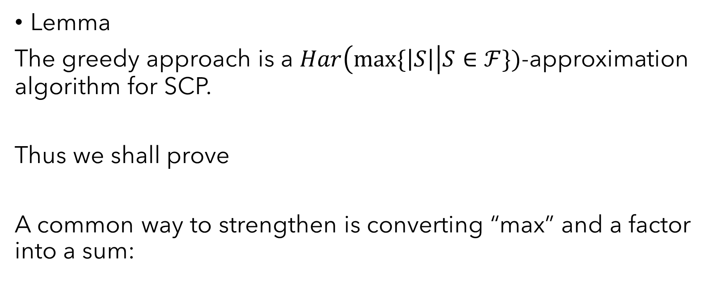
Approximation
Lemma
The greedy approach is a $Har\left(max\{\left|S\right|\right|S∈ℱ\})$-approximation algorithm for SCP.
Thus we shall prove
A common way to strengthen is converting “max” and a factor into a sum:

Slide 8
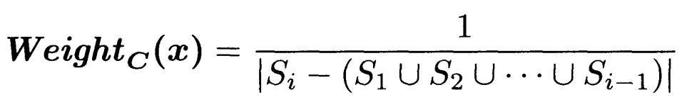
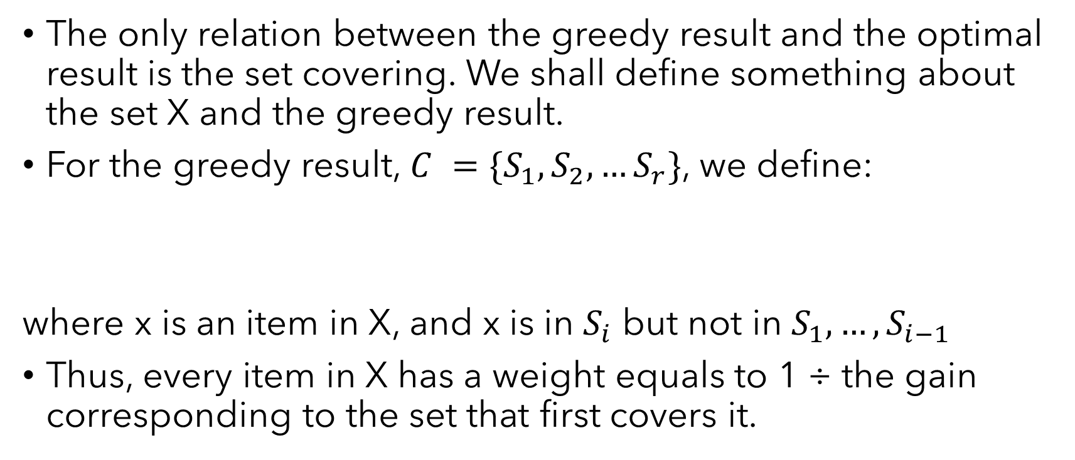
Weight
The only relation between the greedy result and the optimal result is the set covering. We shall define something about the set X and the greedy result.
For the greedy result, $C =\{S_{1},S_{2},…S_{r}\}$, we define:
where x is an item in X, and x is in $S_{i}$ but not in $S_{1},…,S_{i−1}$
Thus, every item in X has a weight equals to 1 ÷ the gain corresponding to the set that first covers it.

Slide 9
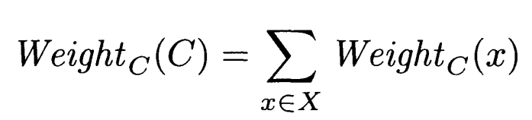
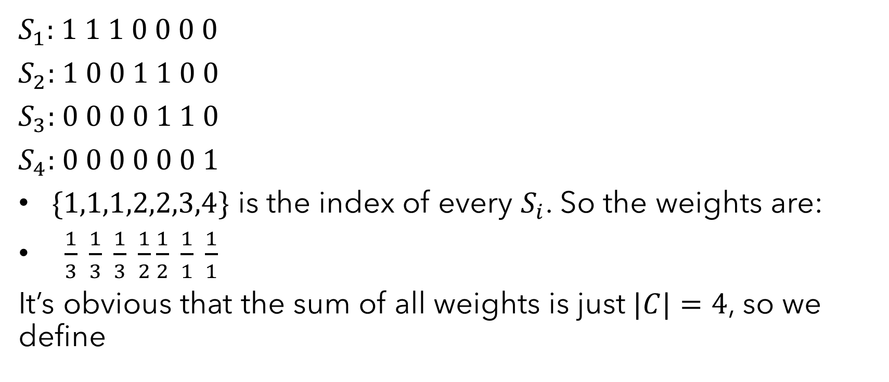
Example of weight
$S_{1}$: 1 1 1 0 0 0 0
$S_{2}$: 1 0 0 1 1 0 0
$S_{3}$: 0 0 0 0 1 1 0
$S_{4}$: 0 0 0 0 0 0 1
$\{1,1,1,2,2,3,4\}$ is the index of every $S_{i}$. So the weights are:
$\frac{1}{3} \frac{1}{3} \frac{1}{3} \frac{1}{2}\frac{1}{2} \frac{1}{1} \frac{1}{1}$
It’s obvious that the sum of all weights is just $|C|=4$, so we define

Slide 10
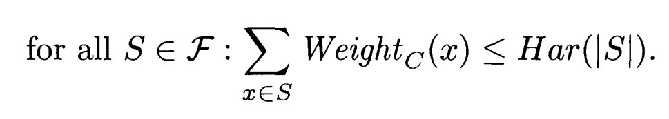
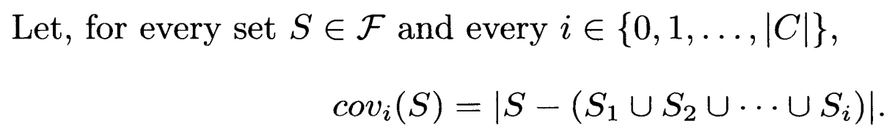

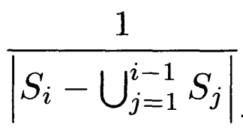
Now we want to prove
So, can represent the number of the gaining items in the i-th time which are in S.
For these items, their weights are all as defined.

Slide 11
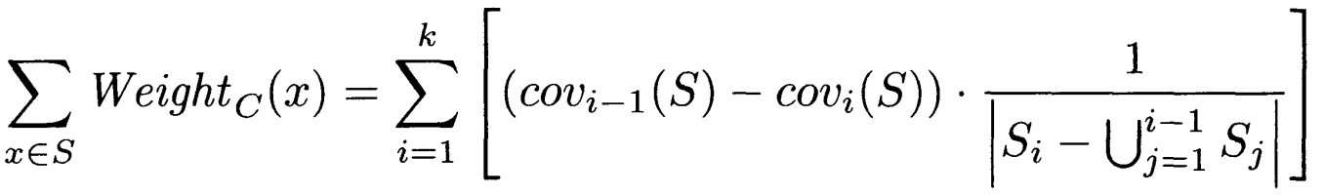
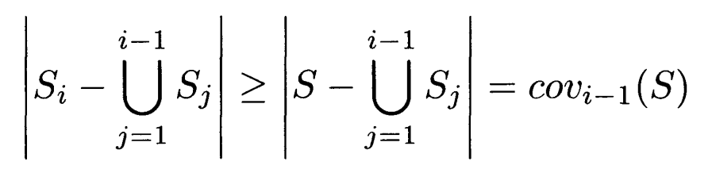
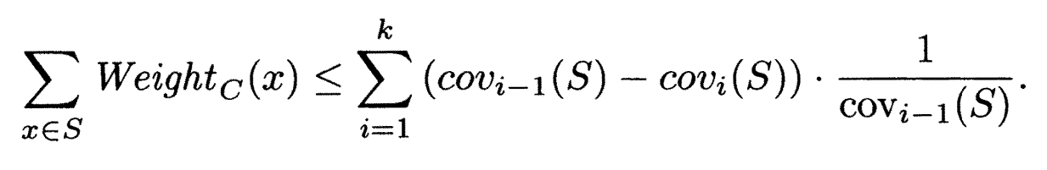

Thus,
We also have the property of greedy. $S_{i}$ gains the most items
in the i-th choice:
Making a substitution, we have:
This format of sum appears in your calculus class!

Slide 12
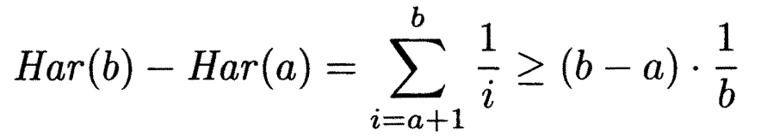
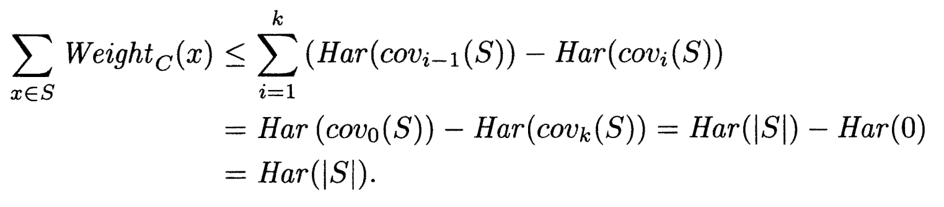
Because
We have
So

Slide 13
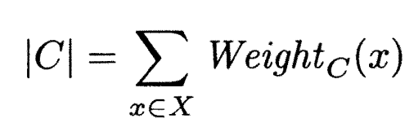
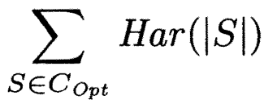
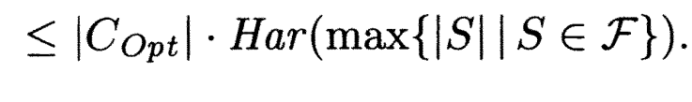
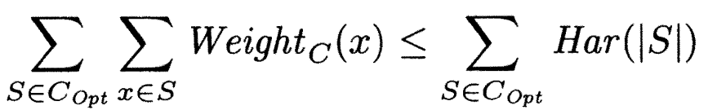
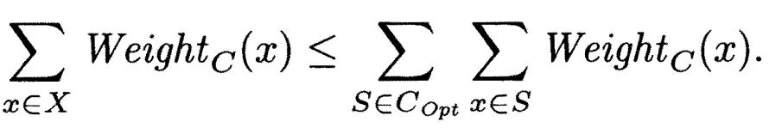
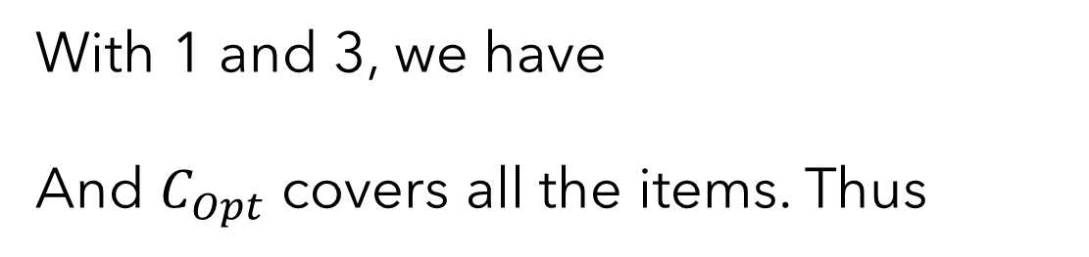
See what we have now…
1
2
3
With 1 and 3, we have
And $C_{Opt}$ covers all the items. Thus

Slide 14
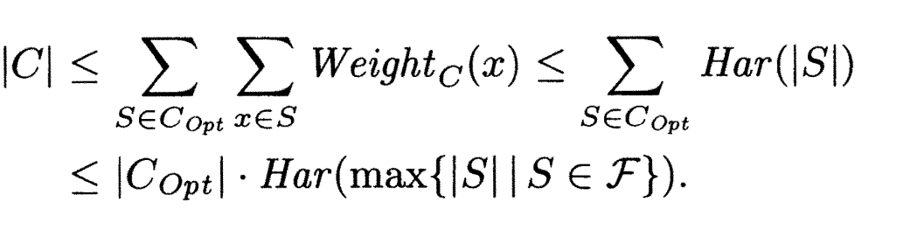
Finally
Finally we get

Slide 15
INTRODUCTION
0-1 Knapsack Problem
INTRODUCTION

Slide 16

0-1 knapsack problem
There are n items, where the i-th item is worth $v_{i}$ dollars and weighs $w_{i}$pounds. We are also given a knapsack that can hold at most $W$ pounds. Using the knapsack, we want to get as many dollars as possible. Each item can’t be separated.

Slide 17
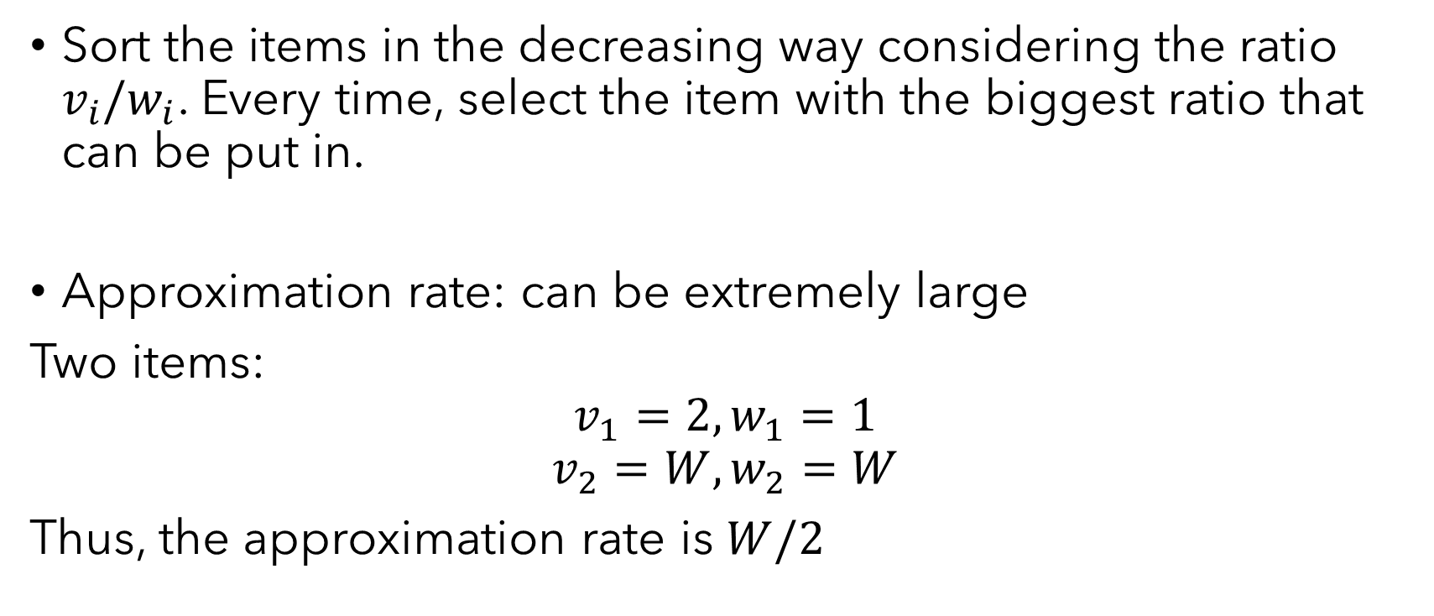
A bad greedy approach
Sort the items in the decreasing way considering the ratio ${v_{i}/w}_{i}$. Every time, select the item with the biggest ratio that can be put in.
Approximation rate: can be extremely large
Two items:
$$v_{1}=2, w_{1}=1$$
$$v_{2}=W,w_{2}=W$$
Thus, the approximation rate is $W/2$

Slide 18
Compare with fraction
For a fraction knapsack problem, the optimal solution can be found with greedy method.
What’s the gap between 0-1 knapsack and fraction knapsack?
——Actually, only one item in the latter will be separated.

Slide 19

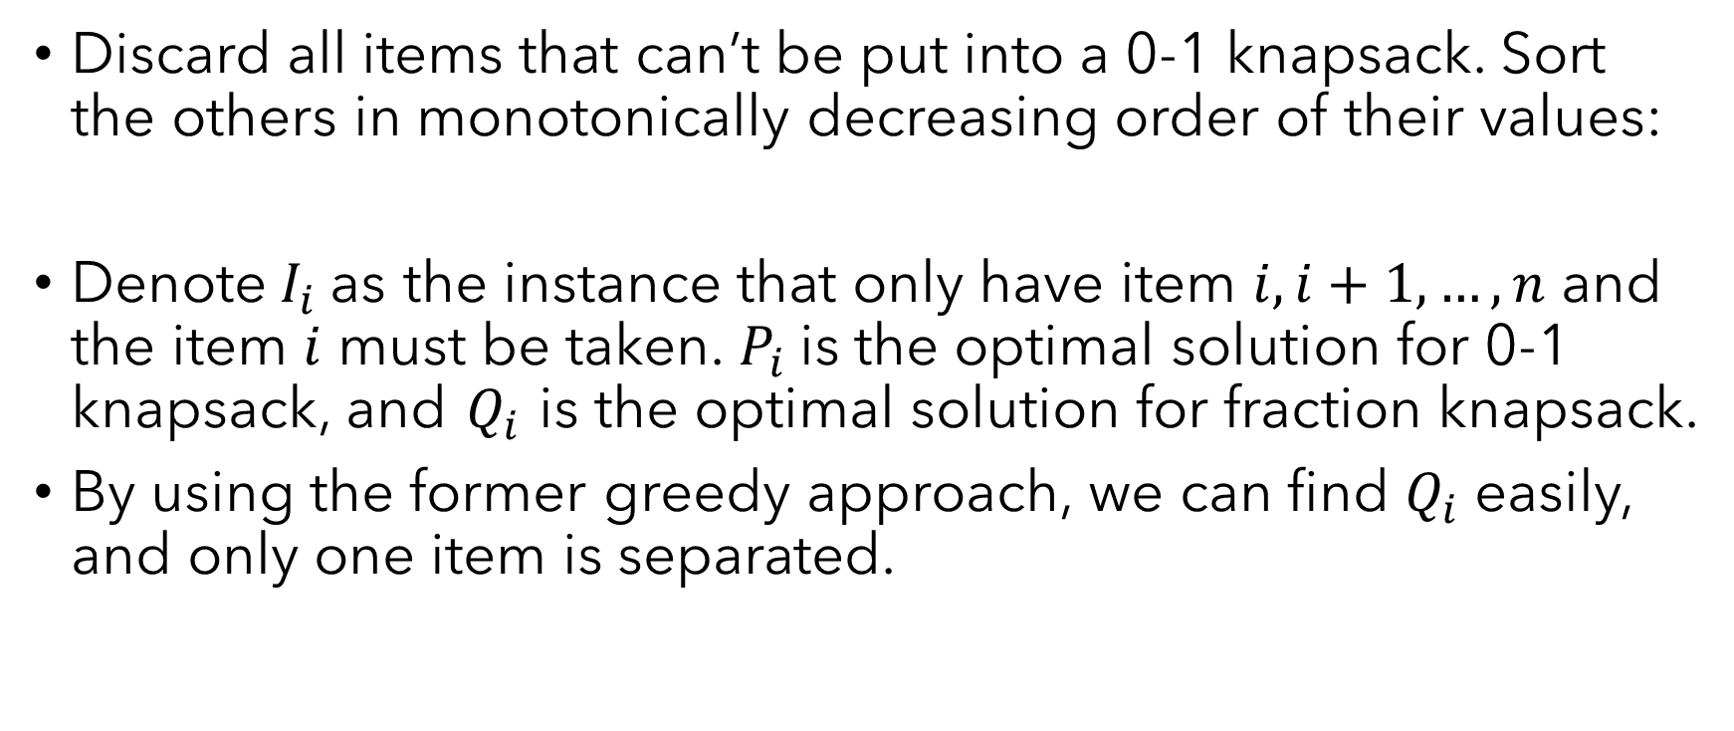
Changed instances
Discard all items that can’t be put into a 0-1 knapsack. Sort the others in monotonically decreasing order of their values:
Denote$I_{i}$as the instance that only have item $i,i+1,…,n$ and the item $i$ must be taken. $P_{i}$is the optimal solution for 0-1 knapsack, and $Q_{i}$is the optimal solution for fraction knapsack.
By using the former greedy approach, we can find $Q_{i}$ easily, and only one item is separated.

Slide 20
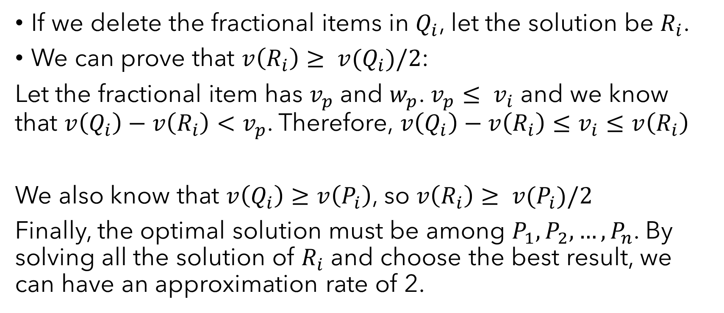
Delete fractional items
If we delete the fractional items in $Q_{i}$, let the solution be $R_{i}$.
We can prove that $v\left(R_{i}\right)≥ v(Q_{i})/2$:
Let the fractional item has $v_{p}$ and $w_{p}$. $v_{p}≤ v_{i}$ and we know that $v\left(Q_{i}\right)−v\left(R_{i}\right)<v_{p}$. Therefore, $v\left(Q_{i}\right)−v\left(R_{i}\right)≤v_{i}≤v\left(R_{i}\right)$
We also know that $v\left(Q_{i}\right)≥v\left(P_{i}\right)$, so $v\left(R_{i}\right)≥ v(P_{i})/2$
Finally, the optimal solution must be among $P_{1},P_{2},…,P_{n}$. By solving all the solution of $R_{i}$ and choose the best result, we can have an approximation rate of 2.

Slide 21


THANK
YOU
221240060@smail.nju.edu.cn

