Slide 1






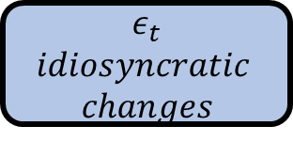



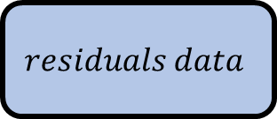



Original data
Data Processing
Prophet model parameter selection
Priori Knowledge
Holiday
Periodicity
Prophet Model
Correct predicted value
$$g\left(t\right)$$
$$trend function$$
$$ε_{t}$$
$$idiosyncratic$$
$$changes$$
$$h\left(t\right)$$
$$holidays effects$$
$$s\left(t\right)$$
$$periodic changes$$
$$Nonlinear term$$
$$Additional term$$
$$residuals$$
XgBoost Model
$$residuals data$$
$$select task model$$
$$select appropriate$$
Continue training?
YES
$$output iteration$$
$$parameters$$
$$results$$
NO
$$Output Data$$

Slide 2





















Original data
Data Processing
$$Y_{true}$$
$$adder$$
$$subtractor$$
Prophet model parameter selection
Priori Knowledge
Holiday
Periodicity
Prophet Model
Correct predicted value
$$g\left(t\right)$$
$$trend function$$
$$ε_{t}$$
$$disturbances$$
$$term$$
$$h\left(t\right)$$
$$holidays effects$$
$$s\left(t\right)$$
$$periodic changes$$
$$Nonlinear term$$
$$Additional term$$
$$Y_{Prophet−predict}$$
$$Y_{true}$$
$$residuals$$
XGBoost Model
$$residuals data$$
$$select task model$$
$$select appropriate$$
Continue training?
YES
$$output iteration$$
$$parameters$$
$$results$$
NO
$$Y_{XGB−predict}$$
$$Y_{Prophet−predict}$$
$$Output Data$$

Slide 3
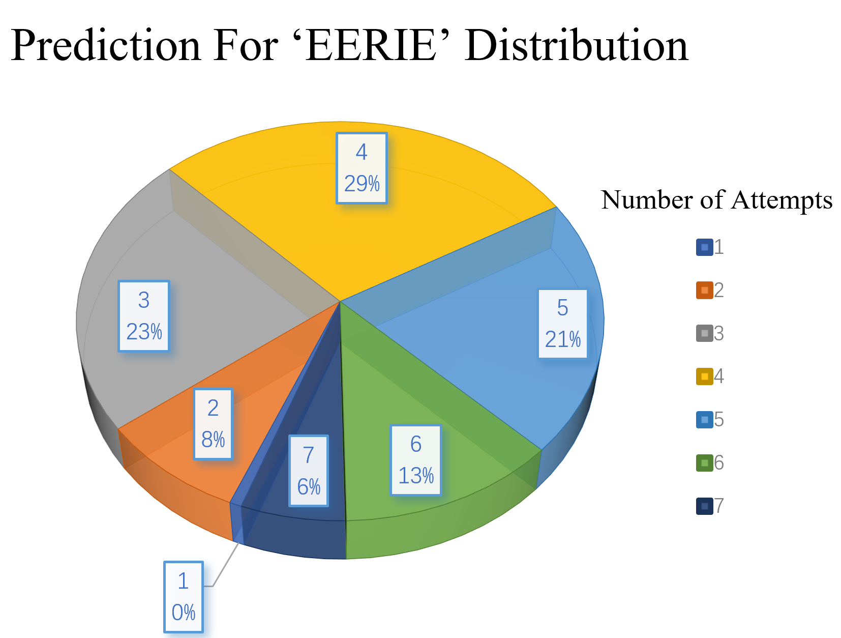
Prediction For ‘EERIE’ Distribution
Number of Attempts

Slide 4
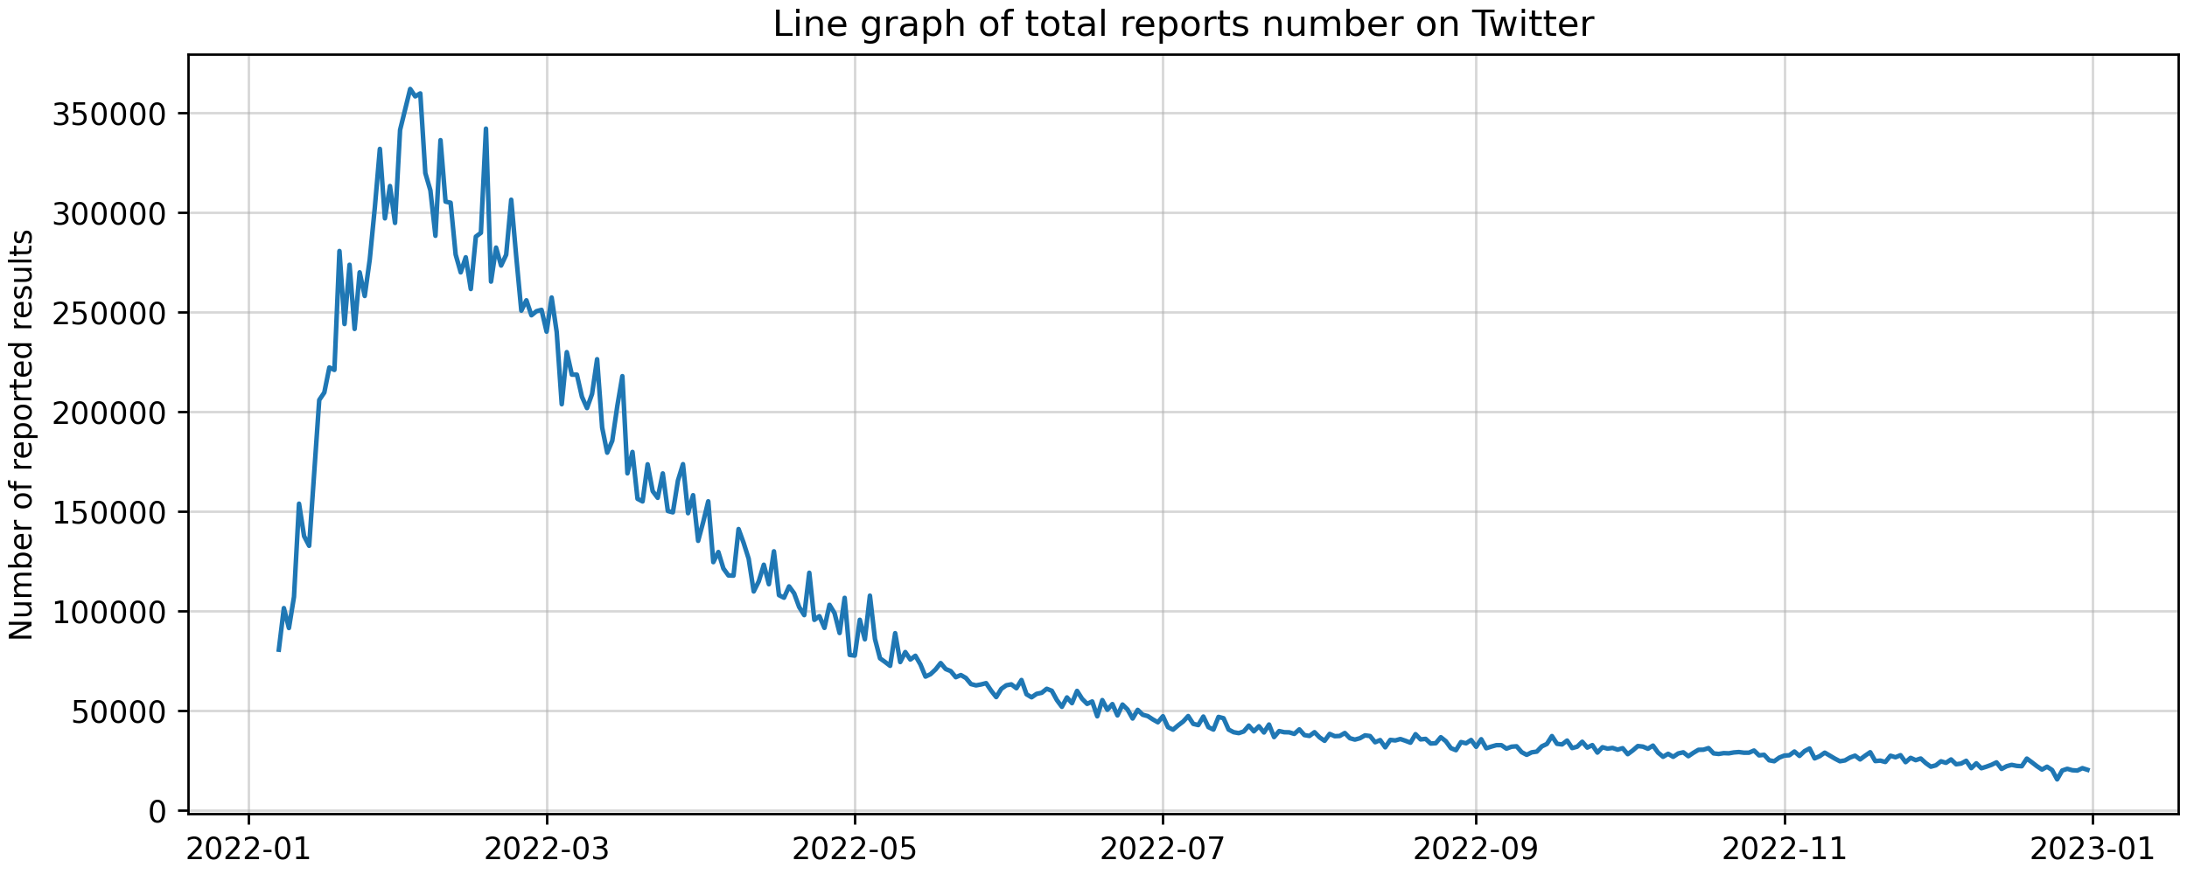
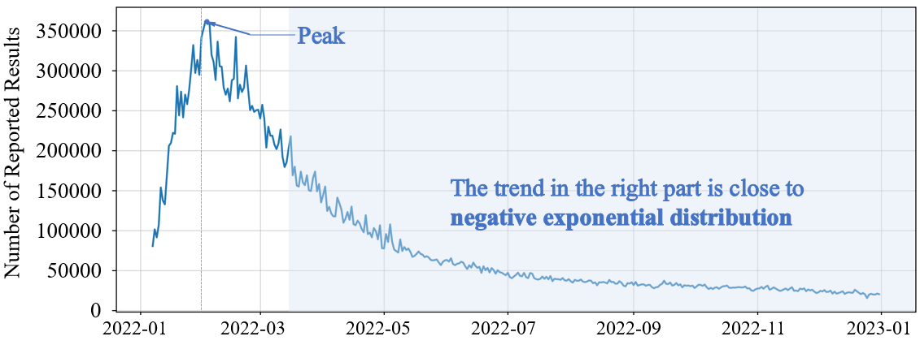
350000
Peak
300000
250000
200000
Number of Reported Results
150000
The trend in the right part is close to
negative exponential distribution
100000
50000
0
2022-01
2022-03
2022-05
2022-07
2022-09
2022-11
2023-01

Slide 5



















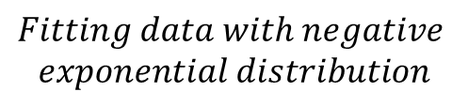


$$subtractor$$
$$Our model$$
$$The overall trend of daily$$
$$Fitting data with negative$$
$$exponential distribution$$
$$reports number fit the$$
$$Negative exponential distribution$$
$$expontial function curve well$$
$$Y_{true}$$
$$The residual changes periodically$$
$$residuals_{1}$$
$$Our$$
$$Observation$$
$$with holidays and weekends$$
$$Prophet Model$$
$$Fitting residuals with Prophet$$
$${residuals}_{1}$$
$$residuals_{2}$$
$Residual_{2} doesn′t satisfy the normal$ $distri$-
$$Extract information from the residual to$$
$$XGBoost$$
$$bution and still contains valid information$$
$$improve the result of the prophet model$$
$$No$$
$$Is the residual$$
$$white noise?$$
$$Yes$$
$$Output$$

Slide 6













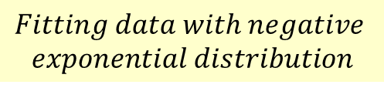

















$$Our model$$
$$subtractor$$
$$The overall trend of daily$$
$$Fitting data with negative$$
$$exponential distribution$$
$$reports number fit the$$
$$Negative exponential$$
$$expontial function curve well$$
$$distribution$$
$$Y_{true}$$
$$The residual changes$$
$$residuals_{1}$$
$$Our$$
$$Observation$$
$$periodically with$$
$$Fitting residuals$$
$$Prophet Model$$
$with Prophet model$
$$holidays and weekends$$
$${residuals}_{1}$$
$$Residual_{2} doesn^{′}t satisfy the$$
$$residuals_{2}$$
$$Extract information from$$
$$normal distribution and still$$
$$XGBoost$$
$$the residual to improve the$$
$$contains valid information$$
$$result of the prophet model$$
$$No$$
$$Is the residual$$
$$white noise?$$
$$Yes$$
$$Output$$

Slide 7
$$Fewer reported results than excepted from trendline$$
$$More reported results than excepted from trendline$$

Slide 8
Coefficient

Slide 9

Word
Frequency
Word
Obscurity
Bigram
Frequency
Word
Adjacency
Spelling
Pattern
Similar to
Other Words
Difficulty
Less
Feedback
Low
Frequency Letter
Letter
Repetition
Letter
Frequency

Slide 10
Problem 2
Analyze
coefficients
Dirichlet
Regression
Predict
“EERIE”
Validation
MAE
MSE
Chi-square
test
AIC
BIC
Problem 3
Analyze
coefficients
Problem 1
Feature engineering
Extract valid information
using XGBoost
Data Preprocessing
Multiple logistic regression
Word Frequency
Letter Frequency
Rank Sum
Ratio
Feature
selection
Fit trend with Negative
exponential curve
Fit residuals with
Prophet Model
Classify
“EERIE”
K-means
clustering
Word Adjacency
Bigram Frequency
validation
Use moving average method to process the data
Calculate Spearman
correlation
Systematic
clustering
Letter Repetition
Date
Sensitivity Analysis
Add disturbance
Calculate F1-score
Problem 4
Four aspects
total reports
numbers
Hard Mode
percentage
First guessing
words
Word difficulty level

Slide 11
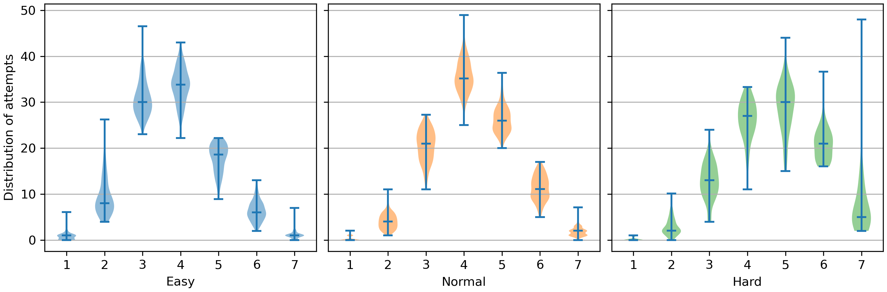

Slide 12
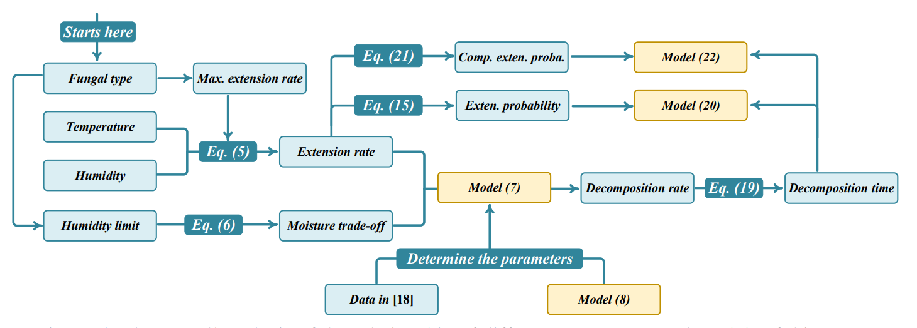

Slide 13
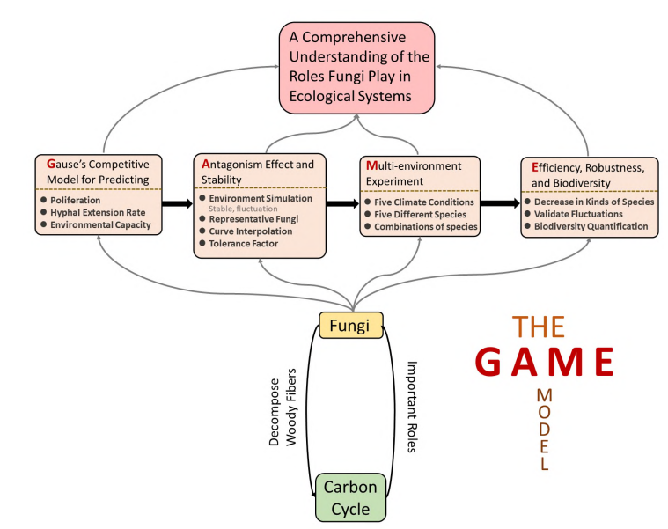

Slide 14
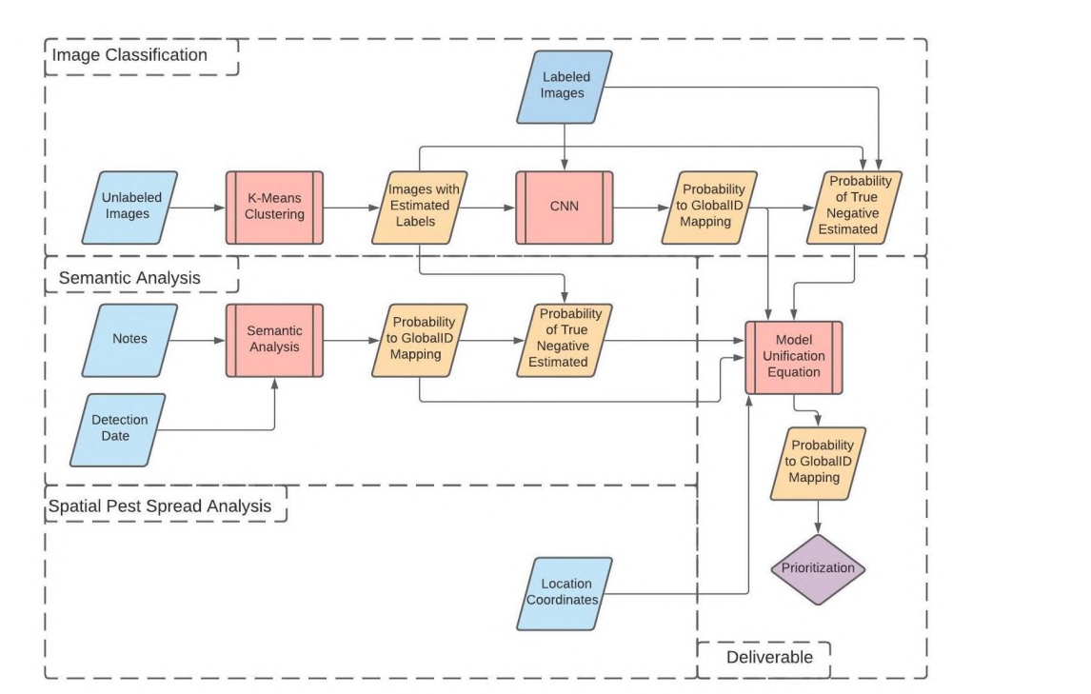

Slide 15
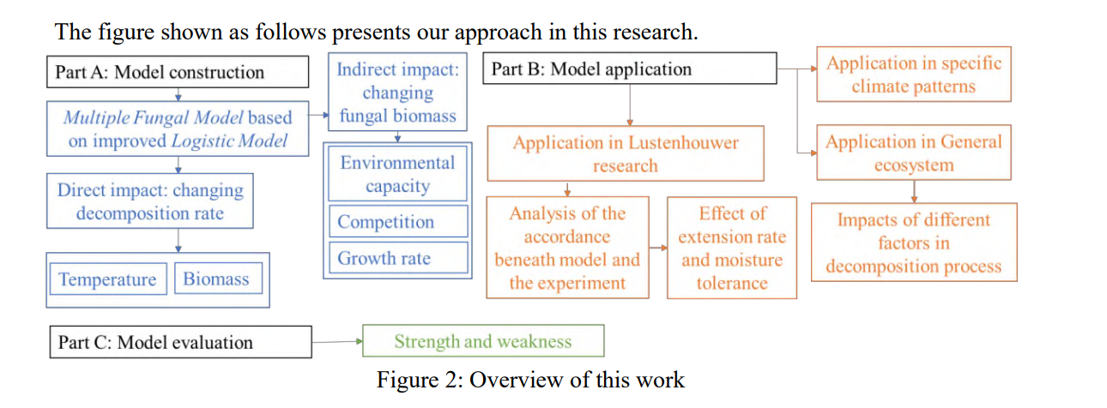

Slide 16
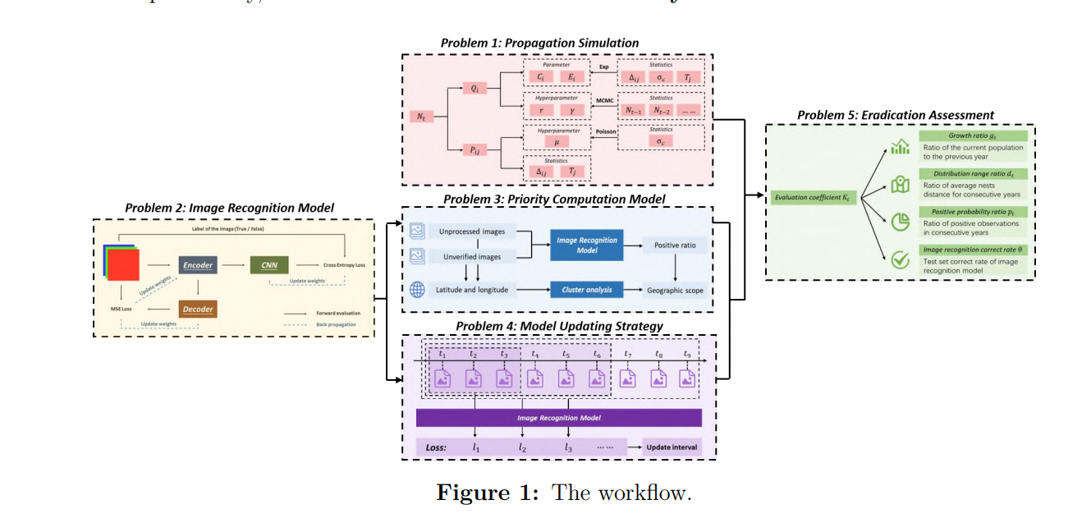

Slide 17
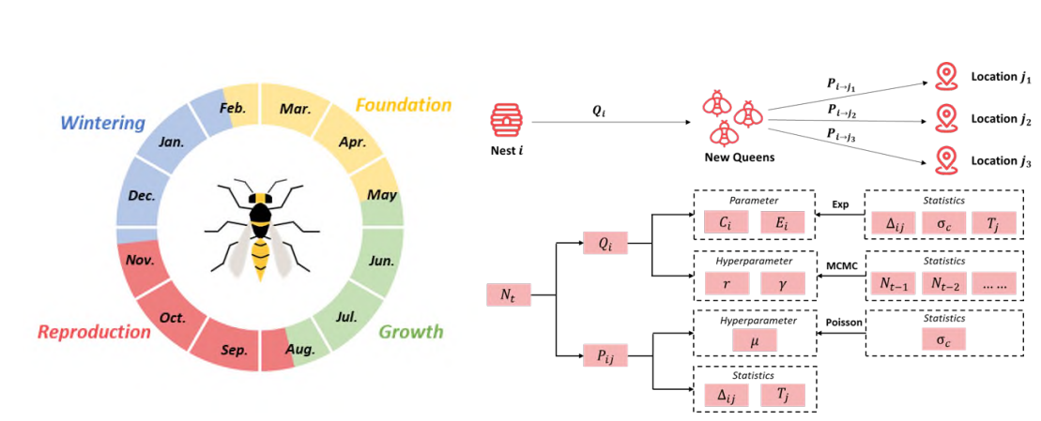

Slide 18
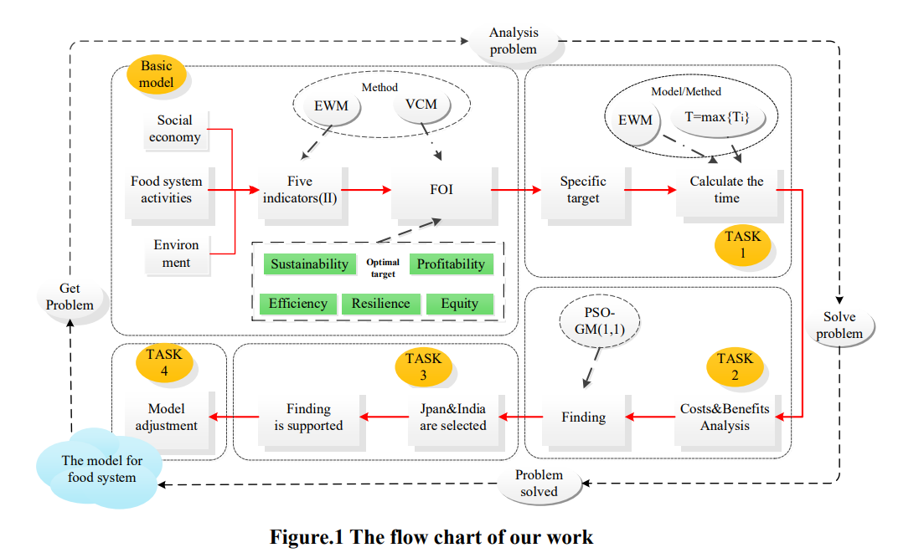

Slide 19
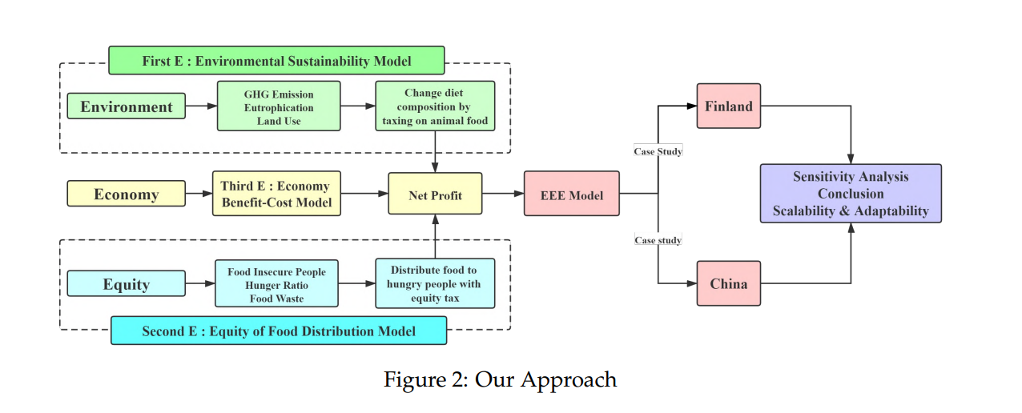

Slide 20
