Slide 1

Proxmox VE 6
Section 1
Introduction and Installation
Instructor: Hadi Alnabriss

Slide 2
Introduction
Open Source
Integrates KVM hypervisor and LXC containers
Central Web Management and CLI
Variety Storage support
Supports Clustering and High availability

Slide 3
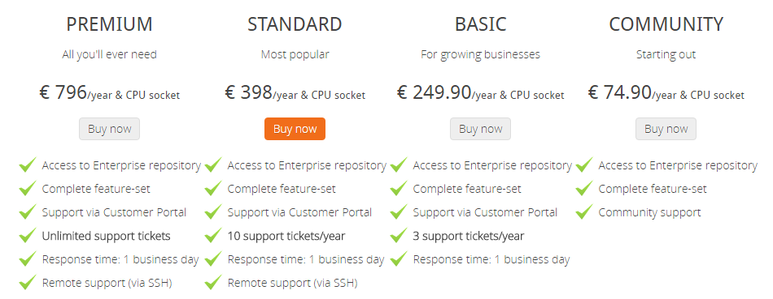
Proxmox VE Subscription

Slide 4
Installation Requirements
Recommended Hardware
CPU: 64bit (Intel EMT64 or AMD64)
Intel VT/AMD-V capable CPU/Mainboard (for KVM Full Virtualization support)
8 GB RAM is good, more is better (grab as much as possible)
Hardware RAID with batteries protected write cache (BBU) or flash protection
Fast hard drives, best results with 15k rpm SAS, Raid10
Two or more Gbit NIC (for bonding), additional NIC´s depending on the preferred storage technology and cluster setup

Slide 5
Download ISO
Download the Latest ISO image from:
https://www.proxmox.com/en/downloads/category/proxmox-virtual-environment
We are going to use VMware in our Lab Environment

Slide 6
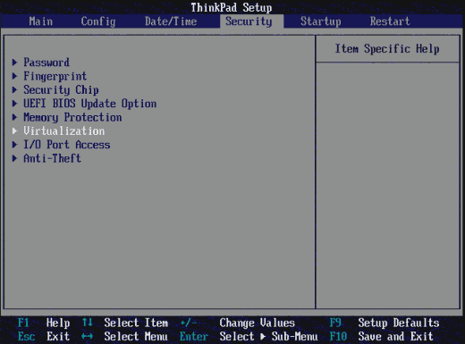
Installation
You have to use an 64 bit OS/CPU
Enable Virtualization from BIOS/EUFI

Slide 7
Create VM
Prepare a new Virtual Machine
Use 20GB Disk
2 GB RAM
One NIC ( Use Bridging)
Mount The downloaded ISO to the new VM

Slide 8
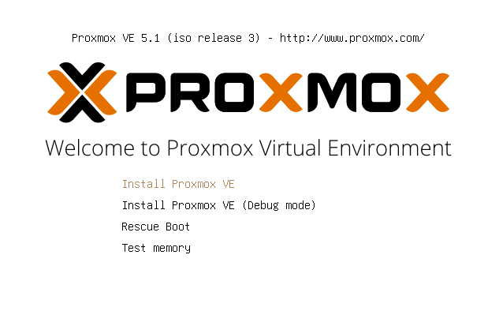
Start Installation
Choose Install Proxmox VE to Start Installation

Slide 9
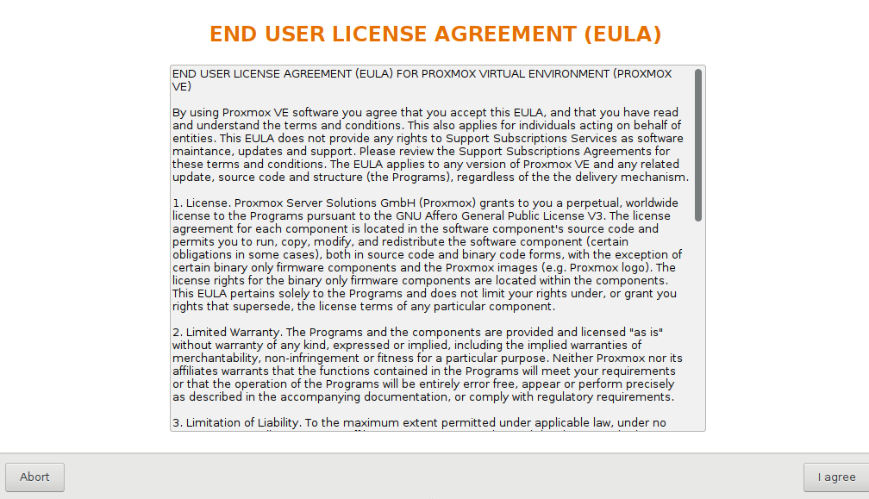
Accept The Agreement

Slide 10
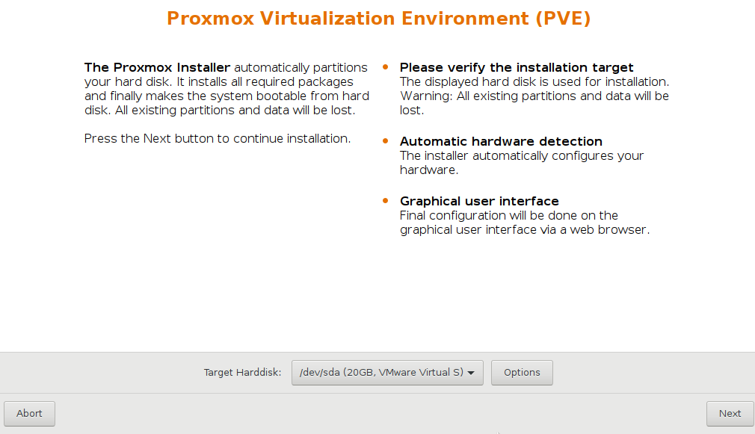
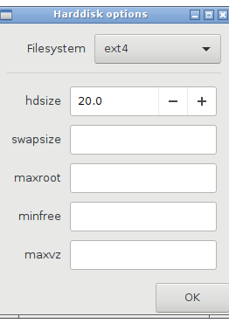
Select Target Harddisk
select the installation disk, or click options to make advanced configurations

Slide 11
Advanced Partitioning Options
The installer creates a Volume Group (VG) called pve, and additional Logical Volumes (LVs) called root, data and swap.
The size of these volumes can be controlled with:
hdsize Defines the total HD size to be used.
This way you can save free space on the HD for further partitioning (i.e. for an additional PV and VG on the same hard disk that can be used for LVM storage).
swapsize Defines the size of the swap volume.
Equals the memory size if (Minimum 4 GB and maximum 8 GB. )
The resulting value cannot be greater than hdsize/8.

Slide 12
Advanced Partitioning Options
maxroot: Defines the maximum size of the root volume, which stores the operating system.
The maximum limit of the root volume size is hdsize/4.
minfree Defines the amount of free space left in volume group pve.
With more than 128GB storage available the default is 16GB, else hdsize/8 will be used.
maxvz: Defines the maximum size of the data volume. The actual size of the data volume is:
datasize = hdsize - rootsize - swapsize - minfree
Where datasize cannot be bigger than maxvz.

Slide 13
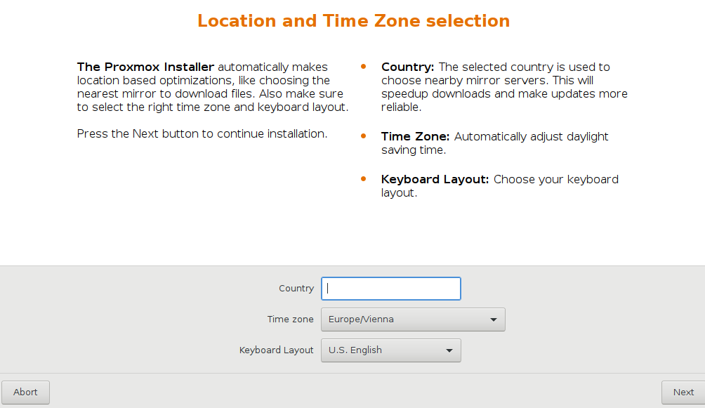
Country & Time Zone

Slide 14
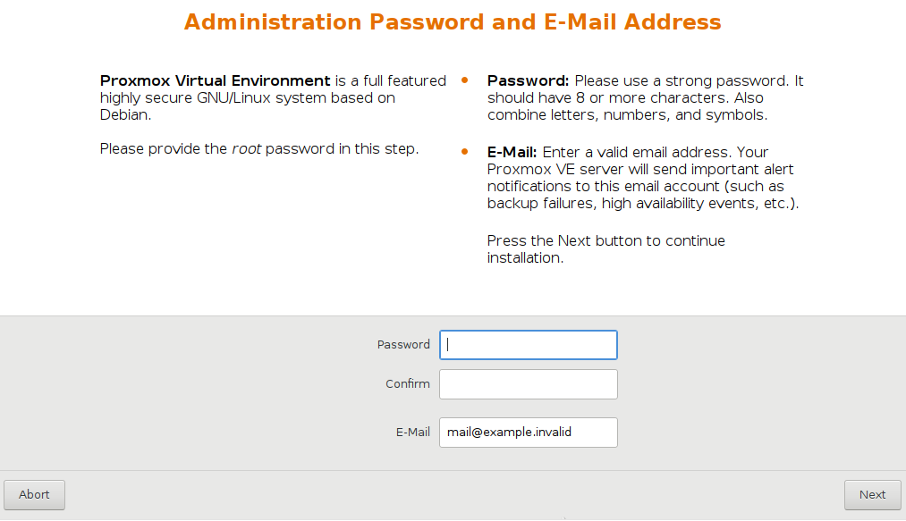
Password and Email

Slide 15
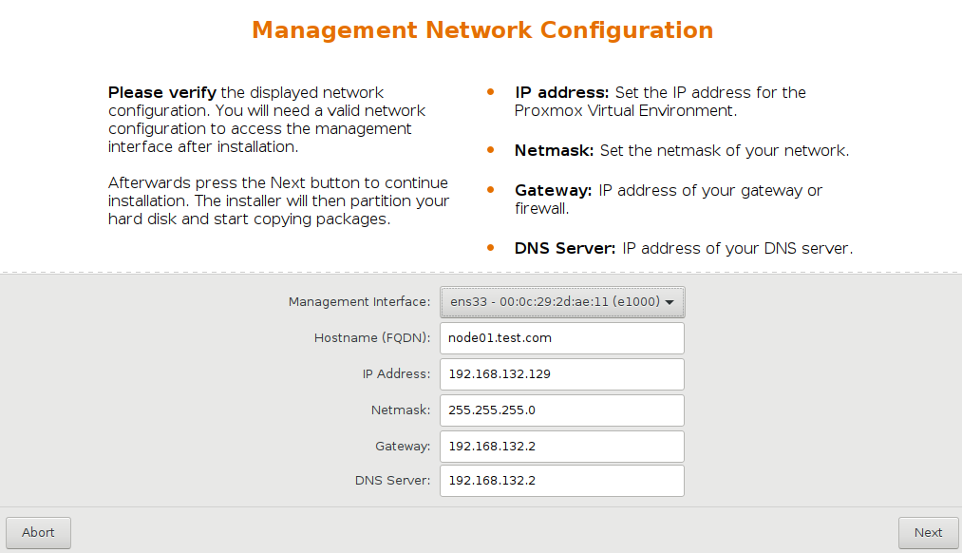
IP and Hostname
In our Lab environment Choose an IP address from your VMware NAT Subnet

Slide 16
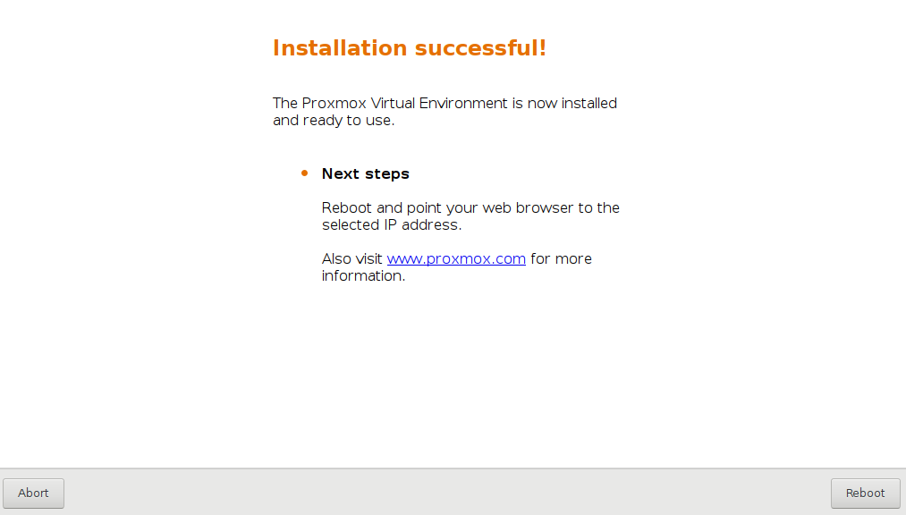
Reboot

Slide 17
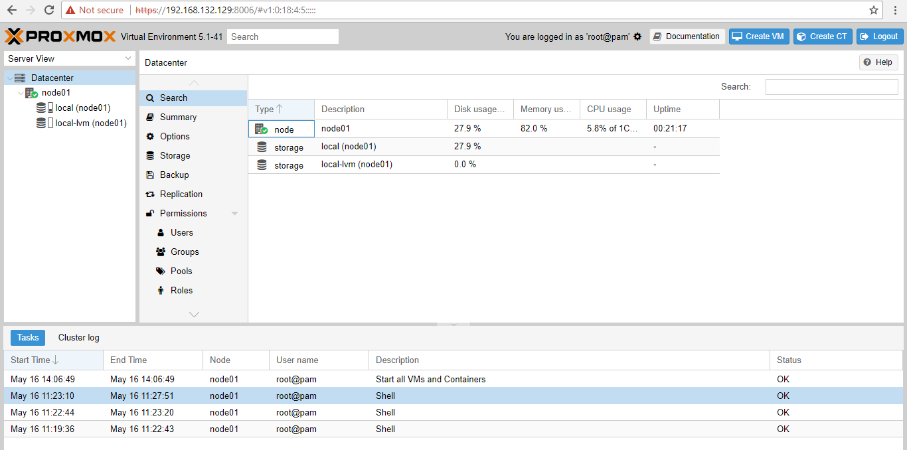
Login to the web interface
After Installation you should be able to access your PVE server from the address:
https://your-ip-address:8006/

Slide 18
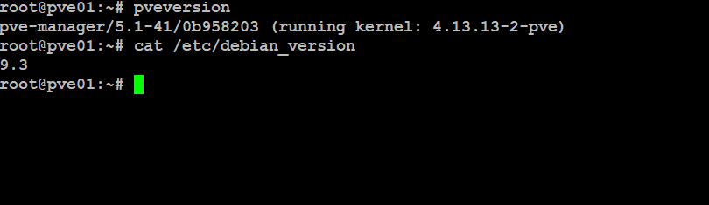
Proxmox VE based on Debian
The Proxmox VE is based on debian
Check the version of debian
cat /etc/debian_version
Check Proxmox VE version
pveversion

Slide 19
Installing Proxmox VE on Debian
You can also install Proxmox VE on a fresh installation of debian (After configuring the repositories)
apt-get update
apt-get install proxmox-ve
Installation details:
https://pve.proxmox.com/wiki/Install_Proxmox_VE_on_Debian_Stretch

Slide 20
Conclusion
Now you must be able to install ProxmoxVE on VirtualBox, Vmware or on Physical Server
Before going to the next section you must have a running instance of PVE to be able to follow the Labs

