Slide 1

Proxmox VE 6
Section 10
Proxmox VE Cluster
Instructor: Hadi Alnabriss

Slide 2
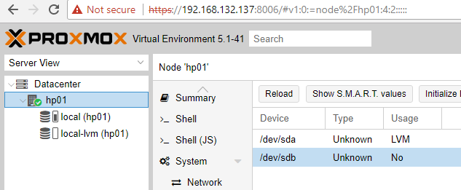
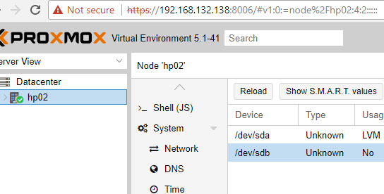
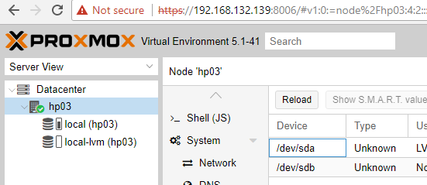
Proxmox VE Cluster
How can you manage multiple hosts in your datacenter?

Slide 3
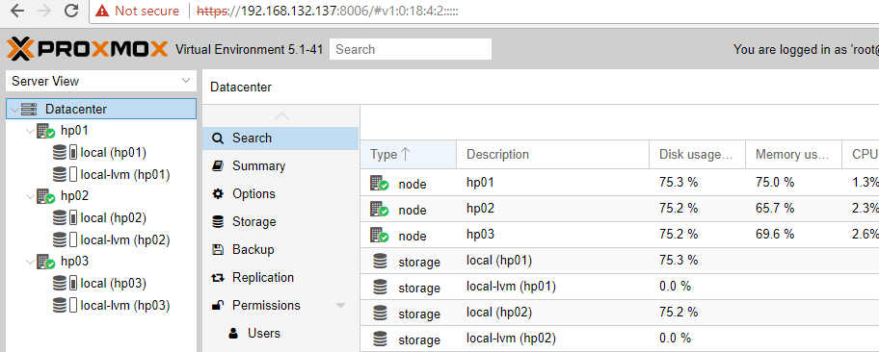
Clustering Advantages
Grouping nodes into a cluster has the following advantages:
(1) Centralized, web based management
(2) Multi-master clusters: each node can do all management task

Slide 4
Clustering Advantages
Grouping nodes into a cluster has the following advantages:
(3) pmxcfs: database-driven file system for storing configuration files, replicated in real-time on all nodes using corosync.
(4) Easy migration of virtual machines and containers between physical hosts
(5) Fast deployment
(6) Cluster-wide services like firewall and HA

Slide 5
Requirements
(1) All nodes must be in the same network
Because corosync uses IP Multicast to communicate between nodes.
Corosync uses UDP ports 5404 and 5405 for cluster communication.
What is corosync?
It is the communication system for nodes in the cluster
Note : Check the corosync service status

Slide 6
Requirements
(2) Time Synchronization.
(3) SSH tunnel on TCP port 22 between nodes is used.

Slide 7
Additional Requirements
If you are interested in High Availability, you need:
At least three nodes for reliable quorum.
All nodes should have the same version.
Also, We recommend a dedicated NIC for the cluster traffic, especially if you use shared storage.

Slide 8
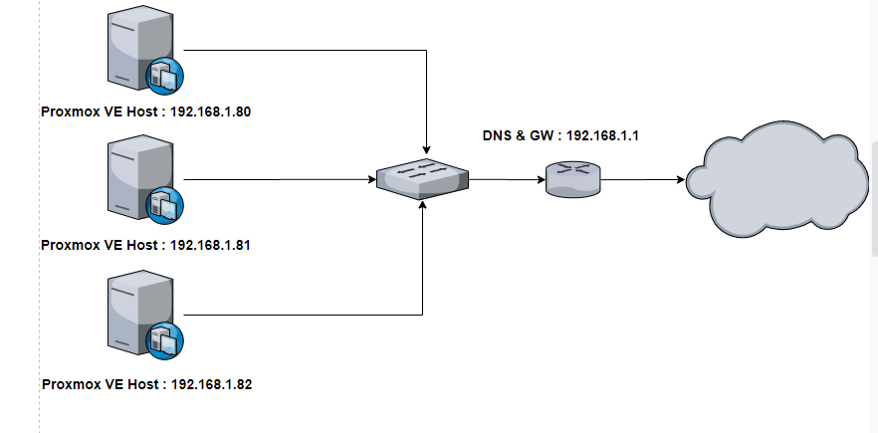
Our Environment

Slide 9
Preparing Nodes
Install Proxmox VE 5 on 3 nodes (use 20GB for Disk, 1GB for RAM and NAT for NIC)
Make sure that each node is installed with the final hostname and IP configuration.
Note (1): Changing the hostname and IP is not possible after cluster creation.
Note (2): We will use the hosts file to define hostname and IP

Slide 10
Prepare hosts file
On each node prepare the hosts file to recognize all the nodes in your cluster
node01 192.168.132.133
node02 192.168.132.134
node03 192.168.132.135

Slide 11
Create the Cluster using Cluster Manager
“pvecm” can be used to:
Create a new cluster,
Join nodes to a cluster,
Leave the cluster,
Get status information
Other various cluster related tasks.

Slide 12
Create the Cluster
No GUI
You cannot create the cluster from GUI

Slide 13
Create the Cluster
On any node
node01# pvecm create YOUR-CLUSTER-NAME
On the other two nodes
node02#pvecm add IP-ADDRESS-CLUSTER
node03#pvecm add IP-ADDRESS-CLUSTER
Note: use the IP address from an existing cluster node (node01 in our case or IP 192.168.132.133).

Slide 14
Cluster Status
To check the cluster status
pvecm status
To see nodes in the cluster
pvecm nodes

Slide 15
Delete Node
A cluster includes the nodes:
node01
node02
node03
node04
To delete node04
power off node04
from (node01, node02 or node03):
pvecm delnode node04

Slide 16
Quorum
Proxmox VE use a quorum-based technique to provide a consistent state among all cluster nodes.

Slide 17
Quorum
A quorum is the minimum number of votes that a distributed transaction has to obtain in order to be allowed to perform an operation in a distributed system.
In case of network partitioning, state changes requires that a majority of nodes are online. The cluster switches to read-only mode if it loses quorum.
Node03
Node01
Network
Node02

Slide 18
Cluster Network
The cluster network is the core of a cluster.
All messages sent over it have to be delivered reliable to all nodes in their respective order.
In Proxmox VE this part is done by corosync, an implementation of a high performance low overhead high availability development toolkit.
It serves our decentralized configuration file system (pmxcfs).

Slide 19
Cluster Network
This needs a reliable network with latencies under 2 milliseconds (LAN performance) to work properly.
While corosync can also use unicast for communication between nodes its highly recommended to have a multicast capable network.
The network should not be used heavily by other members, ideally corosync runs on its own network.

Slide 20
Corosync Configuration
The /etc/pve/corosync.conf file plays a central role in Proxmox VE cluster.
It controls the cluster membership and its network.
For safety: use the pvecm command to configure your cluster

Slide 21
Cluster File System (pmxcfs)
The Proxmox Cluster file system (“pmxcfs”) is a database-driven file system for storing configuration files.
Files are replicated in real time to all cluster nodes using corosync.
We use this to store all PVE related configuration files.
The file system is mounted at /etc/pve

Slide 22
Cluster File System (pmxcfs)
Although the file system stores all data inside a persistent database on disk, a copy of the data resides in RAM.
That imposes restriction on the maximum size, which is currently 30MB.
This is still enough to store the configuration of several thousands of virtual machines.

Slide 23
Cluster File System (pmxcfs) Advantages
This system provides the following advantages:
seamless replication of all configurations to all nodes in real time
provides strong consistency checks to avoid duplicate VM IDs
read-only when a node loses quorum
automatic updates of the corosync cluster configuration to all nodes
includes a distributed locking mechanism

Slide 24
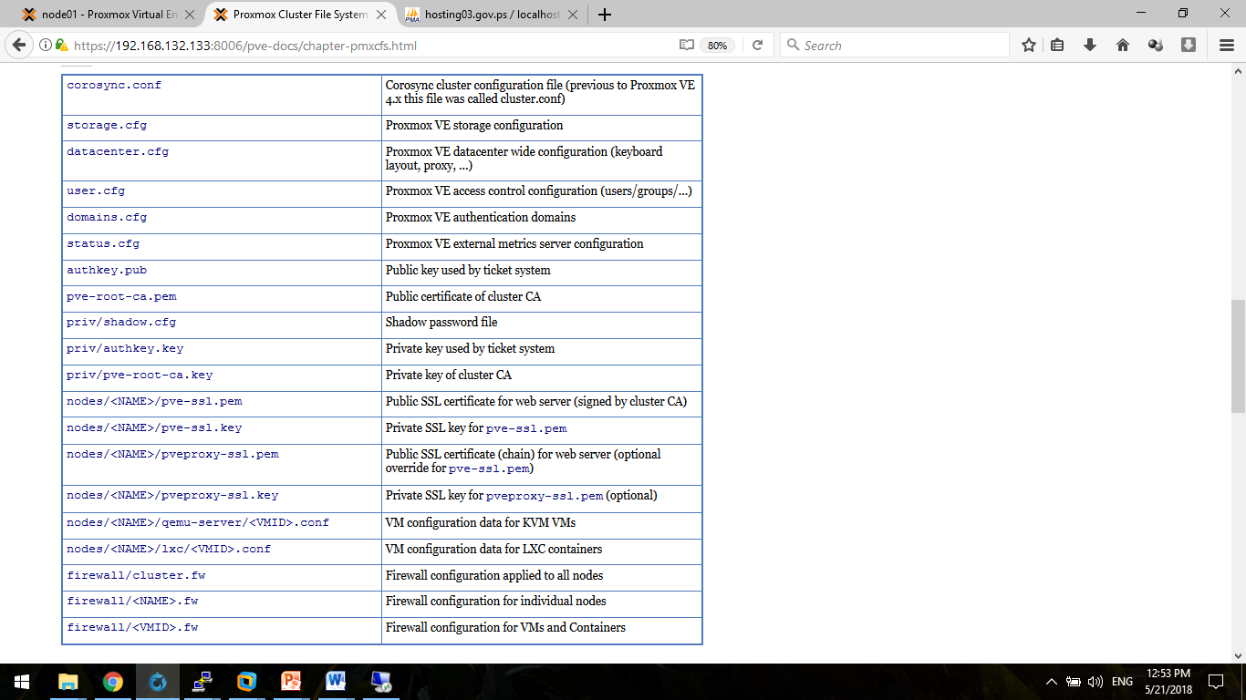
Cluster Filesystem Files

Slide 25
Cluster Filesystem Files

Slide 26
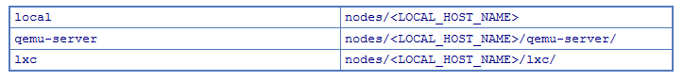
Symbolic links

Slide 27
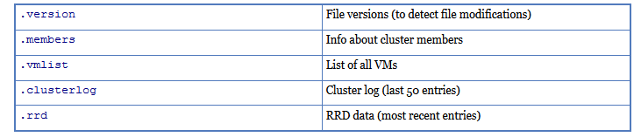
Special status files for debugging (JSON)

Slide 28
Conclusion
Now you must be:
Able to create PVE cluster (add and delete nodes)
Understand Quorum
Understand Proxmox Cluster Filesystem

