Slide 1

Proxmox VE 6
Section 11
High Availability and Shared Storage
Instructor: Hadi Alnabriss

Slide 2
Why High Availability?
Eliminate single point of failure
Reduce downtime

Slide 3
HA in Proxmox VE
Proxmox VE make it much easier to reach high availability because they remove the “hardware” dependency.
It also supports to setup and use redundant storage and network devices.
So if one host fails, you can simply start services on another host within your cluster.
Proxmox VE provides a software stack called ha-manager, which can do that automatically for you

Slide 4
Requirements
At least three cluster nodes (to get reliable quorum)
Shared storage for VMs and containers
Hardware redundancy (everywhere)
Use reliable “server” components

Slide 5
Why Shared Storage?
All the Hosts have access to the same storage
Proxmox VE Host
Proxmox VE Host
Proxmox VE Host
VM
VM
VM
VM
VM
VM
VM
VM
VM
Shared Storage

Slide 6
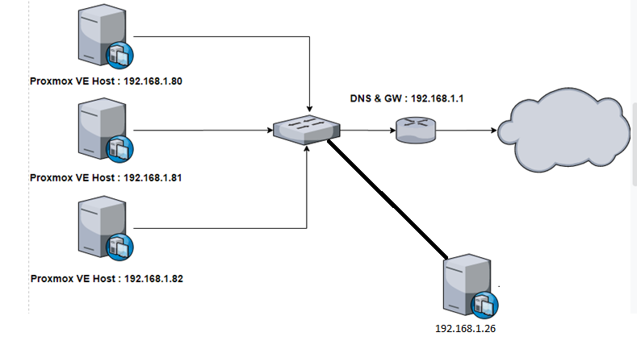
CIFS Example

