Slide 1

Proxmox VE 6
Section 12
CEPH Storage
Instructor: Hadi Alnabriss

Slide 2
Ceph Shared Storage?
CEPH Uses Local Storage as Shared Storage
Proxmox VE Host
Proxmox VE Host
Proxmox VE Host
VM
VM
VM
VM
VM
VM
VM
VM
VM
Local Storage
Local Storage
Local Storage
Replication Manager

Slide 3
What is CEPH?
Ceph is a distributed replicated clustered filesystem
Ceph is a distributed object store and file system designed to provide excellent performance, reliability and scalability.

Slide 4
Why Ceph?
Easy setup and management with CLI and GUI support on Proxmox VE
Thin provisioning
Snapshots support
Self healing
No single point of failure
Scalable to the exabyte level
Runs on economical commodity hardware
No need for hardware RAID controllers
Easy management
Open source

Slide 5
Ceph Components
(1) OSDs (Object Storage Device)
Corresponds to a physical disk. An OSD is actually a directory that Ceph uses, residing on a regular filesystem
(eg. /var/lib/ceph/osd-1 )

Slide 6
Ceph Components
(2) Placement Groups
Placement groups used for tracking metadata for objects
It represents a mostly-static mapping to one or more underlying OSDs.
All PGs in a pool will replicate stored objects into multiple OSDs.
PG calculator
https://ceph.com/pgcalc/

Slide 7
Ceph Components
(3) CRUSH maps
Ensures that replicas don’t end up on the same disk/host/rack/etc,

Slide 8
Ceph Components
(4) Pools
A pool is the layer at which most user-interaction takes place.
This is the important stuff like GET, PUT, DELETE actions for objects in a pool.
Pools contain a number of PGs, not shared with other pools (if you have multiple pools).
You can think of PGs as providing a hash mapping for objects into OSDs, to ensure that the OSDs are filled evenly when adding objects to the pool.

Slide 9
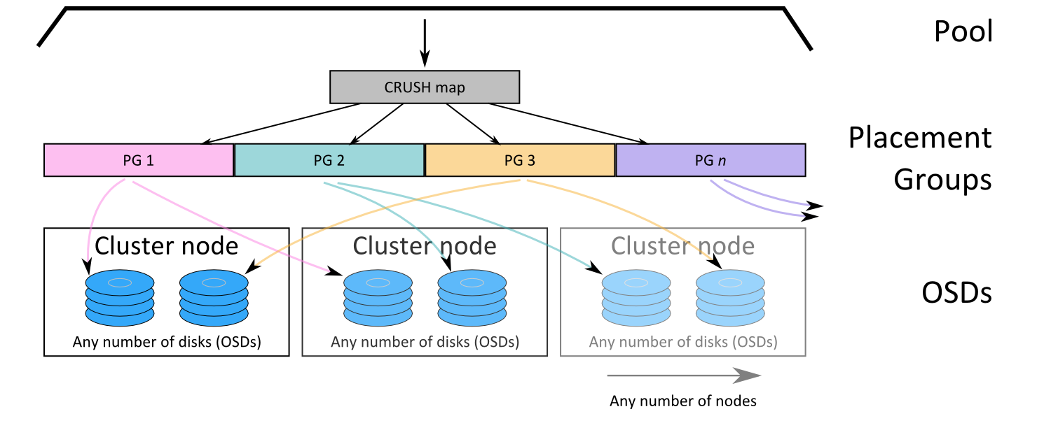
Ceph Components

Slide 10
Before Installing Ceph
We are going to use our 3-nodes cluster that we have created in our previous sections
On each Proxmox VE host:
Add additional Disks (i.e 2 x 4GB)
Add additional NIC
And make a new subnet for Ceph (i.e 10.0.0.0/24)

Slide 11
Install Ceph
Install Ceph on each node
pveceph install --version luminous
This will download some packages from the internet
You might face disk space problem if you are using 8GB disk for your host

Slide 12
Configure Ceph Network
Configure network on one node
pveceph init --network 10.0.0.0/24
This creates an initial config at /etc/pve/ceph.conf

Slide 13
Create Monitors
The Ceph Monitor maintains a master copy of the cluster map.
For HA you need to have at least 3 monitors.
You can create monitor service using the command:
pveceph createmon
Or from GUI
You should run 3 monitors, one on each node

Slide 14
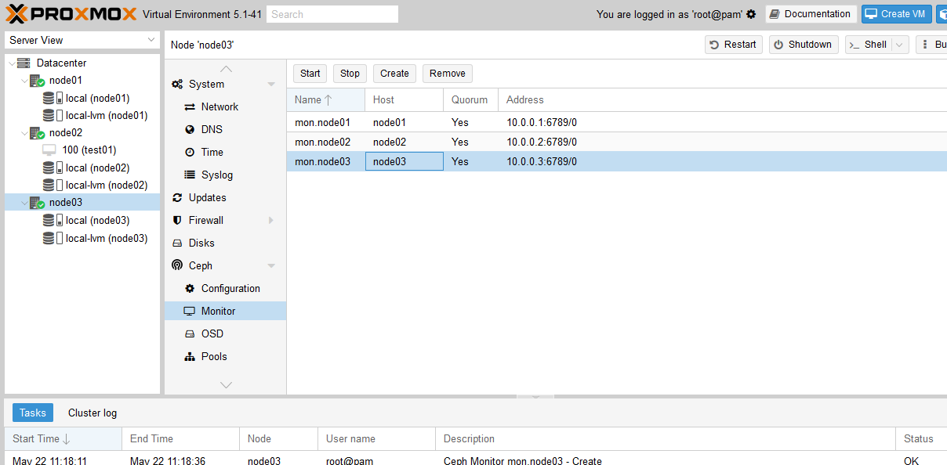
Creating Monitors From GUI

Slide 15
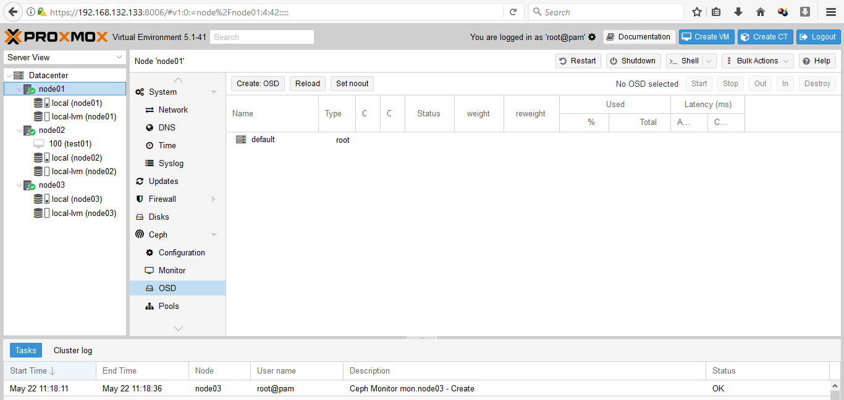
Create OSDs
Add the required disks ( 6 disks )
Again: Don’t use RAID

Slide 16
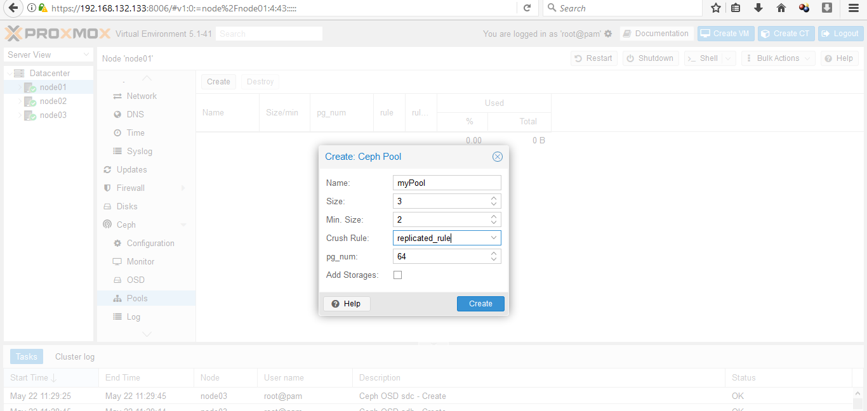
Create the Pool
The pool == our storgae

Slide 17
Keyring
To build a trust relationship between ceph and Proxmox VE (Requires for external Ceph)
mkdir /etc/pve/priv/ceph
cp /etc/pve/priv/ceph.client.admin.keyring /etc/pve/priv/ceph/my-ceph-storage.keyring
As we use local Ceph, this step is not required

Slide 18
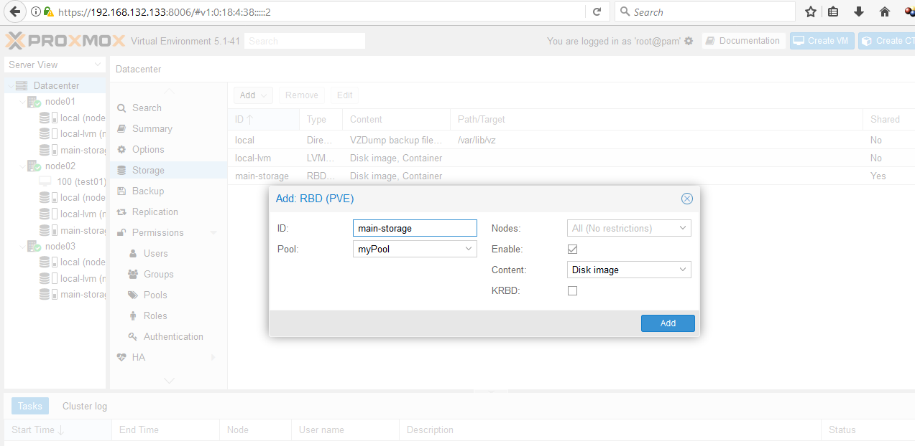
Create Storage
Create a storage that maps to the created Pool (choos RBD PVE storage)

Slide 19
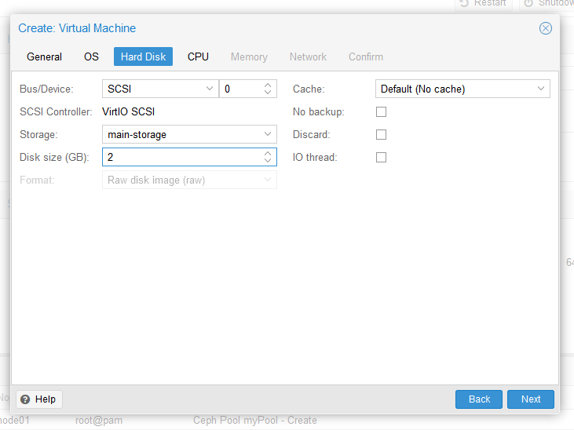
High Availability
Create a VM and choose the Ceph storage for its Hard Disk

Slide 20
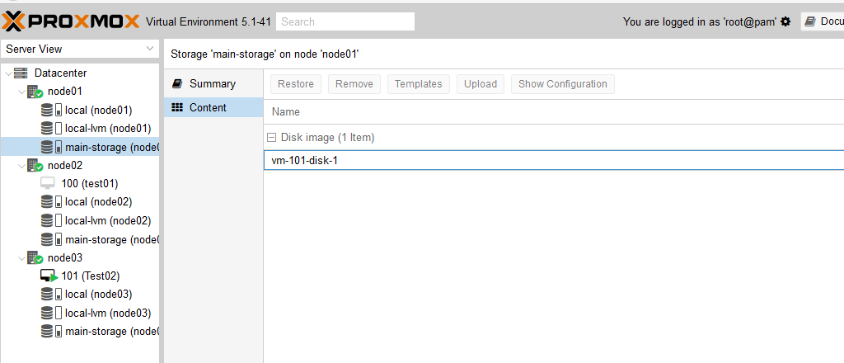
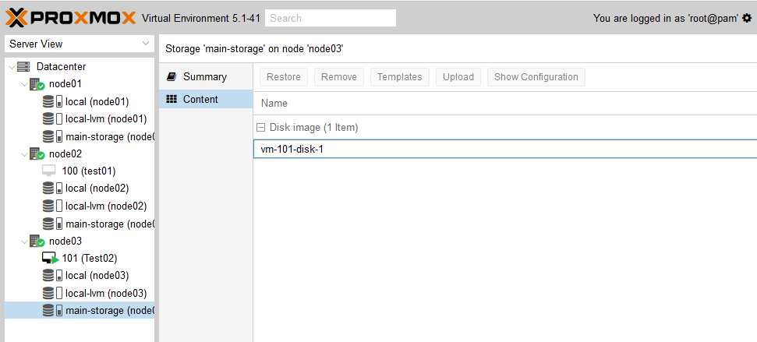
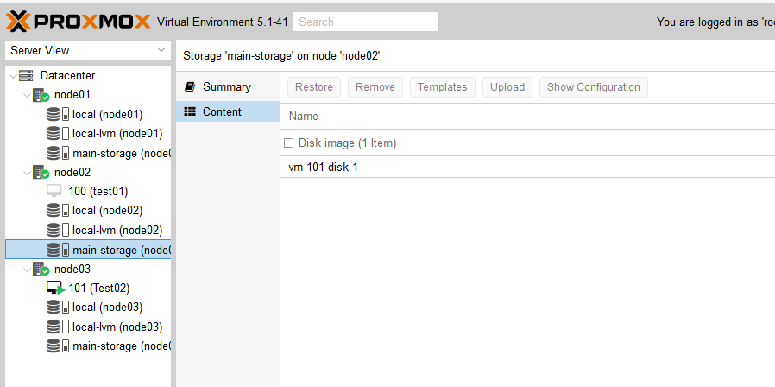
Migration
Now you can migrate VMs and containers on the shared storage ONLINE, with no down time

Slide 21
What is High Availability?
When one of your Hosts fail, the HA manager will migrate all the HA-enabled VMs to another Host

Slide 22
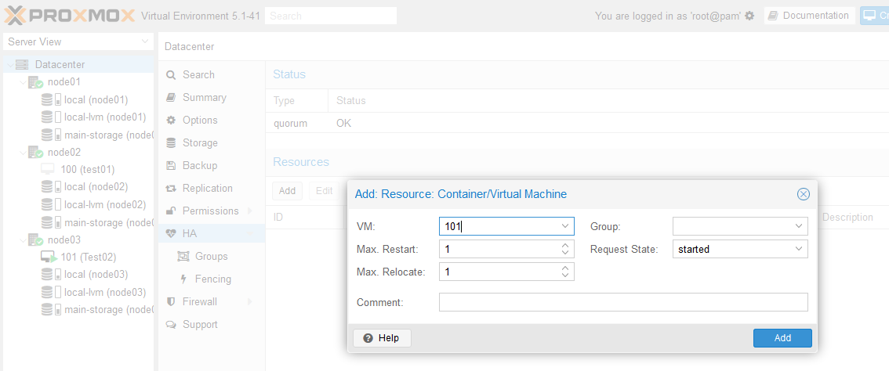
Enable HA for VMs
Add VM as resource to HA

Slide 23
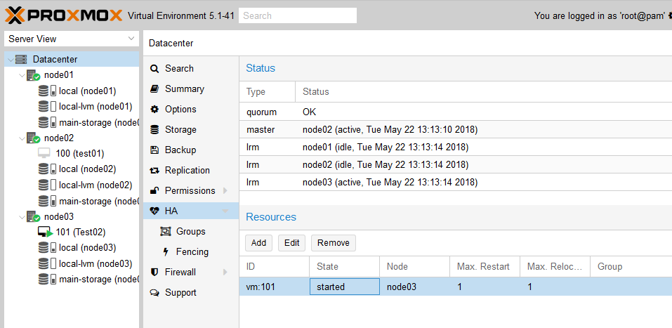
Active Resources

Slide 24
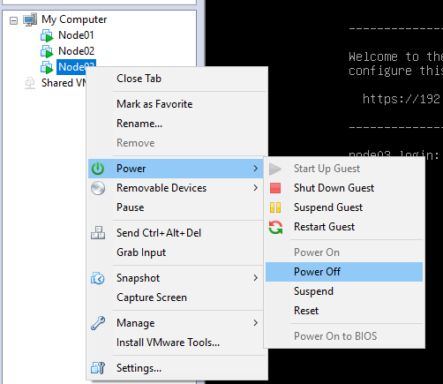
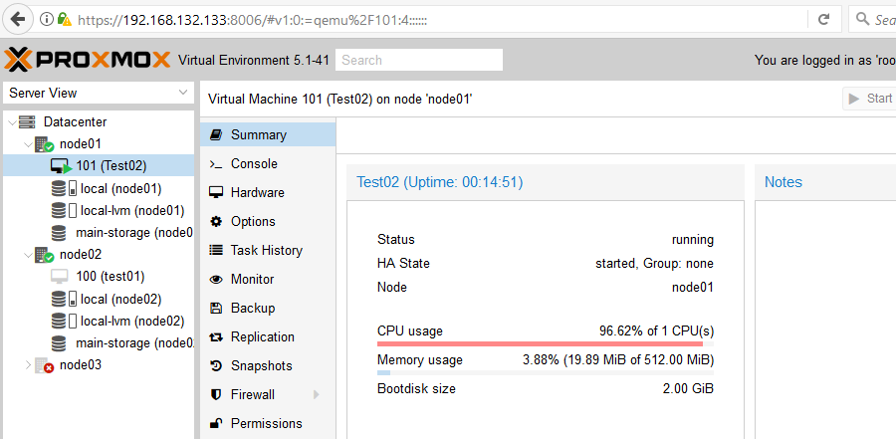
Test HA
Power off the Host: node03
VM 101 must transfer to
Another host

Slide 25
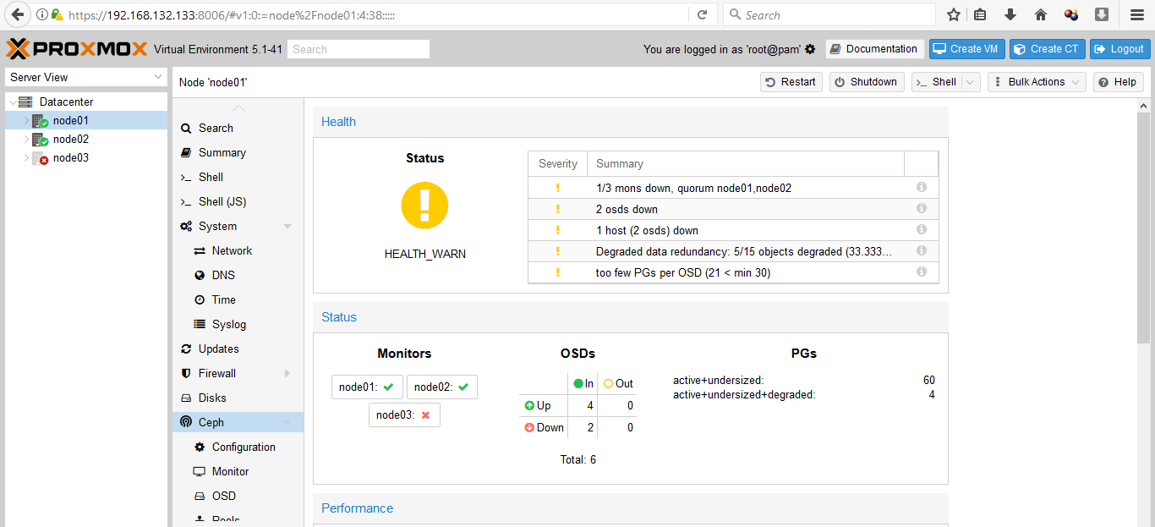
Ceph Health

Slide 26
Increase and Decrease Storage
To add more disks:
Add new Disk
Create OSD for the new Disk
To remove disks:
Stop the OSD for the required disk
Make the disk out

Slide 27
Discussion
The disk is shared, but what about RAM?
What if the VM has a local ISO for CD-ROM?

Slide 28
Conclusion
Now you must be able to:
Create Ceph shared storage
Make Online migrations
Enable High Availability for specific VMs

