Slide 1

Proxmox VE 6
Section 13
GlusterFS Shared Storage
Instructor: Hadi Alnabriss

Slide 2
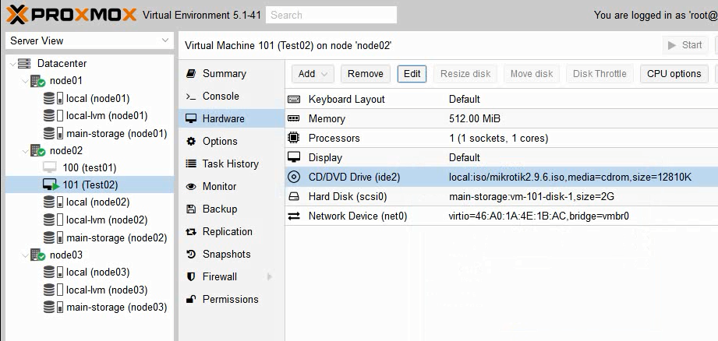
Environment
node01 192.168.132.133
node02 192.168.132.134
node03 192.168.132.135

Slide 3
ISO Files Problem
Ceph Storage accepts VM disks and containers only
But Ceph has many advantages for VM Disks (Like snapshots, thin provisioning and disk resizing).

Slide 4
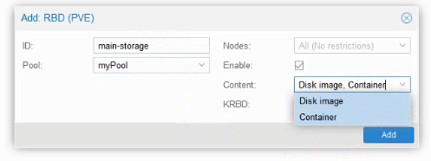
ISO Files Problem
Ceph Storage Doesn’t accept ISO files on its contents.
Where can we upload our ISOs and Templates?

Slide 5
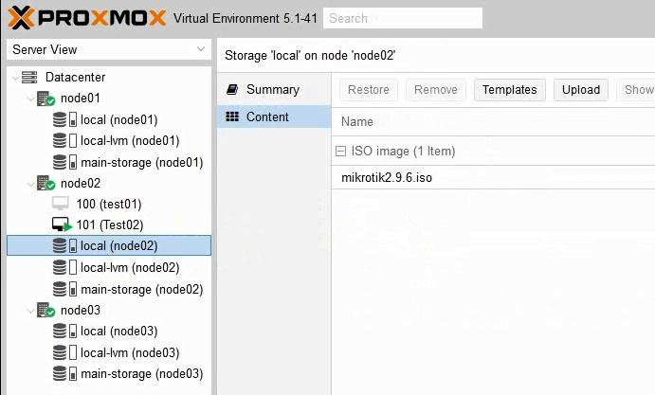
ISO Files Problem
So, Where can we upload our ISOs and Templates?
Maybe On local storage!!

Slide 6
High Availability Test
Now we need to Power Off Node02 to test High Availability.
What should happen?
VM 101 will run on another node (maybe node01)

Slide 7
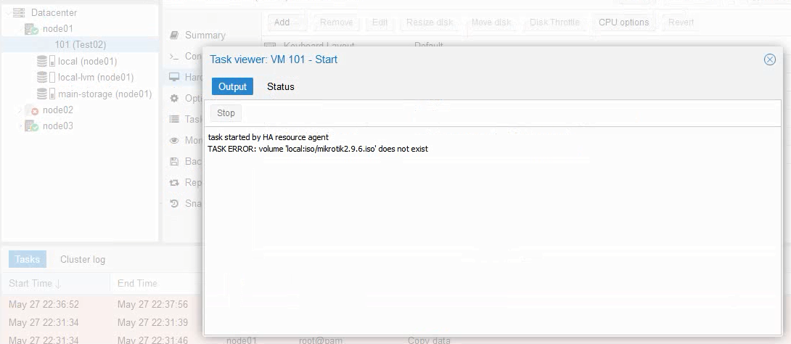
High Availability Test
Actually the Migration failed!!!!!! And HA failed
Why ? Because we have the following error
Volume local:iso/myisofile.iso does not exist

Slide 8
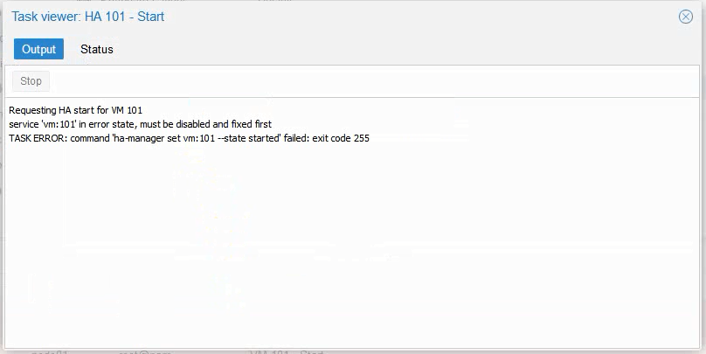
Try to start the VM
Even if you try to remove the ISO file and start the VM it won’t because it is in the “error” state now
Now you need to remove the VM from HA resources, then start the VM and re-add the HA resource

Slide 9
ISOs and Templates Storage Solution
1st solution : to upload each ISO on the three local storages!! Or to make a script to use i.e RSYNC to replicate iso files among nodes
Not feasible solution
2nd Solution : to create another shared storage for ISO files and templates
Best solution is GlusterFS

Slide 10
How to make GlusterFS Storgae?
You need to prepare a directory on each server for example you can create the directory /mnt/myisofiles on the three nodes.
This directory can be located on your root partition
Caution: This is very dangerous, because when you fill up the space you will take your Proxmox server down
So, it is better to create a different partition or even another disk for this folder

Slide 11
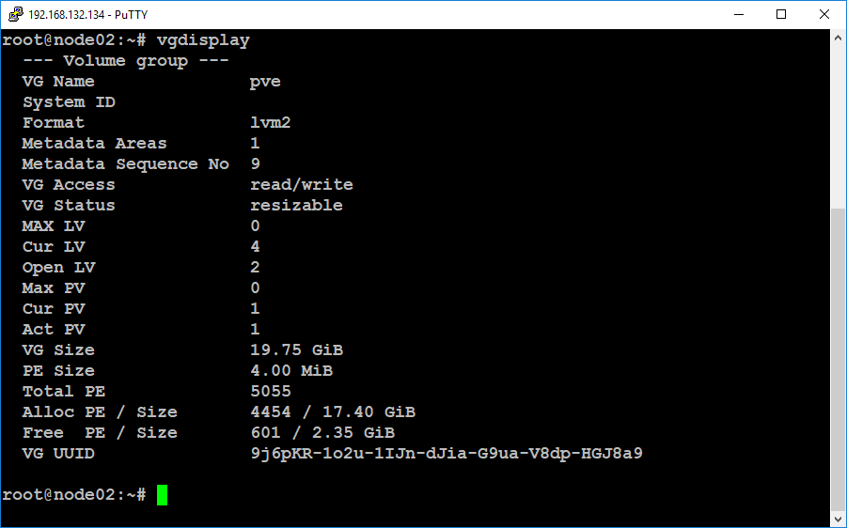
Prepare shared storage
In this lab, I will use the remaining free space in our volume group “pve”
You remember from previous lectures that Proxmox VE by default creates a volume group named “pve”, and it keeps some space FREE in the volume group.

Slide 12
Prepare shared storage
Create a new logical volume using the free space in the volume group pve, use the command:
lvcreate pve -n isolv -l 100%FREE
Format the new logical volume
mkfs -t xfs /dev/pve/isolv
Mount the previous directory using the command
mount -t xfs /dev/pve/isolv /mnt/myisofiles
Or add the mount line to the /etc/fstab file
/dev/pve/isolv /mnt/myisofiles xfs defaults 0 0
mount -a

Slide 13
Install GlusterFS server
Use the command
apt-get update
apt-get install glusterfs-server
systemctl enable glusterfs-server

Slide 14
Probe Nodes
From node01
gluster peer probe node02
gluster peer probe node03
Then Check Status
gluster peer status

Slide 15
Probe Nodes
Create a subfolder /mnt/myisofiles/brick
Use the following command to create a Shared Volume “iso-replica” On the three nodes
gluster volume create iso-replica replica 3 transport tcp \
node01: /mnt/myisofiles/brick \
node02: /mnt/myisofiles/brick \
node03: /mnt/myisofiles/brick \

Slide 16
Start Volume
Use the command
gluster volume start iso-replica
Check status
gluster volume info
Note: for security reasons you might add access list for Ips allowed to connect to the GlusterFS storage
gluster volume set iso-replica auth.allow 192.168.132.133,192.168.132.134,192.168.132.135

Slide 17
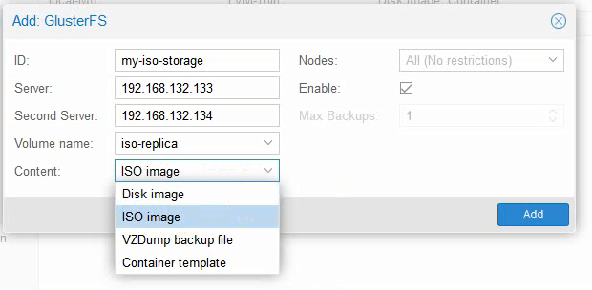
Add storage
From Datacenter >> Storage

Slide 18
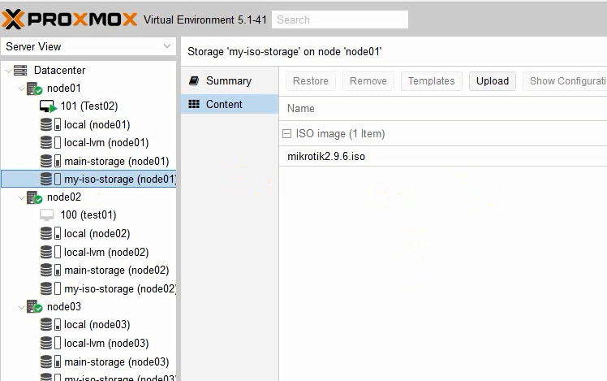
Upload File to this shared storage
Upload File to the GlusterFS storage

Slide 19
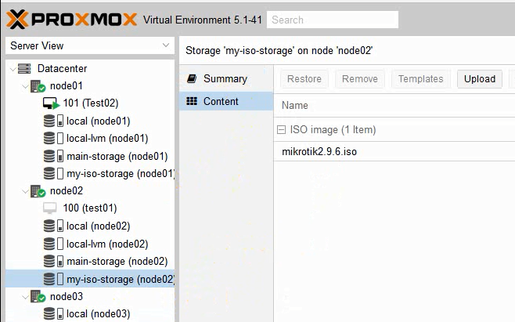
Upload File to this shared storage
File is replicated to Node02

Slide 20
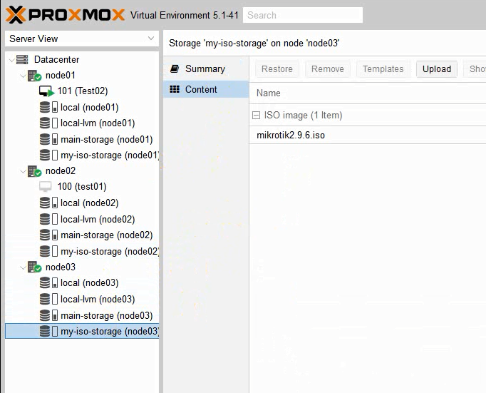
Upload File to this shared storage
File is replicated to Node03

Slide 21
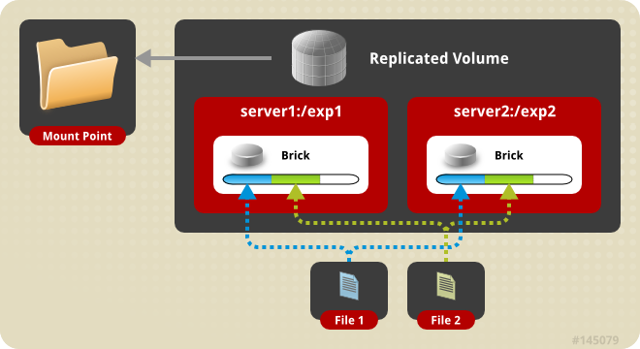
GlusterFS Replication
Replicated volumes create copies of files across multiple bricks in the volume.
Note: The number of bricks should be equal to of the replica count for a replicated volume.

Slide 22
GlusterFS for VM disk
As we have seen before, we can create VM disk on Gluster FS
And we can use GlusterFS for High Availabilty
You can use this storage for two-nodes cluster environment
Not recommended because of quorum problems

Slide 23
Ceph or GlusterFS
I’m not making a research or benchmark tests here.
They Both are great and stable and simple

Slide 24
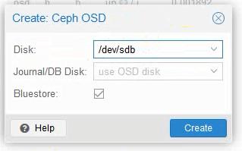
Why Ceph?
(1) Ceph supports Journaling
can write to SSD, which speeds up performance significantly.

Slide 25
Why Ceph?
(2) OSDs management is simple (You can create add and remove OSDs)
(3) Ceph has an advantage in recovering failed disk drives.
Eventually, they both have decent performance, both Ceph and GlusterFS provide a viable alternative to expensive proprietary storage.

Slide 26
Conclusion
If HA didn’t find the ISO file on the new node after migration, it wil fail.
Because RBD Ceph Storgae doesn’t support ISO files, we used GlusterFS to create a shared storage.
GlusterFS can also be used for VMs disks and HA.
Now you know how to configure GlusterFS on 3 nodes
you can use the same steps to create GlusterFS on two nodes only.

