Slide 1

Proxmox VE 6
Section 15
PVE Services
Instructor: Hadi Alnabriss

Slide 2
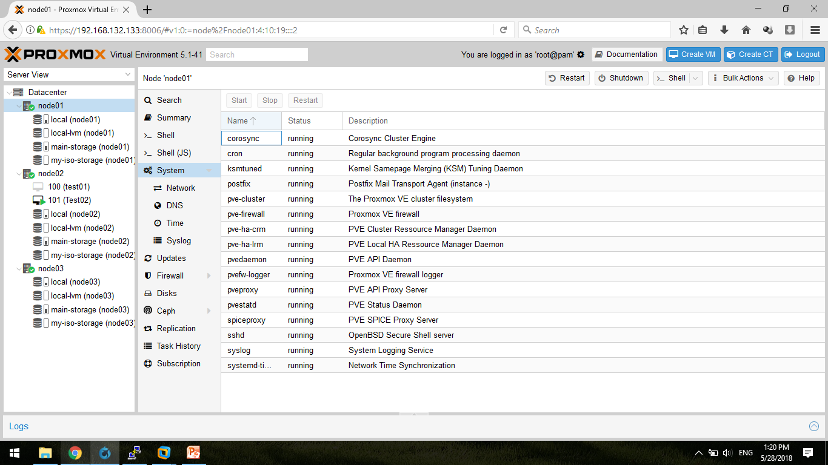
Main Services in PVE
Proxmox VE Services
pve-cluster
pve-ha-crm
pve-ha-lrm
pvedaemon
pveproxy
pvestatd
pve-manager
pve-firewall
pvefw-logger

Slide 3
Main Services in PVE
Cluster Services
cman (corosync 1.x)
corosync 2.x
fenced
rgmanager

Slide 4
Main Services in PVE
Standard Services
cron
ntp
rsyslog
postfix

Slide 5
pve-cluster
This service is the heart of any Proxmox VE installation.
It provides the Proxmox_Cluster_file_system_(pmxcfs)
The service makes the data accessible on the normal file system level, mounted at /etc/pve (using fuse).
Note: You also need this service if you do not run a cluster.
This service also provides a cluster wide locking implementation, and we use it to distribute statistic data to all cluster nodes.

Slide 6
pve-ha-lrm
This is the Proxmox VE High Availability Local Resource Manager.
It reads the requested states for its services from the current manager status file and executes the respective commands.
pve-ha-crm
This is the Proxmox VE High Availability
Cluster Resource Manager.
It makes the cluster wide decisions.
Node01
Node02
Node03
crm
crm
crm
lrm
lrm
lrm

Slide 7
pvedaemon
pvedaemon is the REST API server.
All API calls which require root privileges are done using this Server.
The Server runs as 'root', but only listens to a local address 127.0.0.1 port 85 for security reasons.
It usually serves request from pveproxy, which listens to public ports, and run as non-root user.

Slide 8
pveproxy
pveproxy is the REST API proxy server, listening on port 8006 - used in PVE 3.0+ onwards.
This service run as user 'www-data', and forwards request to other nodes (or pvedaemon) if required.
API calls which do not require root privileges are directly answered by this server.

Slide 9
pvestatd
pvestatd is the PVE Status Daemon.
It queries the status of all resources (VMs, Containers and Storage), and send the result to all cluster members.
You can easily query the resulting data with:
cat /etc/pve/.rrd

Slide 10
pve-manager
This is just a startup script (not a daemon), used to start/stop all VMs and Containers.

Slide 11
pve-firewall
Proxmox VE Firewall manage the Firewall (iptables) which works cluster wide.

Slide 12
pvefw-logger
Proxmox VE Firewall logger logs the Firewall events.

Slide 13
cman
cman is a symmetric general-purpose cluster manager.
It provides a service manager that handles service groups, plus a connection manager that handles:
Cluster membership management,
Messaging among cluster nodes,
Event notification,
Quorum and state transitions.

Slide 14
fenced
The fencing daemon, fenced, fences cluster nodes that have failed.
Fencing a node generally means rebooting it or otherwise preventing it from writing to storage.
Node01
Node02
VM100
VM100
Shared Storage

Slide 15
rgmanager
rgmanager is the Resource Group (Cluster Service) Manager Daemon.
rgmanager handles management of user-defined cluster services (also known as resource groups).
This includes handling of user requests including service start, service disable, service relocate, and service restart.
The service manager daemon also handles restarting and relocating services in the event of failures.

Slide 16
cron
cron daemon execute scheduled commands.

Slide 17
ntp
ntp is the Network Time Protocol (NTP) daemon.

Slide 18
rsyslogd
rsyslogd is a system utility providing support for message logging (syslog).

Slide 19
postfix
Postfix is the mail server (smtp).

Slide 20
Conclusion
Proxmox VE is composed of many services
Each service has specific tasks
Some services are designed to implement Cluster tasks, but it is also essential for single node installations.

