Slide 1

Proxmox VE 6
Section 16
Command Line Interface
Instructor: Hadi Alnabriss

Slide 2
Introduction
You need to be familiar with CLI in PVE
Sometimes you need direct CLI access to your server because:
The web interface is down
You need to make tasks not supported via the web interface
You need to create many tasks using scripts
You need to schedule a task
Firewall Blocking access to port 8006

Slide 3
Proxmox VE is based on Debian
Proxmox VE is based on Debian Linux as we have seen before.
Any Debian installation or command can be added here (cat /etc/debian_version).
Check PVE version : pveversion
Important commands : df , free, top , ps , systemctl
Networking commands: ping , telnet , ss , ip

Slide 4
qm Command
Can be used for VM management, for example:
qm list
qm create VMID
qm start VMID
qm stop VMID
qm status VMID
qm migrate VMID TARGET
qm clone VMID NEWID
qm set VMID -ide1 /dev/sdc
qm unlock VMID

Slide 5
pct Command
Can be used for Containers management, for example:
pct list
pct start CID
pct stop CID
pct status CID
pct enter CID
pct fsck CID

Slide 6
Backup Commands
vzdump and qmrestore

Slide 7
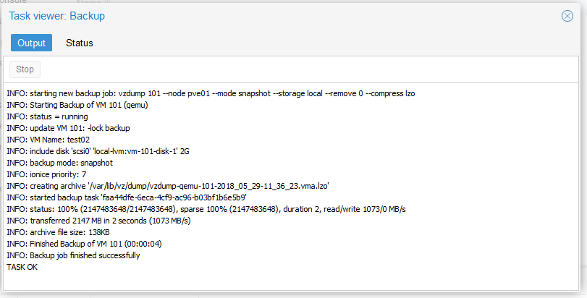
Commands From Logs
Sometimes proxmox VE will show you the executed command in the logs

Slide 8
Accessing PVE files
Find Virtual machines and nodes configurations in /etc/pve

Slide 9
Conclusion
CLI is very important for many tasks and cases
Every task done using Web interface can be done using CLI
You can script, automate and schedule your tasks

