Slide 1

Proxmox VE 6
Section 2
Web Interface and Creating VM
Instructor: Hadi Alnabriss

Slide 2
Web Interface Features
Seamless integration and management of Proxmox VE clusters
AJAX technologies for dynamic updates of resources
Secure access to all Virtual Machines and Containers via SSL encryption (https)
Role based permission management for all objects (VMs, storages, nodes, etc.)
Fast search-driven interface, capable of handling hundreds and probably thousands of VMs
Secure HTML5 console or SPICE
Support for multiple authentication sources (e.g. local, MS ADS, LDAP, …)

Slide 3
Web interface
You can access the web interface from any internet browser, use the URL:
https://your-ip-address:8006

Slide 4
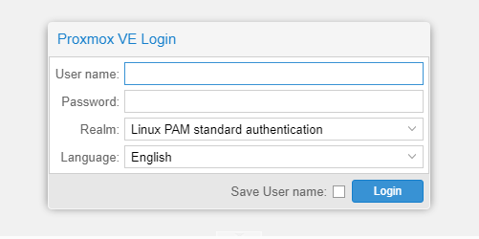
Login
Proxmox VE supports various authentication Realms.

Slide 5
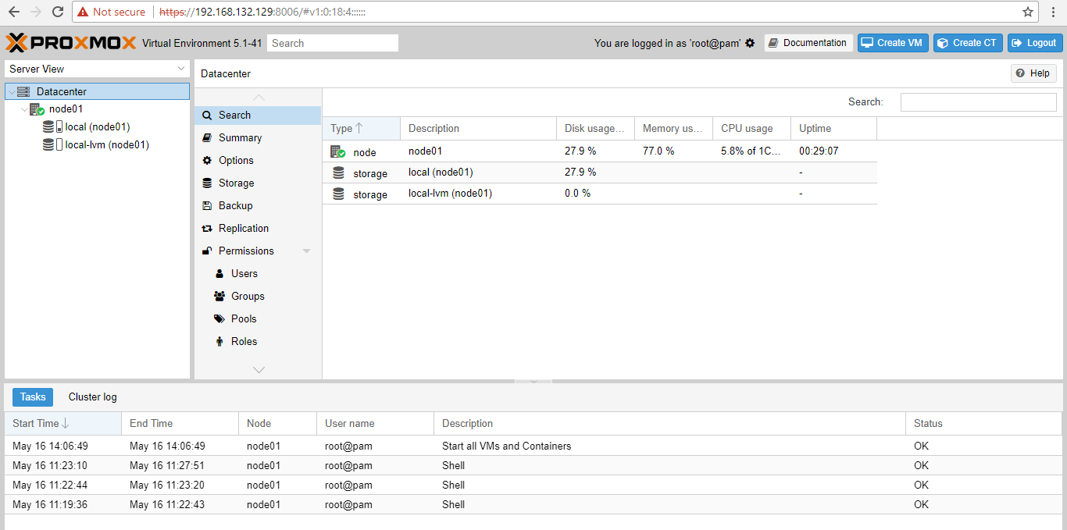
Web interface Panels
Header
Content Panel
Resource Tree
Logs

Slide 6
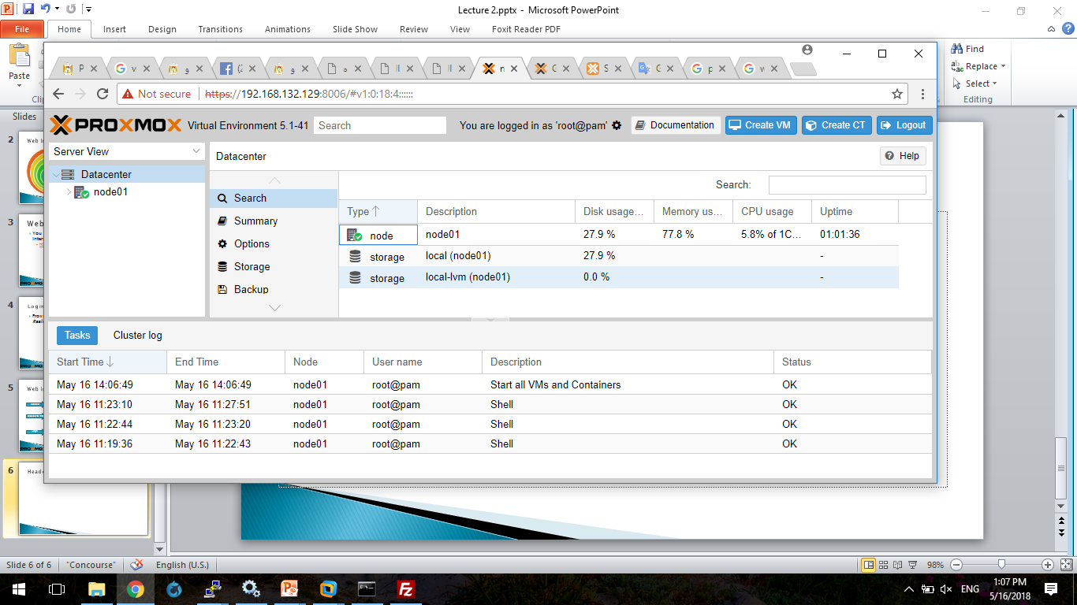
Header
Logo
Version
Search
Identitiy
Settings
Documentation
Create Container
Create VM
Logout

Slide 7
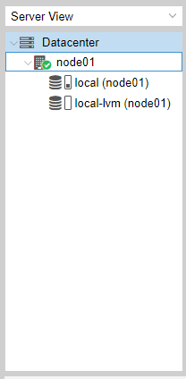
Resource Tree
Datacenter
Contains cluster wide setting (relevant for all nodes)
Node
Represents the hosts inside a cluster, where the guests runs
Guest
VMs, Containers and Templates
Pool
Storage
Data Storage
It is possible to group guests using a pool to simplify management.

Slide 8
Log Panel
Show you what is currently going on in your cluster

Slide 9
Content Panel
This panel shows configurations for selected object in the resource tree.

Slide 10
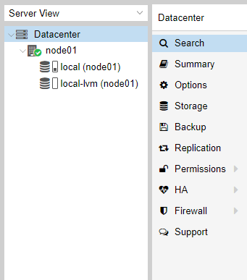
Datacenter
Search: it is possible to search anything in cluster ,this can be a node, VM, Container, Storage or a pool.
Summary: gives a brief overview over the cluster health.
Options: can show and set defaults, which apply cluster wide.
Storage: is the place where a storage will add/managed/removed.
Backup: has the capability to schedule Backups. This is cluster wide, so you do not care about where the VM/Container are on your cluster at schedule time.
Permissions: will manage user and group permission, LDAP, MS-AD and Two-Factor authentication can be setup here.
HA: will manage the Proxmox VE High-Availability
Firewall: on this level the Proxmox Firewall works cluster wide and makes templates which are cluster wide available.
Support: here you get all information about your support subscription

Slide 11
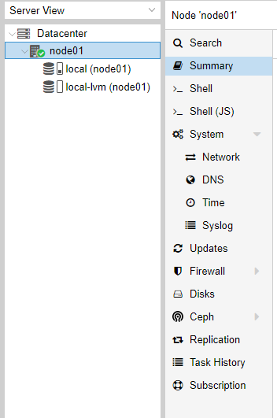
Node
Search: it is possible to search anything on the node, this can be a VM, Container, Storage or a pool.
Summary: a brief overview over the resource usage.
Shell: log you in the shell of the node.
System: is for configuring the network, dns and time, and also shows your syslog.
Updates: will upgrade the system and informs you about new packets.
Firewall: on this level is only for this node.
Disk: a brief overview about you physical hard drives
Ceph: if you use Ceph
Task History: here all past task are shown.
Subscription: here you can upload you subscription key and get a system overview in case of a support case.

Slide 12
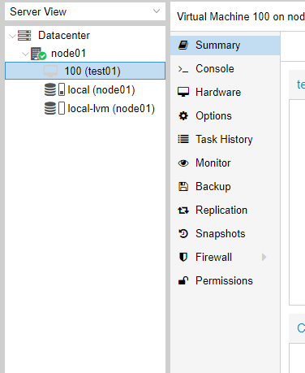
Guests
Summary: gives a brief overview over the VM activity.
Console: an interactive console to your VM.
Hardware: shows and set the Hardware of the KVM VM.
Options: all VM options can be set here
Task History: here all previous task from this VM will be shown.
Monitor: is the interactive communication interface to the KVM process.
Backup: shows the available backups from this VM and also create a backupset.
Snapshots: manage VM snapshots.
Firewall: manage the firewall on VM level.
Permissions: manage the user permission for this VM.

Slide 13
Storage and Pools
You can also select storage or pool from resource tree to display configurations in the content panel

Slide 14
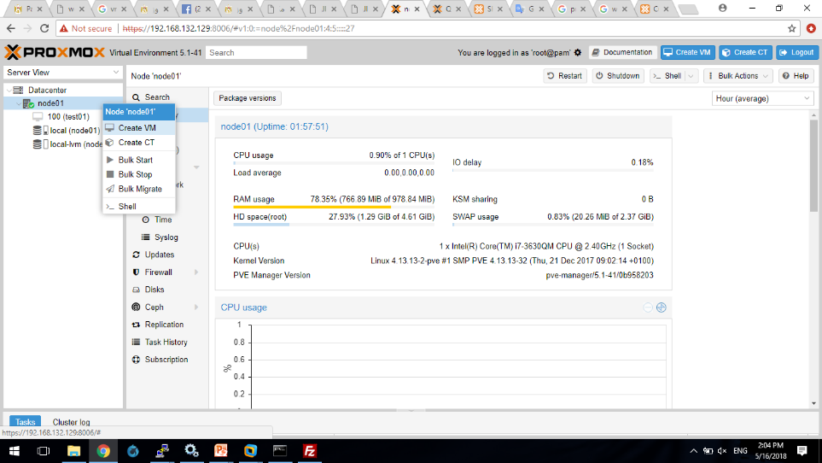
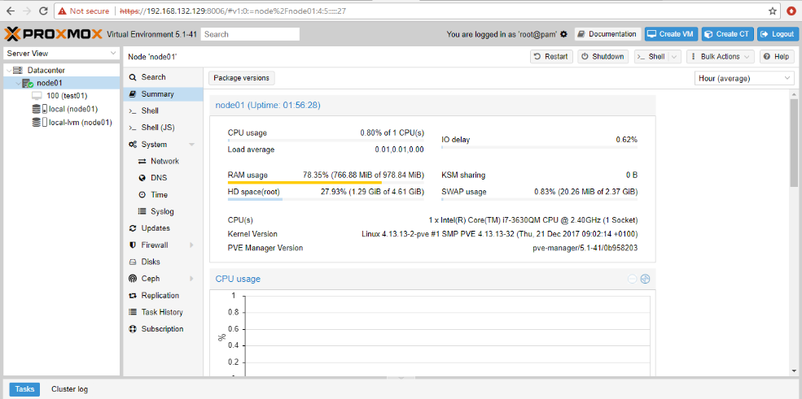
Creating VM
Select Create VM from the header panel, OR write click the node name and choose “create VM”

Slide 15
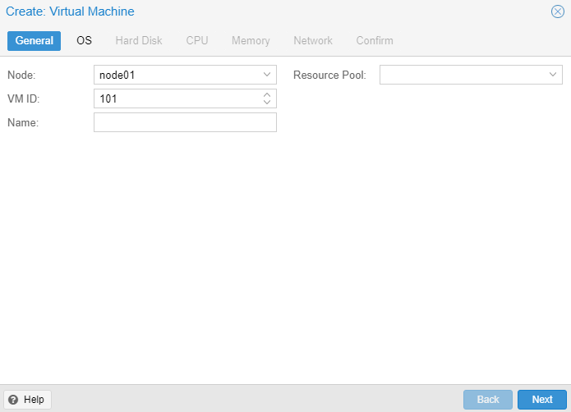
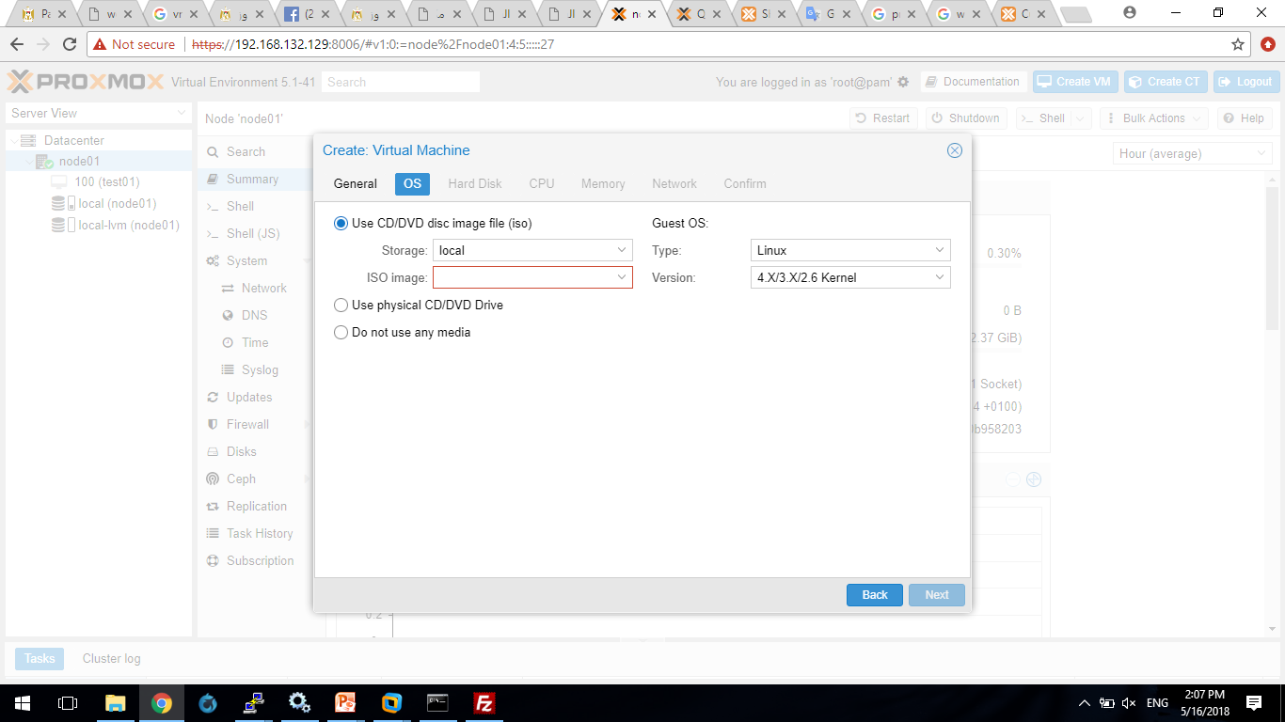
Complete Configurations

Slide 16
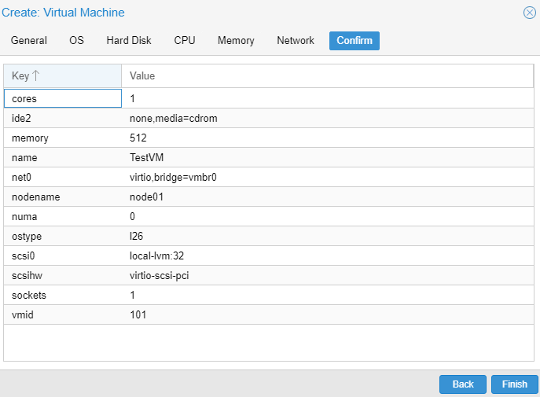
Select Disk Space, CPU and RAM
Follow the steps to choose the Disk Space, RAM and CPU cores
Then Confirm VM creation

Slide 17
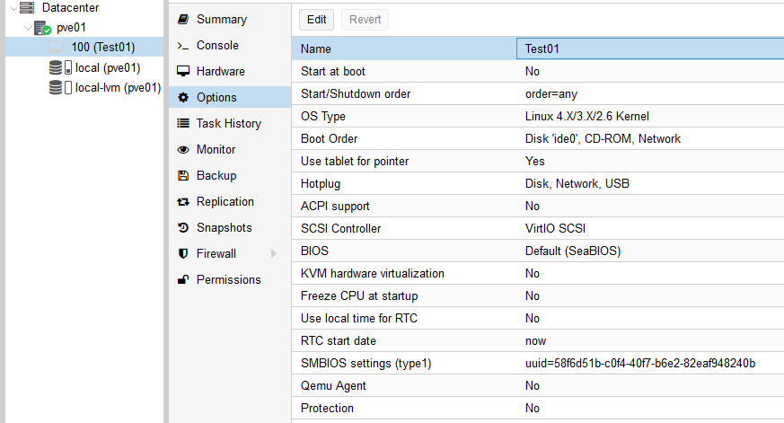
VM Options
Name : VM name
Start at boot : whether to start the VM after restarting host or not
Start/Shutdown order: Choose VMs to start/shutdown before others
OS Type
Boot Order

Slide 18
VM Options
Use Tablet for Pointer : Might help in fixing mouse pointer issues
ACPI Support: This is similar to pressing the power button on a physical machine.
This will send an ACPI event for the guest OS, which should then proceed to a clean shutdown.

Slide 19
VM Options
SCSI Controller
BIOS/ UEFI
KVM Hardware Virtualization (if Kernel-based Virtual Machine supported by CPU)

Slide 20
VM Options
Freeze CPU at Startup : If enabled will suspend the VM when it’s started immediately, then you can resume it.
Use local time for RTC (Real-Time Clock):
When using local time for RTC then the VM will see the RTC time as local time
If not using local time then it will see UTC time

Slide 21
VM Options
Freeze CPU at Startup : If enabled will suspend the VM when it’s started immediately, then you can resume it.
Use local time for RTC (Real-Time Clock):
When using local time for RTC then the VM will see the RTC time as local time
If not using local time then it will see UTC time

Slide 22
VM Options
Protection : If enabled you cannot delete the VM

Slide 23
VM Options
QEMU Agent : qemu-guest-agent
Is a helper daemon installed in the guest for exchanging info between the host and guest, and to execute commands in the guest.
In PVE it is used for mainly two things:
To properly shutdown the guest, instead of relying on ACPI commands or windows policies (ACPI : Advanced Configuration and Power Interface)
To freeze the guest file system when making a backup (on windows, use the volume shadow copy service VSS).
A package must be installed on the guest:
i.e On CentOS (yum install qemu-guest-agent)
For other OS follow: https://pve.proxmox.com/wiki/Qemu-guest-agent

Slide 24
Conclusion
At the end of this lecture you must be able to:
Use the Proxmox VE web interface
Upload ISO to storage
Create VM
Run the VM and modify options

