Slide 1

Proxmox VE 6
Section 3
Virtual Machines and Containers
Instructor: Hadi Alnabriss

Slide 2
QEMU/KVM
QEMU/KVM
Qemu (Quick Emulator) is an open source hypervisor that emulates a physical computer.
From the perspective of the host system where Qemu is running, Qemu is a user program which has access to a number of local resources like partitions, files, network cards which are then passed to an emulated computer which sees them as if they were real devices.
A guest operating system running in the emulated computer accesses these devices, and runs as it were running on real hardware.

Slide 3
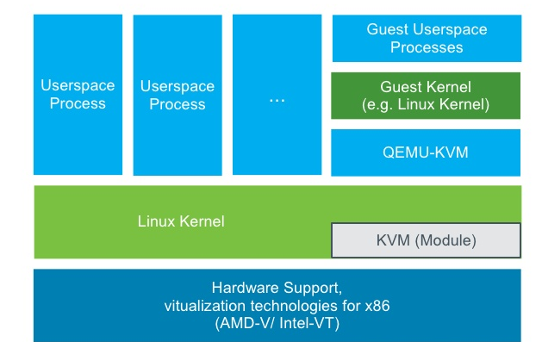
QEMU/KVM

Slide 4
Containers
Containers are a lightweight alternative to fully virtualized VMs.
Instead of emulating a complete Operating System (OS), containers simply use the OS of the host they run on.
This implies that all containers use the same kernel, and that they can access resources from the host directly.

Slide 5
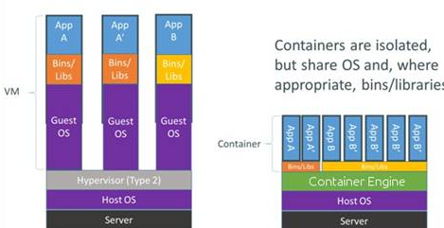
Containers vs VMs

Slide 6
Containers Pros
Containers do not waste CPU power nor memory due to kernel emulation.
Container run-time costs are close to zero and usually negligible.

Slide 7
Containers Cons
You can only run Linux based OS inside containers.
For security reasons, access to host resources needs to be restricted.
This is done with AppArmor, SecComp filters and other kernel features.
Be prepared that some syscalls are not allowed inside containers.

Slide 8
LXC Containers
Proxmox VE uses LXC as underlying container technology.
Consider LXC as low-level library, which provides countless options.
Proxmox VE supports the “pct” command (Proxmox Container Toolkit) for containers management

Slide 9
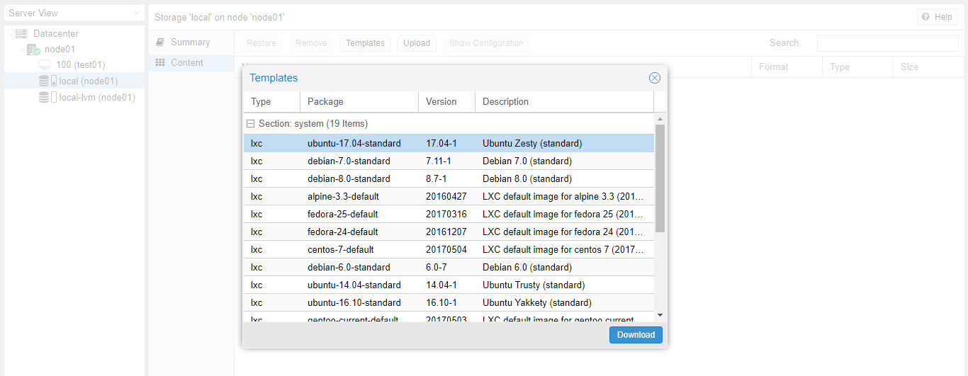
Containers Creation
You need to download image
3. Choose Templates
2. Select Content
1. Select Storage
4. Choose The Required Template
5. Download

Slide 10
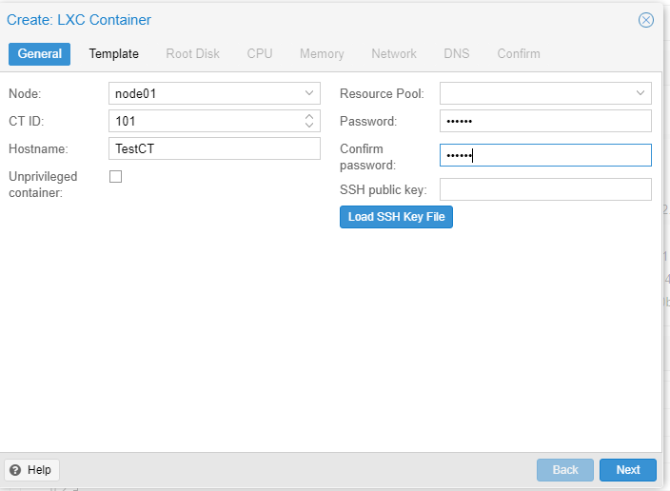
Create Container
Select Create CT from header panel or from node settings in the resource tree panel
Configure Hostname and Password

Slide 11
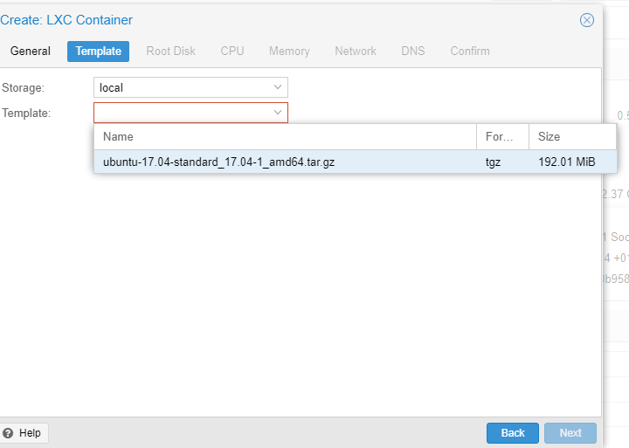
Choose Template
Choose the downloaded template

Slide 12
Continue CT Creation
Complete the configurations
Disk
RAM
CPU
Network
DNS

Slide 13
pct command
pct start 100
pct shutdown 100
pct enter 100
pct stop 100
pct fsck 100
Note : 100 is the container’s ID

Slide 14
Conclusion
At the end of this lecture, you must be able to:
understand the difference between virtual machines and containers
You must be able to create and manage containers

