Slide 1

Proxmox VE 6
Section 4
RAM and Disk Configurations
Instructor: Hadi Alnabriss

Slide 2
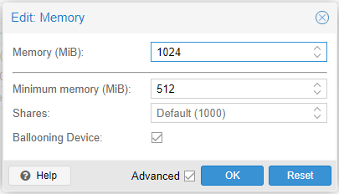
Memory Configurations

Slide 3
Overcommitting
This means that more virtualized CPUs and memory can be allocated to virtual machines than there are physical resources on the system.

Slide 4
Memory Ballooning
Assume we have 10 GB host with 3 Guests with 4G Memory for each
Proxmox Host : 10GB RAM
VM 01
4GB RAM
VM 02
4GB RAM
VM 02
4GB RAM

Slide 5
Memory Ballooning
Allows you to have your guest dynamically change its memory usage by evicting unused memory during run time.

Slide 6
Memory Ballooning
Proxmox Host : 10GB RAM
VM 01
4GB RAM
VM 02
4GB RAM
VM 02
4GB RAM

Slide 7
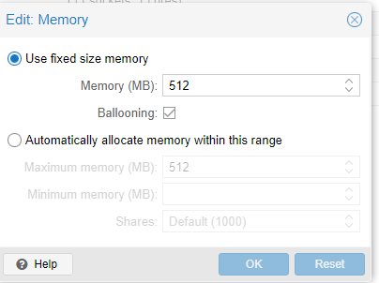
Automatic Allocation
PVE will ensure that the minimum amount is always available to the VM
If RAM usage on the host is below 80%, PVE will dynamically add memory to the guest up to the maximum memory specified.

Slide 8
Shares
When you have many guests using the automatic allocation (Assume that we have one Host with 4 VMs)
And you want to prioritize one of the VMs to get more memory when you have spare RAM available
For this you assign a Shares property of 3000 to the important VM, leaving the other VMs to the Shares default setting of 1000
i.e the host server has 32GB of RAM, and is currently using 16GB, leaving 32 * 80/100 - 16 = 9GB RAM to be allocated to the VMs
The important server will get 3000 pages, and the other three servers will get 3000 page (aggregate)
The important server will get 4.5GB and the other servers will get (4.5GB total)

Slide 9
Adding Disk Formats
QEMU image format is a copy on write format which allows snapshots, and thin provisioning of the disk image.
Raw disk image is a bit-to-bit image of a hard disk, This format does not support thin provisioning or snapshots
VMware image format only makes sense if you intend to import/export the disk image to other hypervisors.

Slide 10
Thin vs Thick Provisioning
In Thin Provisioning the disk size depends on the content of the VM
In Thick Provisioning the disk size is totally allocated

Slide 11
Question
If Raw format doesn’t support thin provisioning and doesn’t support snapshots, why it is used??
Speed ( may be 10% faster than QEMU disk)
General format

Slide 12
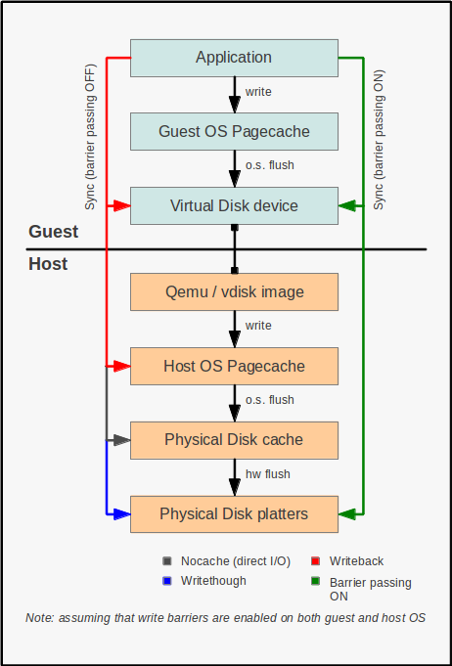
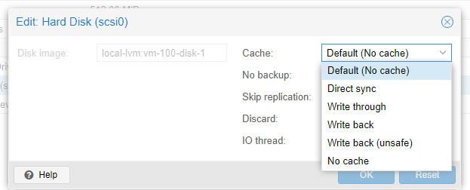
Disk Cache
When you add or edit disk

Slide 13
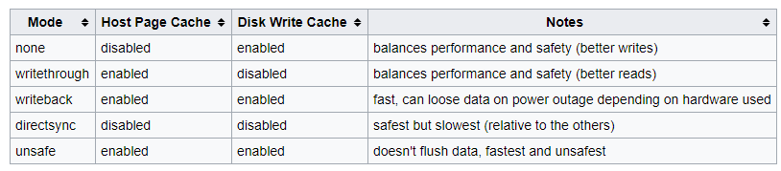
Cache Modes Comparison

Slide 14
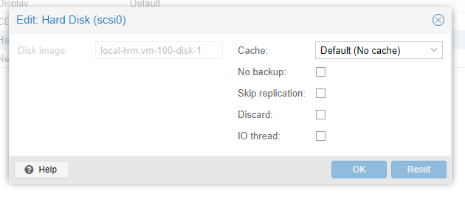
Disk Additional Options
No Backup
Skip Replication
Discard
When the filesystem of a VM marks blocks as unused after removing files, the emulated SCSI controller will relay this information to the storage, which will then shrink the disk image accordingly

Slide 15
Disk Additional Options
IO Thread
Qemu creates one I/O thread per storage controller, instead of a single thread for all I/O,
so it increases performance because each disk has its own storage controller.
Note that backups do not currently work with IO Thread enabled

Slide 16
Emulated and paravirtualized devices
The PC hardware emulated by Qemu includes a mainboard, network controllers, scsi, ide and sata controllers, serial ports, etc
All devices are emulated in software
All these devices are the exact software equivalent of existing hardware devices, and if the OS running in the guest has the proper drivers it will use the devices as if it were running on real hardware
This allows Qemu to runs unmodified operating systems
This however has a performance cost, as running in software what was meant to run in hardware involves a lot of extra work for the host CPU.

Slide 17
Emulated and paravirtualized devices
To mitigate this, Qemu can present to the guest operating system paravirtualized devices, where the guest OS recognizes it is running inside Qemu and cooperates with the hypervisor
It is highly recommended to use the virtio devices whenever you can, as they provide a big performance improvement.
Using the virtio generic disk controller versus an emulated IDE controller will double the sequential write throughput
Using the virtio network interface can deliver up to three times the throughput of an emulated IntelE1000 network card

Slide 18
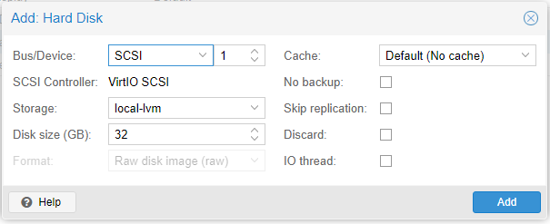
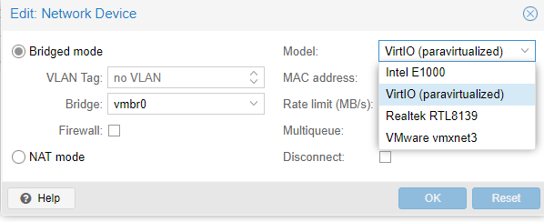
Emulated and Paravirtualized devices

Slide 19
Emulated and Paravirtualized devices
If the paravirtualized devices are much faster than emulated devices, why emulated devices are used?
Because some old OS doesn’t recognize it

Slide 20
Conclusion
You should be understanding:
Memory ballooning and auto-allocation
Disk formats and cache types
Difference between emulated and paravirtualized devices

