Slide 1

Proxmox VE 6
Section 5
Proxmox VE Networking
Instructor: Hadi Alnabriss

Slide 2
Bridges
Bridges are like physical network switches implemented in software.
All VMs can share a single bridge
you can create multiple bridges to separate network domains.
Each host can have up to 4094 bridges.

Slide 3
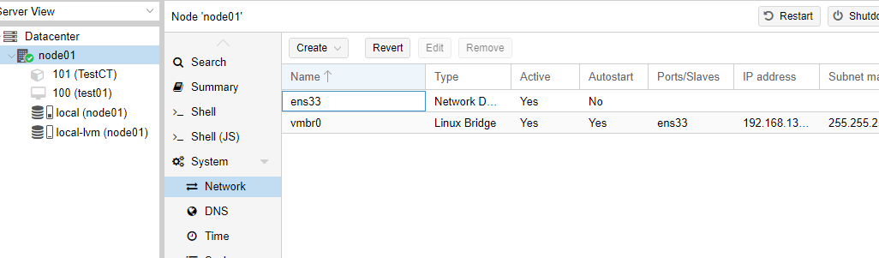
Bridges
The installation program creates a single bridge named vmbr0, which is connected to the first Ethernet card.

Slide 4
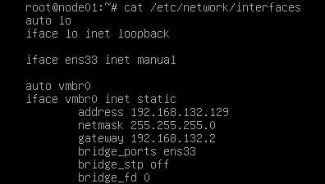
Network Configurations
The corresponding configuration in /etc/network/interfaces

Slide 5
Network Configurations
Note: Proxmox VE doesn’t write configurations directly to the file /etc/network/interfaces, but instead, it uses the file /etc/network/interfaces.new , then these configurations will be activated after reboot

Slide 6
Naming Conventions
Ethernet devices
en[N], This naming scheme is used for new PVE installations since version 5.0.
Ethernet devices
eth[N], This naming scheme is used for PVE hosts before version 5.0
Bridge names
vmbr[N], (vmbr0 - vmbr4094)
Bonds:
bond[N]
VLANs: Simply add the VLAN number to the device name, separated by a period (eno1.50, bond1.30)

Slide 7
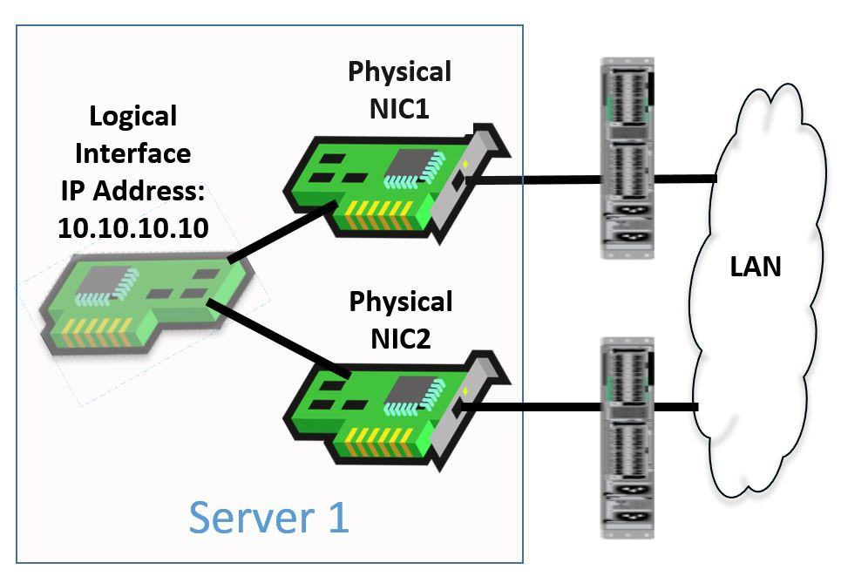
Linux Bond
Bonding
also called NIC teaming
and called Link Aggregation
Bonding is a technique for binding multiple NIC’s to a single network device.

Slide 8
Bonding Advantages
It is possible to achieve different goals, like:
Fault-tolerance.
Increase the performance.

Slide 9
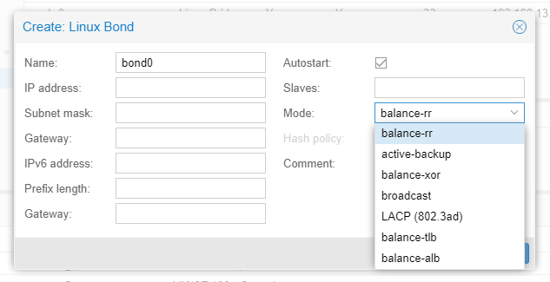
Bonding Modes
There are 7 modes for bonding

Slide 10
Bonding Modes (1)
Round-robin (balance-rr)
Transmit network packets in sequential order from the first available network interface (NIC) slave through the last.
This mode provides load balancing and fault tolerance.

Slide 11
Bonding Modes (2)
Active-backup (active-backup):
Only one NIC slave in the bond is active.
A different slave becomes active if, and only if, the active slave fails.
The single logical bonded interface’s MAC address is externally visible on only one NIC (port) to avoid distortion in the network switch.
This mode provides fault tolerance.

Slide 12
Bonding Modes (3)
XOR (balance-xor):
Transmit network packets based on [(source MAC address XOR’d with destination MAC address) modulo NIC slave count].
This selects the same NIC slave for each destination MAC address.
This mode provides load balancing and fault tolerance.
VM1
MAC: A
VM2
MAC: B
VM3
MAC: C

Slide 13
Bonding Modes (4)
Broadcast (broadcast):
Transmit network packets on all slave network interfaces.
This mode provides fault tolerance.

Slide 14
Bonding Modes (5)
IEEE 802.3ad Dynamic link aggregation (802.3ad)(LACP):
Creates aggregation groups that share the same speed and duplex settings.
Utilizes all slave network interfaces in the active aggregator group according to the 802.3ad specification.
Requires Switch Configurations

Slide 15
Bonding Modes (6)
Adaptive transmit load balancing (balance-tlb):
The outgoing network packet traffic is distributed according to the current load on each network interface slave.
Incoming traffic is received by one currently designated slave network interface.

Slide 16
Bonding Modes (7)
Adaptive load balancing (balance-alb):
Includes balance-tlb plus receive load balancing (rlb)

Slide 17
Conclusion
After watching this lecture you must:
Understand the difference between bridge and NAT mode
Know how to activate network configurations without rebooting PVE server

