Slide 1

Proxmox VE 6
Section 6
Storage Management
Instructor: Hadi Alnabriss

Slide 2
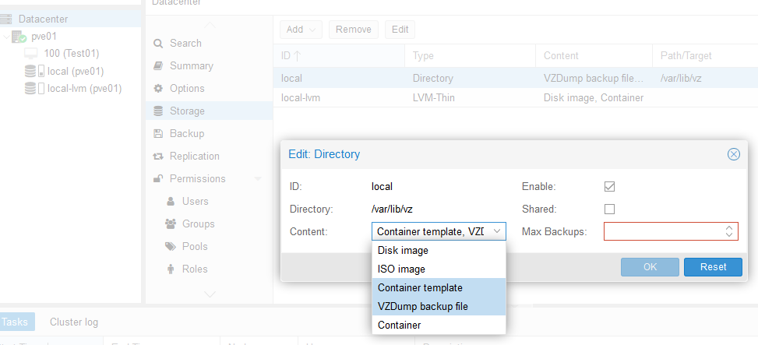
Datacenter Storage
Go to Datacenter > Storage to see all the storages identified by your environment
Allow uploading ISO images to local storage

Slide 3
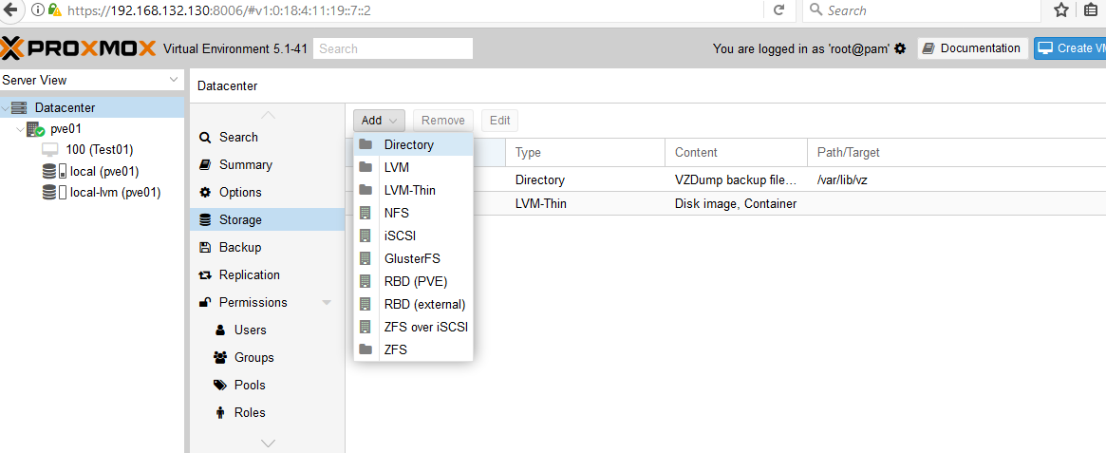
Adding New Storage
You can add more storage

Slide 4
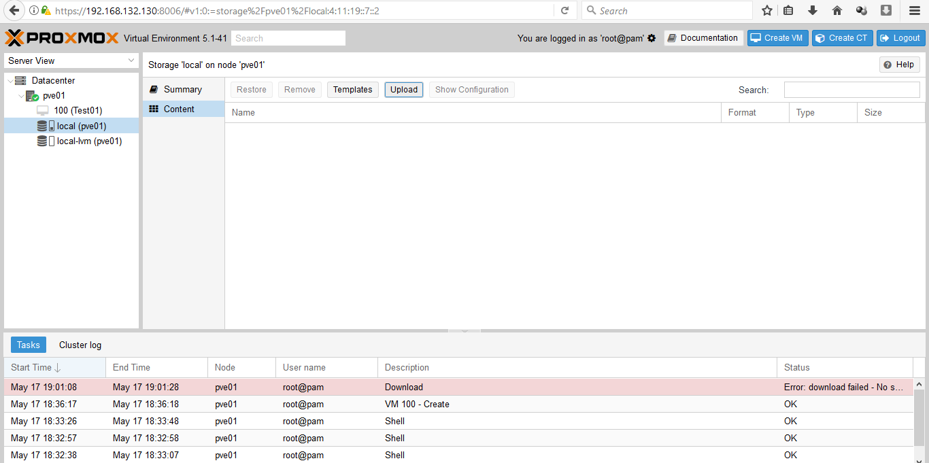
Uploading ISOs

Slide 5
Conclusion
At the end of this lecture:
You must be able to add new storages to your datacenter
Edit Storage accepted contents

