Slide 1

Proxmox VE 6
Section 7
Firewall
Instructor: Hadi Alnabriss

Slide 2
PVE Firewall
Proxmox VE Firewall provides an easy way to protect your IT infrastructure.
You can setup firewall rules to protect:
Hosts
Virtual machines
Containers

Slide 3
Firewall in the Cluster
All configuration is stored on the cluster file system
The iptables-based firewall runs on each cluster node
And thus provides full isolation between virtual machines.
The distributed nature of this system also provides much higher bandwidth than a central firewall solution.

Slide 4
IPv4 & IPv6
The firewall has full support for IPv4 and IPv6.
IPv6 support is fully transparent, and we filter traffic for both protocols by default.
So there is no need to maintain a different set of rules for IPv6.

Slide 5
Zones
The Proxmox VE firewall groups the network into the following logical zones:
Host Traffic from/to a cluster node
VM Traffic from/to a specific VM
For each zone, you can define firewall rules for incoming and/or outgoing traffic.

Slide 6
Configuration Files
All firewall related configuration is stored on the proxmox cluster file system.
So those files are automatically distributed to all cluster nodes.
The pve-firewall service updates the underlying iptables rules automatically on changes.

Slide 7
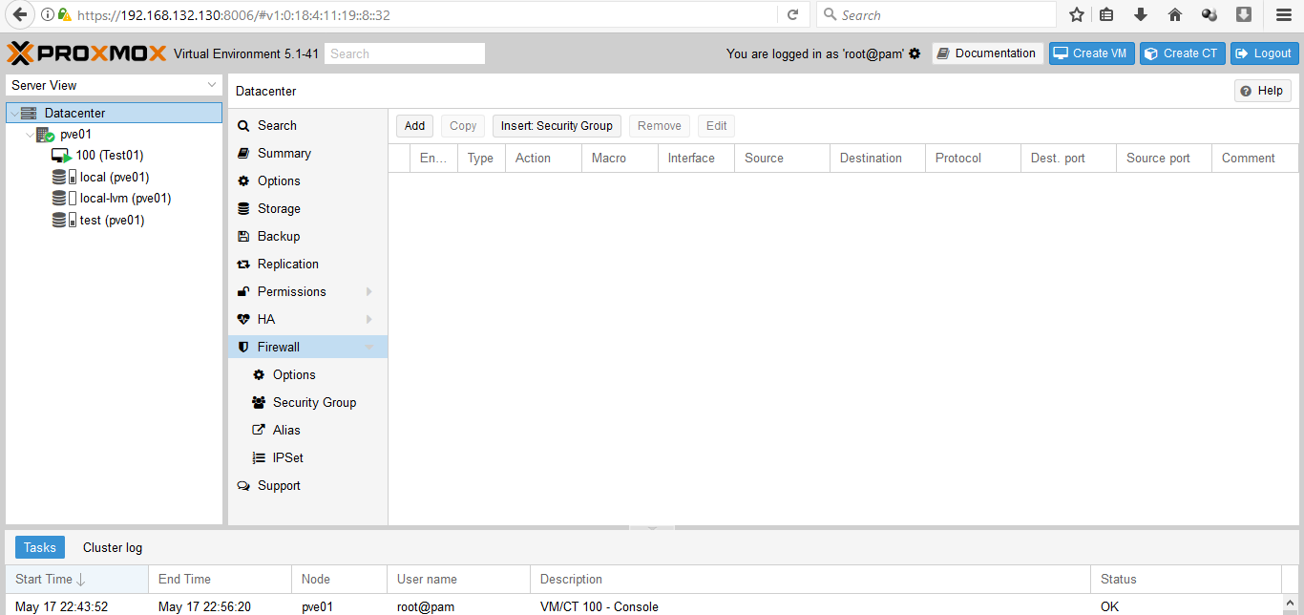
GUI
You can configure anything using the GUI (i.e. Datacenter → Firewall, or on a Node → Firewall)

Slide 8
Enabling the Firewall
The firewall is completely disabled by default, so you need to enable it
From GUI or from /etc/pve/firewall/cluster.fw
If you enable the firewall, traffic to all hosts is blocked by default.
Only exceptions is WebGUI(8006) and ssh(22) from your local network.

Slide 9
Important Note
Please open a SSH connection to one of your Proxmox VE hosts before enabling the firewall.
That way you still have access to the host if something goes wrong .

Slide 10
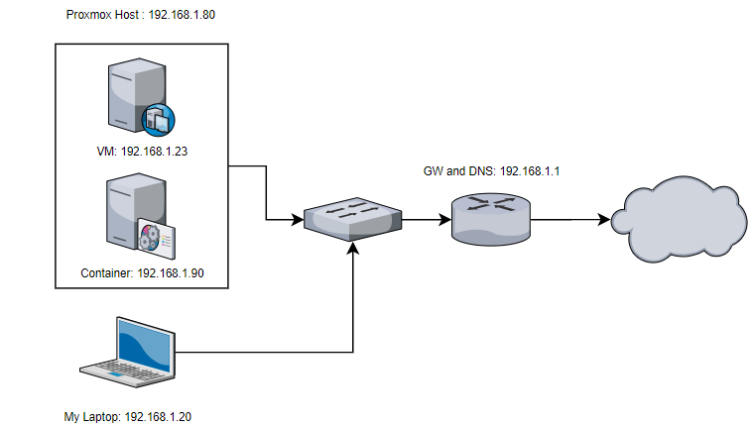
Lab Environment

Slide 11
Host Specific Configuration
Host related configuration is read from:
/etc/pve/nodes/<nodename>/host.fw
This is useful if you want to overwrite rules from cluster.fw config.
You can also increase log verbosity, and set netfilter related options.

Slide 12
VM/Container Configuration
VM firewall configuration is read from:
/etc/pve/firewall/<VMID>.fw

Slide 13
Enabling FW for VMs and Containers
Enable the FW for each VM
Enable the FW on the virtual NIC
You may need to restart the VM/container after enabling the firewall on a network interface.

Slide 14
Firewall Rules
Firewall rules consists of a direction
(IN or OUT)
and an action
(ACCEPT, DENY, REJECT).
You can also specify a macro name.
Macros contain predefined sets of rules and options.

Slide 15
IP Aliases
IP Aliases allow you to associate IP addresses of networks with a name.
You can then refer to those names

Slide 16
IP Sets
IP sets can be used to define groups of networks and hosts.
You can refer to them with ‘+name` in the firewall rules’ source and dest properties.

Slide 17
Security Groups
A security group is a collection of rules, defined at cluster level, which can be used in all VMs' rules.
For example you can define a group named “webserver” with rules to open the http and https ports.

Slide 18
Services and Commands
The firewall runs two service daemons:
pvefw-logger
pve-firewall
There is also a CLI command named pve-firewall, which can be used to start and stop the firewall service:
pve-firewall start
pve-firewall stop
To get the status use:
pve-firewall status

Slide 19
How to allow FTP
FTP is an old style protocol which uses port 21 and several other dynamic ports.
So you need a rule to accept port 21. In addition, you need to load the ip_conntrack_ftp module.
So please run: modprobe ip_conntrack_ftp
And add ip_conntrack_ftp to /etc/modules (so that it works after a reboot).

Slide 20
Suricata IPS integration
If you want to use the Suricata IPS (Intrusion Prevention System), it’s possible.
Packets will be forwarded to the IPS only after the firewall ACCEPTs them.
Rejected/Dropped firewall packets don’t go to the IPS.

Slide 21
Suricata IPS integration
Install suricata on proxmox host:
apt-get install suricata
modprobe nfnetlink_queue
Don’t forget to add nfnetlink_queue to /etc/modules for next reboot.
Then, enable IPS for a specific VM with from the file /etc/pve/firewall/<VMID>.fw
[OPTIONS]
ips: 1
ips_queues: 0

Slide 22
Ports used by Proxmox VE
Web interface: 8006
VNC Web console: 5900-5999
SPICE proxy: 3128
sshd (used for cluster actions): 22
corosync multicast (if you run a cluster): 5404, 5405 UDP

Slide 23
Conclusion
At the End of this lecture you must be able to:
Enable and manage firewall
Create and modify rules
Use Security Groups, IP Sets, Aliases and Macros
Activate and monitor Firewall Logs

