Slide 1
Troubleshooting NLP schedule optimisation with OCV=f(SOC) 7th December 2018
Researcher: Diarmid Roberts
Supervisors: Dr. Solomon Brown, Prof. Andy Cruden, Dr. Rachael Rothman
Sponsor: Drax Power Ltd.

Slide 2
Background
I have two versions of NLP schedule optimisation
One assumes fixed OCV, based on figure of 1.46V at 50% SOC
One makes OCV a linear function of SOC (and hence current in preceding sub-periods)
The example day I used in article looked reasonable – f(SOC) version gave very lightly worse revenue.
Across year f(SOC) returns £26.40/kW vs. fixedSOC £27.99/kW
Seems reasonable…

Slide 3
Problem
I noticed that the difference in outputs varies significantly from day to day
Look at day where results differ lots:
Why no discharge here in f(SOC) model?

Slide 4
Problem
Problem is simultaneous charge and discharge!
Although there’s no specific constraint on this behaviour in fixedOCV model, the solver always sets one variable to zero
This breaks down in the non-convex f(SOC) formulation

Slide 5
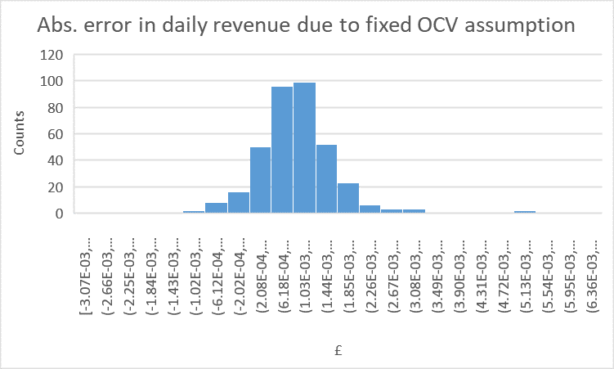
Problem
I checked the fixed OCV results, by correcting for actual OCV.
The error is low:
£27.99 becomes £28.40 across year
So fixedOCV version already gives good results

